Slide 1
CE 3372 water systems design
Pumps and lift stations –Part 1 (fall 2020)

Slide 2
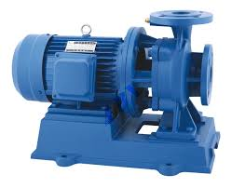
Pumps
A mechanical device that transfers mechanical energy into a liquid; used to
Lift from lower to higher elevation Lift stations
Increase pressure Booster stations
Gas phase equivalent
Compressor
discharge
Pump
suction
Motor

Slide 3
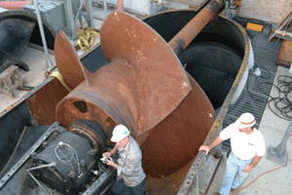

Slide 4
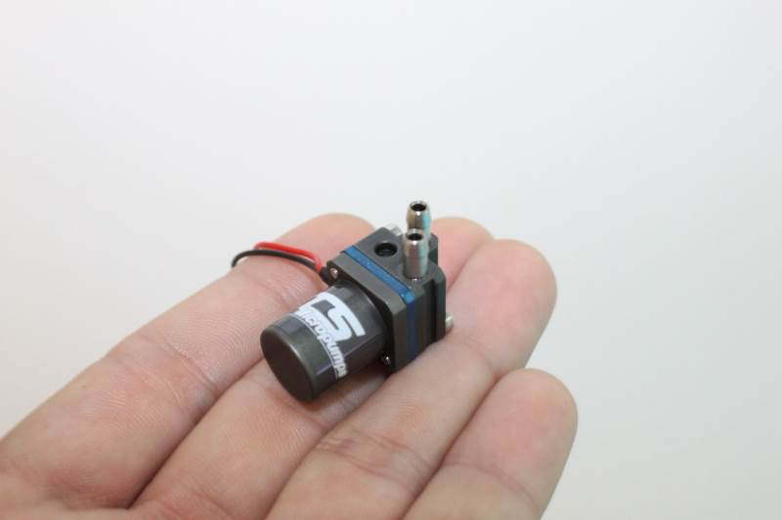
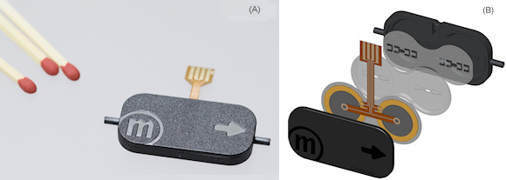

Slide 5
Pumps
Positive (Fixed) Displacement Pumps
Fixed volume of fluid is displaced each cycle regardless of system static head/pressure
Lower flow rates and higher head than non-positive pumps
Variable Displacement Pumps
Varying volume of fluid is displaced dependent on system static head/pressure (back pressure)
Notes:
2 principle types of plants

Slide 6
Pumps
Fixed Displacement Pumps
Screw Pumps
Reciprocating Pumps
Variable Displacement Pumps
Centrifugal (Radial-Flow) Pumps
Propeller Pumps (Axial-Flow)
Jet Pumps (Mixed-Flow)
Notes:
2 principle types of plants

Slide 7
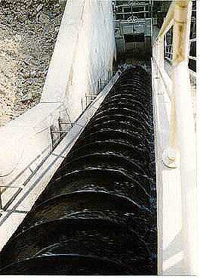
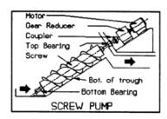
Positive Displacement Pumps
Screw Pump
A revolving shaft with blades rotates in a trough at an incline and pushes water up
Notes:
The auger catches a portion of water and lift it as the pump screw rotates.
The diameter, fill depth, pump angle, etc are determinants of pump charact.
Commonly used in wastewater lifting and hurricane barrier lifting
Very tolerant of debris in liquid. Failure is HUGE

Slide 8
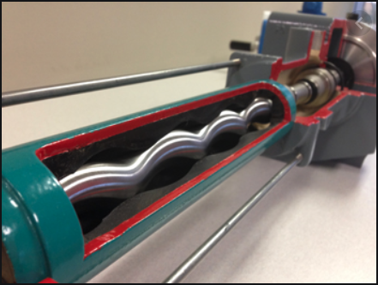
Positive Displacement Pumps
Progressive Cavity Pump
A revolving shaft (rotor) with rotates in a trough (stator)

Slide 9
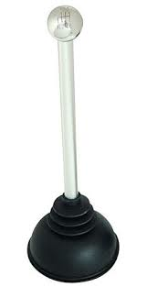
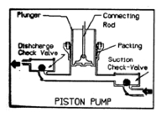
Positive Displacement Pumps
Reciprocating Piston Pump
A piston sucks the fluid into a cylinder and then pushes it out
Notes:
Upstroke, chamber fills. Downstroke, liquid is pushed out
Check valves prevent back flow.
Bore diameter, stroke length and rate are principal det of the operating character of a piston pump.
If no flow can occur, discharge is blocked, piston pump can and will destroy !!

Slide 10
Pumps
Fixed Displacement Pumps
Screw Pumps
Reciprocating Pumps
Variable Displacement Pumps
Centrifugal (Radial-Flow) Pumps
Propeller Pumps (Axial-Flow)
Jet Pumps (Mixed-Flow)
Notes:
2 principle types of plants

Slide 11
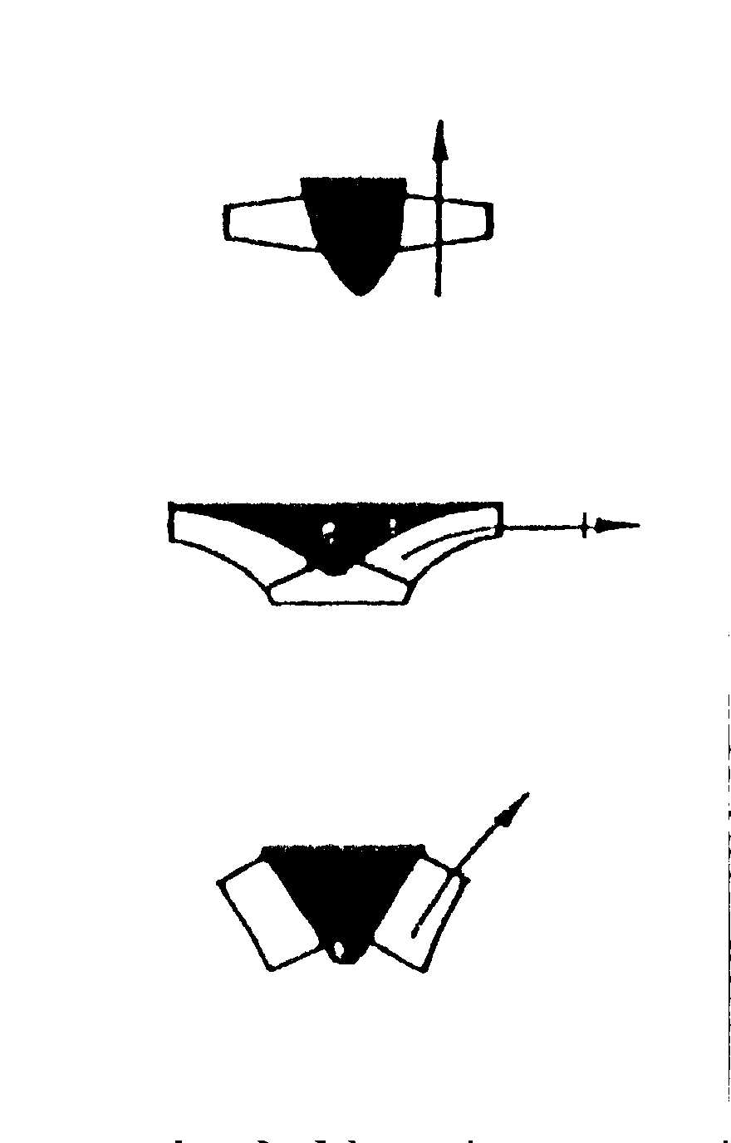
VARIABLE Displacement Pumps
Classification is based on the way water leaves the rotating part of the pump
Radial-flow pump – water leaves impeller in radial direction
Axial-flow pump – water leaves propeller in the axial direction
Mixed-flow pump – water leaves impeller in an inclined direction (has both radial and axial components)
Notes:
Propeller creates thrust
Impeller creates suction

Slide 12
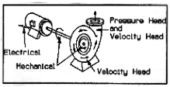
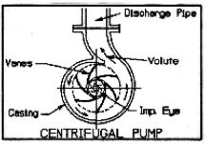
Radial-Flow Pumps
Centrifugal Pump
Accelerates water using an impeller
https://www.youtube.com/watch?v=BaEHVpKc-1Q
https://www.youtube.com/watch?feature=player_detailpage&v=ECv1VwW6RTo#t=122
Discharge
Suction (Eye)
Notes:
Play til 3:11
Rate of impeller is how much momentum it can transfer to the water
Conversion of rotational kinetic energy to hydrodynamic energy of fluid flow
Cent pump can be submersible wet or dry

Slide 13
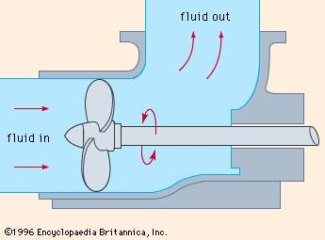

Axial Flow Pumps
Axial flow pumps have impellers whose axis of rotation is collinear with the discharge
Used in high flow, low head applications
discharge
suction
Notes:
Moving the same axis the fan rotates on.
Collinear enough.
Perpendicular to blade

