Slide 1
CE 3372 water systems design
Pumps and lift stations Part 2 (fall 2020)

Slide 2
Selecting Pumps
Design conditions are specified
Pump is selected for the range of applications
A System Curve (H vs. Q) is prepared
System Curve is matched to Pump Curve
Matching point (Operating point) indicates the actual working conditions
Notes:
Range of app (like needing to pump 120 MGPM)

Slide 3
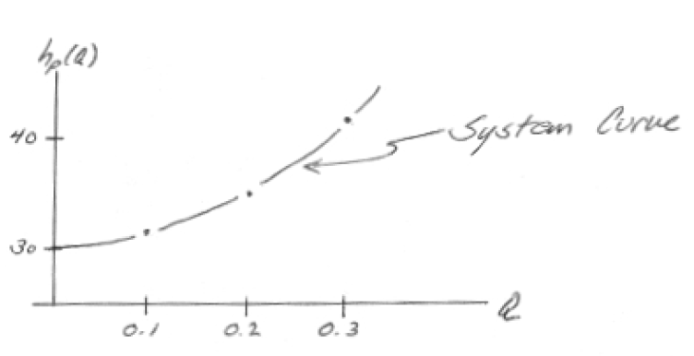
System Curves
A system (characteristic) curve is a plot of required head versus flow rate in a hydraulic system (H vs. Q)
The curve depicts how much energy is necessary to maintain a steady flow under the supplied conditions
Total head, H_{p,} = elevation head + head losses
Notes:
System curve.. How much energy does it take to meet the needs of your system

Slide 4
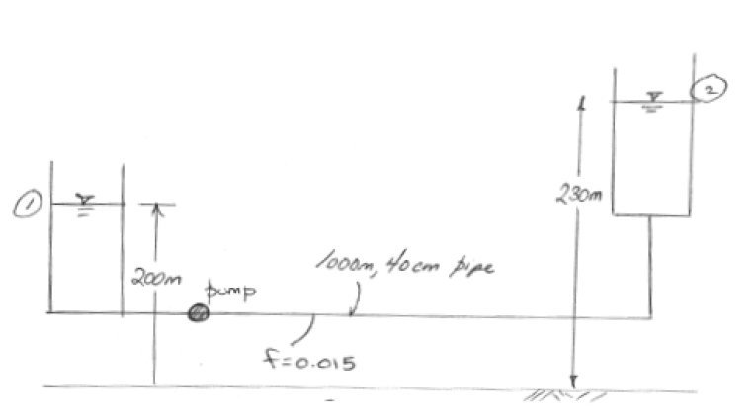
System Curves
Notes:
The amount of head the pump must add to overcome elevation differences is dependent on system characteristics and topology (and independent of the pump discharge rate), and is referred to as static head or static lift. Friction and minor losses, however, are highly dependent on the rate of discharge through the pump. When these losses are added to the static head for a series of discharge rates, the resulting plot is called a system head curve".
Apply the energy equation and incorporate various friction components

Slide 5
System Curves
This relationship tells us that the added head has to be at least 30 meters just to keep the reservoirs at the two levels shown, if any flow is to occur the pump must supply more than 30 meters of head.

Slide 6
Pump Curves
Provided information from the manufacturer on the performance of pumps in the form of curves.
Information may include:
discharge on the x-axis
head on the left y-axis
pump power input on the right y-axis
pump efficiency as a percentage
speed of the pump (rpm)
NPSH of the pump
Notes:
Wire- ratio of electrical energy in to water energy out
Added head versus discharge.
Wire-to-water eﬃciency versus discharge.
Mechanical power versus discharge.
Net Positive Suction Head required versus discharge.
the discharge on the x-axis,
the head on the left y-axis,
the pump power input on the right y-axis,
the pump efficiency as a percentage,
the speed of the pump (rpm = revolutions/min).
the NPSH of the pump.

Slide 7
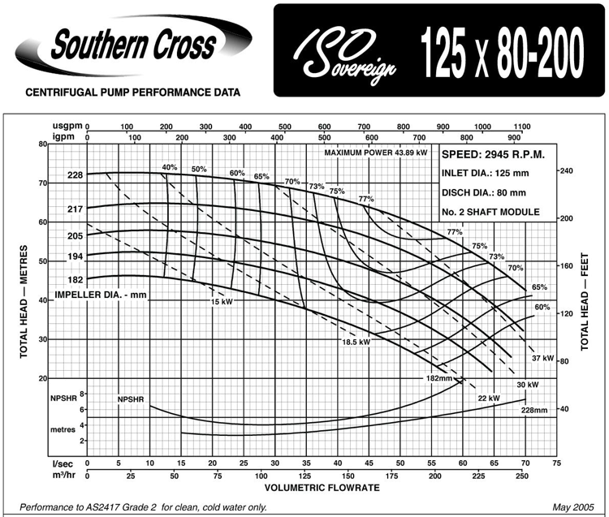
Pump Curves
Provided d.
Notes:
Always read based on diameter of impeller, at a flow of _, head is
NPSH = total head on suction side
Amount req + amount available
Total dynamic head:
Head = Energy per unit weight of water
Energy = Kinetic + Potential
=velocity + (elevation + pressure)
the discharge on the x-axis,
the head on the left y-axis,
the pump power input on the right y-axis,
the pump efficiency as a percentage,
the speed of the pump (rpm = revolutions/min).
the NPSH of the pump.

Slide 8
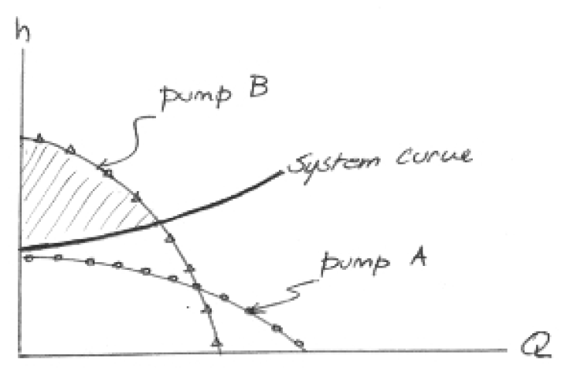
Pump Curves
Operating Point
Pump A cannot meet the needs of the system at any flow rate
Pump B supplies enough head over part of the system curve
The shaded area is the area where the pump supplies excess head
Notes:
System curve and pump curve are VERY important help select an appropriate pump or set of pumps.
System curve is how much head the SYSTEM needs to function
Pump curve is how much head the PUMP needs to function
Plot of pump curve and system curve
Can use a valve to throttle the system curve
So monster.. Head is pizzas (pizza becomes energy after you digest)
Poop factory with monsters
Pump Curve, you have Monster A and B (2 different people) who work together, based on pizzas
Monster B functions on pizzas at this rate and produces poop
And Monster A (system curve) also functions on pizzas at a different rate and produces poop
So if you feed them both the same, they produce the same.

Slide 9
Notes:
Look at the efficiency.
Pump is most efficient then

Slide 10
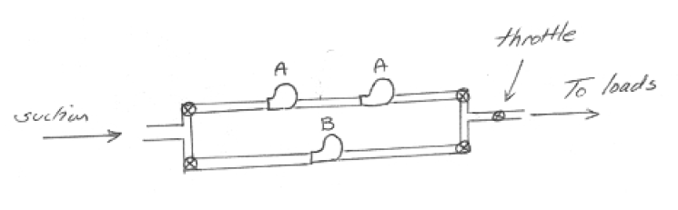
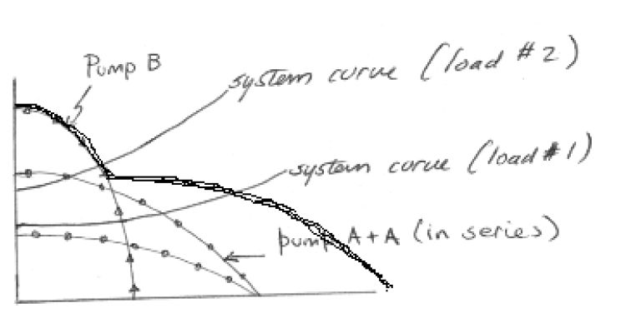
Multiple Pumps
Series and parallel combinations can be used to adjust “pump curves” to fit system requirements.
Parallel pumps add flow for given head
Series pumps add head for given flow

Slide 11
Notes:
For pumps in parallel, the curve of two pumps, for example, is produced by adding the discharges of the two pumps at the same head (assuming identical pumps).

Slide 12
H
3H₁
Three pumps in series
H₁
2H₁
Two pumps in series
H₁
H₁
Single pump
H₁
Q
Q₁
Notes:
For pumps in series, the curve of two pumps, for example, is produced by adding the heads of the two pumps at the same discharge.

