Slide 1
CE 3372 Water Systems Design
LeSSON 06 – Pumps and Lift Stations

Slide 2
Overview
Pumps
Description
Suction Requirements
System and Pump Curves

Slide 3
Pumps

Slide 4
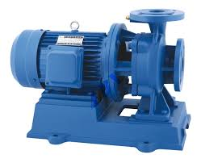
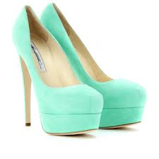
Pumps
A mechanical device that transfers mechanical energy to move fluid
Lift from lower to higher elevation Lift stations
Increase pressure Booster stations

Slide 5
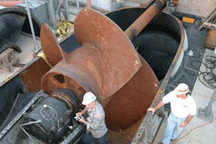

Slide 6
Pumps
Positive Displacement Pumps
Fixed volume of fluid is displaced each cycle regardless of static head/pressure
Lower flow rates and higher head than non-positive pumps
Non-Positive Displacement Pumps (Centrifugal Pumps)
Volume of fluid is dependent on static head/pressure in system (back pressure)
Notes:
2 principle types of plants

Slide 7
Pumps
Positive Displacement Pumps
Screw Pumps
Reciprocating Pumps
Non-Positive Displacement Pumps
Centrifugal (Radial-Flow) Pumps
Propeller Pumps (Axial-Flow)
Jet Pumps (Mixed-Flow)
Notes:
2 principle types of plants

Slide 8
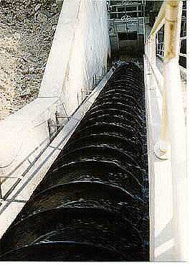
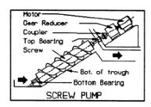
Positive Displacement Pumps
Screw Pump
A revolving shaft with blades rotates in a trough at an incline and pushes water up
Notes:
The auger catches a portion of water and lift it as the pump screw rotates.
The diameter, fill depth, pump angle, etc are determinants of pump charact.
Commonly used in wastewater lifting and hurricane barrier lifting
Very tolerant of debris in liquid. Failure is HUGE

Slide 9
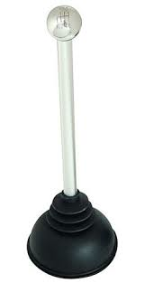
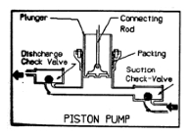
Positive Displacement Pumps
Reciprocating Pump
A piston sucks the fluid into a cylinder and then pushes it out
Notes:
Upstroke, chamber fills. Downstroke, liquid is pushed out
Check valves prevent back flow.
Bore diameter, stroke length and rate are principal det of the operating character of a piston pump.
If no flow can occur, discharge is blocked, piston pump can and will destroy !!

Slide 10
Pumps
Positive Displacement Pumps
Screw Pumps
Reciprocating Pumps
Non-Positive Displacement Pumps
Centrifugal (Radial-Flow) Pumps
Propeller Pumps (Axial-Flow)
Jet Pumps (Mixed-Flow)
Notes:
2 principle types of plants

Slide 11
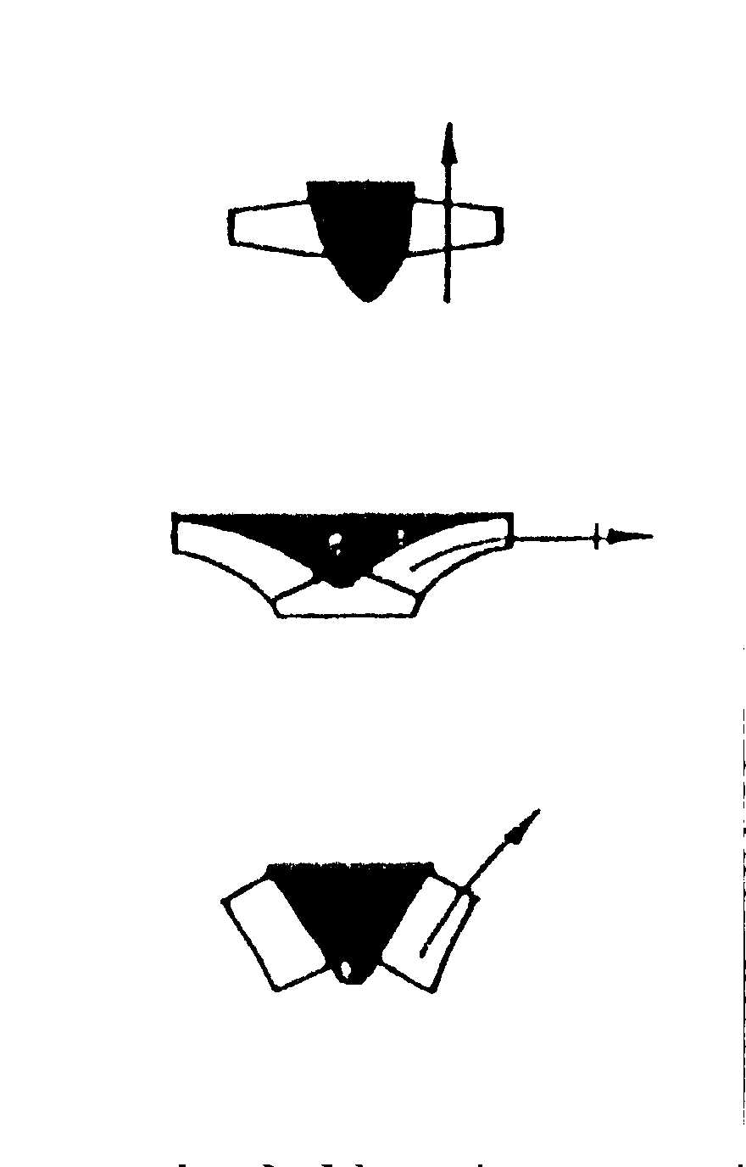
Non-Positive Displacement Pumps
Classification is based on the way water leaves the rotating part of the pump
Radial-flow pump – water leaves impeller in radial direction
Axial-flow pump – water leaves propeller in the axial direction
Mixed-flow pump – water leaves impeller in an inclined direction (has both radial and axial components)
Notes:
Propeller creates thrust
Impeller creates suction

Slide 12
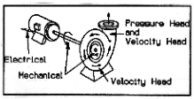
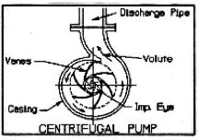
Radial-Flow Pumps
Centrifugal Pump
Accelerates water using an impeller
https://www.youtube.com/watch?v=BaEHVpKc-1Q
https://www.youtube.com/watch?feature=player_detailpage&v=ECv1VwW6RTo#t=122
Discharge
Suction (Eye)
Notes:
Play til 3:11
Rate of impeller is how much momentum it can transfer to the water
Conversion of rotational kinetic energy to hydrodynamic energy of fluid flow
Cent pump can be submersible wet or dry

Slide 13
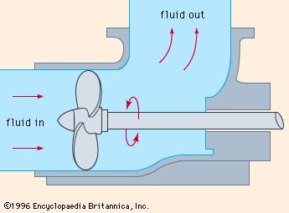

Axial Flow Pumps
Axial flow pumps have impellers whose axis of rotation is collinear with the discharge
Used in high flow, low head applications
discharge
suction
Notes:
Moving the same axis the fan rotates on.
Collinear enough.
Perpendicular to blade

Slide 14
Suction Requirements

Slide 15
Suction Requirements
The most common cause of pumping failure is poor suction conditions
Cavitation occurs when liquid pressure is reduced to the vapor pressure of the liquid
For piping system with a pump, cavitation occurs when P_{abs} at the inflow falls below the vapor pressure of the water
Notes:
They implode in such a great force and high heat and causes a lot of damage to pump
Reduce pump and impeller capacity

Slide 16
Suction Requirements
Liquid must enter the pump eye under pressure; this pressure is called the Net Positive Suction Head available (NPSH_{a}).
A centrifugal pump cannot lift water unless it is primed
the first stage impellers must be located below the static HGL in the suction pit at pump start-up
Notes:
They implode in such a great force and high heat and causes a lot of damage

Slide 17
Suction Requirements
The manufacturer supplies a value for the minimum pressure the pump needs to operate.
This pressure is the Net Positive Suction Head required (NPSH_{r}).
For proper pump operation (w/o cavitation)
NPSH_{a}> NPSH_{r}
Notes:
Draw NPSH example.
Required is by manufacturer
NPSHr must be maintained or exceeded!!
over all operating conditions, including start-up and shut-down.

Slide 18
Suction Requirements
Available suction is computed from
Absolute vapor pressure at liquid pumping temperature
Frictional head loss in inlet piping
Static elevation of the liquid above the pump inlet eye
Absolute pressure at liquid surface in suction pit
Notes:
VP cause of temperature
NPSH is pressure req at the suction of a pump to prevent cavitation
h_{s} (static suction head): it is the difference in elevation between the suction liquid level and the centerline of the pump impeller.

Slide 19
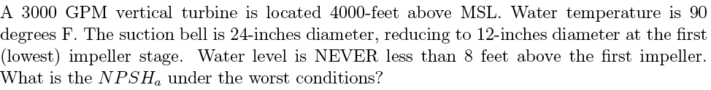
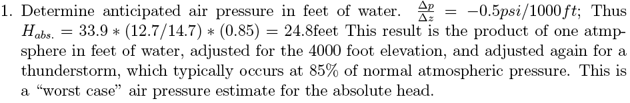
Suction Requirements
Example
Notes:
MSL = mean sea level
Air pressure drops as you go up.
33.9 pressure = 1 atm water at standard
14.7 psi will hold up 33 feet of water. (12.7/14.7psi) is a ratio
85% real big thunderstorm. Atm is 85% of normal

Slide 20
Suction Requirements
Example

Slide 21
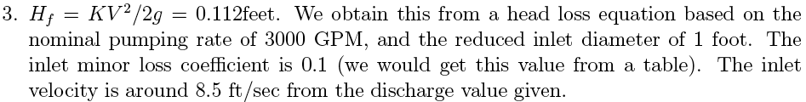
Suction Requirements
Example

Slide 22
Suction Requirements
Example

Slide 23
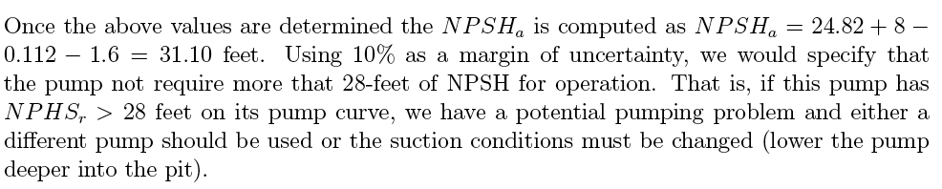
Suction Requirements
Example

Slide 24
System and Pump Curves

Slide 25
Selecting Pumps
Design conditions are specified
Pump is selected for the range of applications
A System Curve (H vs. Q) is prepared
System Curve is matched to Pump Curve
Matching point (Operating point) indicates the actual working conditions
Notes:
Range of app (like needing to pump 120 MGPM)

Slide 26
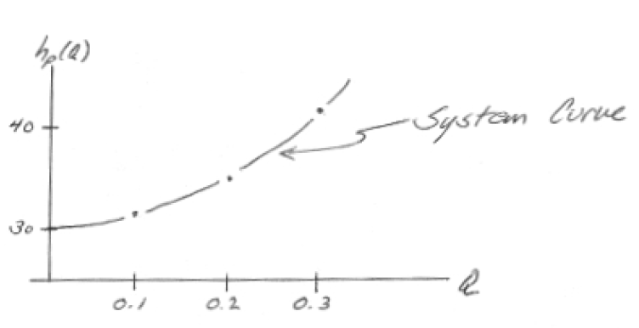
System Curves
A system (characteristic) curve is a plot of required head versus flow rate in a hydraulic system (H vs. Q)
The curve depicts how much energy is necessary to maintain a steady flow under the supplied conditions
Total head, H_{p,} = elevation head + head losses
Notes:
System curve.. How much energy does it take to meet the needs of your system

Slide 27
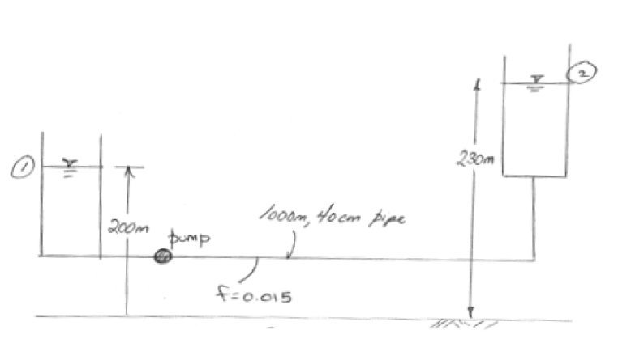
System Curves
Notes:
The amount of head the pump must add to overcome elevation differences is dependent on system characteristics and topology (and independent of the pump discharge rate), and is referred to as static head or static lift. Friction and minor losses, however, are highly dependent on the rate of discharge through the pump. When these losses are added to the static head for a series of discharge rates, the resulting plot is called a system head curve".
Apply the energy equation and incorporate various friction components

Slide 28
System Curves
This relationship tells us that the added head has to be at least 30 meters just to keep the reservoirs at the two levels shown, if any flow is to occur the pump must supply more than 30 meters of head.

Slide 29
Pump Curves
Provided information from the manufacturer on the performance of pumps in the form of curves.
Information may include:
discharge on the x-axis
head on the left y-axis
pump power input on the right y-axis
pump efficiency as a percentage
speed of the pump (rpm)
NPSH of the pump
Notes:
Wire- ratio of electrical energy in to water energy out
Added head versus discharge.
Wire-to-water eﬃciency versus discharge.
Mechanical power versus discharge.
Net Positive Suction Head required versus discharge.
the discharge on the x-axis,
the head on the left y-axis,
the pump power input on the right y-axis,
the pump efficiency as a percentage,
the speed of the pump (rpm = revolutions/min).
the NPSH of the pump.

Slide 30
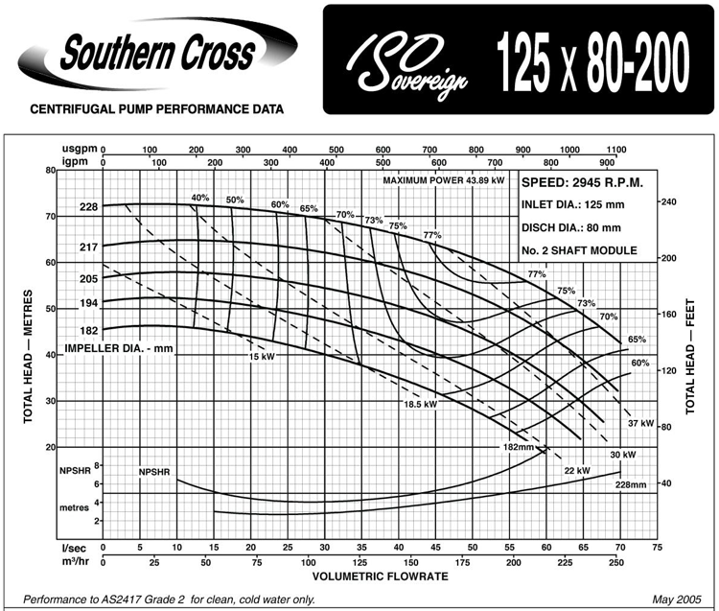
Pump Curves
Provided d.
Notes:
Always read based on diameter of impeller, at a flow of _, head is
NPSH = total head on suction side
Amount req + amount available
Total dynamic head:
Head = Energy per unit weight of water
Energy = Kinetic + Potential
=velocity + (elevation + pressure)
the discharge on the x-axis,
the head on the left y-axis,
the pump power input on the right y-axis,
the pump efficiency as a percentage,
the speed of the pump (rpm = revolutions/min).
the NPSH of the pump.

Slide 31
How to
Provided information from the manufacturer on the performance of pumps in the form of curves.
Information may include:
discharge on the x-axis
head on the left y-axis
pump power input on the right y-axis
pump efficiency as a percentage
speed of the pump (rpm)
NPSH of the pump
Notes:
Wire- ratio of electrical energy in to water energy out
Added head versus discharge.
Wire-to-water eﬃciency versus discharge.
Mechanical power versus discharge.
Net Positive Suction Head required versus discharge.
the discharge on the x-axis,
the head on the left y-axis,
the pump power input on the right y-axis,
the pump efficiency as a percentage,
the speed of the pump (rpm = revolutions/min).
the NPSH of the pump.

Slide 32
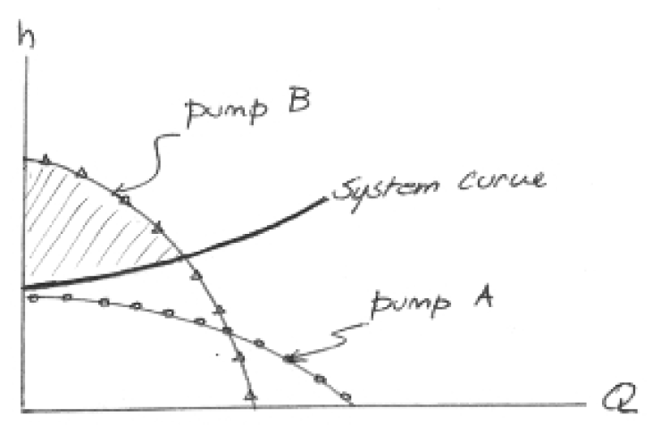
Pump Curves
Pump A cannot meet the needs of the system at any flow rate
Pump B supplies enough head over part of the system curve
The shaded area is the area where the pump supplies excess head
Operating Point
Notes:
System curve and pump curve are VERY important help select an appropriate pump or set of pumps.
System curve is how much head the SYSTEM needs to function
Pump curve is how much head the PUMP needs to function
Plot of pump curve and system curve
Can use a valve to throttle the system curve
So monster.. Head is pizzas (pizza becomes energy after you digest)
Poop factory with monsters
Pump Curve, you have Monster A and B (2 different people) who work together, based on pizzas
Monster B functions on pizzas at this rate and produces poop
And Monster A (system curve) also functions on pizzas at a different rate and produces poop
So if you feed them both the same, they produce the same.

Slide 33
Notes:
Look at the efficiency.
Pump is most efficient then

Slide 34
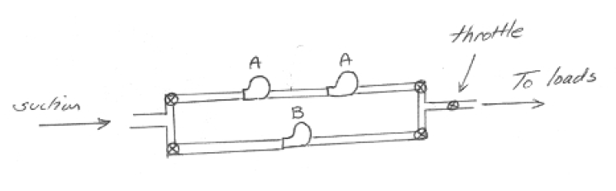
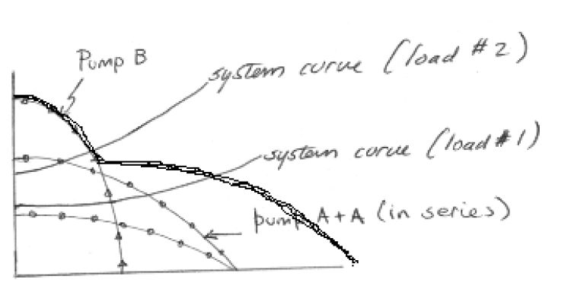
Multiple Pumps
Series and parallel combinations can be used to adjust “pump curves” to fit system requirements.
Parallel pumps add flow for given head
Series pumps add head for given flow

Slide 35
Notes:
For pumps in parallel, the curve of two pumps, for example, is produced by adding the discharges of the two pumps at the same head (assuming identical pumps).

Slide 36
H
3H₁
Three pumps in series
H₁
2H₁
Two pumps in series
H₁
H₁
Single pump
H₁
Q
Q₁
Notes:
For pumps in series, the curve of two pumps, for example, is produced by adding the heads of the two pumps at the same discharge.

Slide 37
Next time
Multiple path pipelines (Networks)
Network analysis by newton-raphson

