Slide 1
CE 3372 water systems design
Network Hydraulics – part 1 (Fall 2020)

Slide 2
Network Hydraulic principles
Conservation of mass at a junction
ΣInflow – ΣOutflow = 0 (at a node)
Positive demand at a node is an outflow
Negative demand (injection into the network) is an inflow
One balance equation for each node
Head has a single value
Often expressed as a pressure (node elevation known)
Visualize as height of column of water in a piezometer at the junction
Pressure Head
Piezometer
Demand (External)
Inflow
Outflow

Slide 3
Network Hydraulic principles
Head Loss
Conservation of energy along a conduit
Modified Bernoulli’s equation
Include fitting losses if known
One energy equation for each conduit (link)
Pressure Head
Elevation Head
Datum

Slide 4
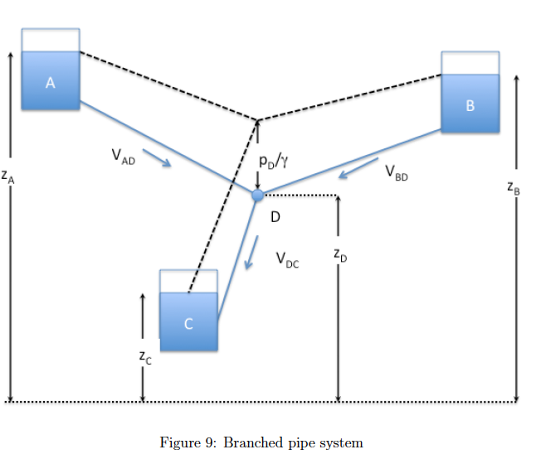
Branched System
Distribution networks are multi-path pipelines
One topological structure is branching
One node (continuity)
Three links (energy)
Four unknowns: V_{AD},V_{BD},V_{DC},H_{D}

Slide 5
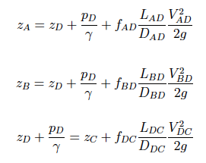

Branched System - analysis
Head loss in each pipe
Continuity at the node

Slide 6
Branched System
4 Equations, 4 unknowns
Non-linear so solve by
Newton-Raphson
Quasi-Linearization
Quadratic in unknown, so usually can find solution in just a few iterations

Slide 7
Branched System
4 Equations, 4 unknowns
Non-linear so solve by
Newton-Raphson
Quasi-Linearization
Quadratic in unknown, so usually can find solution in just a few iterations

Slide 8
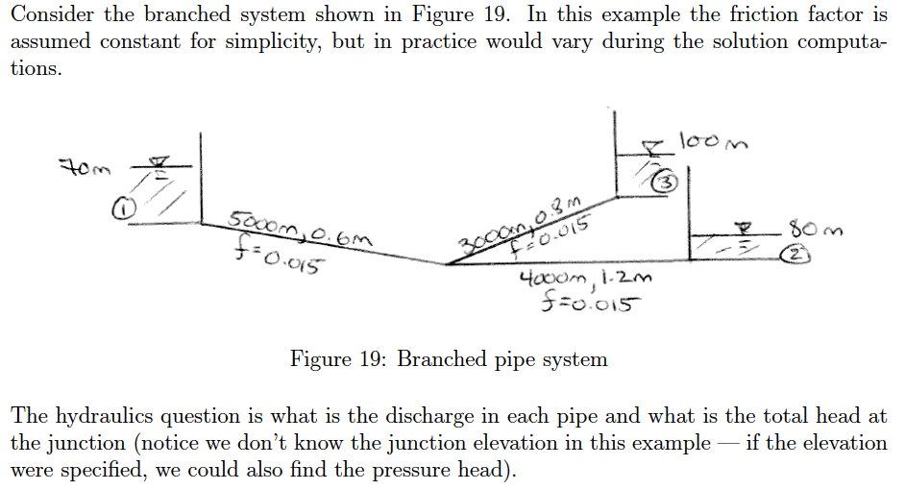
Example – branched system

Slide 9
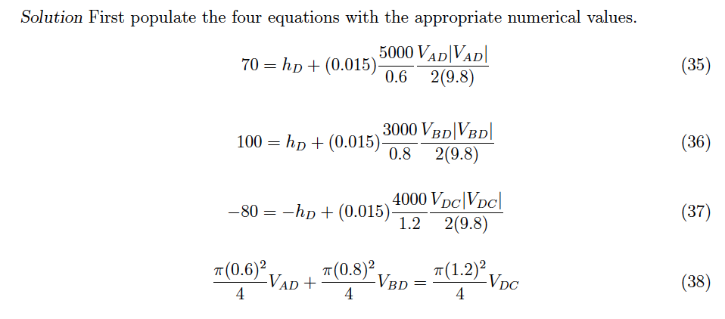
Example – branched system

Slide 10
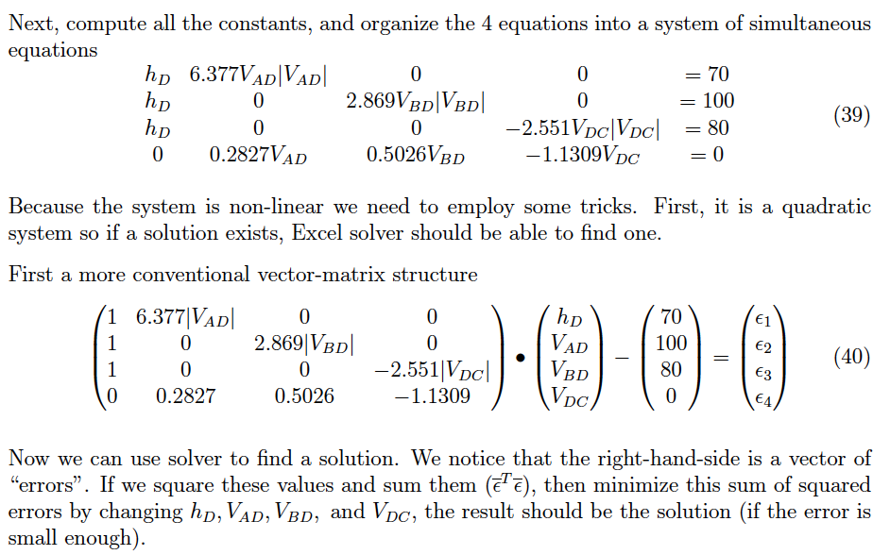
Example – branched system

Slide 11
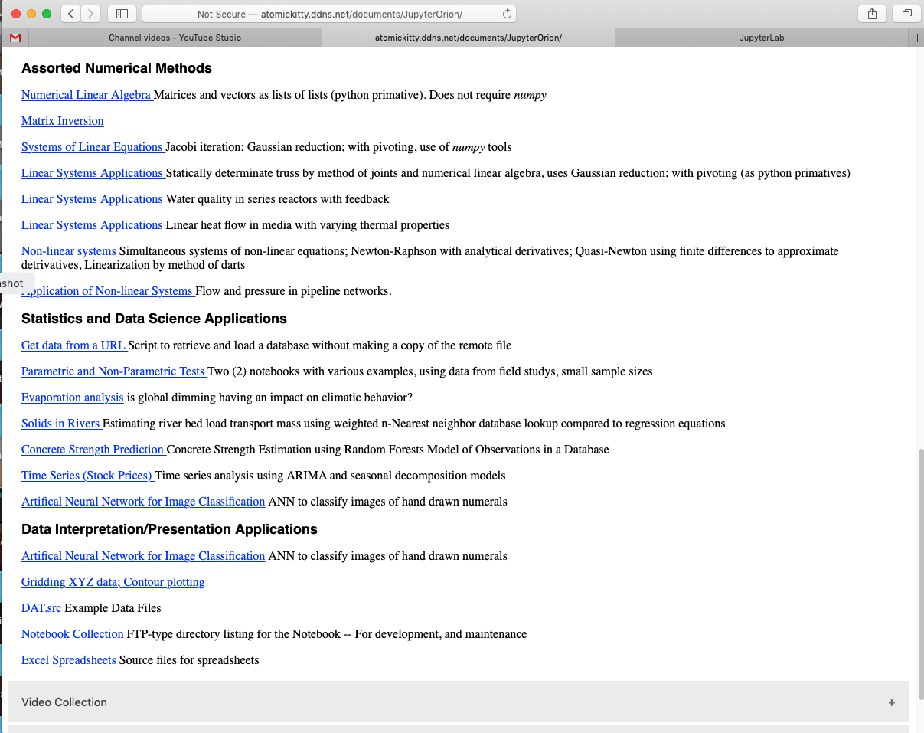
Example – branched system
ENGR 1330 Computational Thinking and Data Science
Non-Linear Systems Notebook http://atomickitty.ddns.net/documents/JupyterOrion/MyJupyterNotebooks/15-NonLinearSystems/
Shared notebook on http://54.243.252.9:8000/user/polaris/lab?

Slide 12
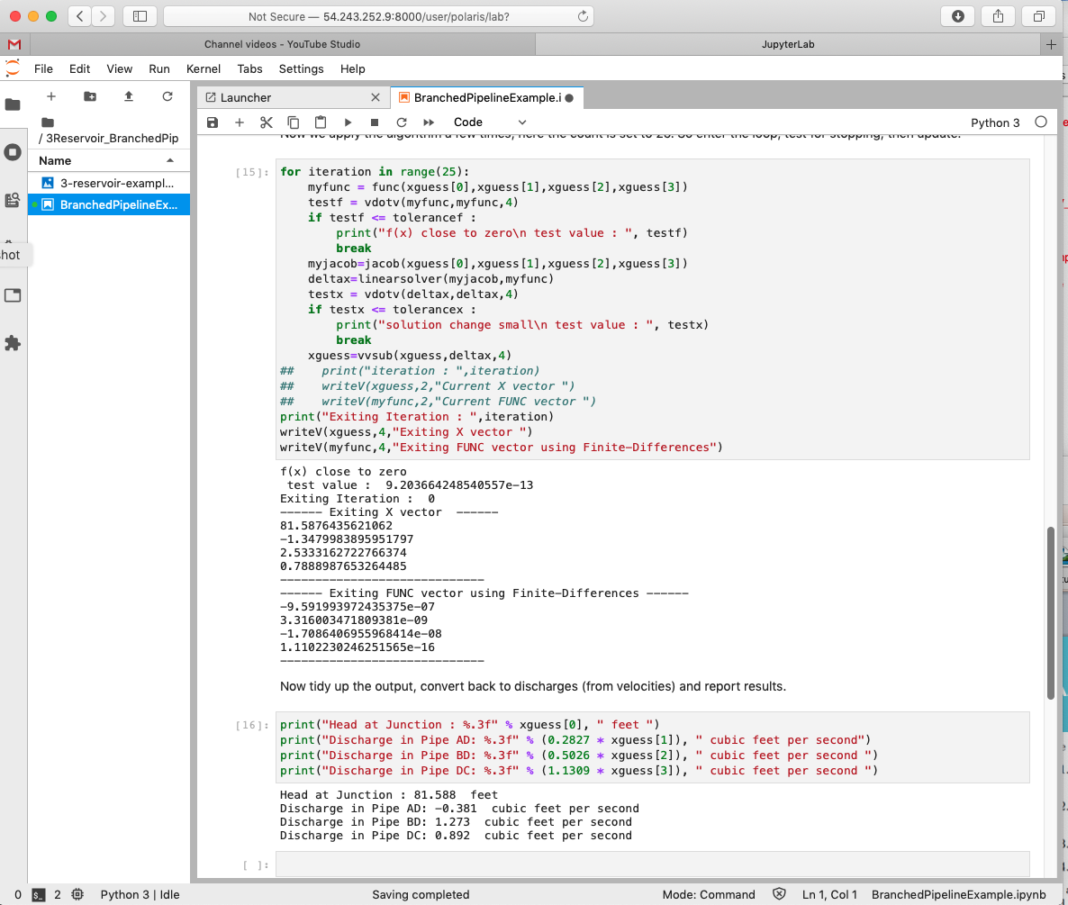
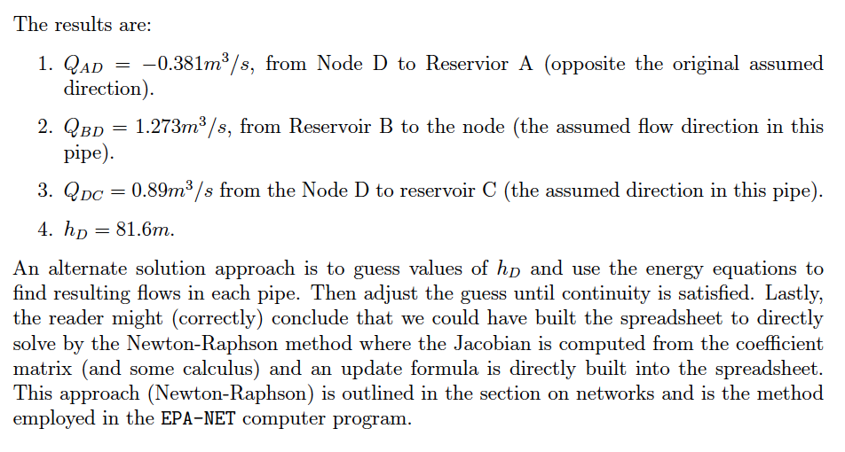
Example – branched system

Slide 13
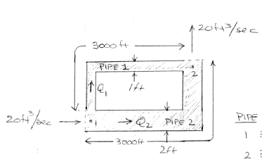
Looped System
Looped system is where one or more pipes rejoin at a different node.

Slide 14
Looped System
Nodes:
Inflow = Outflow
Energy Unique
Links
Head loss along pipe
Head loss in any loop is zero
LOOP

Slide 15
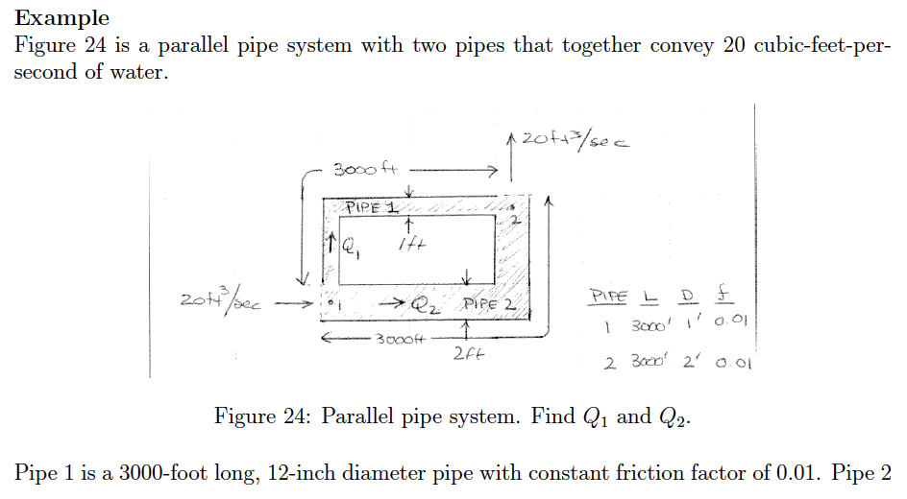
Example – looped system

Slide 16
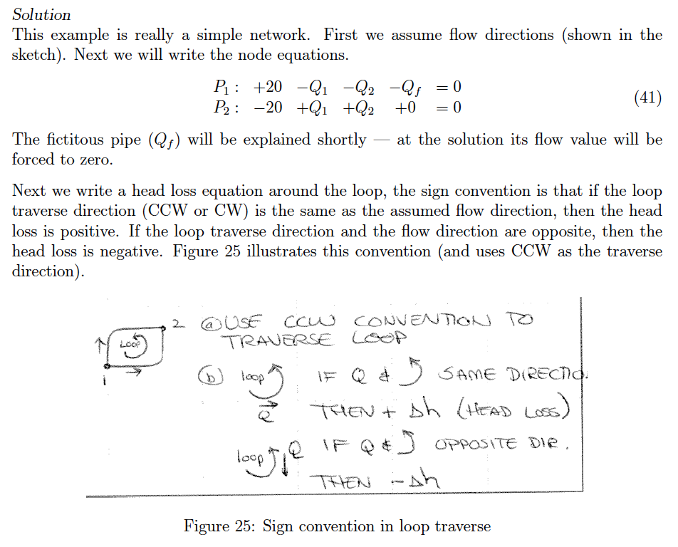
Example – looped system

Slide 17
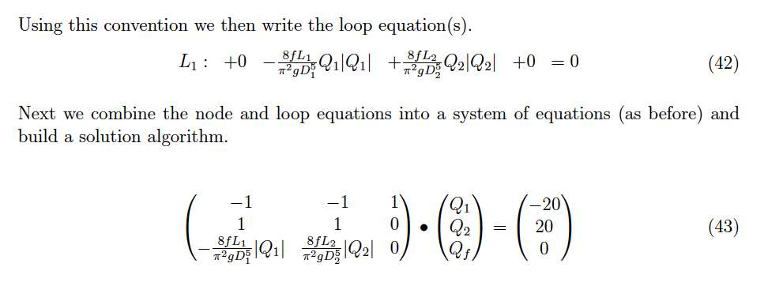
Example – looped system

Slide 18
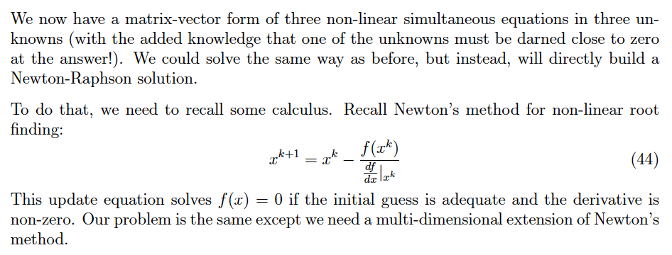
Example – looped system

Slide 19
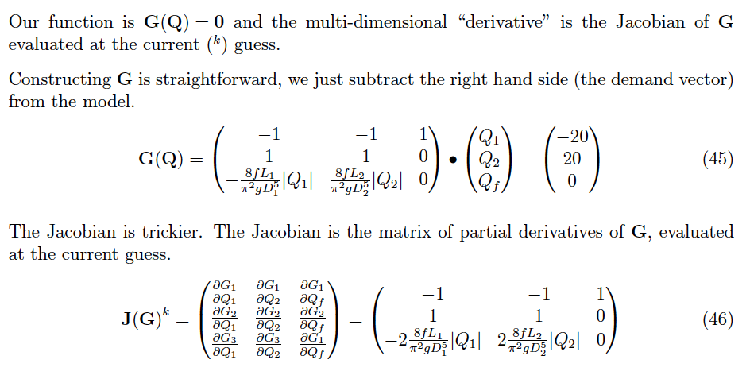
Example – looped system

Slide 20
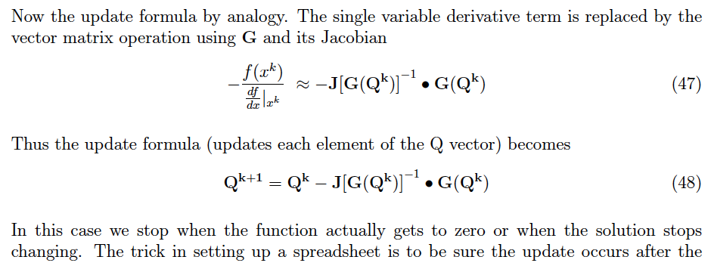

Example – looped system

Slide 21
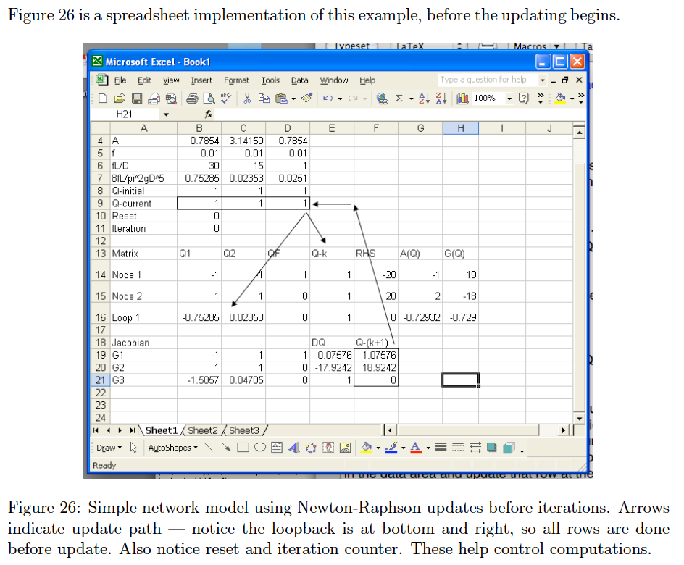
Example – looped system

Slide 22
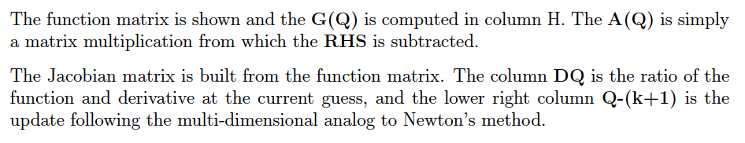
Example – looped system

Slide 23
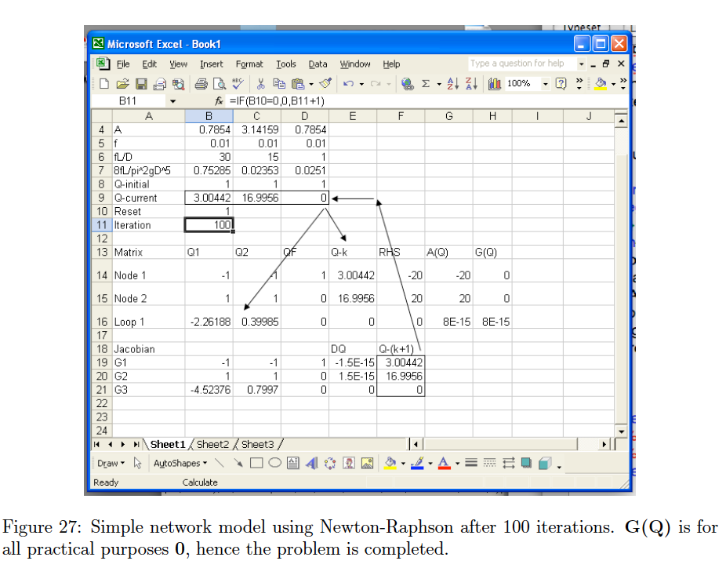
Example – looped system

Slide 24
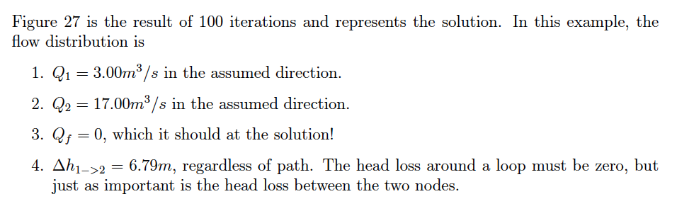
Example – looped system

Slide 25
Networks
Branched and looped systems are called networks
Multiple paths for water to flow in the system
External “demands” are applied at nodes
External “supply” is treated as negative demand

