Slide 1
CE 3372 Water Systems Design
Lesson 9: EPA-NET Introduction

Slide 2
Introduction to EPANET
Introduction to EPANET
Install on PC
Install on Mac (Experimental; Unsupported)
Background on the program
Interface tour
Example problem (from ES4) on EPANET

Slide 3
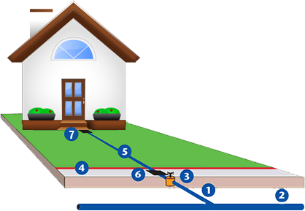
System Components
Water source (Main Supply)
Lake
River
Aquifer
Treatment Facility
Transmission Lines
Pumping Facilities
Distribution Lines
Intermediate Storage Facilities
Treats and disinfects water
Meet water quality standards
Potable water
Convey water from source – treatment facility facility – network
Provide energy to move water
Stabilize line pressures
Reserve for peak demand periods
Provide storage for fire flow req.
Convey water from storage – service areas
Looped(grid) and Branched Layouts
Appurtenances
Fire Hydrants. Valves, auxiliary pumps, fittings

Slide 4
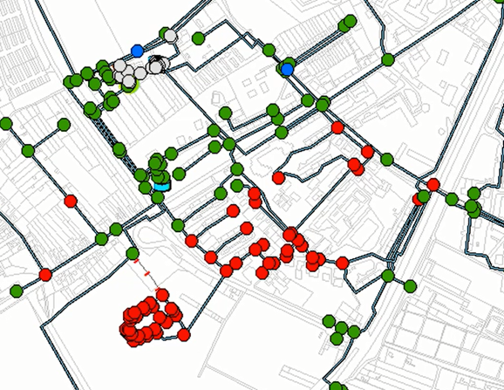
Network Representation
Distribution network - Consists of items designed to convey potable water at adequate pressures and discharges
Tanks
Pumps
Pipes
Valves
Fittings
Meters
Other appurtenences

Slide 5
EPANET
Computer program that simulates flow in closed conduit (pressurized) systems
Nodes
Links (pipes, pumps, valves)
Reservoirs (reservoir, tanks)
Demand schedule (extended period simulation)

Slide 6
Getting the Program
Download and install EPA-NET
PC Users – Google EPANET or Use the class website
MAC Users – Use the class website

Slide 7
Getting the Documentation
Download and PRINT the user manual
EPANET website, or class website.
Topology constructed in a GUI
Lengths, diameters, friction terms entered for each component (pipe, valve)
Demand entered for each node (+ outflow, - inflow)

Slide 8
About the program
Topology (Network Layout) is constructed in a GUI
Nodes
Demand entered for each node (+ outflow, - inflow)
Elevation for each node (to calculate pressure)
Links
Lengths, diameters, friction terms entered for each component.
Pipes, Pumps, Valves are all “link” components
Reservoir/Tank
All models need a reservoir or tank (like the ground in an electric circuit)

Slide 9
Stuff you Have to Choose
Head Loss Models
Darcy-Weisbach
Hazen-Williams
Chezy-Mannings
Flow units (CFS, GPM, CMS and such)
Select SI or US Customary – Preferably before building a model
The program does not convert unit SYSTEMS

Slide 10
Modeling protocol
Sketch a layout on paper
Identify pipe diameters; length; roughness values
Identify node elevations; demands
Supply reservoir (or tank); identify reservoir pool elevation
Identify pumps; pump curve in problem units
Start EPANET, and build the model

Slide 11
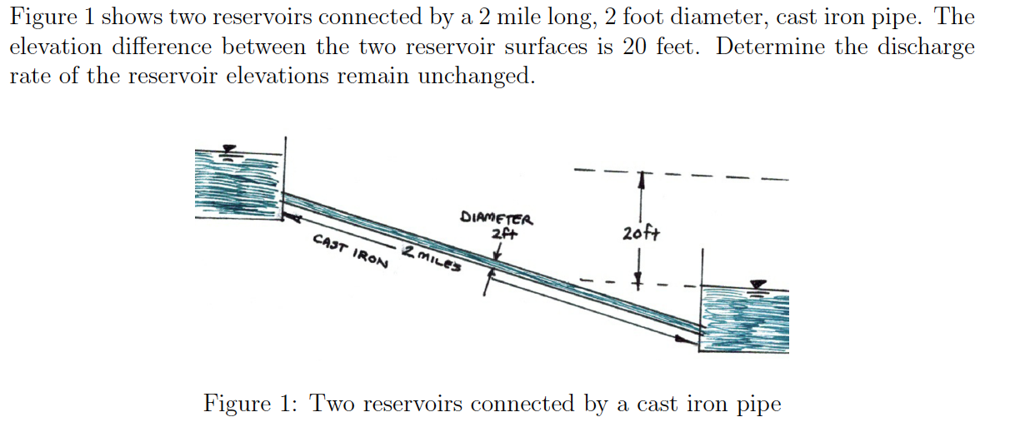
Example 1
Example 1 – Flow between two reservoirs

Slide 12
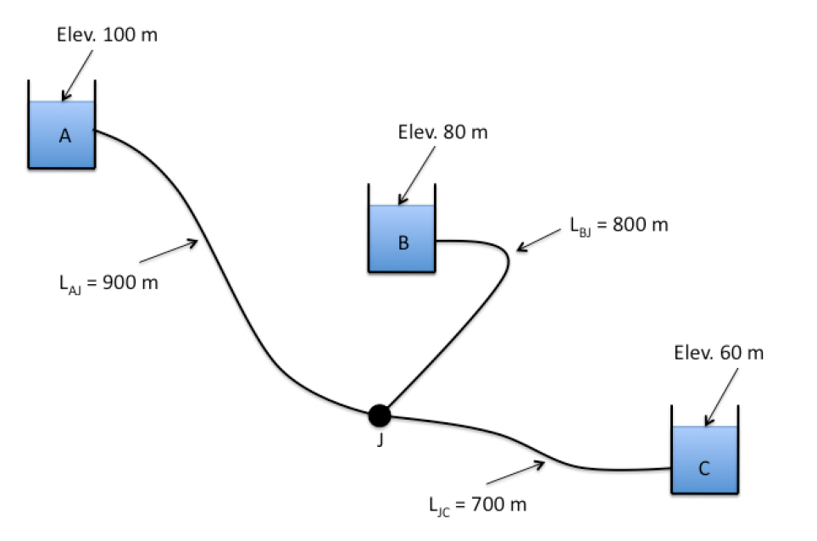
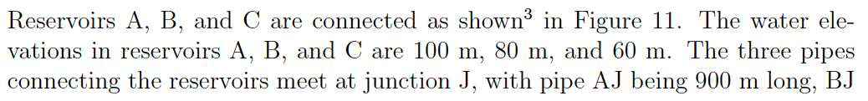
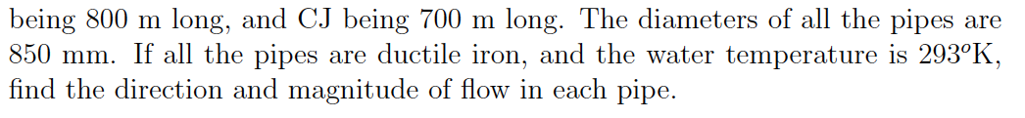
Example 2
Example 2 – Three reservoir (branched)

Slide 13
Next Time
Additional Network models in EPANET

