Slide 1
CE 3372 water systems design
Design Guidelines – drinking water supply Part 1 (fall 2020)

Slide 2
Water distribution design
Design is the management of constraints.
Non-negotiable constraints are dictated by laws of physics, chemistry (and to some extent mankind); examples of these are: water flows downhill unless power (lift station) and money (capital cost to build, operation cost to pay for electricity to run pumps) are applied; Chemical disinfection residual will decay over time unless replenished; this constraint encourages using treated water relatively quickly.
Negotiable constraints are the design variables that can be adjusted to satisfy the non-negotiable constraints and the desired system performance; the main components of this category are money to pay for things, time to build (and operate), aesthetics (pipe alignment/channel geometry); system performance under various anticipated conditions.

Slide 3
Water distribution design
The water system designer's goal is to satisfy a need (some level of performance) by manipulating negotiable constraints. The analytical tools herein are used to test the design before committing to an actual build (presumably so that full-scale experiment fails are avoided).
Design guidelines encapsulated in regulatory documents, design manuals, professional, and manufacturer's literature represent guidance based upon centuries of observation and experimentation (and a lot of failures); the value is that they generally work, and reduce commercial risk for routine water system components.

Slide 4
Water distribution design Elements
Four basic elements of water distribution design are:
How much water will be used?
Where are the raw water supply locations?
Where are the water consumption locations?
What is the water use as a function of time?

Slide 5
Water distribution design Elements
When designing new systems, calculating demands is not a straightforward process. The designer needs to know the expected demands, possible fire demands, and future expansions.
There are some publications that provide average demands for residential,commercial facilities, and production/industrial facilities.
Finding/building a modern database of such information wopuld be a good data science project

Slide 6
Water distribution design Elements
Different demands need to be accounted for:
Customer demand Average use needed to meet non-emergency needs.
Fire flow demand The computed system capacity required for ensuring minimum fire protection while maintaining a minimum working pressure in the system.
Ultimate expansion to the system
Notes:
Many of the guidance documents spend a considerable eort in explaining how to
estimate demand, others don't. Most design documents require some kind of hydraulic
modeling to demonstrate that the system meets various hydraulic and water quality
requirements, so demand estimation is vital for these models.
There are several time related demands that should be considered in design such
as seasonal demands, weekly demands, population growth and industrial demands,
etc. Seasonal demands such as hot dry summers cause increase lawn watering. Small
agricultural operations or nurseries may rely on municipal water supplies to irrigate.
Some of these demands can be estimated from a community?s comprehensive plan,
zoning maps, regional expectations for industrial use, Another critical event to check
is the peak hour demand. During steady state model runs the designer (modeler) can
assign specic peak factors to dierent nodes.
The typical municipal system is very unsteady due to varying demands. A 24 hour
simulation period should be analyzed in order to provide reasonable results. Design-
ing a system requires a minimum system pressure during peak hour demands and a
reasonable working pressures during average demand periods. The design minimum
and working average pressure depends on the level of service required by the com-
munity. The minimum peak demand pressure varies by jurisdiction, but is typically
around 35 psi anywhere in the system. A good average daily pressure is 50 psi or a
range between 45 psi and 55 psi.

Slide 7
Water distribution systems
Water distribution systems convey water from a source to a customer. Sources include:
Ground water: Series of municipal wells usually requiring chemical treatment, at least to the extent of chlorinating (disinfecting).
Surface water: Drawn from lakes or rivers just below the surface. Ocean-desalination plants on or near coastal regions.
Precipitation: Large municipal reservoirs collecting rain runoff and snowmelt (rainwater harvesting).

Slide 8
Transmission and distribution mains
Transmission lines are categorized as mains that carry large volumes of water, great distances, such as between a treatment plant and local storage facilities.
Distribution lines are smaller pipes including valves, hydrants, fittings, and appurtenances, that deliver treated potable water to the customers.

Slide 9
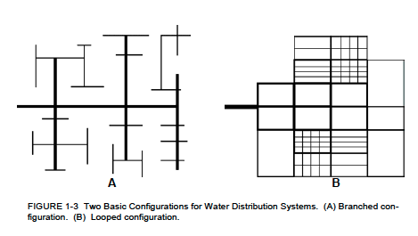
System types
Notes:
The two types of distribution systems are branched and looped/
Branched systems (dendritic systems)
One path to from the source to the customer. Typically one-way flow.
Looped systems
Pipes are interconnected throughout such that water can move through the entire system back and forth, depending on the points of largest demand.

Slide 10
Looped System features
Advantages:
Fluid velocities are lower, reducing head losses, resulting in greater capacity.
Main breaks can be isolated to minimize loss of service to customers.
Fire protection is greater due to greater capacity and ability to isolate breaks.
Looped systems usually provide better residual chlorine content due to inline mixing and fewer dead ends.
Disadvantages:
Looped systems generally cost more because there are pipes that become inadvertently redundant in order to create the loops.

Slide 11
Branched System features
Advantages:
Lower costs: Avoiding construction of pipes and appurtenances just to create a looped system reduces the cost.
In smaller rural communities, branched systems may be the only type that is feasible, logistically and monetarily.
Disadvantages:
Main breaks take all downstream customers out of service.
Branched systems cause poor chlorine residuals in low demand areas and may require periodic flushing of hydrants in order to pull chlorinated water into the system.
Velocities are faster, head losses greater and capacity reduced especially during high demand.
Fire protection is at risk due to inability to isolate a break.

Slide 12
Regulatory guidance documents
Regulatory guidance documents are a principal tool in system design, along with the designers creativity, and the owners access to right-of-way.
The EPA (Environmental Protection Agency) writes federal regulations for construction, maintenance, treatment and operation of potable water facilities.
State’s EPAs(or equivalents) are charged with regulating the standards and permitting. States may write more stringent regulations if they do not violate the intent of the federal code. The various documents are precise, but teduous.
Notes:
For example the federal regulation for water main separation and protection is:
Section 653.119 (Code of Federal Regulations) Protection of Water Main and Water
Service Lines
a) Water Mains:
1) Horizontal Separation:
A) Water mains shall be laid at least ten feet horizontally from any existing
or proposed drain, storm sewer, sanitary, combined sewer or sewer service
connection.
B) Water mains may be laid closer than ten feet to a sewer line
When:
i) local conditions prevent a lateral separation of ten feet.
ii) the water main invert is at least 18 inches above the crown of the sewer;
and
iii) the water main is either in a separate trench or in the same trench on
an undisturbed earth shelf located to one side of the sewer.
C) Both the water main and sewer shall be constructed of slip on or mechanical
joint cast or ductile iron pipe, prestressed concrete pipe, or PVC pipe meet-
ing the requirements of Section 653.111 when it is impossible to meet (A)
or (B) above. The drain or sewer shall be pressure tested to the maximum
expected surcharge head before back lling.
2) Vertical Separation:
A) A water main shall be laid so that its invert is 18 inches above the crown of
the drain or sewer whenever water mains cross storm sewers, sanitary sewers
or sewer service connections. The vertical separation shall be maintained
for that portion of the water main located within ten feet horizontally of
any sewer or drain crossed. A length of water main pipe shall be centered
over the sewer to be crossed with joints equidistant from the sewer or drain.
B) Both water main and sewer shall be constructed of slip on or mechanical
joint cast or ductile iron pipe, prestressed concrete pipe, or PVC pipe when
meeting requirements of Section 653.111 when:
i) it is impossible to obtain the proper vertical separation as described
in (A) above; or
ii) the water main passes under a sewer or drain line.
C) A vertical separation of 18 inches between the invert of the sewer or drain
and the crown of the water main shall be maintained where a water main
crosses under a sewer. Support the sewer or drain lines to prevent settling
and breaking the water main.
D) Construction shall extend on each side of the crossing until the normal
distance from the water main to the sewer or drain line is at least ten feet.
b) Water Service Lines:
1) The horizontal and vertical separation between water service lines, and all
storm sewers, sanitary sewers, combined sewers or any drain or service connec-
tion shall be the same as water main separation described in (a) above.
2) Water pipe described in (a) above shall be used for sewer service lines when
minimum horizontal and vertical separation cannot be maintained.
c) Special Conditions | Alternative solutions shall be presented to the Agency when
extreme topographical, geological or existing structural conditions make strict
compliance with (a) and (b) above technically and economically impractical. Al-
ternative solutions will be approved provided watertight construction structurally
equivalent to approved water main material is proposed.
d) Water mains shall be separated from septic tanks, disposal elds and seepage beds
by a minimum of 25 feet.
e) Water mains and service lines shall be protected against entrance of hydrocarbons
through diusion through any material used in the construction of the line.
EPA drinking water standards exhibit similar tedious precision and the designer will
need to read entire documents to understand the intent and expectation of the regu-
lations.

Slide 13
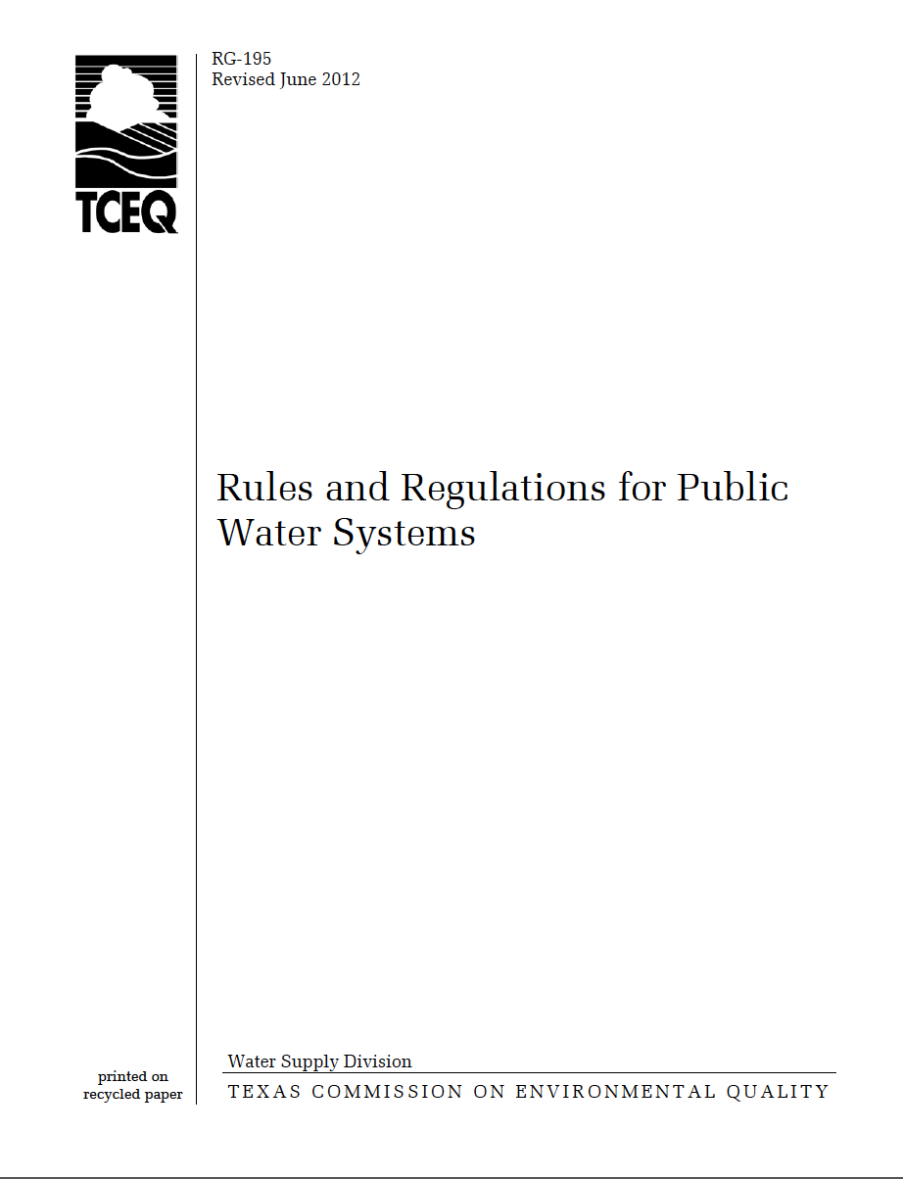
Texas rg-195
Representative of a State Level document
Examine selected content

Slide 14
Representative community manuals
Washington State
City of Houston
City of Lubbock
City of San Marcos

Slide 15
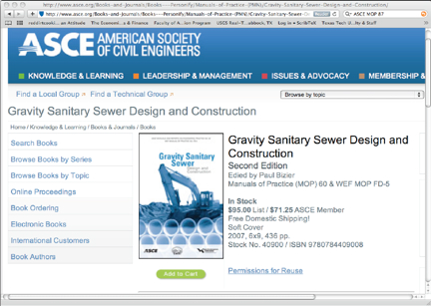
Professional literature
For unusual situations the designer will have to visit the professional literature for guidance
Order of preference for a designer will be a manual of practice, vendor literature, and finally the academic literature.
A manual of practice or even vendor literature is preferred over the academic literature simply because of a perception that the technologies are proven in these documents (proven in the litigation sense).

Slide 16
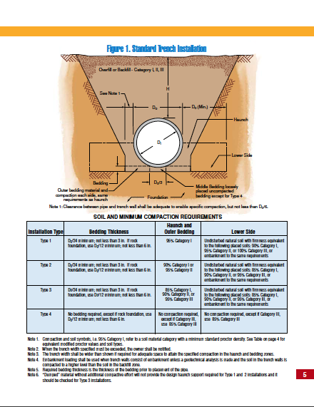

VENDOR literature
For unusual situations the designer will have to visit the professional literature for guidance
Order of preference for a designer will be a manual of practice, vendor literature, and finally the academic literature.
A manual of practice or even vendor literature is preferred over the academic literature simply because of a perception that the technologies are proven in these documents (proven in the litigation sense).

