Slide 1
CE 3372 Water Systems Design
Lesson 18: Introduction to swmm Fall 2020

Slide 2
SWMM
Storm Water Management Model
Originally by University of Florida in the 1970’s
V1-4 are FORTRAN
V5 re-factored into C++
The computation engine is mature
MIKE URBAN
SOBEK
XP-SWMM
Civil Storm
Notes:
Interestingly V4 and V5 are still in use; such a fork is uncommon in the software business

Slide 3
SWMM
Started as a simplified hydraulic model, evolved into an integrated hydrology-hydraulics model
Pretty useful in urban settings
Used for BMP performance estimation
Used for LID performance estimation

Slide 4
Download and Install
Google “EPA-SWMM” to find the software
Download the self-extracting archive
Download the user manual

Slide 5
Tour of the Interface
Nodes and Links
Outfall
Sub-catchments and Rain gages
Date/Time
Hydraulics
Hydrology

Slide 6
Nodes
Junction Nodes
Storage Nodes
Invert Elevations
Flooding

Slide 7
Junction (Node)
Ordinary junction connects hydraulic elements (links)
Junction attributes are:
Invert elevation (elevation of the bottom of the node)
Max elevation (elevation of top of node)
Set to land surface to plot profile grade line in SWMM
Set to land surface + added depth for dual (surface+subsurface drainage)
When program runs, depth at the node is computed, but there is no storage (node has zero area)

Slide 8
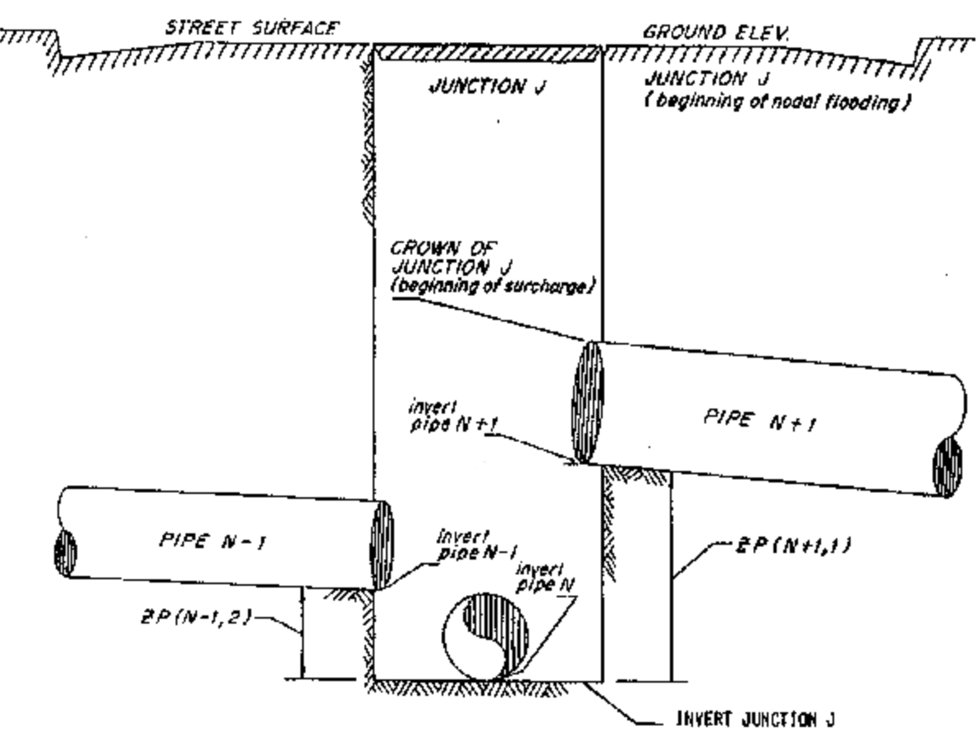
Junction (Node)
Ordinary junction just connects pipes N-1, N, and N+1

Slide 9
Junction (Node)
If flooding occurs, it is only considered when HGL is above node Max. Depth
Node not flooded; pipes are surcharged
Node flooded; pipes are surcharged

Slide 10
Junction (Node)
Flooded node attributes:
How deep is the flooding allowed (surcharge depth) above the top of the node
What is the ponded area during surcharge – treats the node as a vertical wall storage tank
Ponded Area
Ponded Depth
Invert Elevation + Max. Depth
Max. Depth
Invert Elevation

Slide 11
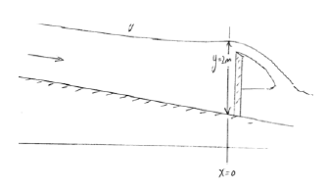
Example 1 : Rectangular Channel
Steady flow over a weir; depth at the weir is 2.0 meters. Determine the water surface profile for a distance 2000 meters upstream using SWMM. Sketch:
Hydraulic Data:
Rectangular B = 1 m
Steady flow Q = 2.5 CMS
S_{o} = 0.001
n = 0.025
Δx = 200 meters
Outfall boundary == fixed

Slide 12
Example 2 : Flow in a Sewer
Discharge in a 3 mile long, 60-inch RCP sewer is 50 MGD. What is the flow depth if the entire sewer is on a 0.1% slope and the downstream boundary (outfall) is a normal depth condition?
Hydraulic Data:
Circular: 60-inches (5 feet)
Steady flow Q = 50 million gallons per day (MGD)
S_{o} = 0.001
n = 0.015
Δx = 2640 feet (use 6 links)
Outfall boundary == normal

Slide 13
Design storm sewer for Goodwin street
“Rational Method Storm Sewer Design” in Mays, L. W. (2008) Water Resources Engineering. Pearson-Prentice Hall (pp. 613-635)
Method: Rational Equation Design Method to make initial design for subsequent hydraulics analysis

Slide 14
Preparation steps
Identify the individual drainage areas.
Determine the area of each contributing area, in acres. (ENGAUGE, PLANIMETER, etc)
Determine the rational runoff coefficient for each area (TABLE LOOKUP)

Slide 15
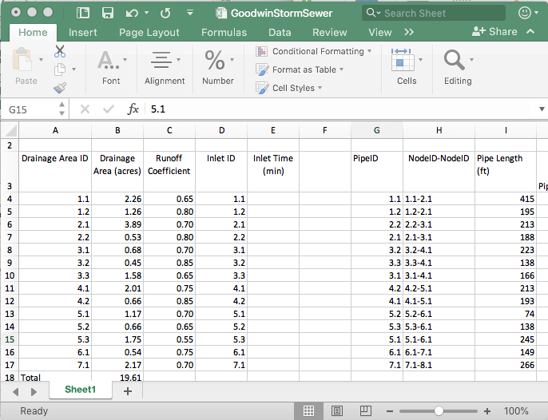
Gather the information into a spreadsheet
Build a sheet with the information
Note the naming convention (a bit awkward, but faithful to the original example)

Slide 16
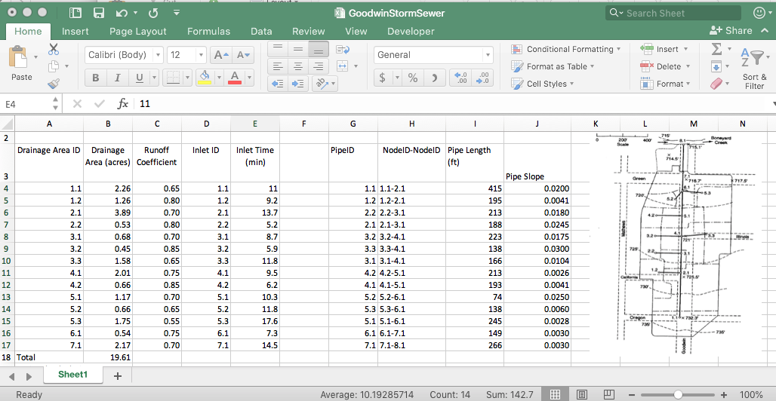
Estimate pipe slopes
Use the node elevations and topographic map to estimate pipe slopes
Populate the spreadsheet

