Slide 2
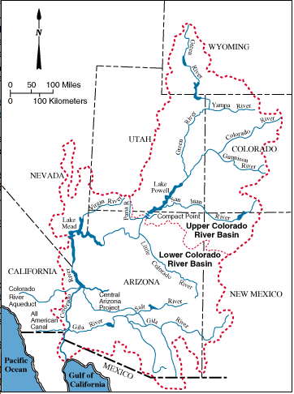
Salt Lake City
Flaming Gorge
Denver
Las Vegas
Glen Canyon
Navajo
Hoover
Davis
Parker
Los Angeles
Phoenix
San Diego
Imperial
Tucson

