Slide 1
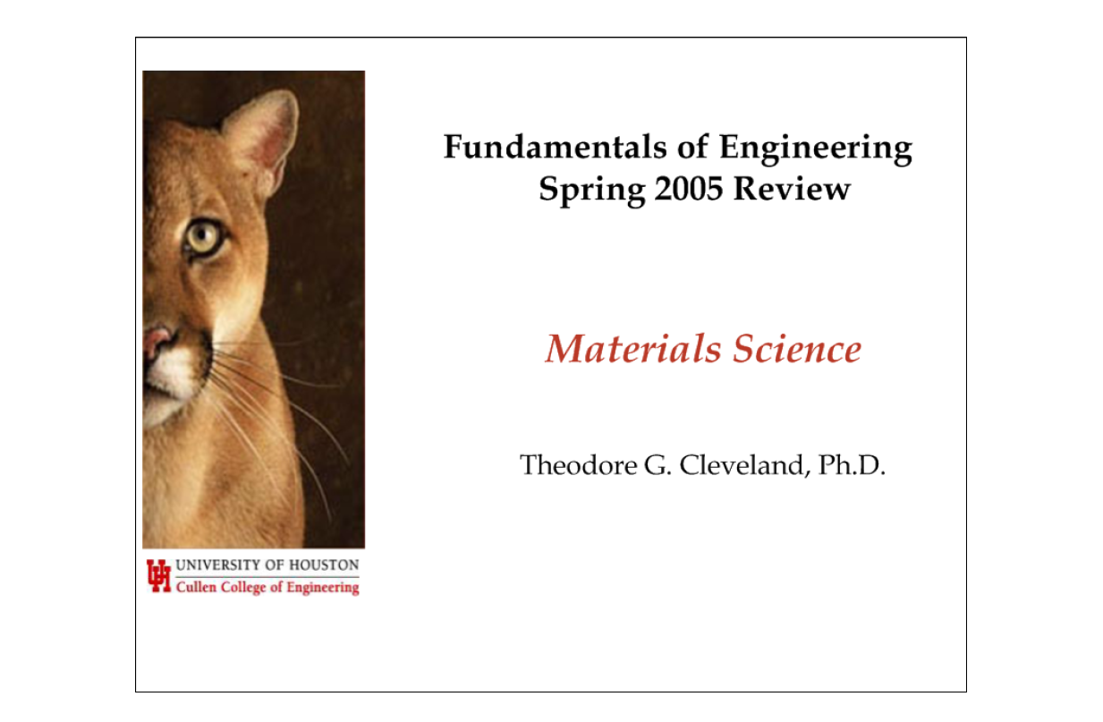

Slide 2
Problem Distribution
Morning: 6% (7 out of 120 problems)
Afternoon: 5% (3 out of 60 problems)
Subject areas
30% stress-strain diagram (3)
20% creep/fatigue (2)
20% processing/properties (2)
20% pahse diagram (2)
10% other (1)

Slide 3
Stress-strain diagram
stress
mild steel
Plastic deformation
Slip deformation
Dislocation motion
isochoric
σ_{y}
E
0.002
strain

Slide 4
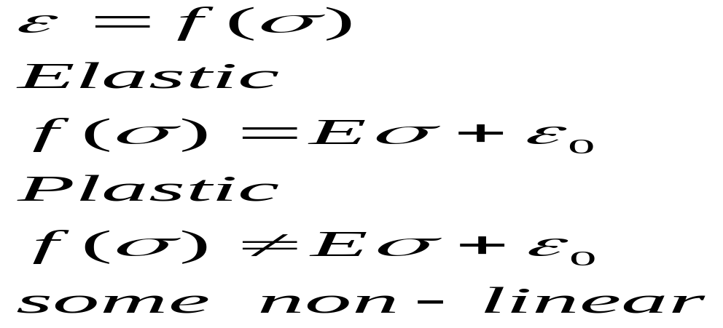
What does the mom-linear portion of a stress-strain diagram represent?
Plastic region
Strain is not linear without stress

Slide 5
What is the 0.2% offset yield stress?
Convention (agreement) where yield stress is defined because its experimentally difficult to determine σ_{y}
Therefore, a line parallel to elastic behavior at 0.002 strain is used to identify a “working” value of yield stress.

Slide 6
What metal exhibits upper and lower yield points?
Steel (any iron alloy) exhibits upper and lower yield.

Slide 7
creep and fatigue
Creep
deformation at constant stress and high temperature
grain boundary sliding, formation of voids (failure)
Fatigue
failure in cyclic loading due to surface defects
sensitive to surface properties (corrosion, finish)
endurance limit for steels (unlimited life)

Slide 8
What is the cause of creep failure?
Deformation of material under constant stress.
Temperature matters (T> 40% MP)
Internal thermal energy allows dislocations. (i.e. C, Fe atoms to rearrange in such a way as to lose ability to resist strain and thus slowly move)

Slide 9
Define metal fatigue?
Failure of material, starts at surface under cyclic loading

Slide 10
Ductility, hardness, toughness
Ductility
deformation withought fracture (% elongation)
increase with temperature, lower carbon content
Hardness
resistance to penetration (Brinell, Rockwell tests)
increases with carbon content, smaller grain size
Toughness
energy absorbed before fracture (Charpy test)
area under the stress-strain curve

Slide 11
Which statement regarding ductile-brittle transition is false?
Sudden loss of ductility below a critical temperature (T)
Loss of toughness at lower temperatures (T)
Carbon steels less susceptible to this transition (F)
Some pure metals (aluminum, copper, nickel) do not exhibit this transition (T)

Slide 12
processing
Annealing
heat and slowly cool (relieves internal stresses)
increases ductility, lowers yield, softens the material
Cold working
stressing past the yield point (reduces grain size)
increases toughness, hardness, yield strength
Quenching
rapid cooling that promotes hardening
strong but brittle material (low toughness)

Slide 13
Which statement regarding carbon steel is false?
a steel can be hardened without carburizing (T)
yield strength can be increased by cold rolling (T)
ductility decreases for steels with more carbon (T)
steels with larger grain size are stronger (F)

Slide 14
Reactions
Eutectic: liquid→ two solid phases
Eutectoid: solid→ two solid phases
Peritectic: liquid + solid→ solid
Peritectoid: two solid phases → solid

Slide 15
What is a peritectoid reaction?
Two solids in solution are in equilibrium with a third solid at a given temperature.

Slide 16
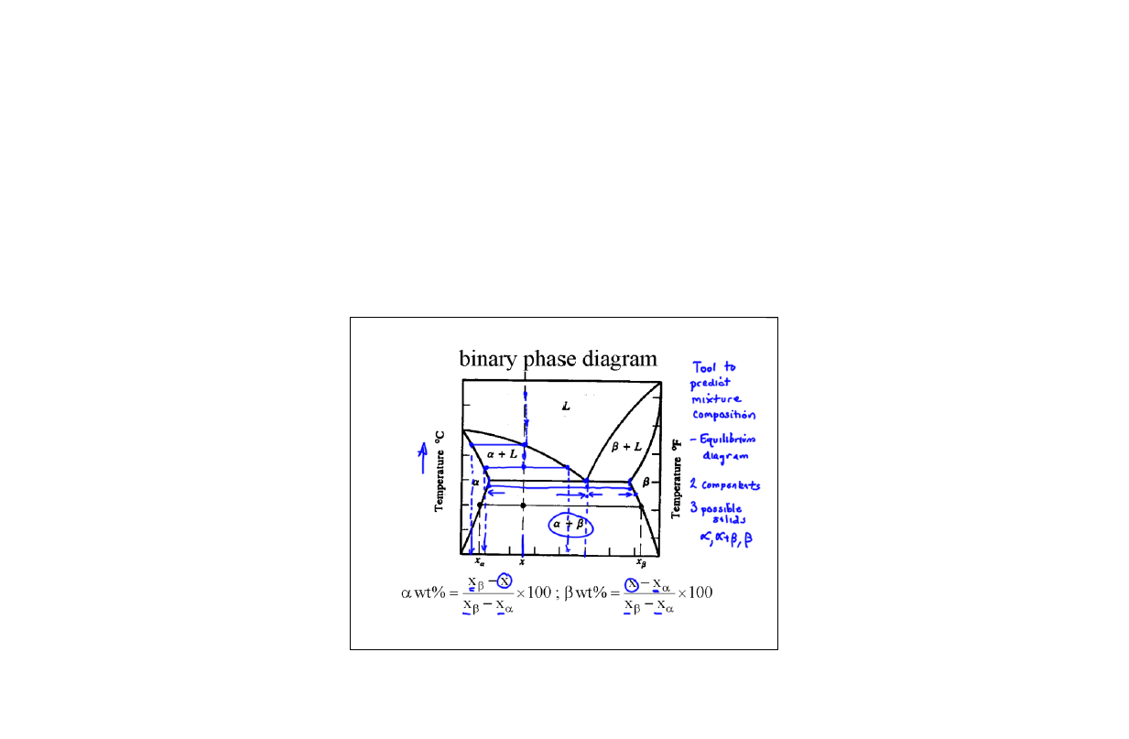
Binary phase diagram

Slide 17
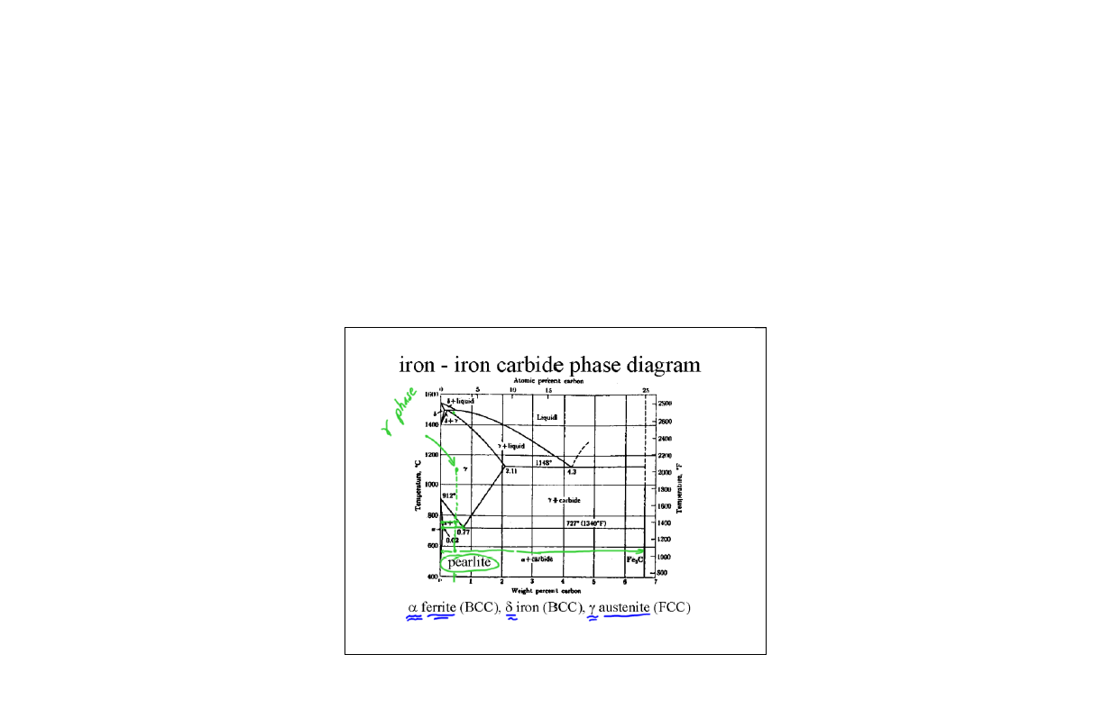

Slide 18
A steel with 0.18wt% carbon is heated to 1100ºC and then slowly cooled to room temperature. What is the phase composition?

Slide 19
Which condition does not lead to stronger metals and alloys?
Presence of second phase precipitates (stronger)
Presence of dispersed fibers or particles (stronger)
Presence of martensite phase in steel (stronger)
Annealing of cold worked metal above its recrystallization temperature (weaker)

Slide 20
Crystal structures
BCC body-centered cubic
FCC face-centered cubic

