Slide 1

FE EXAM PERFORMANCE CIVIL ENGINEERING PROGRAM Department of Civil, Environmental & Construction Engineering Texas Tech University
William D. Lawson, P.E., Ph.D.
7 Feb 2022

Slide 2
Overview
FE Exam Interpretive Context
TTU Civil Engineering Performance (pre-2014)
OVERALL
AM – subject content
PM – subject content
TTU Civil Engineering Performance (2014-2021)
Observations and Recommendations

Slide 3

FE Exam Interpretive Context

Slide 4
Idealized Engineering Licensure Model
Yes
ABET Accredited
Engineering Bachelor
of Science Degree
[or equivalent]
“Licensed
Professional
Engineer”
Mandatory
Continuing
Professional
Competency
Pass
No
Fail
4 Years
of
Acceptable
Experience
Inactive
Pass
FE Exam
Engineer-in
Training
PE Exam
Fail

Slide 5
What is the FE, really?
The FE Exam is designed to provide evidence of technical competency for the purpose of engineering licensure.

Slide 6
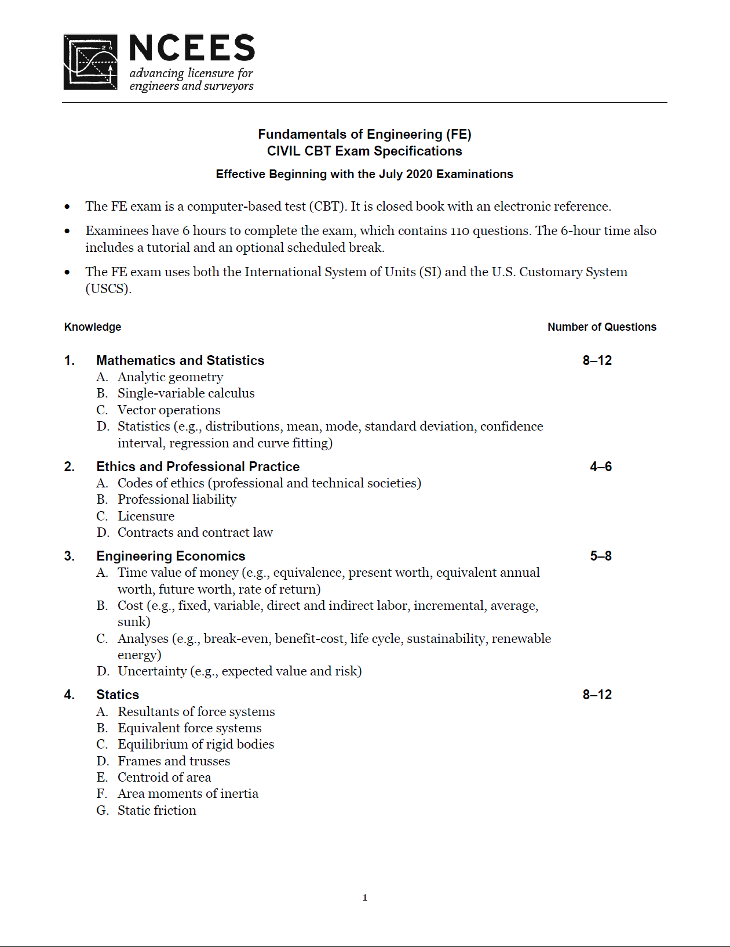

Slide 7
FE Exam Data… herein
1940 | 1950 | 1960 | 1970 | 1980 | 1990 | 2000 | 2010 | 2020 | 2030
1956
Pencil & Paper, 8.0 hrs, General Engr Content, 180 Questions, Open Book
1993
Supplied Reference, Ed. 1- Discipline Specific
1996
4.0 hrs Gen. / 4.0 hrs 180 Questions, Discipline-Specific
2014
CBT, 5.3 hrs, 18 topics, 110 questions
2020
14 Topics, 110 questions

Slide 8
TTU CIVIL Program Performance OVERALL
SPR 2022 Semester

Slide 9
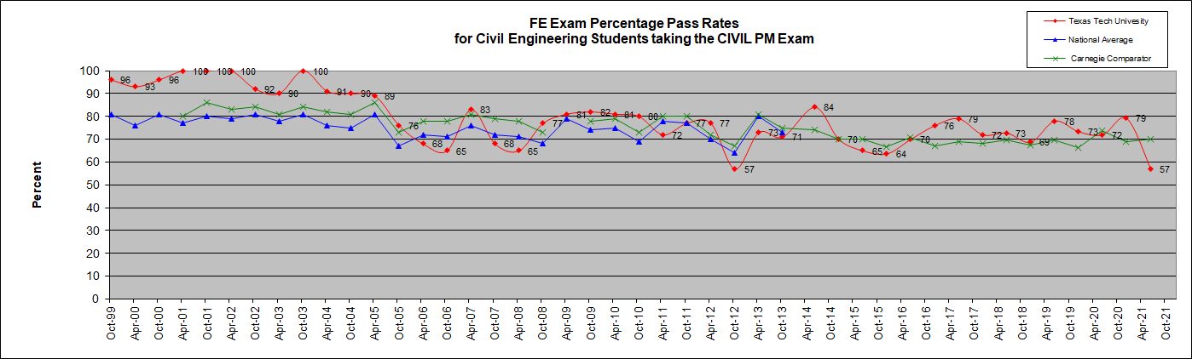
20+ YEARS FE PASS RATE DATA TTU Civil Engineering Program Performance
2014
CBT
EXAM
FORMAT
2020 CBT
EXAM
FORMAT

Slide 10
TTU Carnegie Comparators Carnegie Classification: Prof+A&S/HGC Professions plus arts & sciences, high graduate coexistence “60–79 percent of bachelor’s degree majors were in professional fields, and graduate degrees were observed in at least half of the fields corresponding to undergraduate majors.”
Institution | Location | Control
Auburn University Main Campus | Auburn University, Alabama | Public
Boricua College | New York, New York | Private not-for-profit
California State University-Los Angeles | Los Angeles, California | Public
Capella University | Minneapolis, Minnesota | Private for-profit
Clemson University | Clemson, South Carolina | Public
Cooper Union for the Advancement of Science and Art | New York, New York | Private not-for-profit
Drexel University | Philadelphia, Pennsylvania | Private not-for-profit
Duquesne University | Pittsburgh, Pennsylvania | Private not-for-profit
East Carolina University | Greenville, North Carolina | Public
Eastern Michigan University | Ypsilanti, Michigan | Public
Emerson College | Boston, Massachusetts | Private not-for-profit
Florida Atlantic University | Boca Raton, Florida | Public
Florida Institute of Technology | Melbourne, Florida | Private not-for-profit
Florida International University | Miami, Florida | Public
Georgia Institute of Technology-Main Campus | Atlanta, Georgia | Public
Howard University | Washington, District of Columbia | Private not-for-profit
Illinois Institute of Technology | Chicago, Illinois | Private not-for-profit
Illinois State University | Normal, Illinois | Public
Indiana University-Purdue University-Indianapolis | Indianapolis, Indiana | Public
Inter American University of Puerto Rico-Metro | San Juan, Puerto Rico | Private not-for-profit
Iowa State University | Ames, Iowa | Public
Kansas State University | Manhattan, Kansas | Public
Kent State University Kent Campus | Kent, Ohio | Public
Institution | Location | Control
Lehigh University | Bethlehem, Pennsylvania | Private not-for-profit
Long Island University-Brooklyn Campus | Brooklyn, New York | Private not-for-profit
Long Island University-C W Post Campus | Brookville, New York | Private not-for-profit
Marywood University | Scranton, Pennsylvania | Private not-for-profit
Mississippi College | Clinton, Mississippi | Private not-for-profit
Mississippi State University | Mississippi State, Mississippi | Public
Montana State University | Bozeman, Montana | Public
New Jersey Institute of Technology | Newark, New Jersey | Public
New Mexico State University-Main Campus | Las Cruces, New Mexico | Public
Northcentral University | Prescott Valley, Arizona | Private for-profit
Ohio University-Main Campus | Athens, Ohio | Public
Oklahoma State University-Main Campus | Stillwater, Oklahoma | Public
Oregon State University | Corvallis, Oregon | Public
Pennsylvania State University-Main Campus | University Park, Pennsylvania | Public
Polytechnic Institute of New York University | Brooklyn, New York | Private not-for-profit
Pratt Institute-Main | Brooklyn, New York | Private not-for-profit
Purdue University-Main Campus | West Lafayette, Indiana | Public
Rensselaer Polytechnic Institute | Troy, New York | Private not-for-profit
Rochester Institute of Technology | Rochester, New York | Private not-for-profit
Saint Louis University-Main Campus | Saint Louis, Missouri | Private not-for-profit
San Jose State University | San Jose, California | Public
Silicon Valley University | San Jose, California | Private not-for-profit
Southern Illinois University Carbondale | Carbondale, Illinois | Public
Carnegie Foundation identifies 72 universities, 47 public and 25 private, for the Prof+A&S/HGC classification. Comparators such as Texas A&M University, The University of Texas at Austin, are “Bal/HGC”, “Balanced arts & sciences/professions, high graduate coexistence.” Classification is based on data from 2008 and 2010. Note: this differs from the previous NCEES comparator classification, “Carnegie Research/Doctoral Extensive”.

Slide 11
TTU Carnegie Comparators, cont’d Carnegie Classification: Prof+A&S/HGC Professions plus arts & sciences, high graduate coexistence “60–79 percent of bachelor’s degree majors were in professional fields, and graduate degrees were observed in at least half of the fields corresponding to undergraduate majors.”
Institution | Location | Control
Temple University | Philadelphia, Pennsylvania | Public
Texas A & M International University | Laredo, Texas | Public
Texas Tech University | Lubbock, Texas | Public
The University of Alabama | Tuscaloosa, Alabama | Public
The University of Texas at El Paso | El Paso, Texas | Public
University of Akron Main Campus | Akron, Ohio | Public
University of Alabama in Huntsville | Huntsville, Alabama | Public
University of Arkansas | Fayetteville, Arkansas | Public
University of Central Florida | Orlando, Florida | Public
University of Cincinnati-Main Campus | Cincinnati, Ohio | Public
University of Idaho | Moscow, Idaho | Public
University of Maine | Orono, Maine | Public
University of Nebraska-Lincoln | Lincoln, Nebraska | Public
Institution | Location | Control
University of Nevada-Las Vegas | Las Vegas, Nevada | Public
University of North Dakota | Grand Forks, North Dakota | Public
University of South Carolina-Columbia | Columbia, South Carolina | Public
University of Southern Mississippi | Hattiesburg, Mississippi | Public
University of the West | Rosemead, California | Private not-for-profit
University of Toledo | Toledo, Ohio | Public
University of Wyoming | Laramie, Wyoming | Public
Utah State University | Logan, Utah | Public
Western Illinois University | Macomb, Illinois | Public
Western Michigan University | Kalamazoo, Michigan | Public
Wheelock College | Boston, Massachusetts | Private not-for-profit
Wichita State University | Wichita, Kansas | Public
Worcester Polytechnic Institute | Worcester, Massachusetts | Private not-for-profit
Carnegie Foundation identifies 72 universities, 47 public and 25 private, for the Prof+A&S/HGC classification. Comparators such as Texas A&M University, The University of Texas at Austin, are “Bal/HGC”, “Balanced arts & sciences/professions, high graduate coexistence.” Classification is based on data from 2008 and 2010. Note: this differs from the previous NCEES comparator classification, “Carnegie Research/Doctoral Extensive”.
SPR 2022 Semester

Slide 12
TTU CIVIL Program Performance pre-2014 (AM & PM) data
SPR 2022 Semester

Slide 13
CIVIL Program Performance AM-Portion

Slide 14
15%
Civil Engineering Program AM Portion

Slide 15
7%
Civil Engineering Program AM Portion

Slide 16
Civil Engineering Program AM Portion
9%

Slide 17
7%
Civil Engineering Program AM Portion

Slide 18
9%
Civil Engineering Program AM Portion

Slide 19
8%
Civil Engineering Program AM Portion

Slide 20
7%
Civil Engineering Program AM Portion

Slide 21
7%
Civil Engineering Program AM Portion

Slide 22
7%
Civil Engineering Program AM Portion

Slide 23
7%
Civil Engineering Program AM Portion

Slide 24
Civil Engineering Program AM Portion
7%

Slide 25
10%
Civil Engineering Program AM Portion

Slide 26
½*10%
Civil Engineering Program AM Portion

Slide 27
½*10%
Civil Engineering Program AM Portion

Slide 28
Civil Engineering Program AM Comparison
15%
MATHEMATICS
Tech vs. Nat'l | -1.8
Tech vs. Carnegie | -1.3

Slide 29
Civil Engineering Program AM Comparison
7%
ENGINEERING PROBABILITY & STATISTICS
Tech vs. Nat'l | -2.8
Tech vs. Carnegie | -3.0

Slide 30
Civil Engineering Program AM Comparison
7%
CHEMISTRY
Tech vs. Nat'l | 0.0
Tech vs. Carnegie | 0.3

Slide 31
Civil Engineering Program AM Comparison
7%
COMPUTERS
Tech vs. Nat'l | -0.3
Tech vs. Carnegie | 0.5

Slide 32
Civil Engineering Program AM Comparison
9%
ELECTRICITY AND MAGNETISM
Tech vs. Nat'l | -1.3
Tech vs. Carnegie | -0.5

Slide 33
Civil Engineering Program AM Comparison
8%
ENGINEERING ECON
Tech vs. Nat'l | -3.0
Tech vs. Carnegie | -4.3

Slide 34
Civil Engineering Program AM Comparison
7%
ETHICS AND BUSINESS PRACTICES
Tech vs. Nat'l | 2.0
Tech vs. Carnegie | 1.3

Slide 35
Civil Engineering Program AM Comparison
7%
FLUID MECHANICS
Tech vs. Nat'l | -1.8
Tech vs. Carnegie | -2.5

Slide 36
Civil Engineering Program AM Comparison
7%
MATERIAL PROPERTIES
Tech vs. Nat'l | -1.5
Tech vs. Carnegie | -1.8

Slide 37
Civil Engineering Program AM Comparison
7%
STRENGTH OF MATERIALS
Tech vs. Nat'l | 3.3
Tech vs. Carnegie | 3.0

Slide 38
Civil Engineering Program AM Comparison
7%
THERMODYNAMICS
Tech vs. Nat'l | -6.0
Tech vs. Carnegie | -6.0

Slide 39
Civil Engineering Program AM Comparison
10%
ENGINEERING MECHANICS (STATICS & DYNAMICS)
Tech vs. Nat'l | 0.1
Tech vs. Carnegie | -2.1

Slide 40
Civil Engineering Program AM Comparison
½*10%
ENGINEERING MECHANICS (STATICS)
Tech vs. Nat'l | 0.8
Tech vs. Carnegie | 0.8

Slide 41
Civil Engineering Program AM Comparison
½*10%
ENGINEERING MECHANICS (DYNAMICS)
Tech vs. Nat'l | -0.8
Tech vs. Carnegie | 0.0

Slide 42
CIVIL Program Performance AM-Challenges (pre-2014) (Averages April 2012– October 2013)
STRENGTH OF MATERIALS (7%)
Tech vs. Nat'l | 3.3
Tech vs. Carnegie | 3.0
ELECTRICITY AND MAGNETISM (9%)
Tech vs. Nat'l | -1.3
Tech vs. Carnegie | -0.5
ETHICS AND BUSINESS PRACTICES (7%)
Tech vs. Nat'l | 2.0
Tech vs. Carnegie | 1.3
MATHEMATICS (15%)
Tech vs. Nat'l | -1.8
Tech vs. Carnegie | -1.3
STATICS (½*10%)
Tech vs. Nat'l | 0.8
Tech vs. Carnegie | 0.8
MATERIAL PROPERTIES (7%)
Tech vs. Nat'l | -1.5
Tech vs. Carnegie | -1.8
CHEMISTRY (9%)
Tech vs. Nat'l | 0.0
Tech vs. Carnegie | 0.3
FLUID MECHANICS (7%)
Tech vs. Nat'l | -1.8
Tech vs. Carnegie | -2.5
ENGINEERING PROBABILITY & STATISTICS (7%)
Tech vs. Nat'l | -2.8
Tech vs. Carnegie | -3.0
COMPUTERS (7%)
Tech vs. Nat'l | -0.3
Tech vs. Carnegie | 0.5
ENGINEERING ECONOMICS (8%)
Tech vs. Nat'l | -3.0
Tech vs. Carnegie | -4.3
DYNAMICS (½*10%)
Tech vs. Nat'l | -0.8
Tech vs. Carnegie | 0.0
THERMODYNAMICS (7%)
Tech vs. Nat'l | -6.0
Tech vs. Carnegie | -6.0

Slide 43
CIVIL Program Performance PM-Portion

Slide 44
Civil Engineering Program PM Portion
10%

Slide 45
12%
Civil Engineering Program PM Portion

Slide 46
12%
Civil Engineering Program PM Portion

Slide 47
10%
Civil Engineering Program PM Portion

Slide 48
10%
Civil Engineering Program PM Portion

Slide 49
15%
Civil Engineering Program PM Portion

Slide 50
11%
Civil Engineering Program PM Portion

Slide 51
12%
Civil Engineering Program PM Portion

Slide 52
8%
Civil Engineering Program PM Portion

Slide 53
Civil Engineering Program PM Comparison
10%
CONSTRUCTION MGMNT
Tech vs. Nat'l | -5.3
Tech vs. Carnegie | -7.3

Slide 54
Civil Engineering Program PM Comparison
12%
ENVIRONMENTAL ENGR
Tech vs. Nat'l | -2.0
Tech vs. Carnegie | -2.6

Slide 55
Civil Engineering Program PM Comparison
12%
HYDRAUL/HYDROLOG SYS
Tech vs. Nat'l | 3.0
Tech vs. Carnegie | 2.0

Slide 56
Civil Engineering Program PM Comparison
10%
STRUCTURAL ANALYSIS
Tech vs. Nat'l | -1.6
Tech vs. Carnegie | -1.9

Slide 57
Civil Engineering Program PM Comparison
10%
STRUCTURAL DESIGN
Tech vs. Nat'l | 2.5
Tech vs. Carnegie | 2.4

Slide 58
Civil Engineering Program PM Comparison
15%
SOIL MECH & FOUNDAT
Tech vs. Nat'l | 1.3
Tech vs. Carnegie | 0.3

Slide 59
Civil Engineering Program PM Comparison
11%
SURVEYING
Tech vs. Nat'l | -1.4
Tech vs. Carnegie | -2.6

Slide 60
Civil Engineering Program PM Comparison
12%
TRANSPORTATION
Tech vs. Nat'l | 0.5
Tech vs. Carnegie | -0.5

Slide 61
Civil Engineering Program PM Comparison
8%
MATERIALS
Tech vs. Nat'l | -1.4
Tech vs. Carnegie | -2.9

Slide 62
CIVIL Program Performance PM-Challenges (pre 2014) (Averages Apr 2012– Oct 2013)
HYDRAUL/HYDROLOG SYSTEMS (12%)
Tech vs. Nat'l | 3.0
Tech vs. Carnegie | 2.0
STRUCTURAL ANALYSIS (10%)
Tech vs. Nat'l | -1.6
Tech vs. Carnegie | -1.9
STRUCTURAL DESIGN (10%)
Tech vs. Nat'l | 2.5
Tech vs. Carnegie | 2.4
SURVEYING (11%)
Tech vs. Nat'l | -1.4
Tech vs. Carnegie | -2.6
SOIL MECH & FOUNDATIONS (15%)
Tech vs. Nat'l | 1.3
Tech vs. Carnegie | 0.3
MATERIALS (8%)
Tech vs. Nat'l | -1.4
Tech vs. Carnegie | -2.9
TRANSPORTATION (12%)
Tech vs. Nat'l | 0.5
Tech vs. Carnegie | -0.5
ENVIRONMENTAL ENGR (12%)
Tech vs. Nat'l | -2.0
Tech vs. Carnegie | -2.6
CONSTRUCTION MGMNT (10%)
Tech vs. Nat'l | -5.3
Tech vs. Carnegie | -7.3

Slide 63
TTU CIVIL Program Performance 2014-2020 data
SPR 2022 Semester

Slide 64
Ongoing Evolution of the FE Exam
1940 | 1950 | 1960 | 1970 | 1980 | 1990 | 2000 | 2010 | 2020 | 2030
1956
Pencil & Paper, 8.0 hrs, General Engr Content, 180 Questions, Open Book
1993
Supplied Reference, Ed. 1- Discipline Specific
1996
4.0 hrs Gen. / 4.0 hrs 180 Questions, Discipline-Specific
2014
CBT, 5.3 hrs, 18 topics, 110 questions
2020
14 Topics, 110 questions

Slide 65
20+ YEARS FE PASS RATE DATA TTU Civil Engineering Program Performance
2014
CBT
EXAM
FORMAT
2020 CBT
EXAM
FORMAT

Slide 66
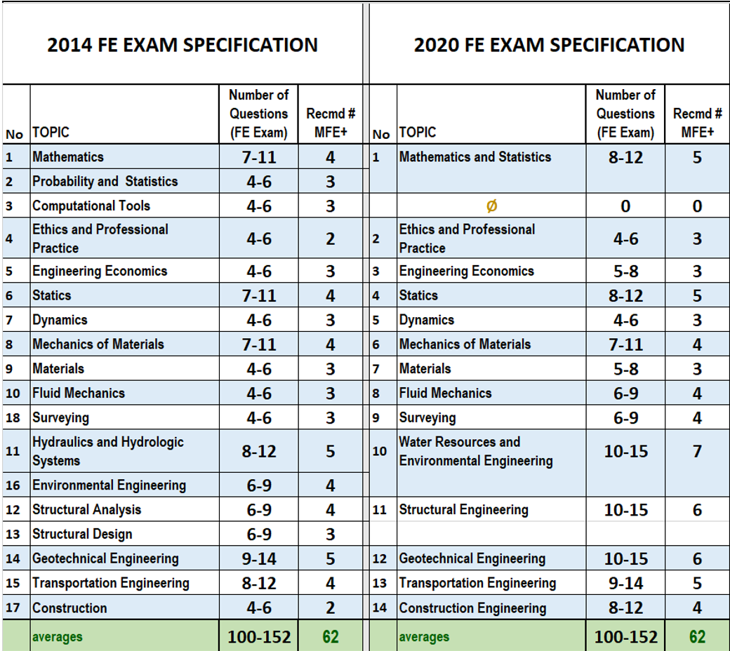
2020 FE Exam (CIVIL)

Slide 68
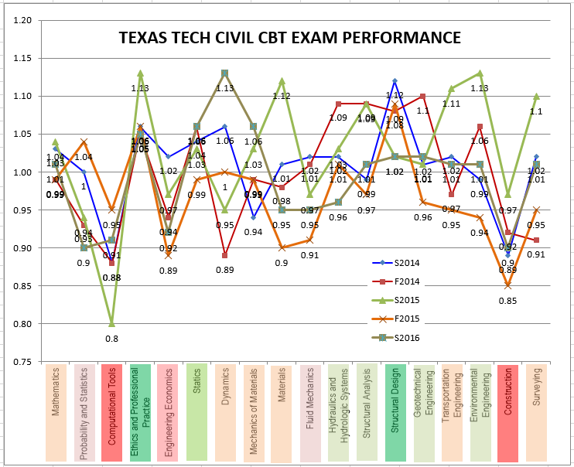
2016
RATIO: TTU/COMPARATOR
*
*
*
*
*




Slide 69
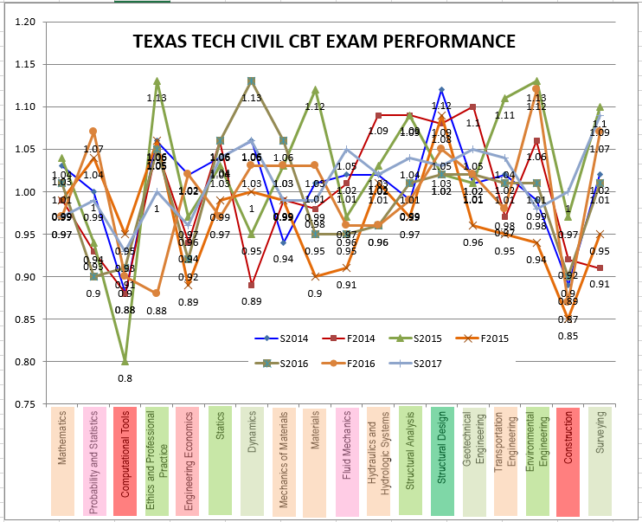
2017
*
*
*
*
*




Slide 70
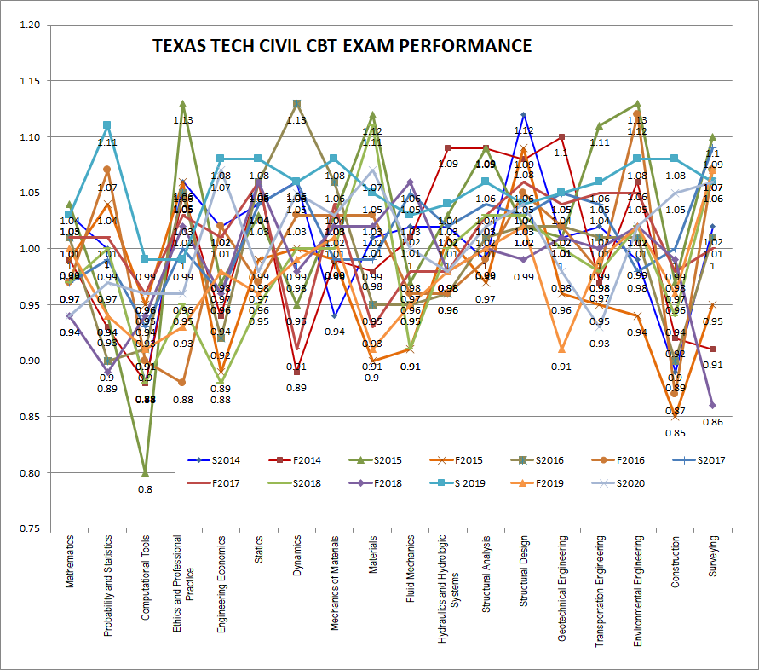
2020
*
*
*








Slide 71
20+ YEARS FE PASS RATE DATA TTU Civil Engineering Program Performance
2014
CBT
EXAM
FORMAT
2020 CBT
EXAM
FORMAT

Slide 72
Summary Observations
NCEES changed the FE Exam in 2014 and again in July 2020.
Prior to 2014, typical performance was about 30 to 80, avg 50% correct, by topic (varies)
FROM JAN 2014- JUN 2021
CIVIL Program analysis suggests that AM performance needs improvement in 4 of 10 topics.
Esp.; Computational Tools, Engineering Economics, Probability & Statistics, Fluid Mechanics
PM performance needs improvement in 1 of 8 topics.
Esp.; Construction

Slide 73
Recommendations
SHORT TERM
Encourage students NOT to take FE early
Take FE Exam when best prepared to pass (graduating semester)
FE review course: special attention to reviews in problem topics
LONGER TERM
Faculty evaluate curriculum relative to FE topics/specification
Use CE 4200 to introduce, and provide diagnostic data for, student FE Exam preparation
Consider Scope and Focus of FE Review Course (CE 4000)
Review? Re-Learn? Learn?
Accumulate FE pass rate data for current version of Exam

