Slide 1
Engineering Ethics
Theodore G. Cleveland, Ph.D., P.E.
Associate Professor
University of Houston

Slide 2
Course Structure
2nd Hour:
  Codes of Ethics
  Texas Engineering Practices Act

Slide 3
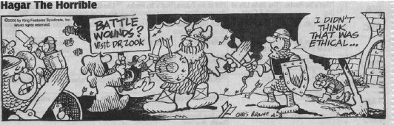
Professional Ethics

Slide 4
Codes of Ethics
Soldiers, police, firefighters, EMTs etc.
  High-stress situations; no time to think.
  Training to respond in a manner to ensure high-probability of correct response.
Code of ethics serves a similar purpose.
  Provide guides to respond to an ethical situation in a manner to ensure a high-probability of correct response.

Slide 5
NSPE Code of Ethics
Example of a code of ethics.
Comprehensive

Slide 6
Preamble
Describes the purpose of the code:
  Safeguard life, health, property.
  Promote the public good.
  Maintain high integrity.

Slide 7
Fundamental Canons
Describes and engineer’s obligation to society.
  Public welfare.
  Competence.
  Honesty.
Notes:
Rule 1 -- public welfare is paramount.
Rule 2 -- obligated to work in areas of competence (discussion).
Rule 3 -- “Tell the truth”
Rule 4 -- Preserve the engineer-client privilege (confidence, secrecy, competitive advantage).
Rule 5 -- “Be honest”
Rule 6 -- Uphold your obligation to the profession.

Slide 8
Rules of Practice
Expanded descriptions of the fundamental canons
Notes:
Rule 1 -- public welfare is paramount.
Provides guidelines for how to act in generalized situations. Describe “correct” engineering behavior. Obligation to report illegal and unethical behavior.
Rule 2 -- obligated to work in areas of competence (discussion).
Experience or education confers “competence”. Self-education would qualify (hard to prove). Judgment is expected. Project management is covered (modern management theory).
Rule 3 -- “Tell the truth”. Disclosure if paid opinion (in advance of the opinion).
Rule 4 -- Preserve the engineer-client privilege (confidence, secrecy, competitive advantage). Don’t sell same job twice (but it does not mean you cannot use the same technology twice -- use federal maps as example). Disclose conflict of interests -- esp.. applies to public employees.
Rule 5 -- “Be honest” Respect other engineers. Do not misrepresent ones own abilities or downplay a competitors abilities. Does not preclude pointing out a competitors experience (which is a matter of business records), but one truly has no way of determining a competitors ability. Don’t accept things that are or look like a bribe, kickback, payoff etc. to obtain a job. You can still meet with your friends for lunch, discuss work, and even take turns paying the bill.
Rule 6 -- Uphold your obligation to the profession.

Slide 9
Professional Obligations
Expanded last fundamental canons.
Notes:
Rule 6 -- Uphold your obligation to the profession.
Acknowledge errors and mistakes. (Seek divine guidance that they are minor and don’t get people killed -- engineering involves risk).
Inform clients/employers when the project may fail. I.E. save them from going down a rathole if you can. Acknowledge when the opinion is an educated guess.
Submit/seal plans only if they are in accordance with current practice. If truly novel, there is risk -- inform the client.
Maintain professional competence by development (I.e. this seminar).

Slide 10
Texas Engineering Practice Act
Defines:
  “practice” of engineering.
  “licensure” qualifications.
  “misconduct” and associated remedies.
Purpose (1001.004):
  Promote the public good (improve quality of life, property, economy, security of the state and the nation)
Notes:
§ 1001.004. Legislative Purpose and Intent; Liberal Construction of Chapter (a) The legislature recognizes the vital impact that the rapid advance of knowledge of the mathematical, physical, and engineering sciences as applied in the practice of engineering has on the lives, property, economy, and security of state residents and the national defense. (b) The purpose of this chapter is to: (1) protect the public health, safety, and welfare; (2) enable the state and the public to identify persons authorized to practice engineering in this state; and (3) fix responsibility for work done or services or acts performed in the practice of engineering.

Slide 11
Texas Engineering Practice Act
Section(s) 1001.## contains specific definitions and exemptions.
  Defines a public work.
  Sets a dollar value on projects that need licensed engineers to perform services.
Establishes fees for various license related activities.
Notes:
Board is empowered by the act to disclose the register of engineers.
§ 1001.208. Roster of Engineers (a) The Board shall prepare and publish a roster of persons, including business entities, licensed, registered, certified, or enrolled by the Board. The roster shall include the name, business address, and other identifying information required by Board rule. (b) The Board shall make the roster available to the public without cost in an online computer database format. (c) The Board shall provide a physical copy of the roster on request and may charge a reproduction and shipping fee for providing a physical copy of the roster. Added by Acts 2001, 77th Leg., ch. 1421, § 1, eff. June 1, 2003.

Slide 12
Texas Engineering Practice Act
Section(s) 1001.210 establishes the continuing education program
  the reason you are here now!
Notes:
§ 1001.210. Continuing Education Programs (a) The Board shall recognize, prepare, or administer continuing education programs for its license holders. A license holder must participate in the programs to the extent required by the Board to keep the person’s license. (b) The Board may not require a license holder to obtain more than 15 hours of continuing education annually. The Board shall permit a license holder to certify at the time the license is renewed that the license holder has complied with the Board’s continuing education requirements. (c) The Board shall permit a license holder to receive continuing education credit for educational, technical, ethical, or professional management activities related to the practice of engineering, including: (1) successfully completing or auditing a course sponsored by an institution of higher education; (2) successfully completing a course certified by a professional or trade organization; (3) attending a seminar, tutorial, short course, correspondence course, videotaped course, or televised course; (4) participating in an in-house course sponsored by a corporation or other business entity; (5) teaching a course described by Subdivisions (1)-(4); (6) publishing an article, paper, or book on the practice of engineering; (7) making or attending a presentation at a meeting of a technical or engineering management society or organization or writing a paper presented at such a meeting; (8) participating in the activities of a professional society or association, including serving on a committee of the organization; and (9) engaging in self-directed study. (d) A license holder may not receive more than five continuing education credit hours annually for engaging in self-directed study.

Slide 13
Texas Engineering Practice Act - Continuing Education
A course sponsored by
  an institution of higher education
  a professional or trade organization
A seminar, tutorial, short course, correspondence course, videotaped course, or televised course.
participating in an in-house course sponsored by a corporation or other business entity
Notes:
§ 1001.210. Continuing Education Programs (a) The Board shall recognize, prepare, or administer continuing education programs for its license holders. A license holder must participate in the programs to the extent required by the Board to keep the person’s license. (b) The Board may not require a license holder to obtain more than 15 hours of continuing education annually. The Board shall permit a license holder to certify at the time the license is renewed that the license holder has complied with the Board’s continuing education requirements. (c) The Board shall permit a license holder to receive continuing education credit for educational, technical, ethical, or professional management activities related to the practice of engineering, including: (1) successfully completing or auditing a course sponsored by an institution of higher education; (2) successfully completing a course certified by a professional or trade organization; (3) attending a seminar, tutorial, short course, correspondence course, videotaped course, or televised course; (4) participating in an in-house course sponsored by a corporation or other business entity; (5) teaching a course described by Subdivisions (1)-(4); (6) publishing an article, paper, or book on the practice of engineering; (7) making or attending a presentation at a meeting of a technical or engineering management society or organization or writing a paper presented at such a meeting; (8) participating in the activities of a professional society or association, including serving on a committee of the organization; and (9) engaging in self-directed study. (d) A license holder may not receive more than five continuing education credit hours annually for engaging in self-directed study.

Slide 14
Texas Engineering Practice Act - Continuing Education
Teaching a course described by Subdivisions (1)-(4)
Publishing an article, paper, or book on the practice of engineering
Making or attending a presentation at a meeting of a technical or engineering management society or organization or writing a paper presented at such a meeting;
Notes:
§ 1001.210. Continuing Education Programs (a) The Board shall recognize, prepare, or administer continuing education programs for its license holders. A license holder must participate in the programs to the extent required by the Board to keep the person’s license. (b) The Board may not require a license holder to obtain more than 15 hours of continuing education annually. The Board shall permit a license holder to certify at the time the license is renewed that the license holder has complied with the Board’s continuing education requirements. (c) The Board shall permit a license holder to receive continuing education credit for educational, technical, ethical, or professional management activities related to the practice of engineering, including: (1) successfully completing or auditing a course sponsored by an institution of higher education; (2) successfully completing a course certified by a professional or trade organization; (3) attending a seminar, tutorial, short course, correspondence course, videotaped course, or televised course; (4) participating in an in-house course sponsored by a corporation or other business entity; (5) teaching a course described by Subdivisions (1)-(4); (6) publishing an article, paper, or book on the practice of engineering; (7) making or attending a presentation at a meeting of a technical or engineering management society or organization or writing a paper presented at such a meeting; (8) participating in the activities of a professional society or association, including serving on a committee of the organization; and (9) engaging in self-directed study. (d) A license holder may not receive more than five continuing education credit hours annually for engaging in self-directed study.

Slide 15
Texas Engineering Practice Act - Continuing Education
Participating in the activities of a professional society or association, including serving on a committee of the organization
Engaging in self-directed study
  (up to 5 hours).
Notes:
§ 1001.210. Continuing Education Programs (a) The Board shall recognize, prepare, or administer continuing education programs for its license holders. A license holder must participate in the programs to the extent required by the Board to keep the person’s license. (b) The Board may not require a license holder to obtain more than 15 hours of continuing education annually. The Board shall permit a license holder to certify at the time the license is renewed that the license holder has complied with the Board’s continuing education requirements. (c) The Board shall permit a license holder to receive continuing education credit for educational, technical, ethical, or professional management activities related to the practice of engineering, including: (1) successfully completing or auditing a course sponsored by an institution of higher education; (2) successfully completing a course certified by a professional or trade organization; (3) attending a seminar, tutorial, short course, correspondence course, videotaped course, or televised course; (4) participating in an in-house course sponsored by a corporation or other business entity; (5) teaching a course described by Subdivisions (1)-(4); (6) publishing an article, paper, or book on the practice of engineering; (7) making or attending a presentation at a meeting of a technical or engineering management society or organization or writing a paper presented at such a meeting; (8) participating in the activities of a professional society or association, including serving on a committee of the organization; and (9) engaging in self-directed study. (d) A license holder may not receive more than five continuing education credit hours annually for engaging in self-directed study.

Slide 16
Texas Engineering Practice Act - License Required
§ 1001.301. License Required
  Practice engineering
  Use following titles:
    (1) “engineer”
    (2) “professional engineer”
    (3) “licensed engineer”
    (4) “registered engineer”
    (5) “registered professional engineer”
    (6) “licensed professional engineer”
    (7) “engineered.”
Notes:
§ 1001.210. Continuing Education Programs (a) The Board shall recognize, prepare, or administer continuing education programs for its license holders. A license holder must participate in the programs to the extent required by the Board to keep the person’s license. (b) The Board may not require a license holder to obtain more than 15 hours of continuing education annually. The Board shall permit a license holder to certify at the time the license is renewed that the license holder has complied with the Board’s continuing education requirements. (c) The Board shall permit a license holder to receive continuing education credit for educational, technical, ethical, or professional management activities related to the practice of engineering, including: (1) successfully completing or auditing a course sponsored by an institution of higher education; (2) successfully completing a course certified by a professional or trade organization; (3) attending a seminar, tutorial, short course, correspondence course, videotaped course, or televised course; (4) participating in an in-house course sponsored by a corporation or other business entity; (5) teaching a course described by Subdivisions (1)-(4); (6) publishing an article, paper, or book on the practice of engineering; (7) making or attending a presentation at a meeting of a technical or engineering management society or organization or writing a paper presented at such a meeting; (8) participating in the activities of a professional society or association, including serving on a committee of the organization; and (9) engaging in self-directed study. (d) A license holder may not receive more than five continuing education credit hours annually for engaging in self-directed study.

Slide 17
Texas Engineering Practice Act - Renewal Procedure
§ 1001.353. Defines
  Regular renewal
  Late (grace period) and associated increase in fees.
  Expired and retesting process (by reference to other sections of the act)
Notes:
§ 1001.210. Continuing Education Programs (a) The Board shall recognize, prepare, or administer continuing education programs for its license holders. A license holder must participate in the programs to the extent required by the Board to keep the person’s license. (b) The Board may not require a license holder to obtain more than 15 hours of continuing education annually. The Board shall permit a license holder to certify at the time the license is renewed that the license holder has complied with the Board’s continuing education requirements. (c) The Board shall permit a license holder to receive continuing education credit for educational, technical, ethical, or professional management activities related to the practice of engineering, including: (1) successfully completing or auditing a course sponsored by an institution of higher education; (2) successfully completing a course certified by a professional or trade organization; (3) attending a seminar, tutorial, short course, correspondence course, videotaped course, or televised course; (4) participating in an in-house course sponsored by a corporation or other business entity; (5) teaching a course described by Subdivisions (1)-(4); (6) publishing an article, paper, or book on the practice of engineering; (7) making or attending a presentation at a meeting of a technical or engineering management society or organization or writing a paper presented at such a meeting; (8) participating in the activities of a professional society or association, including serving on a committee of the organization; and (9) engaging in self-directed study. (d) A license holder may not receive more than five continuing education credit hours annually for engaging in self-directed study.

Slide 18
Texas Engineering Practice Act - Public Officials
§ 1001.402. Enforcement by Certain Public Officials.
  A public official of the state or of a political subdivision of the state who is responsible for enforcing laws that affect the practice of engineering may accept a plan, specification, or other related document only if the plan, specification, or other document was prepared by an engineer, as evidenced by the engineer’s seal.

Slide 19
Texas Engineering Practice Act - Public Works
§ 1001.407. Construction of Certain Public Works
  The state or a political subdivision of the state may not construct a public work involving engineering in which the public health, welfare, or safety is involved, unless:
    (1) the engineering plans, specifications, and estimates have been prepared by an engineer; and
    (2) the engineering construction is to be performed under the direct supervision of an engineer.

Slide 20
Texas Engineering Practice Act
§131.81 Definitions
  Defines meanings of acronyms (ABET) etc. and specific terms such as “graduate engineer” etc.
  Gross negligence
  Incompetence
Notes:
(16) Gross negligence - Any willful or knowing conduct, or pattern of conduct, which includes but is not limited to conduct that demonstrates a disregard or indifference to the rights, health, safety, welfare, and property of the public or clients. Gross negligence may result in financial loss, injury or damage to life or property, but such results need not occur for the establishment of such conduct. (17) Incompetence - An act or omission of malpractice which may include but is not limited to recklessness or excessive errors, omissions or failures in the license holder’s record of professional practice; or an act or omission in connection with a disability which includes but is not limited to mental or physical disability or addiction to alcohol or drugs as to endanger health, safety and interest of the public by impairing skill and care in the provision of professional services.

Slide 21
Texas Engineering Practice Act
§137.17 Continuing Education Program
  (a) Each license holder shall meet the Continuing Education Program (CEP) requirements for professional development as a condition for license renewal.
  ……..
  (d) A minimum of 1 PDH per renewal period must be in the area of professional ethics, roles and responsibilities of professional engineering, or review of the Texas Engineering Practice Act and Board Rules.
Notes:
Texas Engineering Practice Act and Rules ~ Page 51 of 68 §137.17 Continuing Education Program (a) Each license holder shall meet the Continuing Education Program (CEP) requirements for professional development as a condition for license renewal. (b) Terms used in this section are defined as follows: (1) Professional Development Hour (PDH) - A contact hour (clock hour) of CEP activity. PDH is the basic unit for CEP reporting. (2) Continuing Education Unit (CEU) - Unit of credit customarily used for continuing education courses. One continuing education unit equals 10 hours of class in an approved continuing education course. (3) College/Unit Semester/Quarter Hour - Credit for course in ABET-approved program or other related college course. (4) Course/Activity - Any qualifying course or activity with a clear purpose and objective which will maintain, improve, or expand the skills and knowledge relevant to the license holder’s field of practice. (c) Every license holder is required to obtain 15 PDH units during the renewal period year.
(d) A minimum of 1 PDH per renewal period must be in the area of professional ethics, roles and responsibilities of professional engineering, or review of the Texas Engineering Practice Act and Board Rules. (e) If a license holder exceeds the annual requirement in any renewal period, a maximum of 15 PDH units may be carried forward into the subsequent renewal period. Professional Development Hours must not be anticipated and cannot be used for more than one renewal period. (f) PDH units may be earned as follows: (1) Successful completion or auditing of college credit courses. (2) Successful completion of continuing education courses, either offered by a professional or trade organization, university or college, or offered in-house by a corporation, other business entity, professional or technical societies, associations, agencies, or organizations, or other group. (3) Successful completion of correspondence, on-line, televised, videotaped, and other short courses/tutorials. (4) Presenting or attending seminars, in-house courses, workshops, or professional or technical presentations made at meetings, conventions, or conferences sponsored by a corporation, other business entity, professional or technical societies, associations, agencies, or organizations, or other group. (5) Teaching or instructing as listed in paragraphs (1) through (4) above. (6) Authoring published papers, articles, books, or accepted licensing examination items. (7) Active participation in professional or technical societies, associations, agencies, or organizations, including: (A) Serving as an elected or appointed official; (B) Serving on a committee of the organization; (C) Serving in other official positions. (8) Patents Issued. (9) Engaging in self-directed study.

Slide 22
Texas Engineering Practice Act
  §137.37 Sealing Misconduct A license holder shall be guilty of misconduct and subject to disciplinary action if the license holder:
    (1) knowingly signs or seals any engineering document or product if its use or implementation may endanger the health, safety, property or welfare of the public.
    (2) signs or affixes a seal on any document or product when the license is inactive or has been revoked, suspended, or has expired.
    (3) alters a sealed document without proper notification to the responsible license holder.
Notes:
Texas Engineering Practice Act and Rules ~ Page 51 of 68 §137.17 Continuing Education Program (a) Each license holder shall meet the Continuing Education Program (CEP) requirements for professional development as a condition for license renewal. (b) Terms used in this section are defined as follows: (1) Professional Development Hour (PDH) - A contact hour (clock hour) of CEP activity. PDH is the basic unit for CEP reporting. (2) Continuing Education Unit (CEU) - Unit of credit customarily used for continuing education courses. One continuing education unit equals 10 hours of class in an approved continuing education course. (3) College/Unit Semester/Quarter Hour - Credit for course in ABET-approved program or other related college course. (4) Course/Activity - Any qualifying course or activity with a clear purpose and objective which will maintain, improve, or expand the skills and knowledge relevant to the license holder’s field of practice. (c) Every license holder is required to obtain 15 PDH units during the renewal period year.
(d) A minimum of 1 PDH per renewal period must be in the area of professional ethics, roles and responsibilities of professional engineering, or review of the Texas Engineering Practice Act and Board Rules. (e) If a license holder exceeds the annual requirement in any renewal period, a maximum of 15 PDH units may be carried forward into the subsequent renewal period. Professional Development Hours must not be anticipated and cannot be used for more than one renewal period. (f) PDH units may be earned as follows: (1) Successful completion or auditing of college credit courses. (2) Successful completion of continuing education courses, either offered by a professional or trade organization, university or college, or offered in-house by a corporation, other business entity, professional or technical societies, associations, agencies, or organizations, or other group. (3) Successful completion of correspondence, on-line, televised, videotaped, and other short courses/tutorials. (4) Presenting or attending seminars, in-house courses, workshops, or professional or technical presentations made at meetings, conventions, or conferences sponsored by a corporation, other business entity, professional or technical societies, associations, agencies, or organizations, or other group. (5) Teaching or instructing as listed in paragraphs (1) through (4) above. (6) Authoring published papers, articles, books, or accepted licensing examination items. (7) Active participation in professional or technical societies, associations, agencies, or organizations, including: (A) Serving as an elected or appointed official; (B) Serving on a committee of the organization; (C) Serving in other official positions. (8) Patents Issued. (9) Engaging in self-directed study.

Slide 23
Texas Engineering Practice Act - Professional Ethics
  §137.51 General Practice
  §137.53 Engineer Standards of Compliance with Professional Procurement Services Act
  §137.55 Engineers Shall Protect the Public
  §137.57 Engineers Shall be Objective and Truthful
  §137.59 Engineers’ Actions Shall Be Competent
  §137.61 Engineers Shall Maintain Confidentiality of Clients
  §137.63 Engineers’ Responsibility to the Profession
Notes:
§137.51 General Practice (a) In order to safeguard, life, health and property, to promote the public welfare, and to establish and maintain a high standard of integrity and practice, the rules relating to professional conduct in this title shall be binding on every person holding a license and on all firms authorized to offer or perform engineering services in this Texas. (b) License holders having knowledge of any alleged violation of the Act and/or Board rules shall cooperate with the Board in furnishing such information or assistance as may be required. (c) A license holder shall promptly answer all inquiries concerning matters under the jurisdiction of the Board, and shall fully comply with final decisions and orders of the Board. Failure to comply with these matters will constitute a separate offense of misconduct subject to any of the penalties provided under §1001.502 of the Act. Texas Engineering Practice Act and Rules ~ Page 54 of 68 (d) Any license holder who directly or indirectly enters into any contract, arrangement, plan, or scheme with any person, firm, partnership, association, or corporation or other business entity which in any manner results in a violation of §137.77 of this title (relating to Firm Registration Compliance) shall be subject to legal and disciplinary actions available to the Board. Professional engineers shall perform or directly supervise the engineering work of any subordinates as characterized in §131.81(10) of this title (relating to Definitions). Under no circumstances shall engineers work in a part-time arrangement with a firm not otherwise in full compliance with §137.77 of this chapter (relating to Firm Registration Compliance) in a manner that could enable such firm to offer or perform professional engineering services. (e) A licensed professional engineer may offer or perform engineering services on a full or part-time basis as a firm, sole-proprietor, or

Slide 24
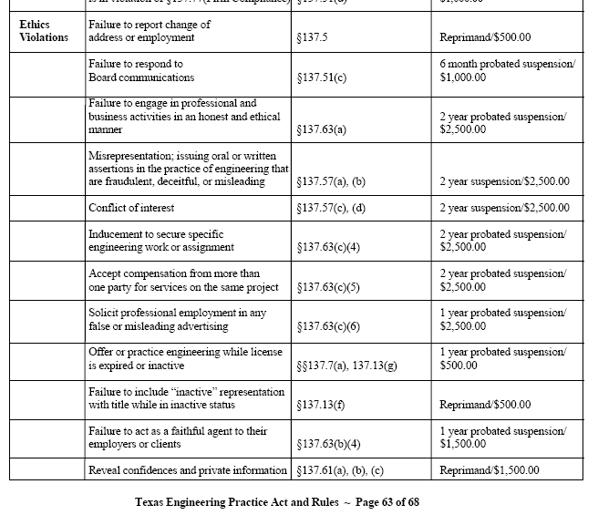
Texas Engineering Practice Act

Slide 25
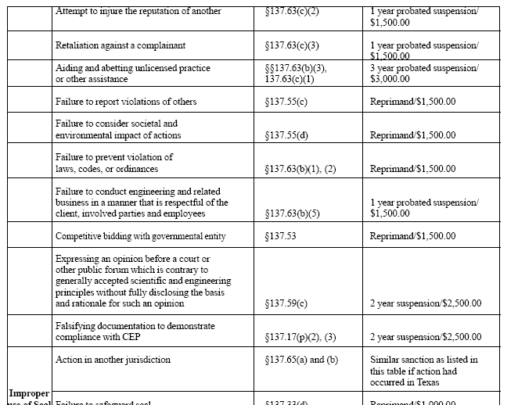
Texas Engineering Practice Act

Slide 26
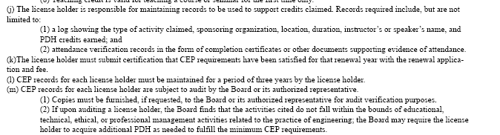
Documentation of Prof. Development

Slide 27
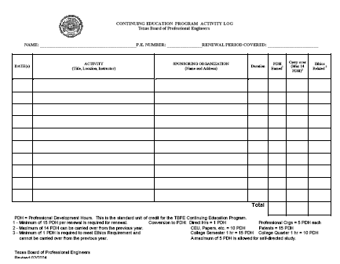
Documentation of Prof. Development

Slide 28
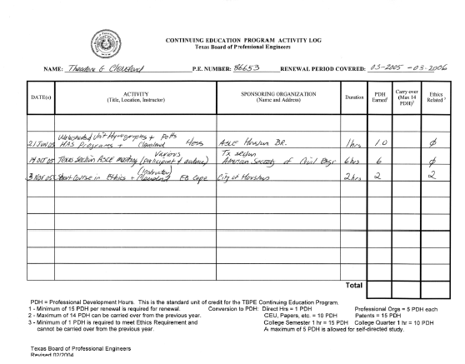
Documentation of Prof. Development

Slide 29
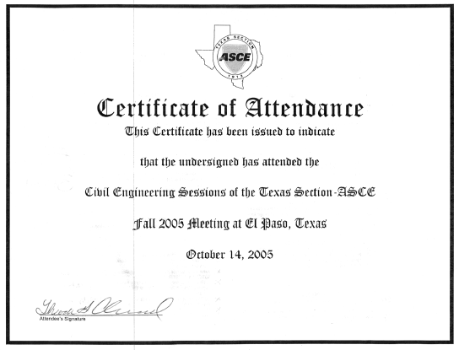
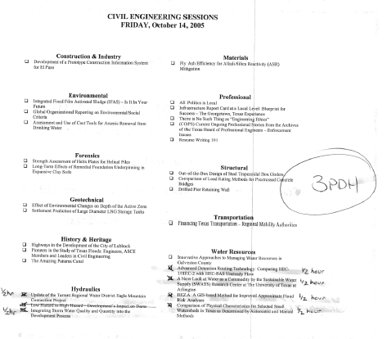
Documentation of Prof. Development

Slide 30
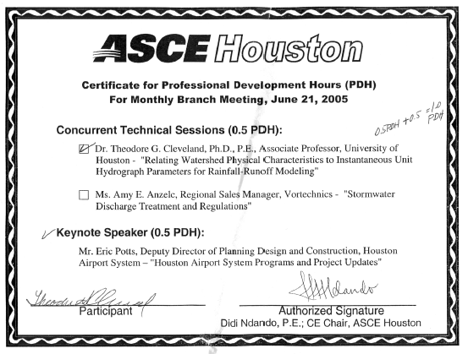
Documentation of Prof. Development

Slide 31
Documentation of Prof. Development

Slide 32
Documentation of Prof. Development
TBPE has on-line “record” keeping tool similar to the manual log.
You still need to maintain back-up records to prove attendance.
I need to maintain records of your attendance if I am audited (as an instructor) – PLEASE make your e-mail legible.

Slide 33
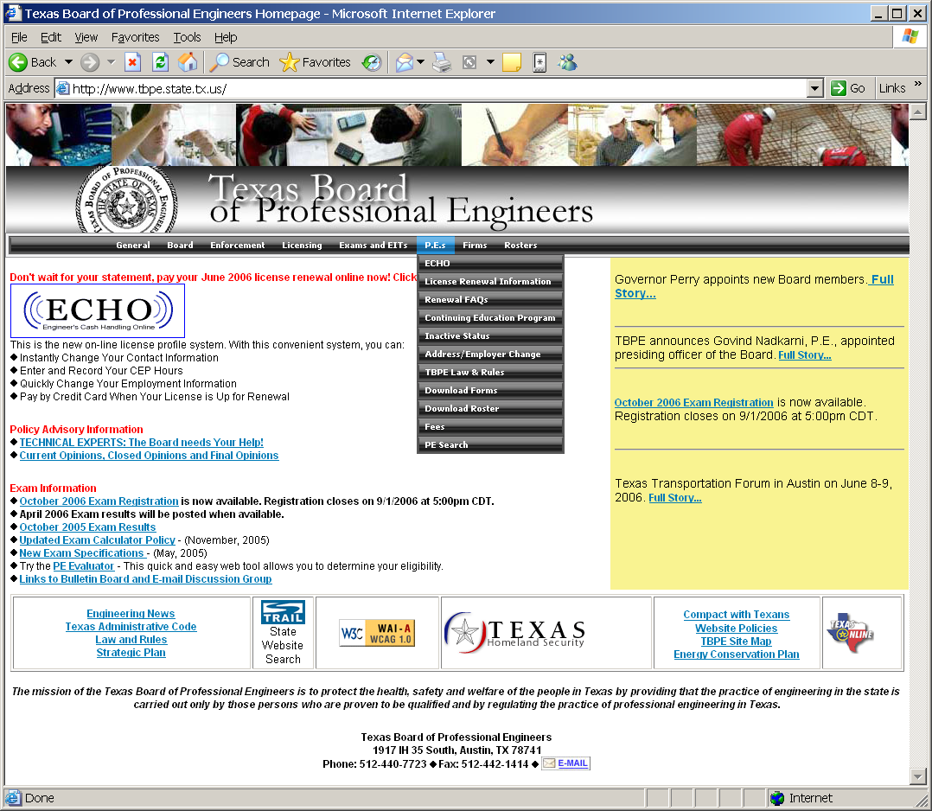
Documentation of Prof. Development

Slide 34
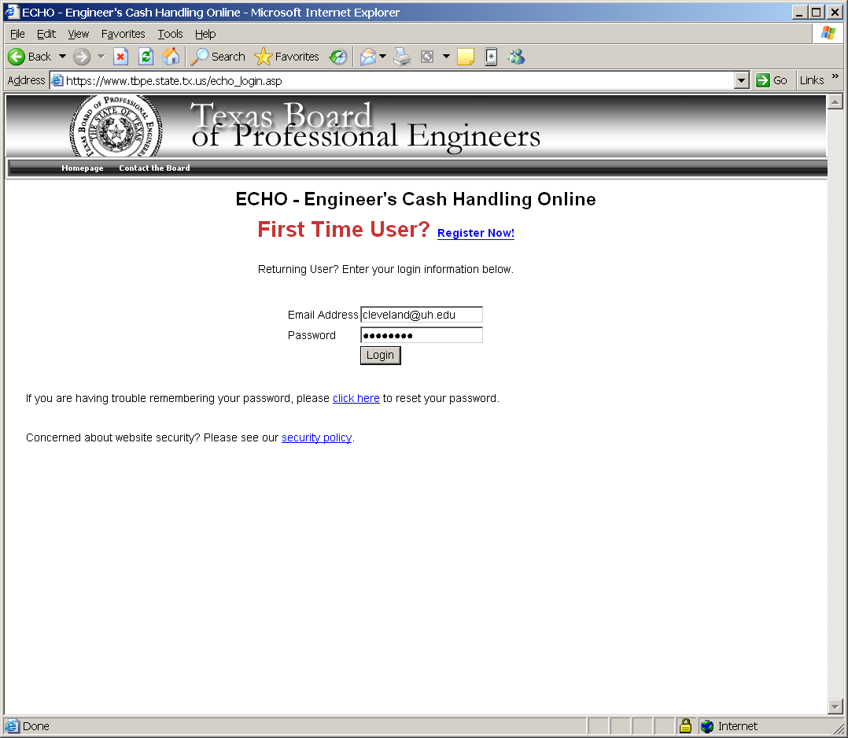
Documentation of Prof. Development

Slide 35
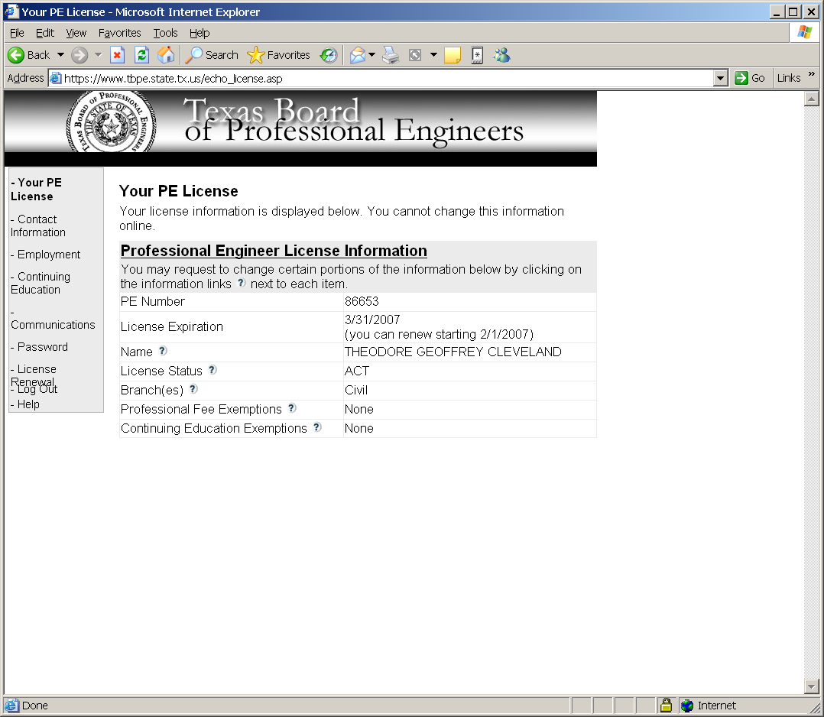
Documentation of Prof. Development

Slide 36
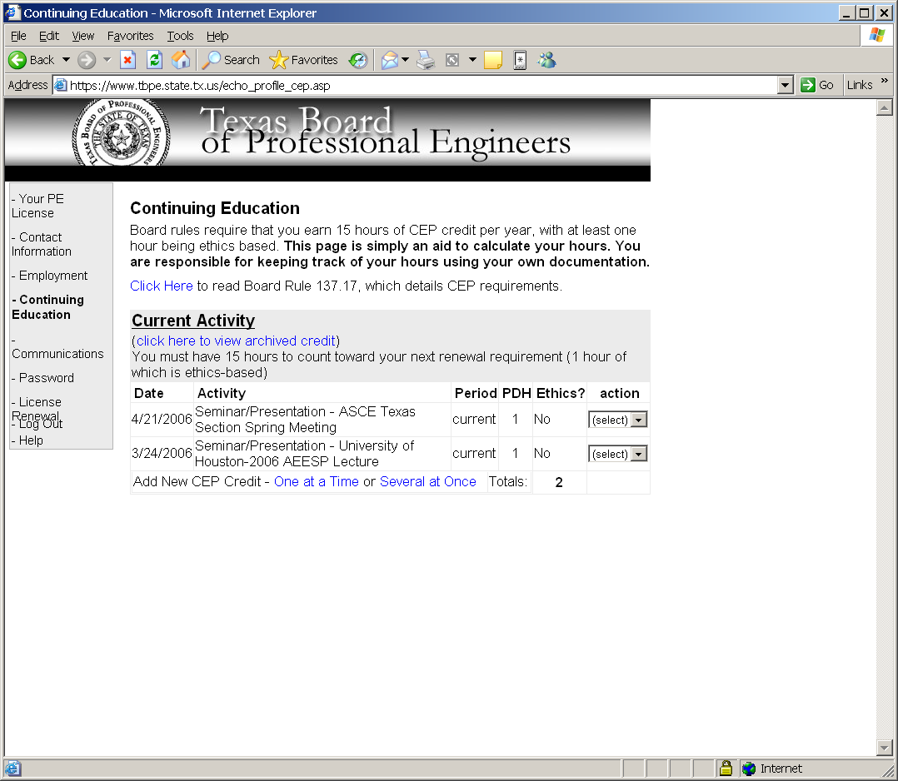
Documentation of Prof. Development

Slide 37
Problems
A persons behavior is ethical when one:
Does what is best for oneself.
Has good intentions, no matter how things turn out.
Does what is best for everyone.
Does what is most profitable.
Notes:
Ethics is concerned with moral standards and with promoting the general welfare. Only “C” fits this context. The other three answers may not involve socially approved conduct or promote general welfare, and thus cannto guarentee ethical behavior.

Slide 38
Problems
Which of the following ensure that behavior is ethical?
  Following the law
  Acting in the best interest of society.
  Following non-legal standards for socially approved conduct.
All of the above.
II and III only.
None of the above.
I only.
Notes:
Ethics is concerned with standards of socially acceptable conduct. Following the law (I) cannot ensure ethical behavior because the law itself may be unethical (slavery was once legal). Acting in the interest of society (II) and following other socially approved conduct even if non-legal will ensure behavior is ethical.

Slide 39
Problems
Which of the following ensure that behavior is ethical?
  Following the law
  Acting in the best interest of society.
  Following non-legal standards for socially approved conduct.
All of the above.
II and III only.
None of the above.
I only.
Notes:
Ethics is concerned with standards of socially acceptable conduct. Following the law (I) cannot ensure ethical behavior because the law itself may be unethical (slavery was once legal). Acting in the interest of society (II) and following other socially approved conduct even if non-legal will ensure behavior is ethical.

Slide 40
Problems
Engineers should follow their professional code of ethics because:
It helps them avoid legal problems.
If provides a clear definition of what the public has a right to expect.
It raises the image of the profession and hence gets engineers more pay.
The public will trust engineers more once they know that engineers have a code of ethics.
Notes:
A voiding legal problems is a good thing; but its not the most relevant reason. In fact being ethical might attract legal problems (may be sued of you don’t certify poor workmanship)
Raising the image of the profession is good, but not to get more pay. That is self-interest and not an ethical motivation.
Increased public trust is good, but knowledge of a code is meaningless unless engineers actually follow it. The U.S Congress has a code of ethics, and they are not always the most trustworthy body at times.
Only B really fits – it establishes what the public has a right to expect.

Slide 41
Problems
Engineers should act ethically because:
If they don’t they risk getting fired.
The boss wants them to.
It feels good.
That’s the way responsible engineers behave.
Notes:
Probably true, but it is not the most relevant reason.
Self-interest reason – want to eat; not an ethically motivated reason.
Nice outcome, but not the most relevant reason.
Responsibility and ethics are related.

Slide 42
Problems
The first and foremost obligation of registered professional engineers is to:
The public welfare.
Their employer.
The government.
The engineering profession.
Notes:
First obligation is to the public good (see code of ethics).

Slide 43
Problems
Registered professional engineers should undertake services for clients only when:
They need the work.
Their own bid is the lowest.
They are technically competent to carry out the services.
Carrying out services wouldn’t involve excessive time and effort.
Notes:
Self-interest motivation.
Economics, not ethics.
Yes
Time expenditure is self-interest and economic based.

Slide 44
Problems
With respect to the rules (morals) of professional conduct for engineers:
The rules are a bad thing because they encourage engineers to spy on each other and betray their colleagues.
The rules are a useful legal defense in court when engineers can demonstrate that they obeyed the rules..
The rules enhance the image of the profession and hence its economic benefits to its members.
The rules are important in providing a summary of what the public has a right to expect form responsible engineers.
Notes:
Rules do require those who have knowledge of violations to report to the state board. This requirement may require some documentation and scrutiny, thus leading to allegations of spying, but the violations themselves are what is bad, and the “spying” is necessary to determine responsible behavior, hence the rules are ethically justified (utility ethics).
True statement, but it is a secondary indirect effect of the ethical value of the rules.
Also true, but again a secondary benefit.
Best statement – provide a guidepost of public expectations.

Slide 45
Problems
Rules (morals) of professional conduct for engineers require all registered engineers to conform to all but one of the following rules – which rule is not required?
Do not charge excessive fees.
Do not compete unfairly with others.
Perform services only in areas of their competence.
Avoid conflicts of interest.
Notes:
Fees are a economic decision, not an ethics decision. Some clients are willing to pay larger fees because of interest in extra quality, unusually quick delivery time, other special circumstances.
An example is the KBR/Halliburton fuel situation. At the time of the beginning of the invasion the Army and Marines did not have the ability to move fuel into Iraq. The Pentagon decided it did not have time for competitive bid, so it selected KBR to deliver fuel (at very high cost). Had the Pentagon been a private client this process would be ethically justified if KBR charged high fees because they assumed a lot of risk.

Slide 46
Problems
You are a quality control engineer supervising the completion of a
product whose specifications include using only U.S.-made parts.
However at a very late stage in the project you notice that one of
the sub-contractors has supplied you with a part having foreign
made bolts in it – these are not very noticeable, and would function
identically to U.S.-made bolts. The customer urgently needs to
finished product – which of the following is the most ethical action?

Slide 47
Problems
Say nothing and deliver the product with the foreign bolts included and hope the customer does not notice.
Find (or invent) some roughly equivalent violation of the contract or specifications for which the customer is responsible – then tell them you will ignore their voilation if they ignore yours.
Tell the customer about the problem and let them decide what they wish you to do next.
Put efforts into finding legal loopholes in the origincal specifications or negotiations to avoid your company’s appearing to have violated the specifications.
Notes:
Dishonest and deceptive.
Two wrongs don’t make a right.
D. Violates spirit of original agreement; ethically bound not to distort intent of original agreement.
C. Correct – Allows client to decide what is in their best interest. It establishes basis for good-faith negotiations. Some risk of immediate termination, but its not productive to work for perfect people (sarcasm intended).

Slide 48
Problems
You are the engineer for a building project that is behind schedule. Your boss wants you to certify some roofing construction as properly completed even though you suspect there are some questionable installation techniques and you have not yet discussed these with the contractor. Should you:
  Certify it, and negotiate a raise as your price.
  Refuse to certify.
  Tell the clients about the problem, saying you will certify if they want you to.
  Certify, but keep a close watch in case any problems develop.
Notes:
B. Is most correct.
Unethical – bound to uphold professional standards. Not only unethical, this action is probably illegal.
Correct – you may lose your job, but you don’t want to work for someone who is unwilling to to the job properly.
Incorrect. Clients are not engineers – you are duty bound to not to certify inadequate work – Key is INADEQUATE.
Incorrect, The certification is still wrong even with careful monitoring.
The ethical issue in this problem is not the roof, it’s the demand to certify. It would be reasonable to Not Certify the roof, notify the client, and let the client decide if she would accept the building without the roof certification with long-term monitoring instead. There would be need for building code variances and the risk to the client needs to be identified (the cost of a roof performance failure in the future may greatly exceed any monetary savings provided by using the roof as-is).
Obviously if the roof is a safety issue and not performance (e.g. collapse as opposed to leaks), then the only option is to require the roof be properly build.

Slide 49
Problems
You are the engineer and manager at an aerospace company that supplies parts for a space shuttle. As an engineer you know the launch would face unknown risks because the equipment you supply is operating beyond its tested range of behavior. As a manager you know it is important that the launch be carried out promptly Should you:
  Allow your management judgment override your engineering judgment and permit the launch.
  Toss a coin, neither role (engineer or manager) overrides.
  Defer to group decision, abstain from voting as you have a conflict of interest.
  Allow your engineering judgment to override your managerial judgment and delay the launch.
Notes:
Answer D is most correct.
The launch may work if allowed on schedule, but one does not know. Answer B is silly, who is responsible for success or failure? People or the coin?
Answer C is tricky but wrong, if your engineering role tells you the system is unsafe because of untested equipment you are obligated to participate and if you have the ability, delay the launch.
Answer A is incorrect. For two reasons, one engineers are ethically bound to delay the launch to protect public health and in this case the clients property. At a utilitarian level, the consequences of failure are death (of the astronauts), so the need to err on the conservative side is greater. While the ethical decision is the same if the craft is manned or unmanned, it is morally acceptable to view the launch itself as the equipment test in an unmanned system. It is not morally acceptable when the system is manned.

Slide 50
Problems
Your company buys large quantities of parts from various suppliers in a competitive market. As a PE you make critical decisions on which supplier is used for which parts. A new supplier is eager for business. They are also eager to provide you with many benefits – meals at fancy restaurants, trips to resorts for business meetings, expensive gifts, and so on. What should you do?:

Slide 51
Problems
Do not accept any gifts that go beyond reasonable business entertaining.
Report all gifts and let the company decide.
Accept the gifts because you know your judgment will not be biased.
Tell other suppliers and have them provide similar benefits so your judgment won’t be biased.
Notes:
Duh!
For an engineer this is not a correct answer. The appearance of a conflict is a conflict (discussion).
Still have the appearance of a conflict.
Two wrongs done make a right.
General guidelines:
Low value gifts (gimmie caps etc.) are acceptable unless your company forbids.
Perishables and meals that can be consumed in one sitting are acceptable unless company forbids.
Paid trip to attend a meeting is very gray – if actual work occurs then it will probably be ok. Think of ISD administrators going to Rancho Mirage (a resort near Palm Springs) for some discussions that could be easily handled by FAX and conference calls. Key guideline is will the action withstand the “Newspaper Test.”
Bottle of scotch, not OK.
City/State/Federal – Cannot accept anything. Having said this I still have lunch with colleagues/friends I have worked with over the years and I (and they) don’t worry about who pays for lunch or dinner. We exchange cards at Christmas, etc. I know for a fact that I have written proposals that they have reviewed and not selected; we are still friends, I don’t ever expect my business/profession to affect a friendship (otherwise it was not a friendship to begin with).

