Slide 1
Water Resources Management
Lecture 5 – linear programming

Slide 2
Introduction
Resource Allocation using Linear Programming
Setting up an LP model
Solving LP using R
Install Package(s)
Load the Library
Build the Model

Slide 3
Resource Allocation using LP
Linear Programming is a mathematical programming tool to search for optimal solutions to allocation problems that have
Linear Objective Function (Objective is a weighted linear combination of the decision variables)
Linear Constraint Set
Non-negative decision variables
Notes:
http://www.un.org/waterforlifedecade/iwrm.shtml

Slide 4
Objective function
The objective function (merit function) is the mathematical expression of the benefit, utility, or cost incurred for various decisions. In LP it must be a linear combination of the decision variables.
Economic cost is a common example:
COST(x) = w₁*x₁+w₂*x₂+ … + w_{N}*x_{N}
Notes:
http://www.un.org/waterforlifedecade/iwrm.shtml

Slide 5
COST COEFFICIENTS
COST(x) = w₁*x₁+w₂*x₂+ … + w_{N}*x_{N}
The weights (w₁,w₂, etc.) are called the cost (utility, benefit) coefficients
The variables (x₁,x₂, etc.) are called the decision or allocation variables. They represent how much of something is allocated at some unit cost (the cost coefficient).
For example if x₁ is the volume of water delivered in liters and w₁ is the price $1.00/liter
Then the cost of 6.2 liters is w₁*x₁ =(1.0)(6.2)=$6.20
Notes:
http://www.un.org/waterforlifedecade/iwrm.shtml

Slide 6
constraints
The amount of a decision variable that is available or can be used is called a constraint.
Suppose that we only have 100 Liters of water available to deliver, then the constraint would be x₁ <= 100; that is, we can deliver anywhere from 0 to 100 liters, but not more (or less)
The entire set of constraints is called the constraint set. It must be comprised of linear combinations of the decision variables (for an LP solution).
Notes:
http://www.un.org/waterforlifedecade/iwrm.shtml

Slide 7
The LP MODEL
The combination of the objective function, and the constraint set, along with a directive to either minimize (make small) or maximize (make big) the objective function is the linear program.
Notes:
http://www.un.org/waterforlifedecade/iwrm.shtml

Slide 8
example
Construction company contracted to excavate 6-foot and 18-foot wide trenches. Can transport no more than $10,000 yd³/day of excavation material from the site because of a limited supply of dump trucks. To meet the construction schedule, the company must excavate at least 1,600 yd³/day from the 6-foot trench and at least 3,000 yd³/day from the 18-foot trench.
Notes:
http://www.un.org/waterforlifedecade/iwrm.shtml

Slide 9
example
The company has 12 heavy equipment operators that can operate either a Backhoe Type 1 or Backhoe Type 2. The company has a total of 12 of each type of backhoe available – unused machines can be assigned to another job.
Backhoe Type 1 can excavate 200 yd³/day from a 6-foot trench at a cost of $394 per machine day. Backhoe Type 2 can excavate 1,000 yd³/day from an 18-foot trench at a cost of $1,110 per machine day
Notes:
http://www.un.org/waterforlifedecade/iwrm.shtml

Slide 10
Construction management example
What is the best allocation of operators (machines) to minimize daily cost and meet scheduling requirements?
Notes:
http://www.un.org/waterforlifedecade/iwrm.shtml

Slide 11
SETTING UP A linear program
As with all allocation problems (regardless of linearity) we need a goal.
In this example the goal is to minimize the daily machine cost, so the cost (objective) function is expressed as
COST(x) = $394x₁ + $1110x₂
Where, x₁ is the number of operators assigned to a Type 1 machine x₂ is the number of operators assigned to a Type 2 machine.
Notes:
http://www.un.org/waterforlifedecade/iwrm.shtml

Slide 12
SETTING UP A linear program
Next we need to explicitly state the constraint set.
The first constraint is on the total amount of material that can be transported off the site as a function of machine count – in this case
200 x₁ + 1000 x₂ <= 10,000 (Dump Trucks)
Notes:
http://www.un.org/waterforlifedecade/iwrm.shtml

Slide 13
SETTING UP A linear program
The next constraint is on minimum trenching requirements for each trench width
200 x₁ + 0000 x₂ >= 1,600 ( 6-foot trench) 000 x₁ + 1000 x₂ >= 3,000 (18-foot trench)
Notes:
http://www.un.org/waterforlifedecade/iwrm.shtml

Slide 14
SETTING UP A linear program
The next constraint is on the total number of operators and supply of machines available
x₁ + 0 x₂ <= 12 ( Operators ) 000x₁ + 0 x₂ <= 12 (Type 1 Available)
00 x₁ + 0 x₂ <= 12 (Type 2 Available)
Notes:
http://www.un.org/waterforlifedecade/iwrm.shtml

Slide 15
SETTING UP A linear program
The last constraint is non-negativity
000x₁ + 0 x₂ >= 0
00 x₁ + 0 x₂ >= 0
Notes:
http://www.un.org/waterforlifedecade/iwrm.shtml

Slide 16
Construction management linear program
Lastly we need to decide if we are minimizing or maximizing the objective function – in this example, it is minimization.
Next we will write the entire model at once, the result is the linear programming problem
Notes:
http://www.un.org/waterforlifedecade/iwrm.shtml

Slide 17
Construction management linear program
Min COST(x) = $394x₁ + $1110x₂
Subject to
200 x₁ + 1000 x₂ <= 10,000 (Dump Trucks)
200 x₁ + 0000 x₂ >= 1,600 (6-foot trench) 000 x₁ + 1000 x₂ >= 3,000 (18-foot trench) x₁ + 0 x₂ <= 12 (Operators)
x₁ + 0 x₂ <= 12 (Type 1 Available)
x₂ <= 12 (Type 2 Available)
Notes:
http://www.un.org/waterforlifedecade/iwrm.shtml

Slide 18
Construction management linear program
The last two constraints are redundant (in this example!), so the LP is
Min COST(x) = $394x₁ + $1110x₂
Subject to
200 x₁ + 1000 x₂ <= 10,000 (Dump Trucks)
200 x₁ + 0000 x₂ >= 1,600 (6-foot trench) 000 x₁ + 1000 x₂ >= 3,000 (18-foot trench) x₁ + 0 x₂ <= 12 (Operators)
Notes:
http://www.un.org/waterforlifedecade/iwrm.shtml

Slide 19
Solving the linear program
Really simple LP can be solved by inspection; if there are only 2 variables, they can also be solved graphically
For larger problems usually a variant of the SIMPLEX algorithm (Dantzig’s algorithm with lexicographical pivoting) is used. The details of the algorithm are described in the readings.
Here we will use R as a tool to solve the LP and find the decision variable values and the associated cost of the decision(s).
Notes:
http://www.un.org/waterforlifedecade/iwrm.shtml
Most people prefer the first option in the top scenario, the second option in the bottom scenario even though the two versions of the problem are the same, because the people who will be saved in one version are the same people who will not die in the other.
6

Slide 20
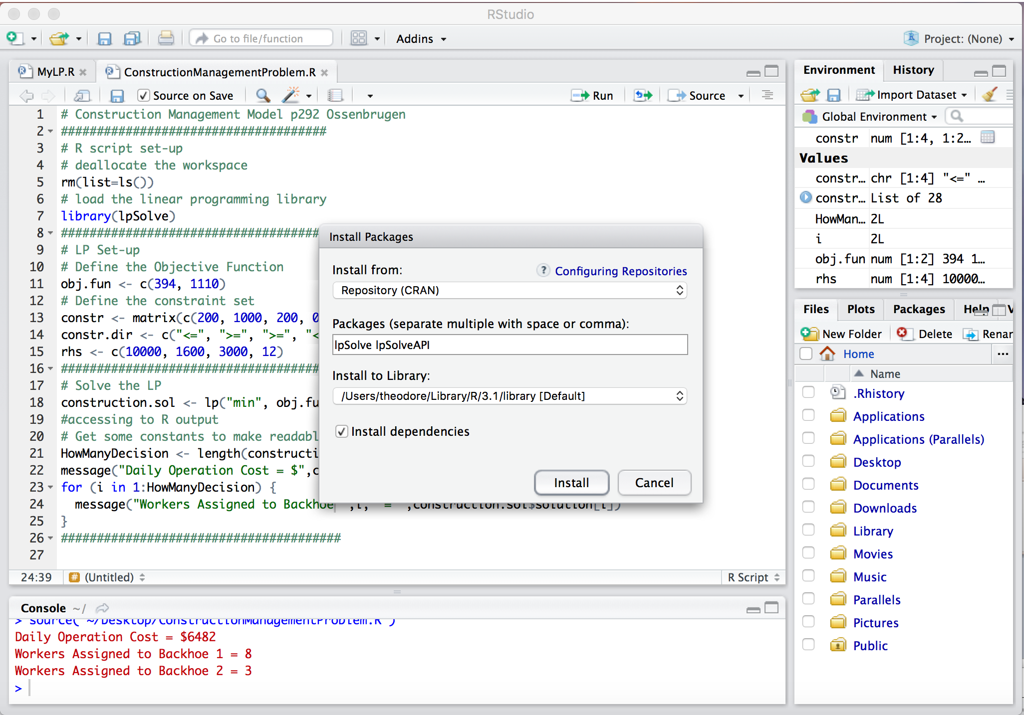
OBTAIN THE REQUIRED PACKAGES
We will need the packages:
LpSolve, and LpSolveAPI
In R Studio simply run the pagakge installer and it will get the packages from the CRAN
Notes:
http://www.un.org/waterforlifedecade/iwrm.shtml
Most people prefer the first option in the top scenario, the second option in the bottom scenario even though the two versions of the problem are the same, because the people who will be saved in one version are the same people who will not die in the other.
In the cartoon the decision that maximizes Expected(Life) is Decision A. Now if we add on some economic aspect (perhaps A costs thousands of times more than B) then we have a bit of a dilemma.

Slide 21
TRANSLATING THE Linear Program TO the R Script
lpSolve has a particular syntax; for small problems we can type the parts directly.
Larger problems write script to generate the LP from an input file
Notes:
http://www.un.org/waterforlifedecade/iwrm.shtml
Most people prefer the first option in the top scenario, the second option in the bottom scenario even though the two versions of the problem are the same, because the people who will be saved in one version are the same people who will not die in the other.
In the cartoon the decision that maximizes Expected(Life) is Decision A. Now if we add on some economic aspect (perhaps A costs thousands of times more than B) then we have a bit of a dilemma.

Slide 22
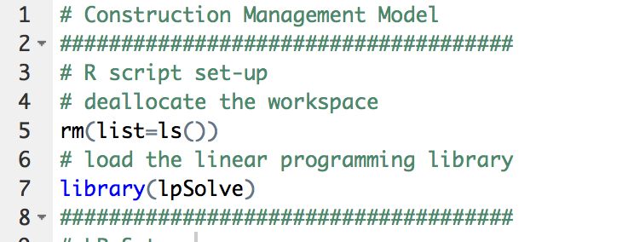
TRANSLATING THE Linear Program TO the R Script
First, clear the R workspace and load the library
Notes:
http://www.un.org/waterforlifedecade/iwrm.shtml
Most people prefer the first option in the top scenario, the second option in the bottom scenario even though the two versions of the problem are the same, because the people who will be saved in one version are the same people who will not die in the other.
In the cartoon the decision that maximizes Expected(Life) is Decision A. Now if we add on some economic aspect (perhaps A costs thousands of times more than B) then we have a bit of a dilemma.

Slide 23
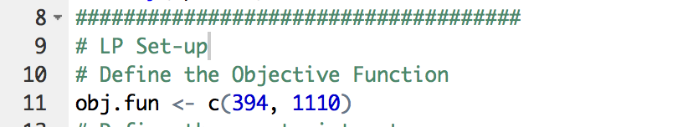
TRANSLATING THE Linear Program TO the R Script
Then construct the objective function
In the example the cost coefficient for Backhoe 1 is $394 per ... and Backhoe 2 is $1110 per …. These weights are supplied to the objective function as a vector.
Notes:
http://www.un.org/waterforlifedecade/iwrm.shtml
Most people prefer the first option in the top scenario, the second option in the bottom scenario even though the two versions of the problem are the same, because the people who will be saved in one version are the same people who will not die in the other.
In the cartoon the decision that maximizes Expected(Life) is Decision A. Now if we add on some economic aspect (perhaps A costs thousands of times more than B) then we have a bit of a dilemma.

Slide 24
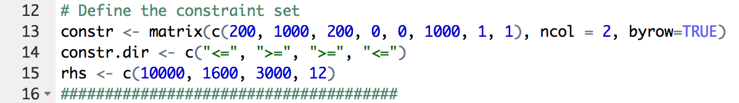
TRANSLATING THE Linear Program TO the R Script
Then construct the constraint set – the constraint coefficient matrix, inequalities, and right-hand-side are entered as separate objects
Notes:
http://www.un.org/waterforlifedecade/iwrm.shtml
Most people prefer the first option in the top scenario, the second option in the bottom scenario even though the two versions of the problem are the same, because the people who will be saved in one version are the same people who will not die in the other.
In the cartoon the decision that maximizes Expected(Life) is Decision A. Now if we add on some economic aspect (perhaps A costs thousands of times more than B) then we have a bit of a dilemma.

Slide 25
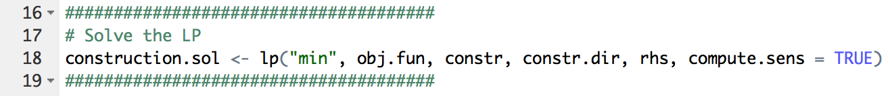
TRANSLATING THE Linear Program TO the R Script
Now we can call the solver and have it search for values that satisfy the constraint set and minimize the objective function
Actually not much to the R script (but there is a lot going on behind the scene).
Notes:
http://www.un.org/waterforlifedecade/iwrm.shtml
Most people prefer the first option in the top scenario, the second option in the bottom scenario even though the two versions of the problem are the same, because the people who will be saved in one version are the same people who will not die in the other.
In the cartoon the decision that maximizes Expected(Life) is Decision A. Now if we add on some economic aspect (perhaps A costs thousands of times more than B) then we have a bit of a dilemma.

Slide 26
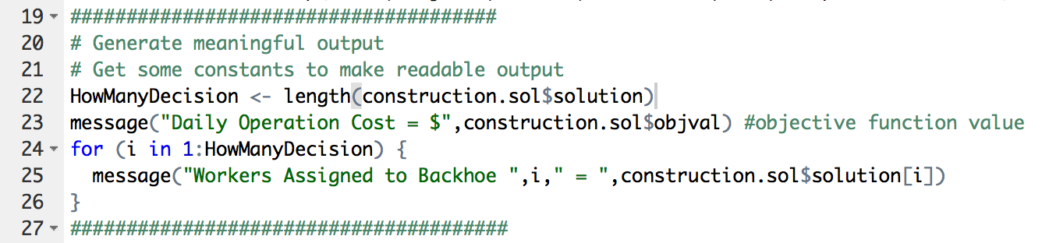
TRANSLATING THE Linear Program TO the R Script
Lastly, interrogate the solution object (construction.sol) and generate some meaningful output for the analyst to interpret
Notes:
http://www.un.org/waterforlifedecade/iwrm.shtml
Most people prefer the first option in the top scenario, the second option in the bottom scenario even though the two versions of the problem are the same, because the people who will be saved in one version are the same people who will not die in the other.
In the cartoon the decision that maximizes Expected(Life) is Decision A. Now if we add on some economic aspect (perhaps A costs thousands of times more than B) then we have a bit of a dilemma.

Slide 27
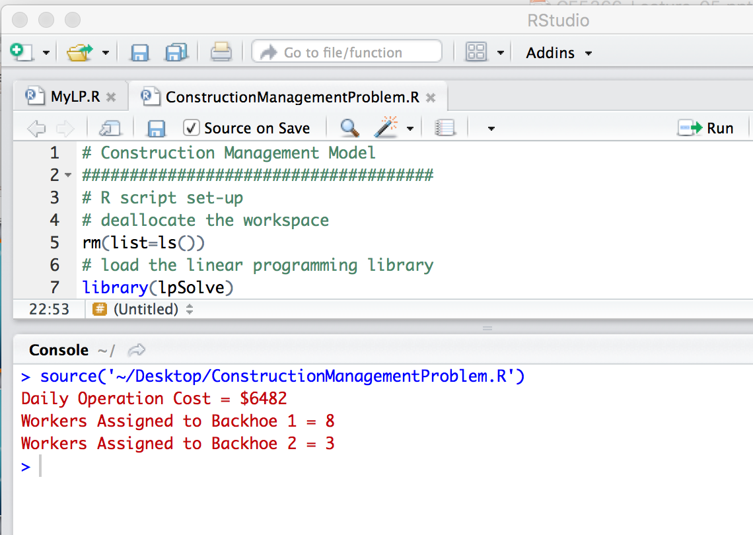
Lp solution to the construction management example
Run the R script, and examine the results!
Notes:
http://www.un.org/waterforlifedecade/iwrm.shtml
Most people prefer the first option in the top scenario, the second option in the bottom scenario even though the two versions of the problem are the same, because the people who will be saved in one version are the same people who will not die in the other.
In the cartoon the decision that maximizes Expected(Life) is Decision A. Now if we add on some economic aspect (perhaps A costs thousands of times more than B) then we have a bit of a dilemma.

Slide 28
Wastewater treatment plant allocation
The construction management example illustrates how to set up a LP model – it could have been solved graphically – now we examine an example that cannot not be solved graphically (using 2D-paper)
Notes:
http://www.un.org/waterforlifedecade/iwrm.shtml
Most people prefer the first option in the top scenario, the second option in the bottom scenario even though the two versions of the problem are the same, because the people who will be saved in one version are the same people who will not die in the other.
In the cartoon the decision that maximizes Expected(Life) is Decision A. Now if we add on some economic aspect (perhaps A costs thousands of times more than B) then we have a bit of a dilemma.

Slide 29
Wastewater treatment plant allocation
Town A
Town B
Town A produces 3 MGD of BOD=200ppm wastewater per day
Town B produces 2 MGD of BOD=200ppm wastewater per day
x₁
x₂
x₃
x₄
Plant 1
Plant 2
Effluent (BOD<=30ppm)
Notes:
http://www.un.org/waterforlifedecade/iwrm.shtml
Most people prefer the first option in the top scenario, the second option in the bottom scenario even though the two versions of the problem are the same, because the people who will be saved in one version are the same people who will not die in the other.
In the cartoon the decision that maximizes Expected(Life) is Decision A. Now if we add on some economic aspect (perhaps A costs thousands of times more than B) then we have a bit of a dilemma.

Slide 30
Wastewater treatment plant allocation
Town A
Town B
Plant 1 can treat 3 MGD and remove 90% of incoming BOD
Plant 2 can treat 4 MGD and remove 80% of incoming BOD
x₁
x₂
x₃
x₄
Plant 1
Plant 2
Effluent (BOD <= 30ppm)
Notes:
http://www.un.org/waterforlifedecade/iwrm.shtml
Most people prefer the first option in the top scenario, the second option in the bottom scenario even though the two versions of the problem are the same, because the people who will be saved in one version are the same people who will not die in the other.
In the cartoon the decision that maximizes Expected(Life) is Decision A. Now if we add on some economic aspect (perhaps A costs thousands of times more than B) then we have a bit of a dilemma.

Slide 31
Wastewater treatment plant allocation
Town A
Town B
The regional treatment operator can allocate wastewater flows from either town to either plant
Unit Costs for each pipeline (x₁…x₄) are:
x₁
x₂
x₃
x₄
Plant 1
Plant 2
Pipeline | $1000/MGD-year
1 | $46
2 | $50
3 | $55
4 | $40
Effluent (BOD<=30ppm)
Notes:
http://www.un.org/waterforlifedecade/iwrm.shtml
Most people prefer the first option in the top scenario, the second option in the bottom scenario even though the two versions of the problem are the same, because the people who will be saved in one version are the same people who will not die in the other.
In the cartoon the decision that maximizes Expected(Life) is Decision A. Now if we add on some economic aspect (perhaps A costs thousands of times more than B) then we have a bit of a dilemma.

Slide 32
Wastewater treatment plant allocation
Town A
Town B
What allocation minimizes the treatment and pumping costs subject to the requirement that the effluent concentration not exceed 30 ppm BOD?
x₁
x₂
x₃
x₄
Plant 1
Plant 2
Pipeline | $1000/MGD-year
1 | $46
2 | $50
3 | $55
4 | $40
Effluent(BOD <= 30ppm)
Notes:
http://www.un.org/waterforlifedecade/iwrm.shtml
Most people prefer the first option in the top scenario, the second option in the bottom scenario even though the two versions of the problem are the same, because the people who will be saved in one version are the same people who will not die in the other.
In the cartoon the decision that maximizes Expected(Life) is Decision A. Now if we add on some economic aspect (perhaps A costs thousands of times more than B) then we have a bit of a dilemma.

Slide 33
Wastewater treatment plant allocation
Write the objective function
Town A
Town B
x₁
x₂
x₃
x₄
Pipeline | $1000/MGD-year
1 | $46
2 | $50
3 | $55
4 | $40
Plant 1
Plant 2
Effluent(BOD <= 30ppm)
Notes:
http://www.un.org/waterforlifedecade/iwrm.shtml
Most people prefer the first option in the top scenario, the second option in the bottom scenario even though the two versions of the problem are the same, because the people who will be saved in one version are the same people who will not die in the other.
In the cartoon the decision that maximizes Expected(Life) is Decision A. Now if we add on some economic aspect (perhaps A costs thousands of times more than B) then we have a bit of a dilemma.

Slide 34
Wastewater treatment plant allocation
Write the objective function
Water quality constraint
Notes:
http://www.un.org/waterforlifedecade/iwrm.shtml
Most people prefer the first option in the top scenario, the second option in the bottom scenario even though the two versions of the problem are the same, because the people who will be saved in one version are the same people who will not die in the other.
In the cartoon the decision that maximizes Expected(Life) is Decision A. Now if we add on some economic aspect (perhaps A costs thousands of times more than B) then we have a bit of a dilemma.

Slide 35
Wastewater treatment plant allocation
Write the objective function
Water quality constraint
Treatment Plant Capacity
Notes:
http://www.un.org/waterforlifedecade/iwrm.shtml
Most people prefer the first option in the top scenario, the second option in the bottom scenario even though the two versions of the problem are the same, because the people who will be saved in one version are the same people who will not die in the other.
In the cartoon the decision that maximizes Expected(Life) is Decision A. Now if we add on some economic aspect (perhaps A costs thousands of times more than B) then we have a bit of a dilemma.

Slide 36
Wastewater treatment plant allocation
Write the objective function
Water quality constraint
Treatment Plant Capacity
All water must be treated
Notes:
http://www.un.org/waterforlifedecade/iwrm.shtml
Most people prefer the first option in the top scenario, the second option in the bottom scenario even though the two versions of the problem are the same, because the people who will be saved in one version are the same people who will not die in the other.
In the cartoon the decision that maximizes Expected(Life) is Decision A. Now if we add on some economic aspect (perhaps A costs thousands of times more than B) then we have a bit of a dilemma.

Slide 37
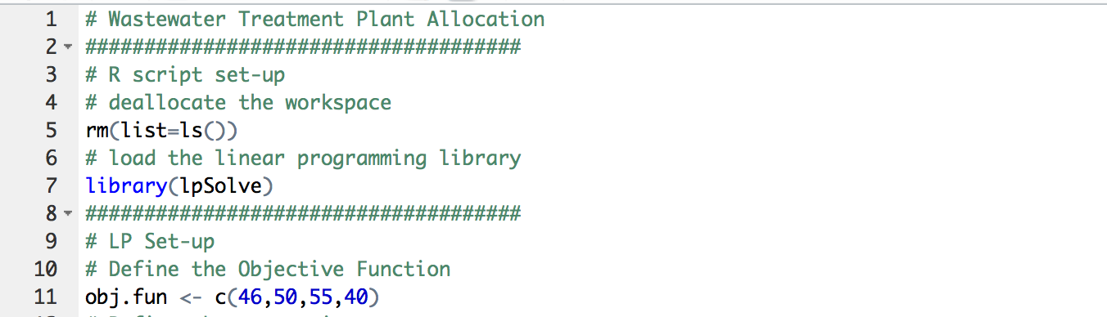
Wastewater treatment plant allocation
The next step is to translate the Linear Program model into R Script
First the objective function

Slide 38
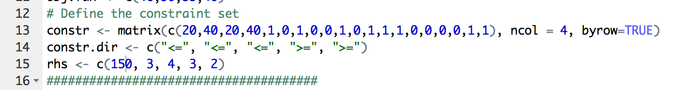
Wastewater treatment plant allocation
The constraint set

Slide 39
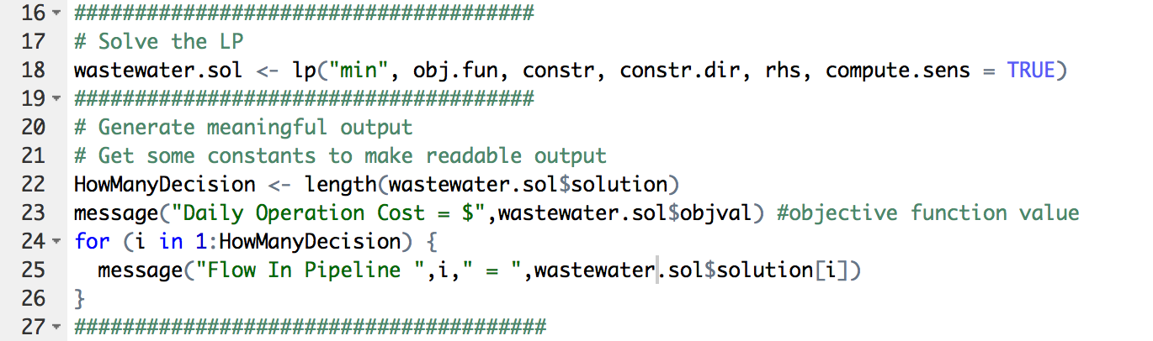
Wastewater treatment plant allocation
Solve the LP and write results

Slide 40
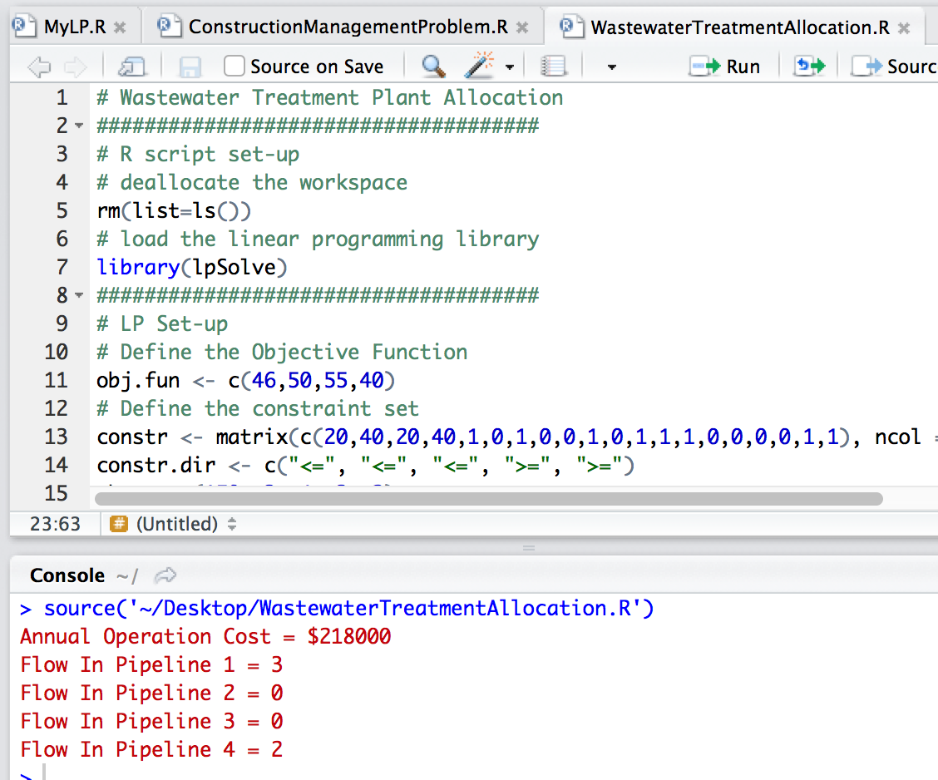
Wastewater treatment plant allocation
Run the script

Slide 41
Summary
Linear Programming as a tool to allocate resources (make decisions)
Structure of an LP
Simple Examples
Solved using R and LpSolve package
Notes:
http://www.un.org/waterforlifedecade/iwrm.shtml
Most people prefer the first option in the top scenario, the second option in the bottom scenario even though the two versions of the problem are the same, because the people who will be saved in one version are the same people who will not die in the other.
In the cartoon the decision that maximizes Expected(Life) is Decision A. Now if we add on some economic aspect (perhaps A costs thousands of times more than B) then we have a bit of a dilemma.

