Slide 1
Water Resources Management
Lecture 2 – economic analysis mathematics

Slide 2
Defining alternatives
Application of economics principles to assign value to an alternative
Decision principles used to select the best alternative based on value

Slide 3
Physical consequences
Economic value – a basis for comparisons
Definitions/Concepts
Economic Analysis
Principles of engineering economics
Cash flows
Discounting methods

Slide 4
Cash flow diagrams
Graphic representation of cash outflow (costs) and inflow (revenue).
Convention is revenue (benefit) is plotted upward, and expenses (costs) is plotted downward.
All cash flows during a year are usually lumped into sums occurring at the end of the year

Slide 5
Discounting factors
Discounting factor is a tool to convert a value at one date to an economically equivalent value at another date
All discounting problems can be expressed as combinations of two fundamental factors
Single-payment Compound-amount Factor
Single-payment Present-worth Factor

Slide 6
CONVERT PRESENT VALUE TO FUTURE VALUE
The factor computes the number of monetary units (FV) that will accumulate in N years for every initial unit (PV) invested at a rate of return of i-percent.
FV=PV(1 + i)^{N}
FV
PV
N Years
1
2
…
N-1
N

Slide 7
CONVERT FUTURE VALUE TO PRESENT VALUE
The factor computes the number of current monetary units (PV) that a future value (FV) is worth if the monetary units are invested at a rate of return of i-percent.
PV=FV(1 + i)^{-N}
FV
PV
N Years
1
2
…
N-1
N
Notes:
Use cash-flow to compare alternatives using monetary units recoverable at some common point in time. Monetary discounting is important as it effects the type of alternative that will appear preferable. Read (pg 5 James and Lee)

Slide 8
OTHER FACTORS
Notice the cash flow diagram looks the same – it is a tool to move values along the time axis. All other diagrams can be determined by combinations of these two concepts.
Can either apply algebra to make the combinations, or just use simple computer programming (e.g. R)
Notes:
Use cash-flow to compare alternatives using monetary units recoverable at some common point in time. Monetary discounting is important as it effects the type of alternative that will appear preferable. Read (pg 5 James and Lee)

Slide 9
example
Determine the present worth (PV) of a stream of annual payments, each payment is $100 for a period of 10 years. The discount rate is 3-percent per year.
Sketch a cash flow diagram
FV
PV
N Years
1
2
…
9
10
Notes:
Use cash-flow to compare alternatives using monetary units recoverable at some common point in time. Monetary discounting is important as it effects the type of alternative that will appear preferable. Read (pg 5 James and Lee)

Slide 10
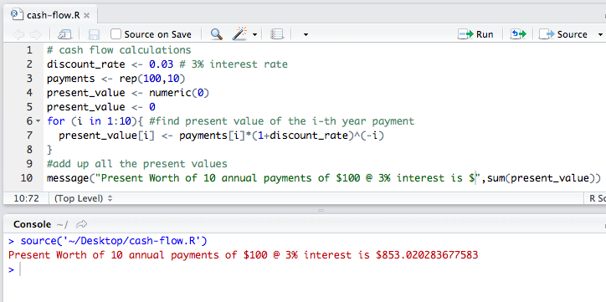
example
Determine the present worth of each future payment ( PV=FV(1 + i)^{-N} )
Sum these present worth(s) to determine the present worth of the entire series of payments
Notes:
Use cash-flow to compare alternatives using monetary units recoverable at some common point in time. Monetary discounting is important as it effects the type of alternative that will appear preferable. Read (pg 5 James and Lee)

Slide 11
Discounting techniques
Refers to systematic application of discounting factors to compare alternatives
The 4 accepted techniques are:
Present worth method
Rate-of-return method
Benefit-cost ratio method
Annual-cost method
Each method produces the same evaluation of relative value

Slide 12
Present worth method
Move all present worths to the same time base
Compute all present worths using the same discount rate
Base all present worths on the same period of analysis
Calculate the present worth of each alternative, retain only alternatives with positive present worth.
Choose the alternative in a set of mutually exclusive alternatives having the greatest present worth
If alternatives have intangibles that are approximately equal (policy), choose the alternative having the least cost.
Notes:
Pg 5 james and lee – read the relevant portion

Slide 13
Rate of return method (PART 1)
Compare all alternatives over the same period of analysis
Calculate the rate of return for each alternative. Retain alternatives with a rate of return exceeding the minimum acceptable value.
If sets of mutually exclusive alternatives are involved, proceed to the next part.
Notes:
Pg 5 7 James and lee

Slide 14
Rate of return method (PART 2)
Rank the alternatives in the set of mutually exclusive alternatives in order of increasing cost. Calculate the rate of return on the incremental cost and incremental benefits of the next alternative above the least costly alternative. Choose the more costly alternative if the incremental rate of return exceeds the minimum acceptable discount rate. Otherwise choose the less costly alternative. Continue the analysis by considering the alternatives in order of increased costliness, the alternative on the less costly side of each increment being the most costly project chosen this far.
Notes:
Pg 5 7 James and lee

Slide 15
Benefit/cost ratio method (PART 1)
Compute all benefit/cost ratios using the same discount rate
Compare all alternatives over the same period of analysis
Calculate the benefit/cost ratio for each alternative. Retain alternatives with ratios exceeding unity
If sets of mutually exclusive alternatives are retained, proceed to next part
Notes:
Pg 5 7 James and lee

Slide 16
Benefit/cost ratio method (PART 2)
Rank the alternatives in the set of mutually exclusive alternatives in order of increasing cost. Calculate the benefit/cost ratio by using the incremental cost and incremental benefit of the next alternative above the least costly alternatives. Choose the more costly alternative if the incremental benefit/cost ratio exceeds unity. Otherwise choose the less costly alternative. Continue the analysis by considering the alternatives in order of increasing costliness, the alternative on the less costly side of each increment being the most costly project chosen thus far
Notes:
Pg 5 7 James and lee

Slide 17
Annual cost method
Compute all annual costs by using the same discount rate
Base all annual costs on the same period of analysis
Calculate the net annual benefit of each alternative. Retain alternatives with positive net annual benefit
Choose the alternative in a set of mutually exclusive alternatives having the greatest net annual benefit.
Notes:
Pg 5 7 James and lee
http://www.gilmanbedigian.com/tort-reform-and-the-value-of-human-life

Slide 18
uncertainty
Comparing alternatives usually has to look into the future – inherent uncertainty
Uncertain objectives
Uncertain constraints
Uncertain public response
Uncertain technological change
Uncertainty in recurring events (e.g. flooding magnitude and times)
Notes:
Pg 5 7 James and lee

Slide 19
Planning horizon
Design life (economic)
Typically 50 to 100 years
Service life (physical life)
Variable – technology can change, need can change, the thing can break
Compare things over the same period of analysis – using negative (salvage) cash flow if necessary to use comparable planning horizons

Slide 20
Alternative structure (for comparisons)
Alternatives capable of achieving the design objective should be defined
Identify consequences of each alternative and express in monetary units
Comparisons should be on cost-to-go (to eliminate consideration of sunk costs)
Intangibles should be identified – search policy to see if economic values are already assigned (or surrogates are available)
Compare on uniform basis over common analysis periods

