Slide 1
Example 6
HEC-HMS Simulation
Multiple Sub-Basins

Slide 2
Purpose
Illustrate using HEC-HMS to develop a multiple sub-basin model
  Include routing concepts

Slide 3
Learning Objectives
Learn how to use HMS to construct a multiple sub-basin model
Learn how to supply lag-routing data
Learn how to estimate lag-routing times

Slide 4
Problem Statement
Simulate the response of the Ash Creek watershed at Highland Road for 20 May 1978 historical conditions.
  Use Example 3B as the base “model”
  Treat the watershed as comprised of multiple sub-basins.

Slide 5
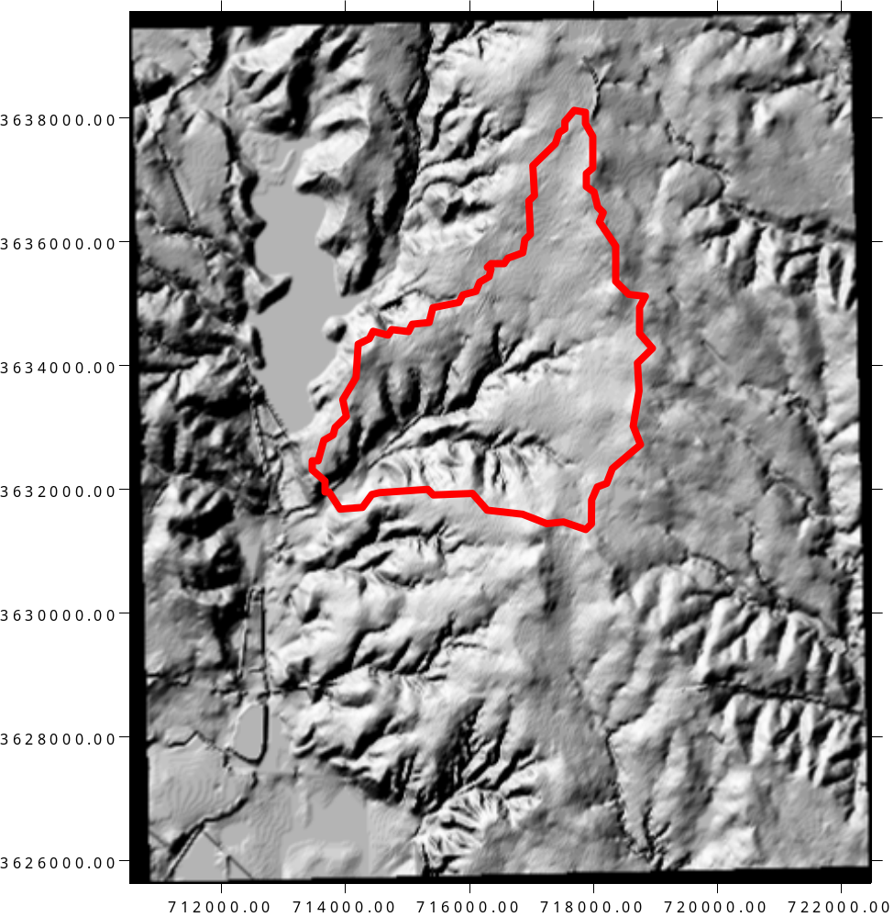
Background and Data
Watershed Outlet
  Highland Road and Ash Creek, Dallas, TX.
  Area is residential subdivisions, light industrial parks, and some open parkland.
  White Rock Lake is water body to the North-West

Slide 6
Physical Properties
Watershed Properties
  AREA=6.92 mi2
  MCL=5.416 mi
  MCS=0.005595
  CN=86
  R=0

Slide 7
Consider the arbitrary scheme shown
  Green => Red
  Blue => Red
Green and Blue need to be routed to the outlet.

Slide 8
Red Watershed
Rainfall-Runoff for this sub-area directly to the outlet
  Unit hydrograph
    AREA
    Tc
  Loss model
    CN

Slide 9
Green Watershed
Rainfall-runoff for this watershed directly to ITS outlet.
  Unit hydrograph
    AREA
    Tc
  Loss model
    CN
Then “route” to the main outlet
  Tlag = Distance/Speed

Slide 10
Blue Watershed
Rainfall-runoff for this watershed directly to ITS outlet.
  Unit hydrograph
    AREA
    Tc
  Loss model
    CN
Then “route” to the main outlet
  Tlag = Distance/Speed

Slide 11
Composite Discharge
Contributions of each watershed combined at the outlet for the total discharge

Slide 12
Preparing the Model
Need area of each watershed sub-basin
Need distances from Green and Blue outlets to main outlet

Slide 13
Prepare a PDF base map with drawings and use measuring tools.

Slide 14
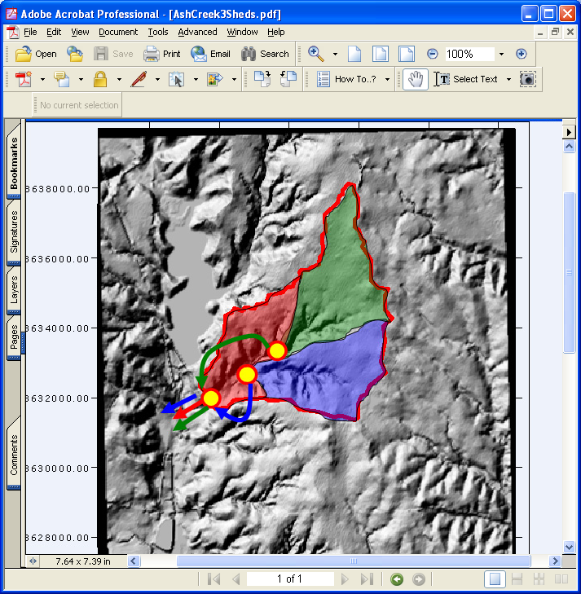
Example 5
Use measuring tools in acrobat.
  Known total area is 6.92 square miles, so we don’t need a reference rectangle.
  The left axis is UTM and is in meters. So distances stragihtforward

Slide 15
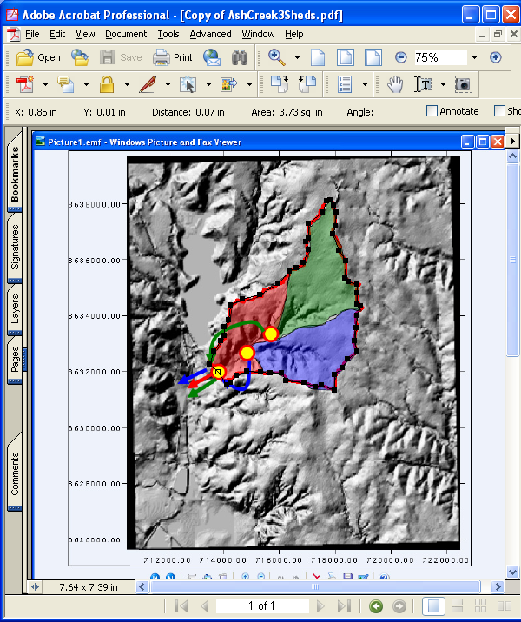
Example 5
Use measuring tools in acrobat.
  6.92 sq.mi = 3.73 sq.in
  2000 m = 0.90 in (horizontal axis)
  2000 m = 0.89 in (vertical axis)
Use these measurements to scale the sub-areas and stream channel distances.

Slide 16
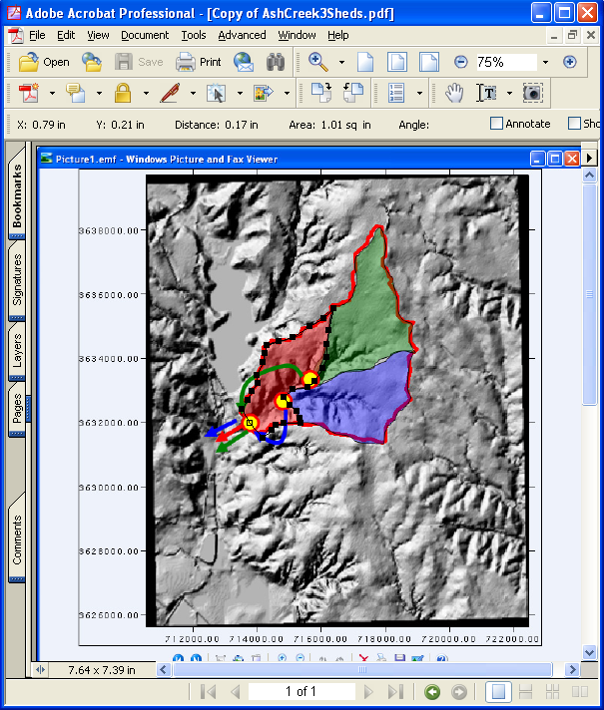
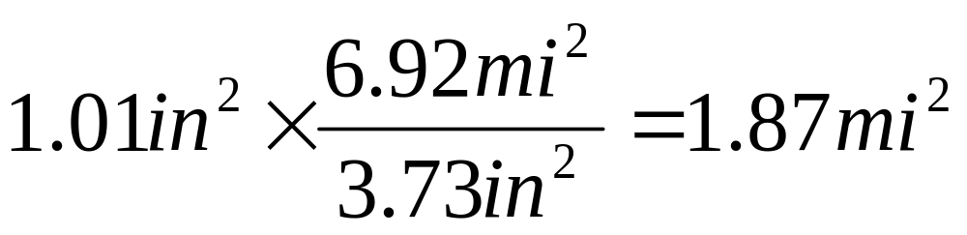
Red Watershed
Use measuring tools in acrobat.
  Area Measured = 1.01 sq.in.
Convert to sq. mi.

Slide 17
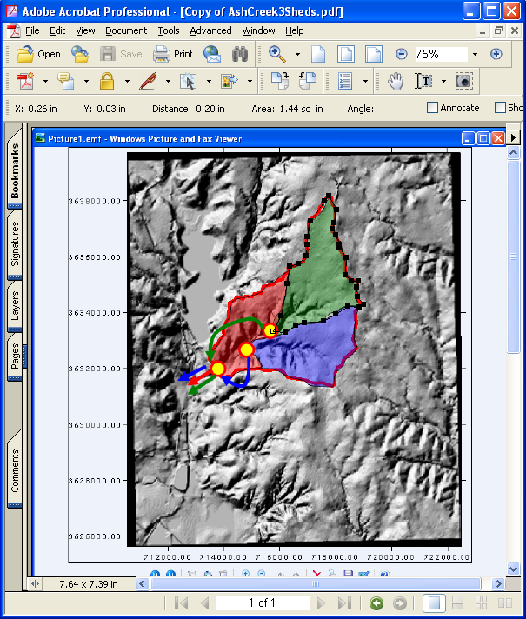
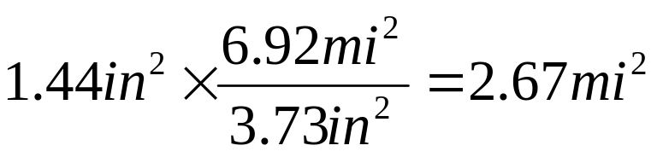
Green Watershed
Use measuring tools in acrobat.
  Measure = 1.44 sq.in.
  Convert to sq. mi.
Distance from local outlet to the gage

Slide 18

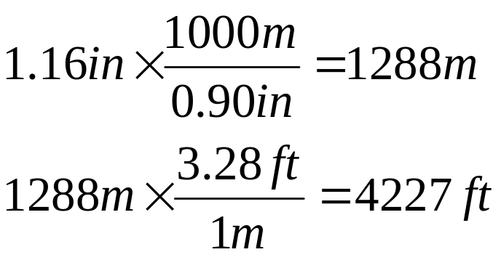
Green Watershed
Distance from local outlet to the gage
  Perimeter tool for polygon-type measurements
  Measure 1.16 in
  Convert

Slide 19
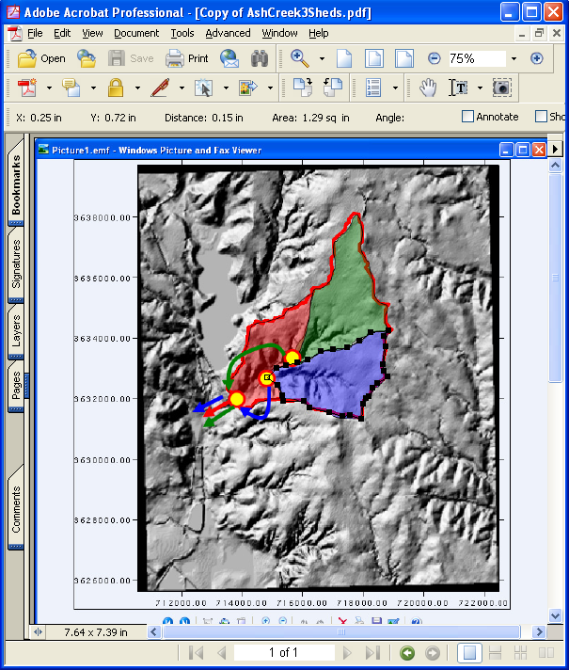
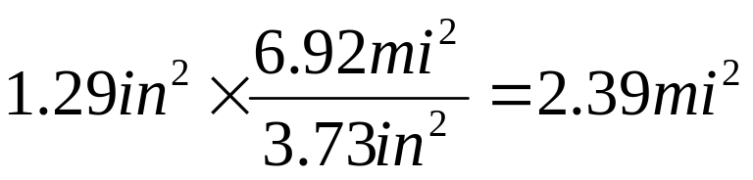
Blue Watershed
Use measuring tools in acrobat.
  Measure = 1.44 sq.in.
  Convert to sq. mi.
Distance from local outlet to the gage

Slide 20

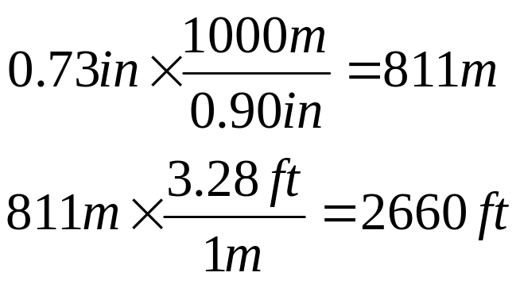
Blue Watershed
Distance from local outlet to the gage
  Perimeter tool for polygon-type measurements
  Measure 0.73 in
  Convert

Slide 21

Summarize Progress So Far
Sub-Basin ID | Property | Value
Red | AREA | 1.87 sq.mi.
Red | CN | 86
Red | Dist. To Outlet | 0
Green | AREA | 2.67sq.mi.
Green | CN | 86
Green | Dist. To Outlet | 4227ft
Blue | AREA | 2.39sq.mi
Blue | CN | 86
Blue | Dist. To Outlet | 2660 ft
Close enough (less than 1% overage), but could adjust by multiply each by 0.997

Slide 22
Additional Considerations
The two distances to the outlet would also need an estimate of slope.
As a way to keep the example brief enough for the module, we will just assume the slope is close to the MCL reported in the earlier examples, that is S=0.0056

Slide 23
Additional Considerations
Now need to estimate the routing information.
This example is simple lag routing, so we need a travel time from each sub-basin to the main outlet.

Slide 24
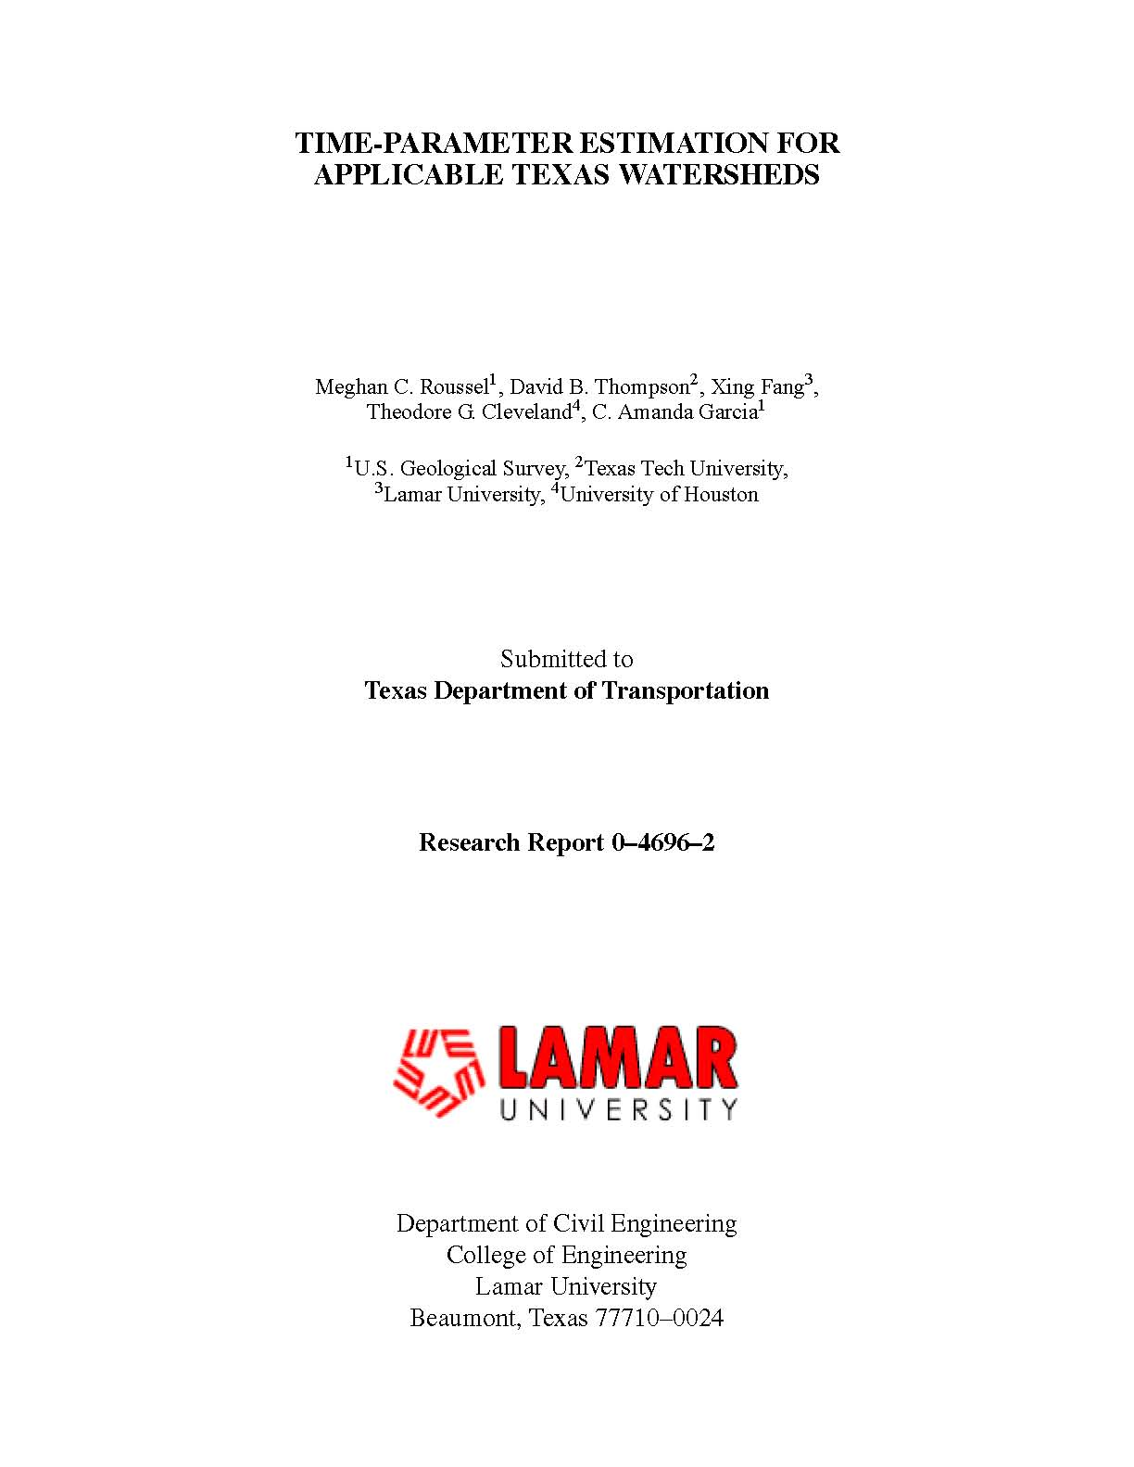
TxDOT research report 0-4695-2 has a method to estimate such a time.
  Use the application example at back of the report

Slide 25
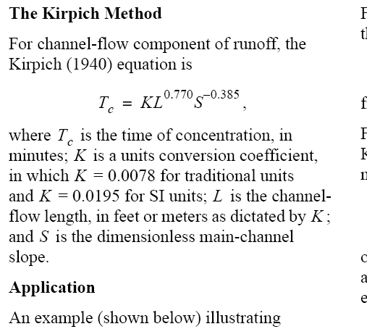
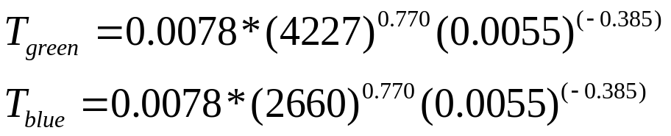
Estimate Lag Time for Routing
Use the values to estimate the lag time for the routing step
These produce values of 37 and 26 minutes.
Ready to build a HEC-HMS model

Slide 26
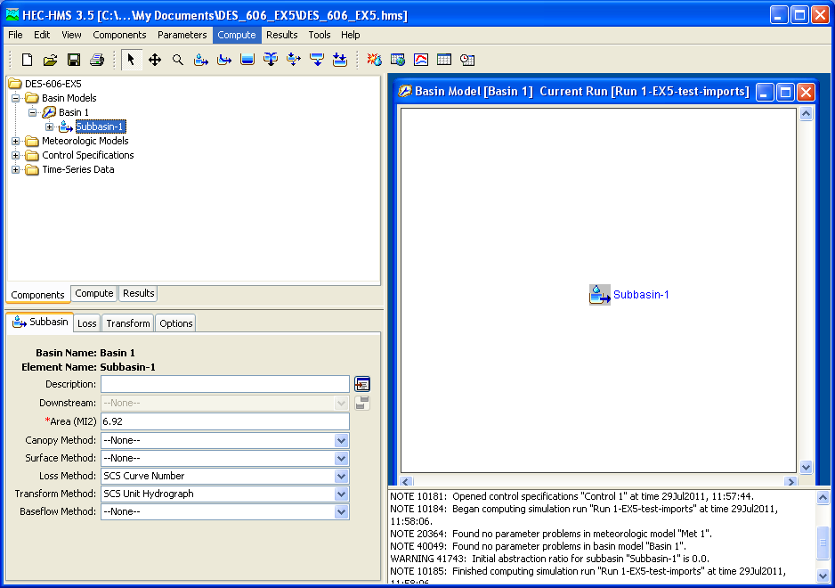
Example 6 – Clone a Prior Model
Clone the prior examples
  New
  Import
  ….
Verify the import
  Run and look for errors

Slide 27
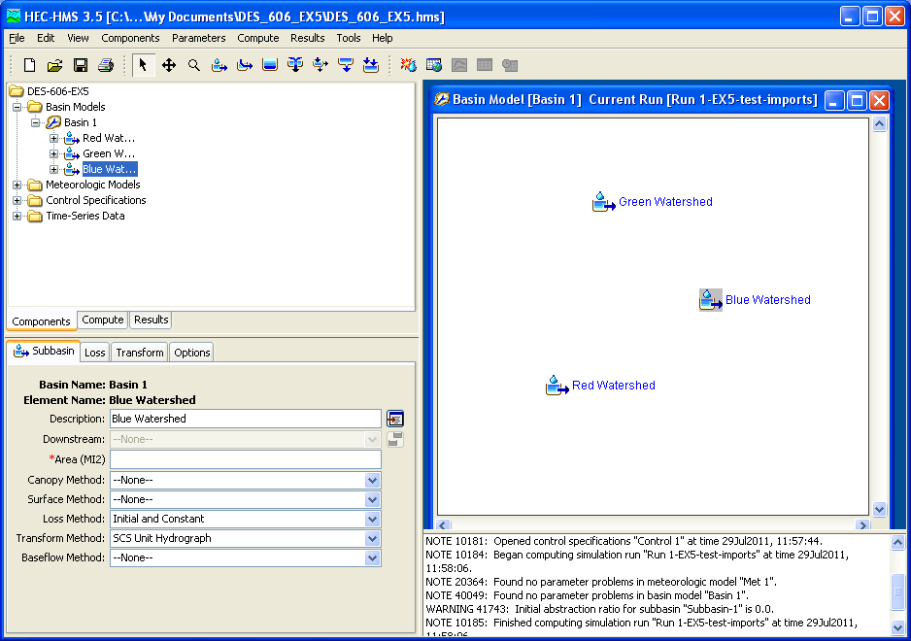
Example 6 – Clone a Prior Model
Modify the basin model
  Three sub-basins.

Slide 28
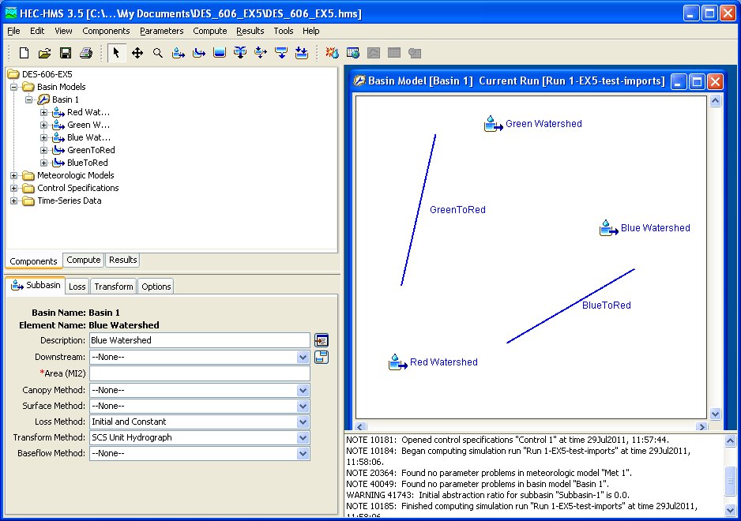
Example 6 – Clone a Prior Model
Modify the basin model
  Three sub-basins.
  Create routing elements (reaches)

Slide 29
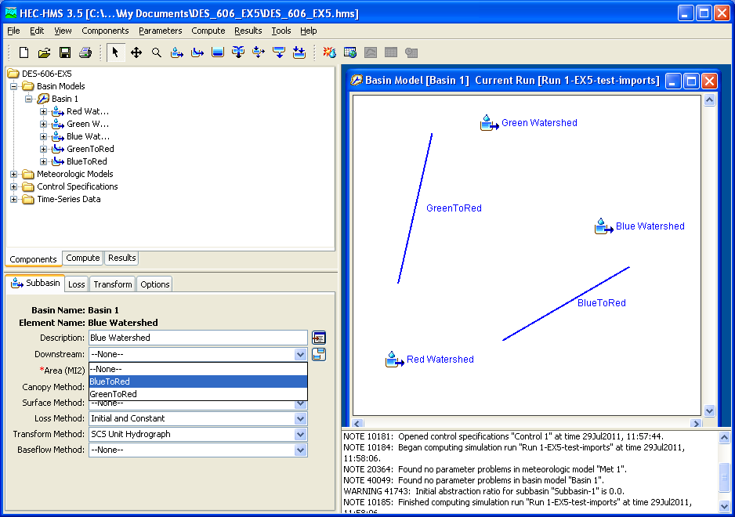
Example 6 – Clone a Prior Model
Reaches
  Not connected, will supply connectivity in various “downstream” specifications.

Slide 30
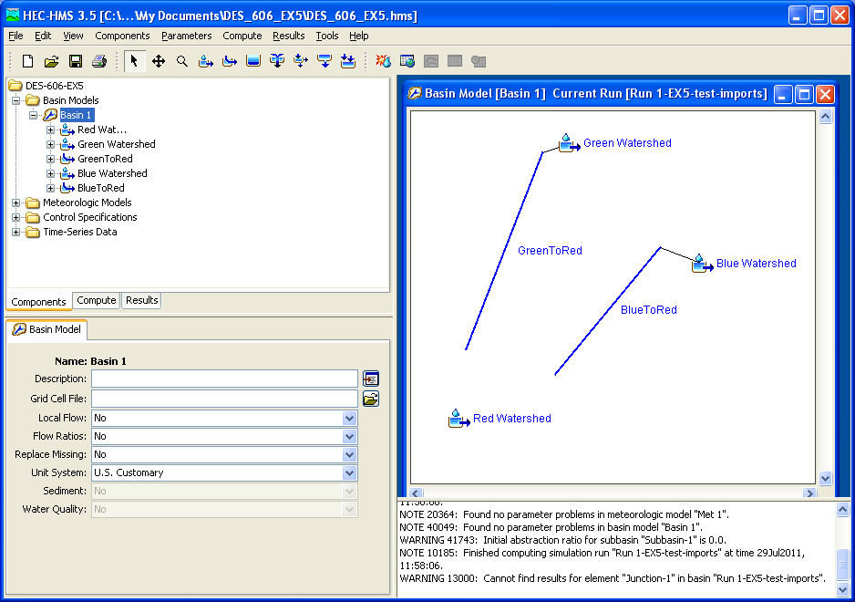
Example 6 – Clone a Prior Model
Reaches
  Have Green and Blue reaches connected to their upstream elements, but they cannot connect to a watershed element
  Use a “Junction” element.

Slide 31
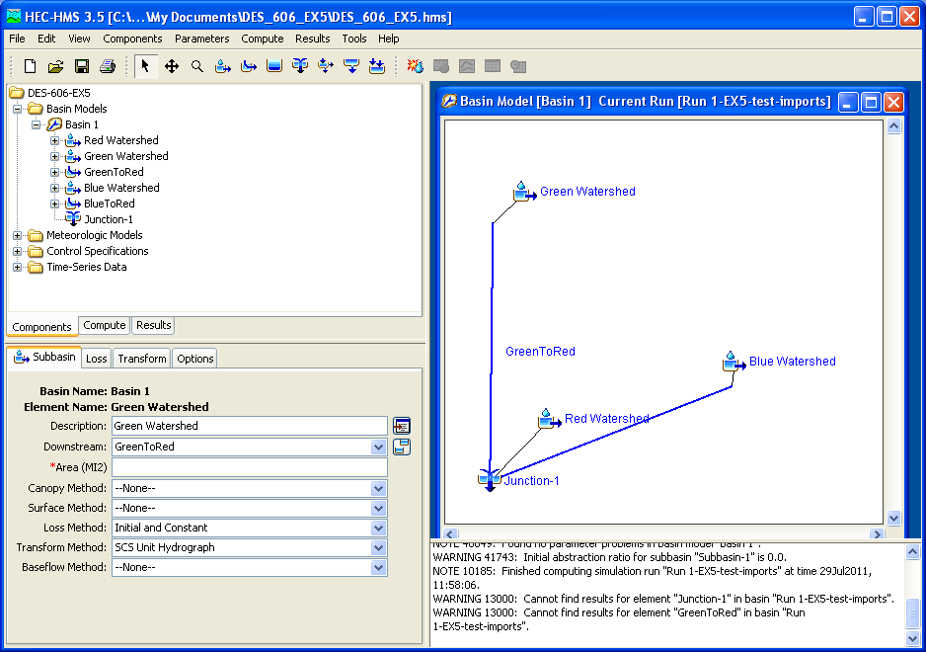
Example 6 – Clone a Prior Model
Connection Diagram
  After a bit of fussing, here is our hydrologic system.
  Watersheds (G&B) connect downstream to their reaches, than connect to the junction.
  Watershed (R ) connects directly to the junction

Slide 32
Example 6 – Clone a Prior Model
Now parameterize each element.
  Watersheds
  Reaches
Discover that we now need to re-estimate the watershed response times, as each sub-basin is now smaller.

Slide 33
Example 6 – Clone a Prior Model
Discover that we now need to re-estimate the watershed response times, as each sub-basin is now smaller.
  Should repeat steps of Example 2.
  In this example for brevity, will use the SQRT(AREA) rule suggested in 0-4696-2 report.
Resulting times are:
  RED: 41 minutes
  GREEN: 49 minutes
  BLUE: 46 minutes

Slide 34
Example 6 – Clone a Prior Model
Enter these times into the respective sub-basin Transform models
Update the Meterological Model
  Need all 3 sub-basins receiving rain from Gage 1
Move the “observed” flow to the junction so we can examine the output of the combined hydrographs.
Run the model and diagnose warnings/errors
  Forgot to update the Loss models for the 2 new watersheds, so go back and fix and retry.
  Clean run, lets examine the output.

Slide 35
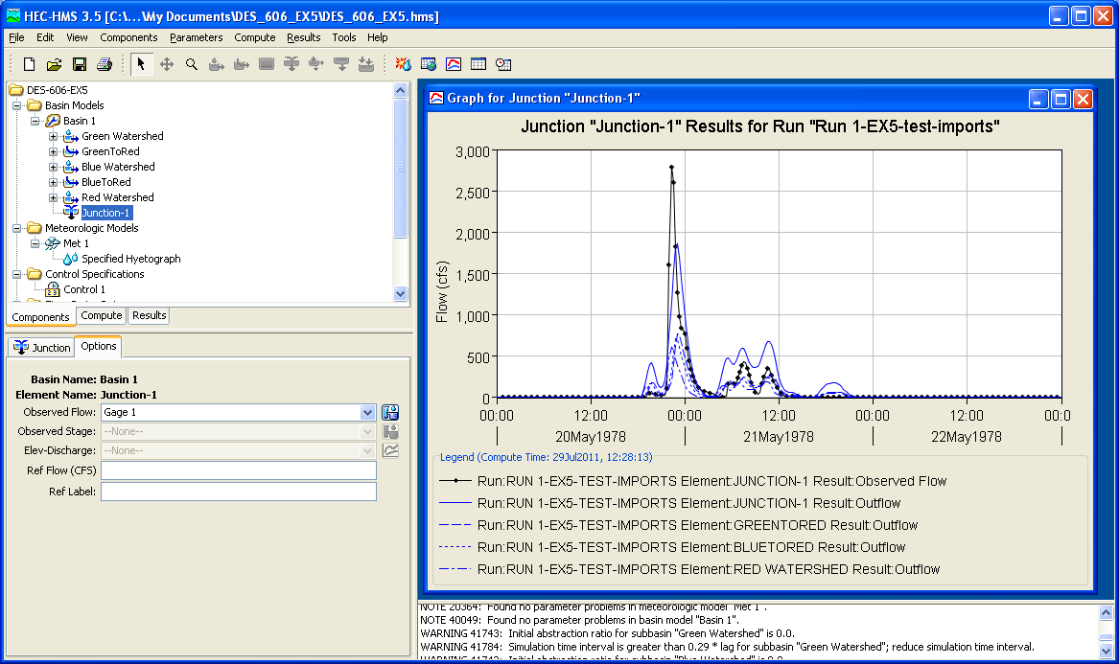
Example 6 – Lag Routing

Slide 36
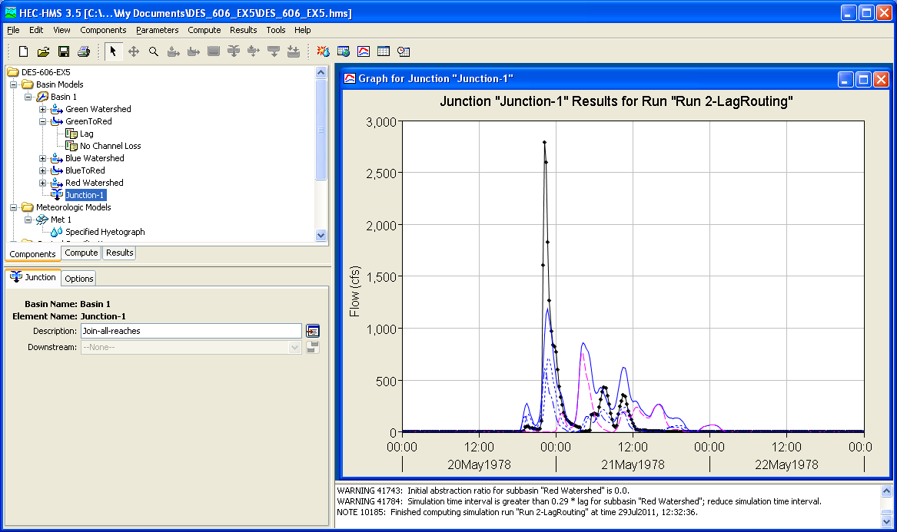
Long Routing Lag GreenToRed
Lagged Green 5 hours

Slide 37
HEC-HMS Example 6
Learning Summary
  Configured a multiple sub-basin model.
    Introduce the “junction” element
    Introduce the “reach” element
  Used external tools to measure sub-basis sizes and routing distances.
    Calculations to determine scaled watershed areas
    Calculations to determine routing distances (for lag routing)

Slide 38
HEC-HMS Example 6
Learning Summary
  Used 0-4696-2 report to estimate lag routing time parameters.
    Kerby-Kirpich variant.
    Calculations to estimate lag times
  Used 0-4696-2 (“rule of thumb”) to estimate revised watershed characteristic times.
    Sub-basins are smaller that original single-basin model, response time must be adjusted!
    Could use Example 2 – but goal here is to illustrate all the parts running, so took a shortcut.

Slide 39
HEC-HMS Example 6
Learning Summary
  Updated model components and ran several diagnosis tests
    Run the model and let the program identify missing components
    Go back to component editor and fix the missing items.
  Run the “multiple-basin” model and interpret results.

Slide 40
HEC-HMS Example 6
Closing Remarks
  Examples 4 and 5 provide illustrations of how to construct and populate input for most HEC-HMS situations the analyst is likely to encounter.
  These examples are pedagogical in intent.
HEC-HMS requires a lot of external (to the program) thinking and preparation
  Assemble data reports before modeling if at all possible.

Slide 41
HEC-HMS Example 6
Learn more
  HEC HMS user manual
  FHWA-NHI-02-001 Highway Hydrology
Next module
  Parametric Unit Hydrographs

