Slide 1
CE 5362 Surface Water Modeling
1D/2D Hydrodynamic Models

Slide 2
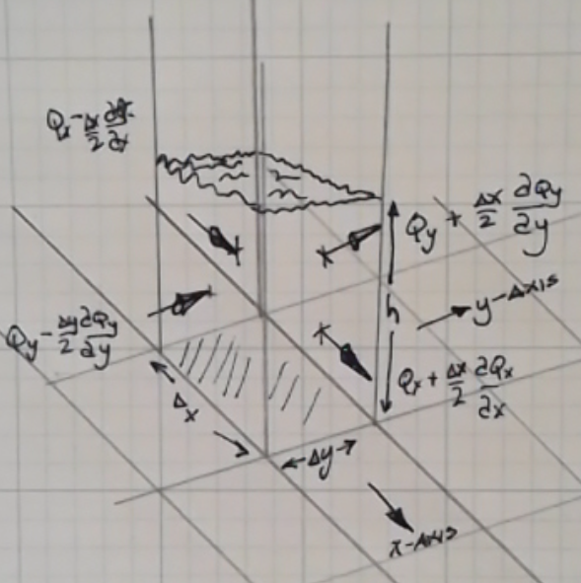
2D Diffusion Hydrodynamic Model
2D horizontal flow – an extension of St.Venant-type formulation
Assume: Hydrostatic pressure distribution; constant density; planar dimension (x,y) much larger then vertical dimension (z)
\cite{DHM-report}
Notes:
If the same inputs (in an algorithm) produce different results, but similar statistical behavior (stochastic)

Slide 3
2D Diffusion Hydrodynamic Model
Sketch of a computational cell
x, y directions shown, z is up.
Within the cell, average flow depth is h
On the 4 cell faces, are the flux terms Q, shown here as series expansions about the cell center.
Apply continunity principle
Notes:
If the same inputs (in an algorithm) produce different results, but similar statistical behavior (stochastic)

Slide 4
2D Diffusion Hydrodynamic Model
Sketch of a computational cell
x, y directions shown, z is up.
Within the cell, average flow depth is h
On the 4 cell faces, are the flux terms Q, shown here as series expansions about the cell center.
Apply continunity principle
Notes:
If the same inputs (in an algorithm) produce different results, but similar statistical behavior (stochastic)

Slide 5
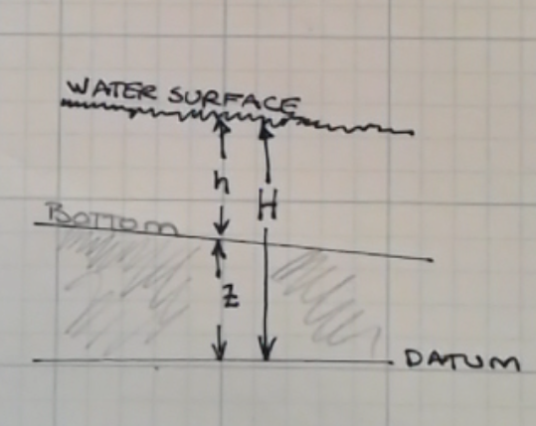
2D Diffusion Hydrodynamic Model
Apply continunity principle
Where,
Notes:
If the same inputs (in an algorithm) produce different results, but similar statistical behavior (stochastic)

Slide 6
2D Diffusion Hydrodynamic Model
Momentum-x
Momentum-y
Notes:
If the same inputs (in an algorithm) produce different results, but similar statistical behavior (stochastic)

Slide 7
2D Diffusion Hydrodynamic Model
DHM moniker comes from next few steps, where the momentum terms are converted into linear-flux law terms so the equations of motion can be placed directly into continunity and a diffusion equation results.
The PDE is pretty non-linear, but the construction allows use of very stable methods
Notes:
If the same inputs (in an algorithm) produce different results, but similar statistical behavior (stochastic)

Slide 8
2D Diffusion Hydrodynamic Model
First divide momentum by gh
Notes:
If the same inputs (in an algorithm) produce different results, but similar statistical behavior (stochastic)

Slide 9
2D Diffusion Hydrodynamic Model
First divide momentum by gh
Notes:
If the same inputs (in an algorithm) produce different results, but similar statistical behavior (stochastic)

Slide 10
2D Diffusion Hydrodynamic Model
Rename the leftmost three terms “m” (a function of current state)
Notes:
If the same inputs (in an algorithm) produce different results, but similar statistical behavior (stochastic)

Slide 11
2D Diffusion Hydrodynamic Model
Stipulate that the friction slope is well approximated by Chezy/Manning formulation
Notes:
If the same inputs (in an algorithm) produce different results, but similar statistical behavior (stochastic)

Slide 12
2D Diffusion Hydrodynamic Model
Rewrite in terms of momentum equations
Notes:
If the same inputs (in an algorithm) produce different results, but similar statistical behavior (stochastic)

Slide 13
2D Diffusion Hydrodynamic Model
Substitute into continunity, and the result is a diffusion equation in H, quite non-linear.
Notes:
If the same inputs (in an algorithm) produce different results, but similar statistical behavior (stochastic)

Slide 14
2D Diffusion Hydrodynamic Model
Solving takes a trial-and-error approach (hence a lot of iteration)
General algorithm is:
Between nodes points (velocity grid) compute average Manning’s n, average geometric factors (h)
Assume m=0,estimate nodal flow depths for next time (t+Dt) using the momentum equations (as difference equations)
Use these new depths, and old depths to estimate the midtimestep value of m (including the dynamic components, this could be an elaborate computation)
Recompute values of K using these midstep m values
Find flow depths at next time (t+Dt) using continunity (same as step 2, but with midstep m values)
Return to step 3 and repeat until K matches the midstep estimate – declare that convergence and update, proceede to next time step.
Notes:
If the same inputs (in an algorithm) produce different results, but similar statistical behavior (stochastic)

Slide 15
2D Diffusion Hydrodynamic Model
Solving takes a trial-and-error approach (hence a lot of iteration)
General algorithm is:
Between nodes points (velocity grid) compute average Manning’s n, average geometric factors (h)
Assume m=0,estimate nodal flow depths for next time (t+Dt) using the momentum equations (as difference equations)
Use these new depths, and old depths to estimate the midtimestep value of m (including the dynamic components, this could be an elaborate computation)
Recompute values of K using these midstep m values
Find flow depths at next time (t+Dt) using continunity (same as step 2, but with midstep m values)
Return to step 3 and repeat until K matches the midstep estimate – declare that convergence and update, proceede to next time step.
Notes:
If the same inputs (in an algorithm) produce different results, but similar statistical behavior (stochastic)

Slide 16
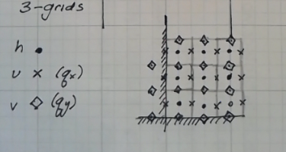
2D Diffusion Hydrodynamic Model
Grid system is complicated, there are 3 grids
A grid of depth nodes,
A grid of Qx nodes,
A grid of Qy nodes
Notes:
If the same inputs (in an algorithm) produce different results, but similar statistical behavior (stochastic)

Slide 17
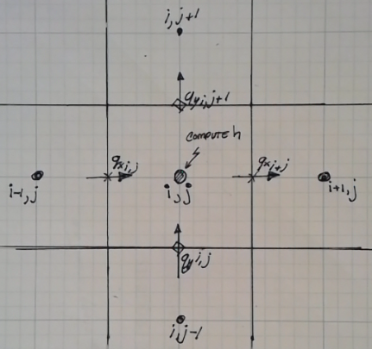
2D Diffusion Hydrodynamic Model
Grid system is complicated, there are 3 grids
A grid of depth nodes,
A grid of Qx nodes,
A grid of Qy nodes
Notes:
If the same inputs (in an algorithm) produce different results, but similar statistical behavior (stochastic)

Slide 18
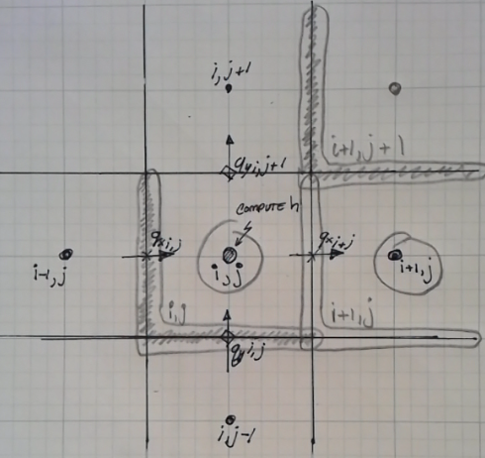
2D Diffusion Hydrodynamic Model
Grid system is complicated, there are 3 grids
A grid of depth nodes,
A grid of Qx nodes,
A grid of Qy nodes
An effective naming scheme is important
Notes:
If the same inputs (in an algorithm) produce different results, but similar statistical behavior (stochastic)

