Slide 1
CE 5362 Surface Water Modeling
1D/2D Hydrodynamic Models

Slide 2
Steady Flow Examples
Rectangular Channel – Fixed Depth Change
Rectangular Channel – Fixed Spatial Change
Notes:
If the same inputs (in an algorithm) produce different results, but similar statistical behavior (stochastic)

Slide 3
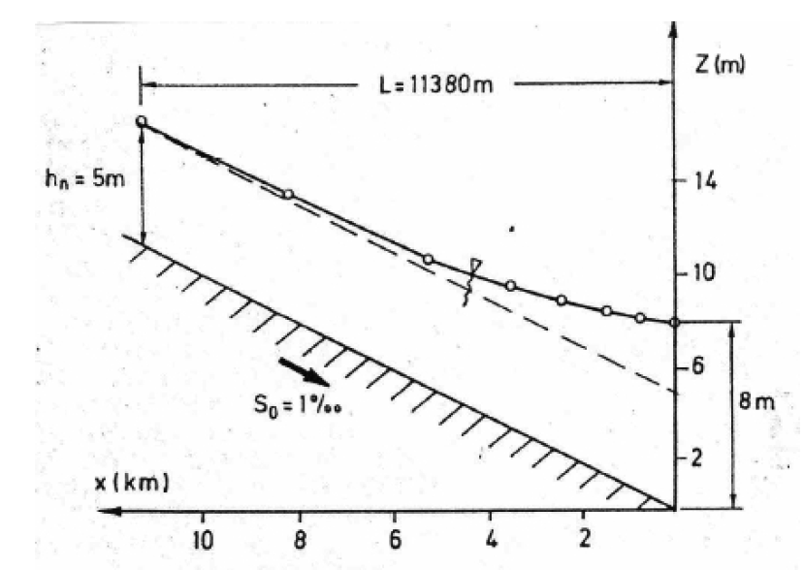
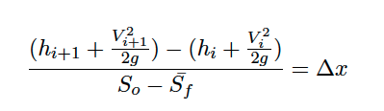
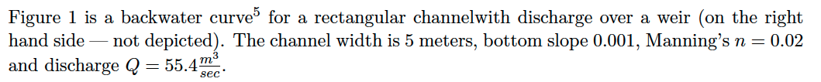
Rectangular Channel – Fixed Depth Change
Notes:
If the same inputs (in an algorithm) produce different results, but similar statistical behavior (stochastic)

Slide 4
Rectangular Channel – Fixed Spatial Change

