Slide 1
CE 5362 Surface Water Modeling
Characteristics for Boundary Conditions

Slide 2
Unsteady Flow
Unsteady flow where depth and discharge are changing in time and space
Illustrate the Lax Scheme to map the St. Venant Equations into a set of difference equations
Notes:
If the same inputs (in an algorithm) produce different results, but similar statistical behavior (stochastic)

Slide 3
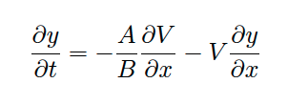
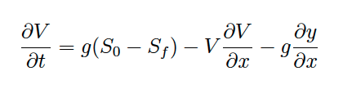
Continuity and Momentum
Continuity (here y is flow depth)
Momentum

Slide 4

Continunity and Momentum
Mesh courant number:
Update formula for depth at each cell center from known velocities and depths at the current time level.
Update formula for velocity at each cell center from known velocities and depths at the current time level.

Slide 5
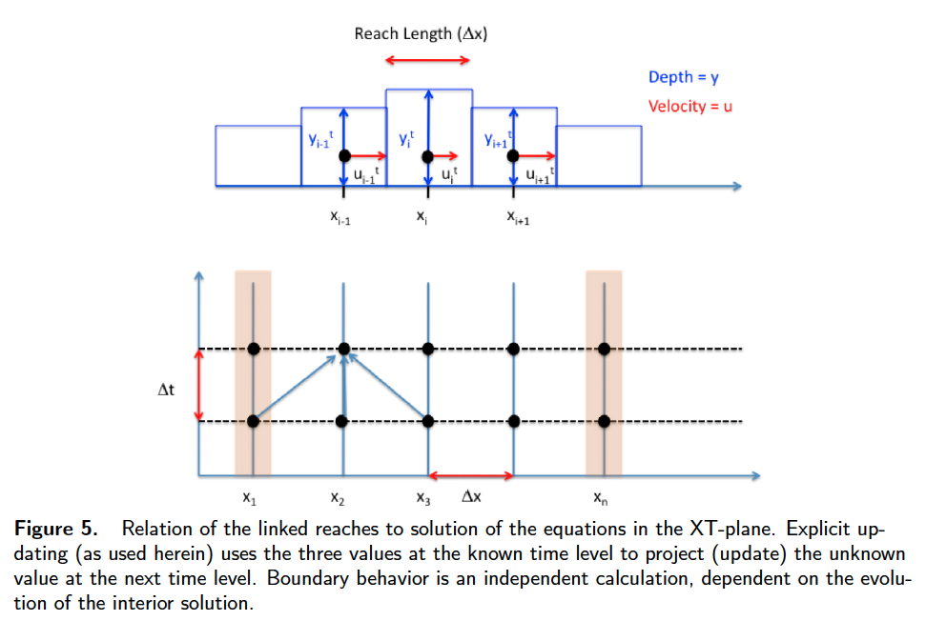
Boundary Conditions
Update formulas handle interior nodes (cells)
Special considerations required at the boundaries

Slide 6
Boundary Conditions
Types of boundaries: Specified stage (depth)
Compute velocity
Specified velocity
Specified velocity
Compute depth
Known depth
i
i+1
i-2
i-1
Domain Boundary
Domain Boundary

Slide 7
Characteristic Curves
Types of boundaries: Specified stage (depth)
Compute velocity
Specified velocity
Specified velocity
Compute depth
Known depth

