Slide 1
CE 5362 Surface Water Modeling
1D/2D Hydrodynamic Models

Slide 2
Unsteady Flow
Unsteady flow where depth and discharge are changing in time and space
Illustrate the Lax Scheme to map the St. Venant Equations into a set of difference equations
Notes:
If the same inputs (in an algorithm) produce different results, but similar statistical behavior (stochastic)

Slide 3
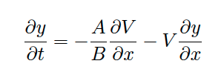
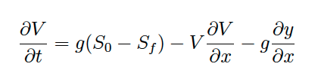
Continuity and Momentum
Continuity (here y is flow depth)
Momentum

Slide 4
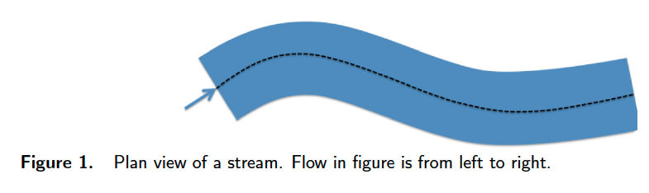
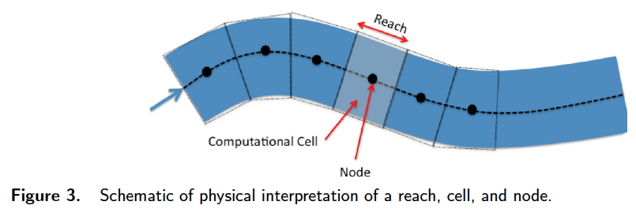
Mapping from the Physical to Computational Domain
Physical domain
Computational (Spatial) Domain

Slide 5
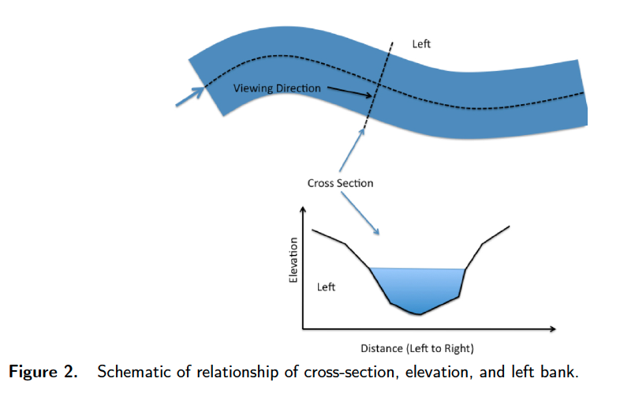
Mapping from the Physical to Computational Domain
Physical domain –Cross Sections
Correspond to each end of a reach
Could also be an average for a reach
Left is referenced to looking downstream (convention all over the world)

Slide 6
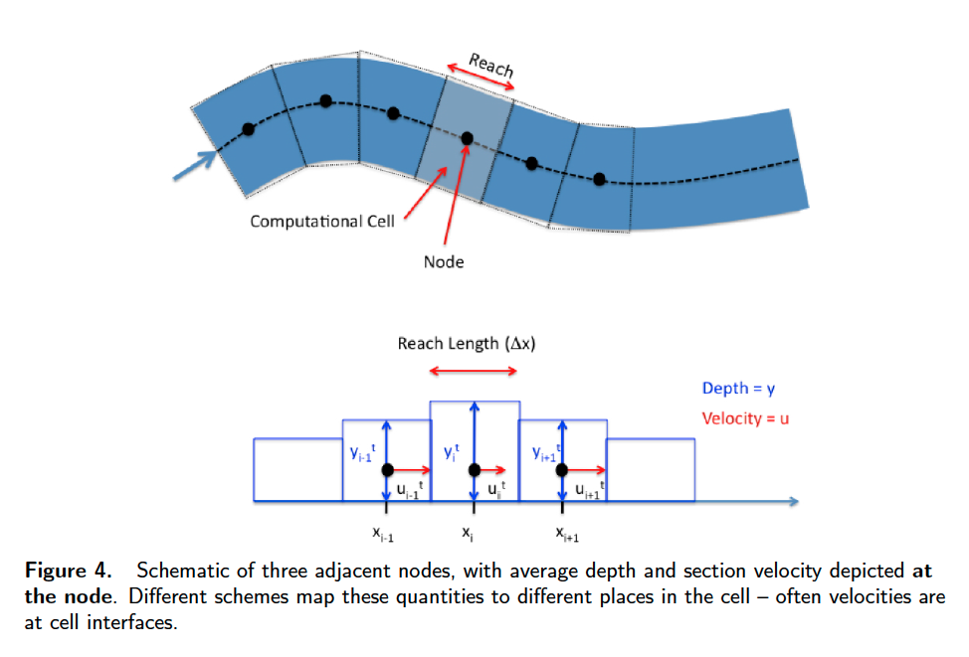
Mapping from the Physical to Computational Domain
Computational domain “indexing”
Depth and velocity not always at same location
Usually depth a cell center, velocity at cell interface
Problematic only at boundaries and when plotting

Slide 7



Building the Difference Equations
First order time difference
Lax replaced the known value with a spatial average for both depth and velocity

Slide 8




Building the Difference Equations
Centered difference in space
Lax used centered differences for the spatial derivatives
Lax also used spatial averages for the depth-area and slope functions

Slide 9


Continuity
Starting with the PDE, first replace the time derivative

Slide 10

Continunity
Then replace the space derivatives

Slide 11

Continuity
then the spatial averages for the remaining terms.

Slide 12
Continunity
Next multiply by Δt
Move the time level t term to the right hand side

Slide 13

Continunity
Rename the mesh courant number and simplify
The result is an update formula for depth at each cell center from known velocities and depths at the current time level.

Slide 14
Continunity
Starting with the PDE,
first replace the time derivative
then replace the space derivatives
then the spatial averages for the remaining terms.
Next multiply by t
Move the time level t term to the right hand side
Rename the constant t
2x = r and simplify

