Slide 1
CECE Progress Report 14 April 2021
Integration and next steps of Common Engineering Core

Slide 2
Major Assumptions
Common Yr1 and Common Engineering Core used interchangeably in CECE internal planning documents.
Four (4) core areas:
A-Z of engineering (ENGR 1100)
Nature Inspired Principles (ENGR 1320)
Computational Thinking (ENGR 1330)
Socio-Technological Aspects (ENGR 2392)

Slide 3
Downstream Course Mapping
Downstream mapping of courses where these core principles can be integrated:
CIVE
CONE
ENGR

Slide 4
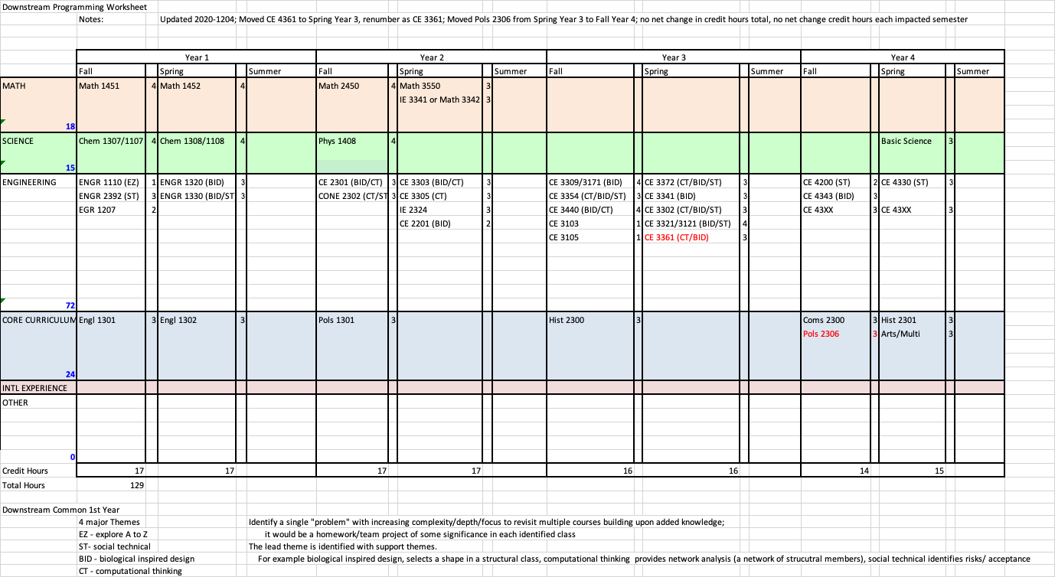

Slide 5
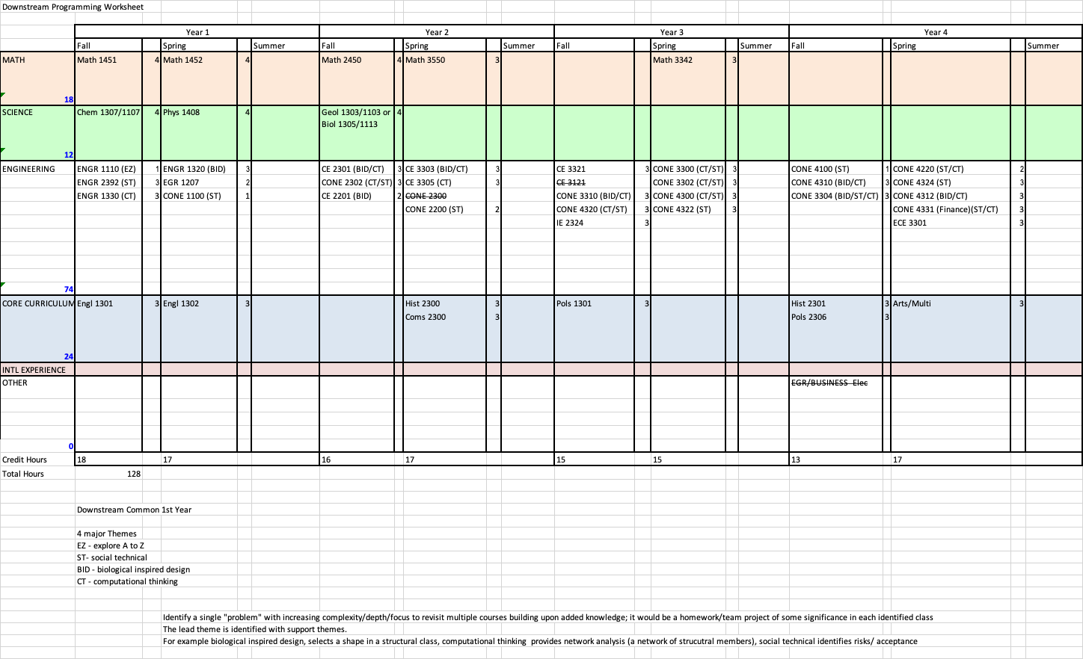

Slide 6
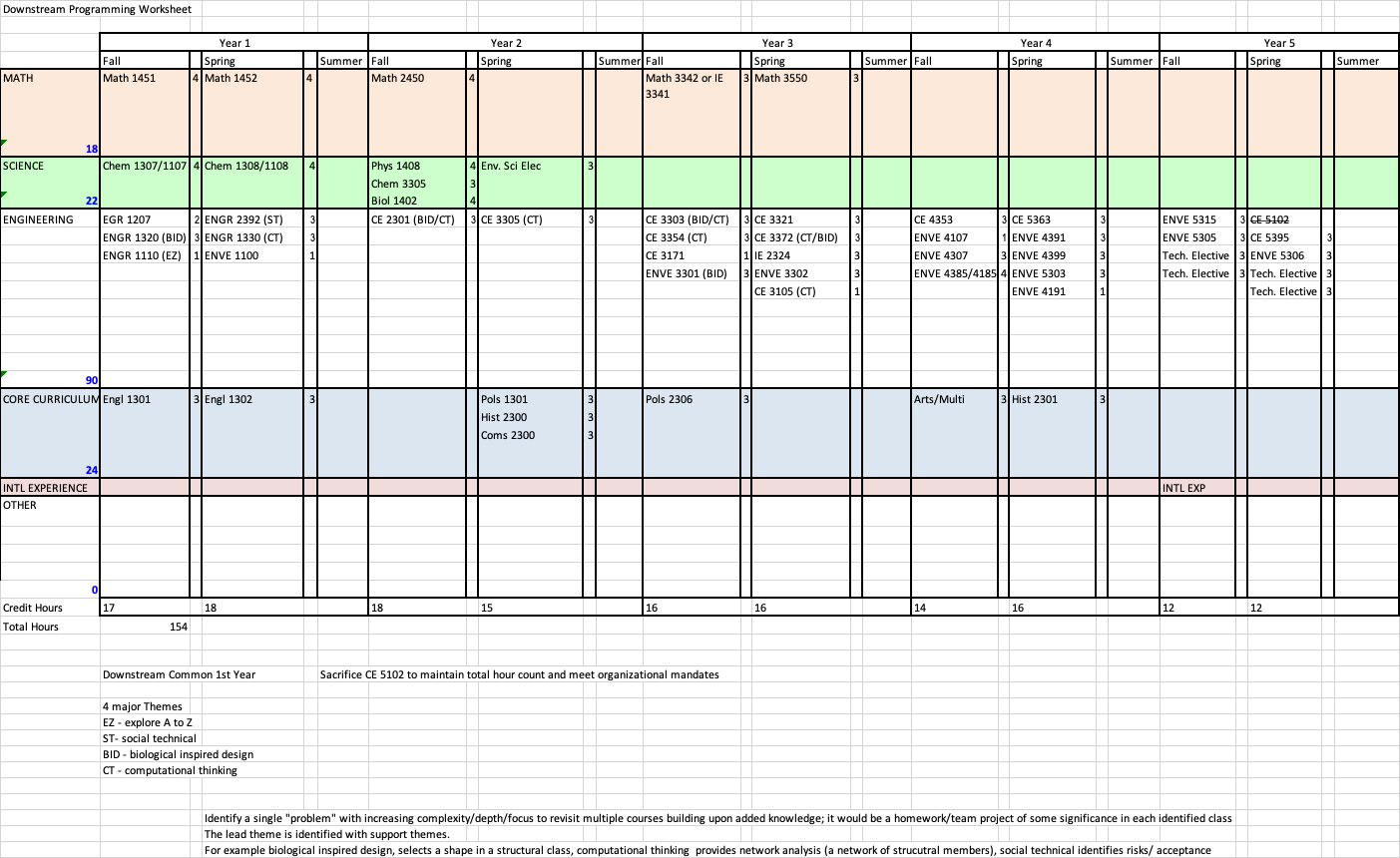

Slide 7
Implementation
Exploring Several Implementation Concepts
Example Problem Library (partial examples)
Case Study Approach
Identified several large scale projects that are elaborate enough to require all major aspects in CIVE (structures, fluid mechanics, geotechnical engineering, environmental engineering, data management, ethics, sociological interactions, nature inspired/compatable)
A JIT skill-development library (no examples yet – just an idea)

Slide 8
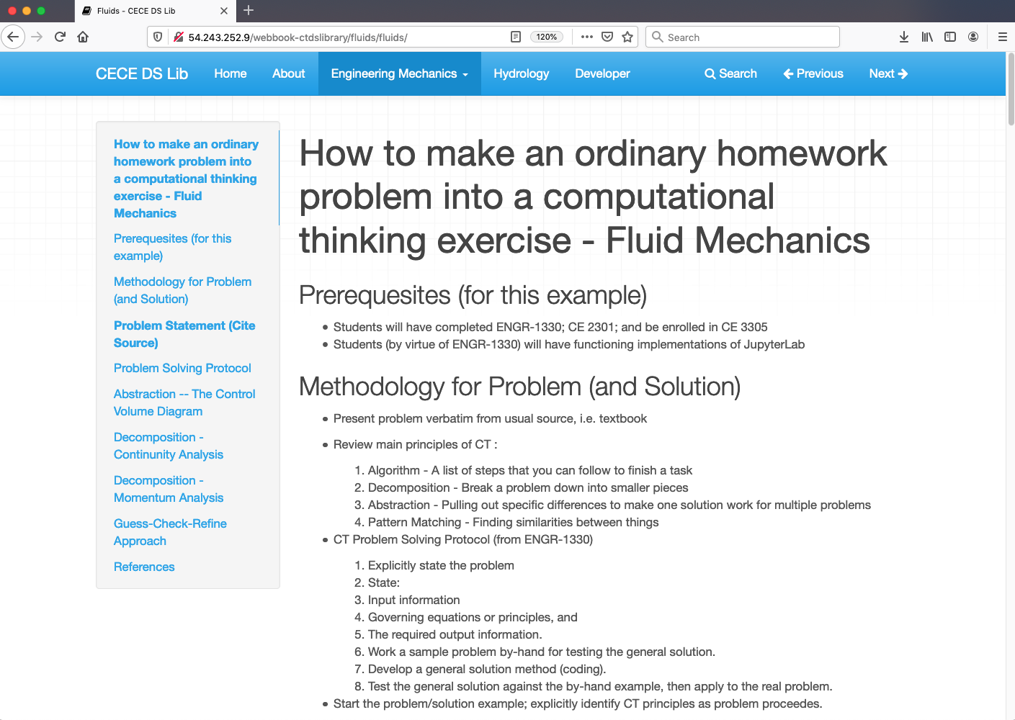

Slide 9
Portage Bay Project - Seattle

Slide 10
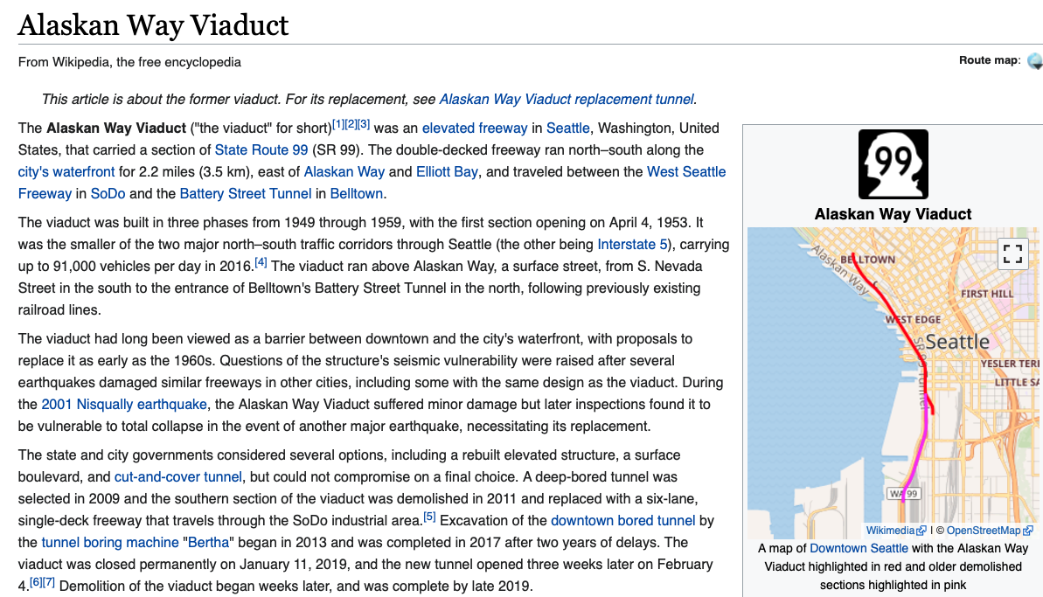

Slide 11
Planning for Near Future
Example Problem Library is closest to being deployable
Create example(s) for faculty to use as an extended homework exercise; these seem readily adaptable for CTDS, and BID
Relevant literature articles that can employed for ST
Case Study (by parts) is longer term activity, but have identified a couple projects we can examine that use all 4 core areas in some fashion, and they either have real-time data, or we can get useful data to weave into the curriculum in progressively elaborate depth.

