Slide 1
Materials for Civil and Construction Engineers
CHAPTER 1
Materials Engineering Concepts
Mamlouk/Zaniewski, Materials for Civil and Construction Engineers, Fourth Edition. Copyright © 2017 Pearson Education, Inc.

Slide 2
1.7 Material Variability
All materials have variability
Some materials are more uniform than others
Steel vs. concrete vs. wood
Error vs. blunder
Three sources of variance:
Material
Sampling
Testing
Use good sampling and testing techniques to minimize those variabilities
Mamlouk/Zaniewski, Materials for Civil and Construction Engineers, Fourth Edition. Copyright © 2017 Pearson Education, Inc.

Slide 3
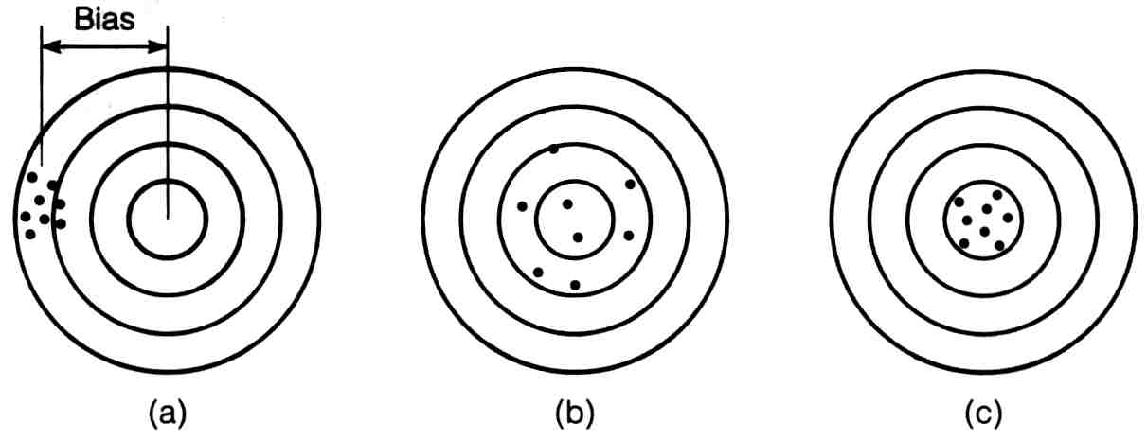
Precision: measure many times and get same result
Bias: tendency to deviate in one direction from true value
Accuracy: close to true value; absence of bias
Mamlouk/Zaniewski, Materials for Civil and Construction Engineers, Fourth Edition. Copyright © 2017 Pearson Education, Inc.

Slide 4
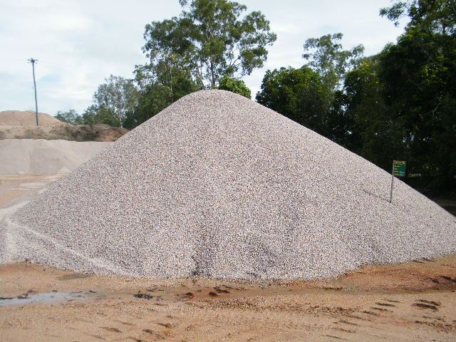
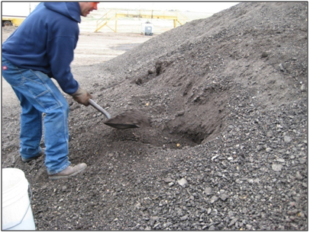
Sampling
Proper sampling must ensure that a random and representative sample is taken from the population (e.g., stockpile, lot, etc.)
Random: have an equal chance of being selected
Representative: perfect average of the entire stockpile
Sample size:
depends on materials variability & tolerance level of results
more variability dictates a larger sample
Rigorous statistical evaluations required for special applications:
high quality asphalt and portland cement concrete
Mamlouk/Zaniewski, Materials for Civil and Construction Engineers, Fourth Edition. Copyright © 2017 Pearson Education, Inc.

Slide 5
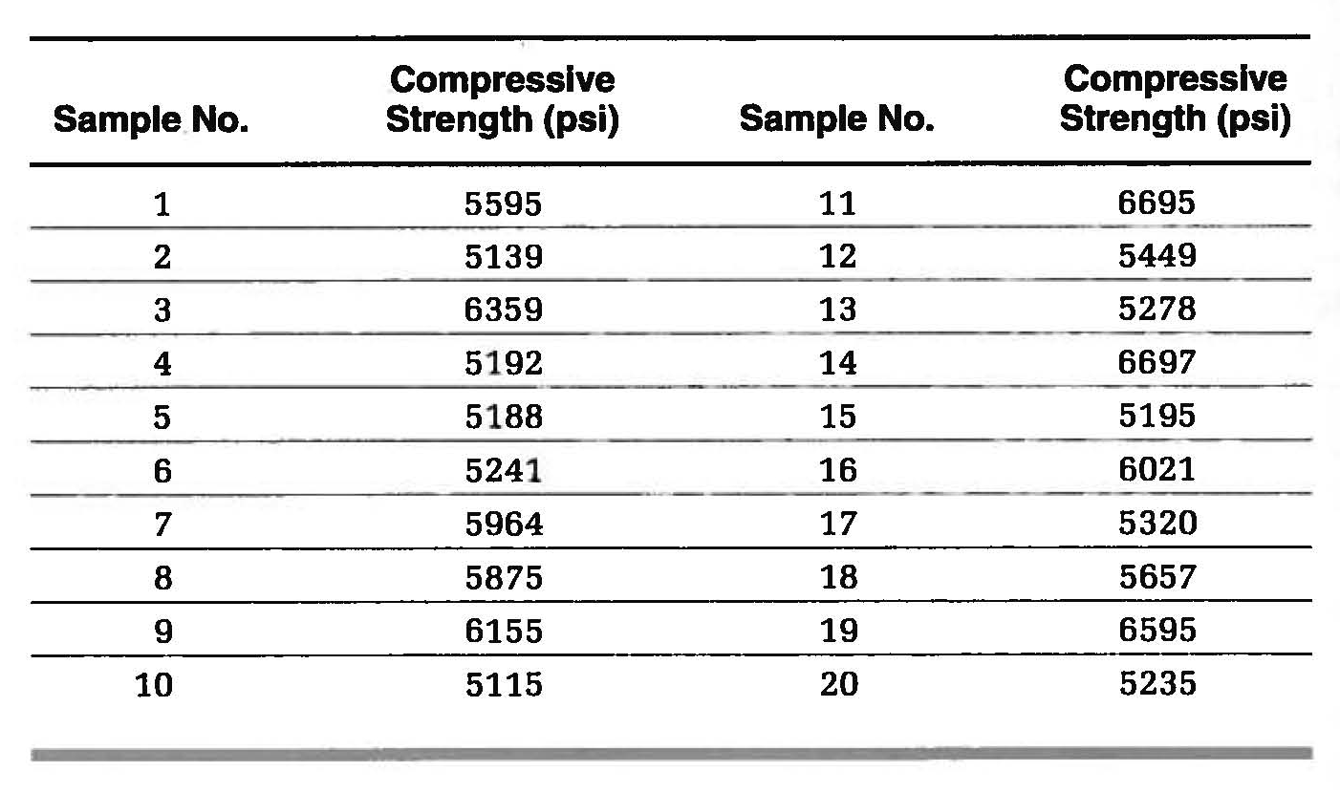
Problem 1.47
Mamlouk/Zaniewski, Materials for Civil and Construction Engineers, Fourth Edition. Copyright © 2017 Pearson Education, Inc.

Slide 6
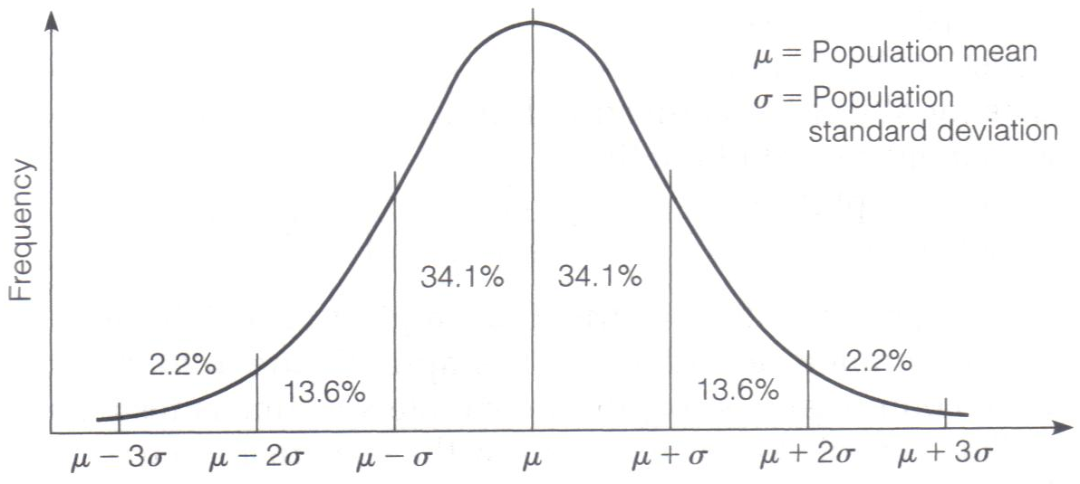
Normal Distribution
Describes many populations that occur in nature, including material properties
Area under the curve between any two values represents the probability of occurrence
Mamlouk/Zaniewski, Materials for Civil and Construction Engineers, Fourth Edition. Copyright © 2017 Pearson Education, Inc.

Slide 7
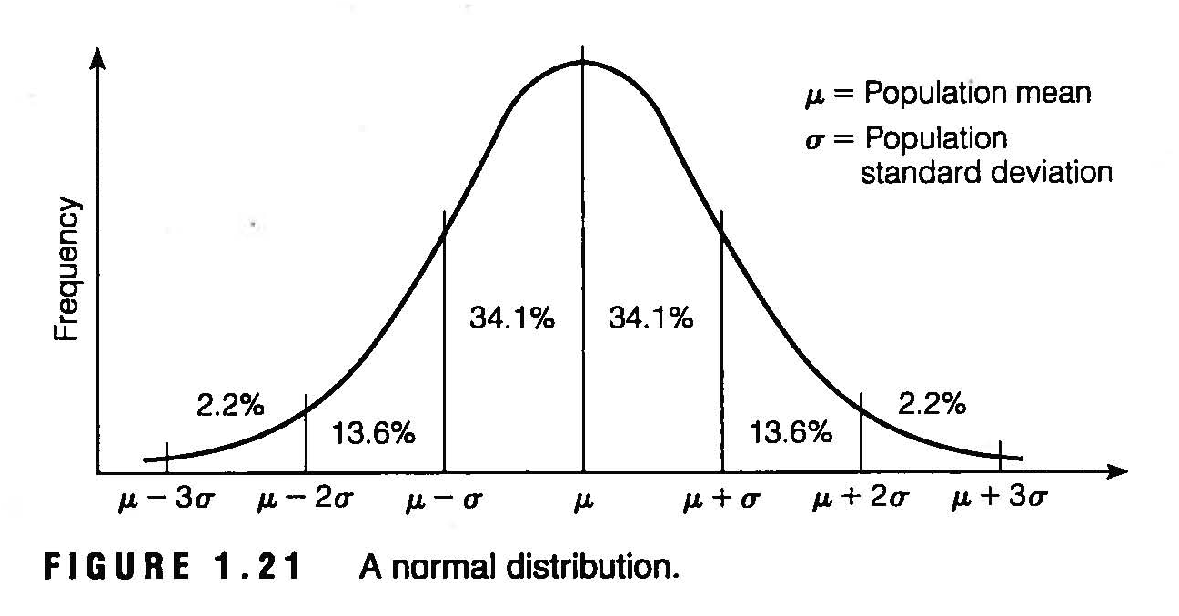
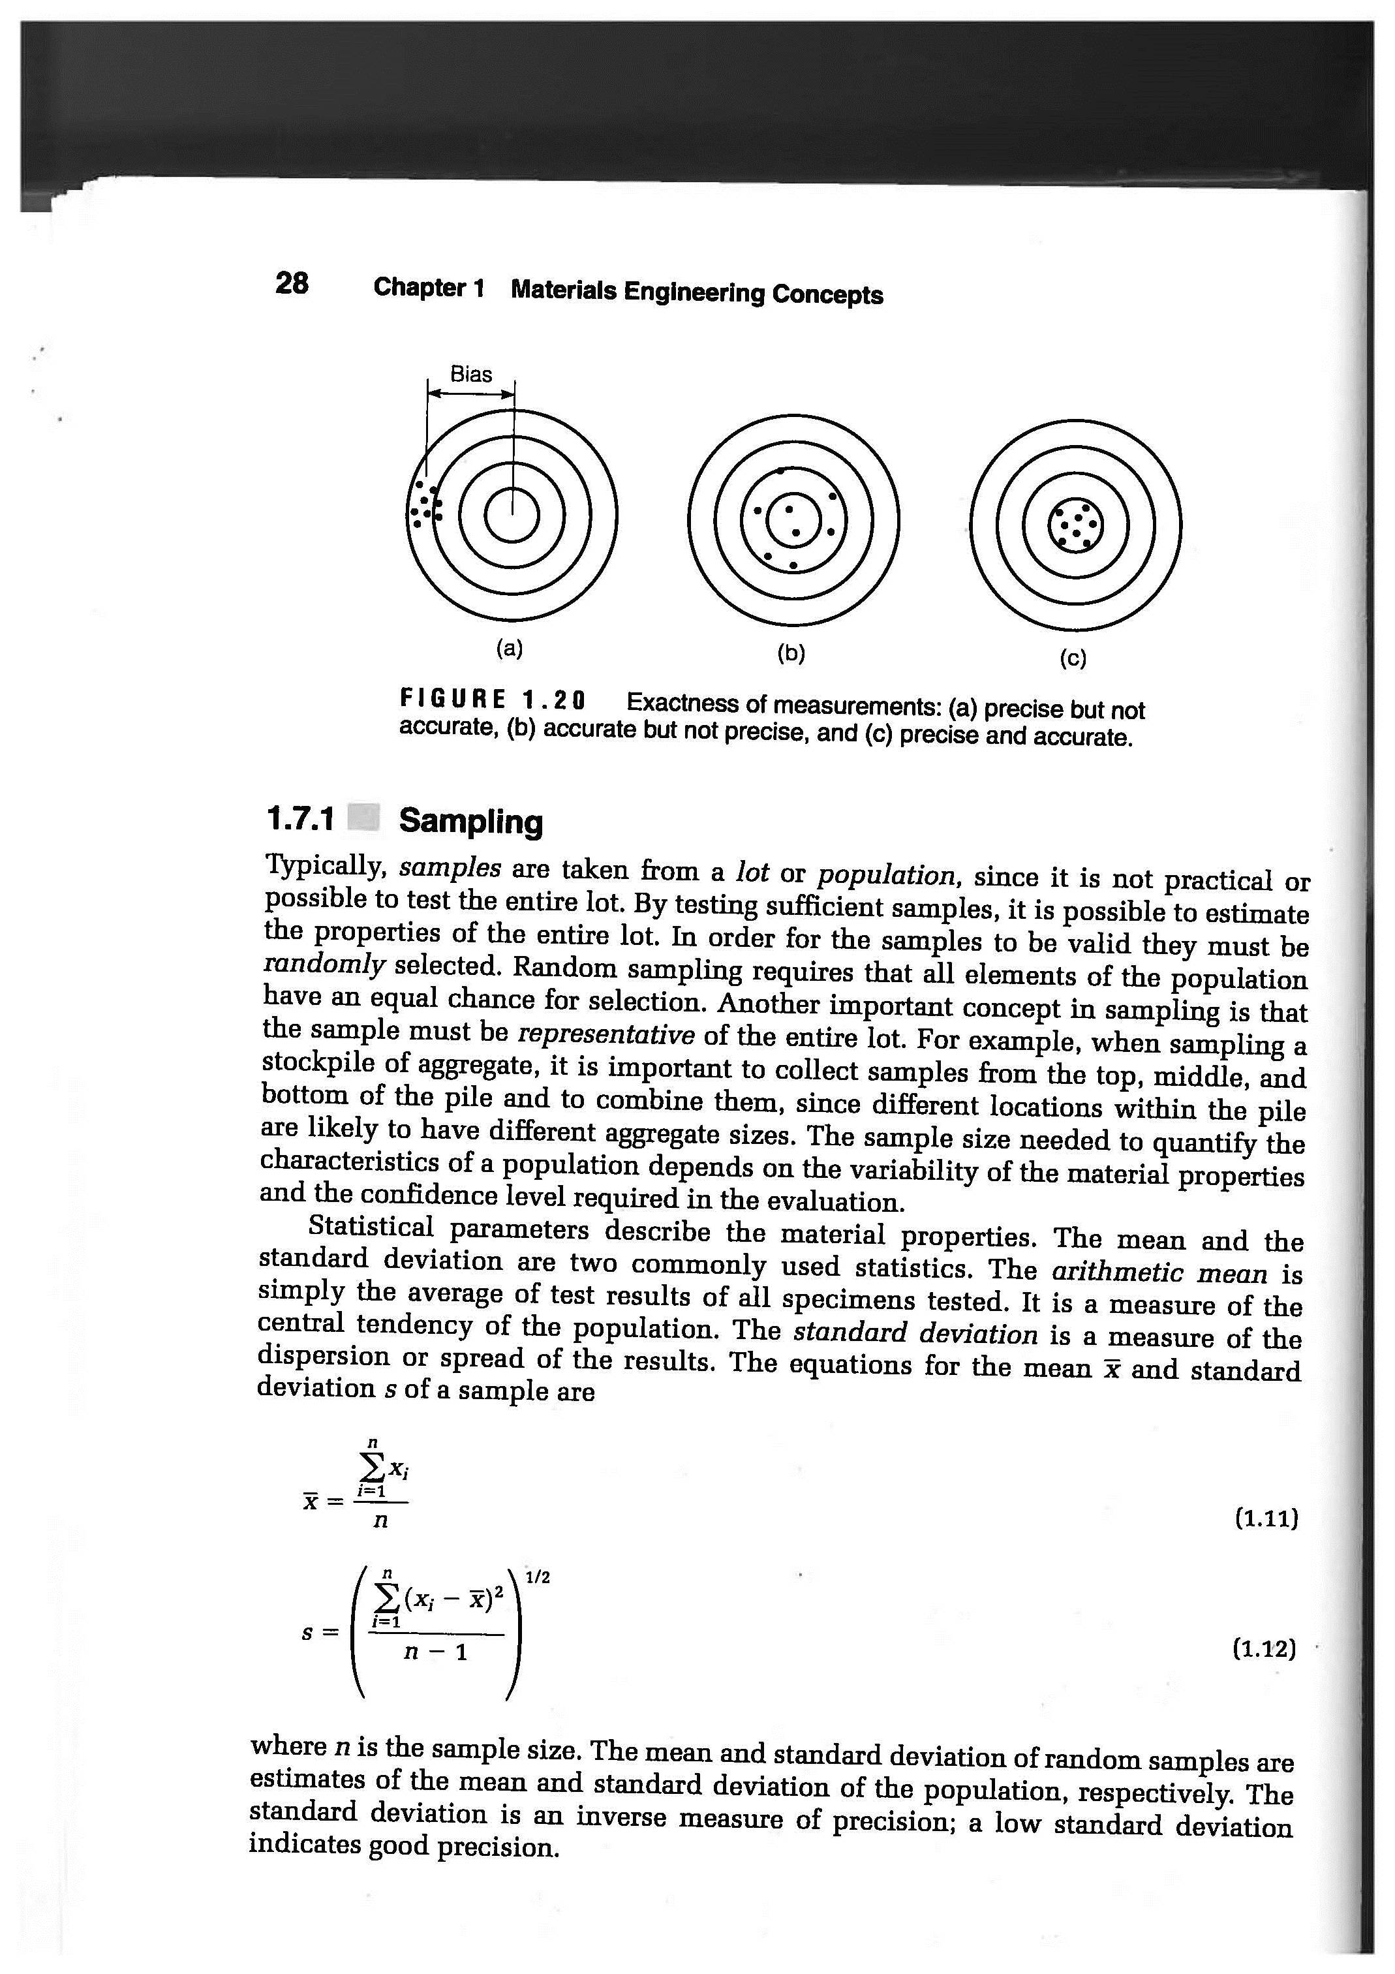
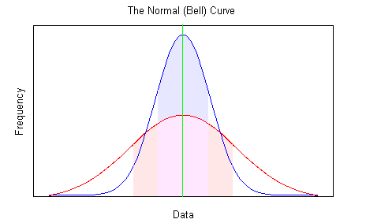
Material Property Data Analysis
Arithmetic average or Mean
Standard Deviation (s or s)
Mamlouk/Zaniewski, Materials for Civil and Construction Engineers, Fourth Edition. Copyright © 2017 Pearson Education, Inc.

Slide 8
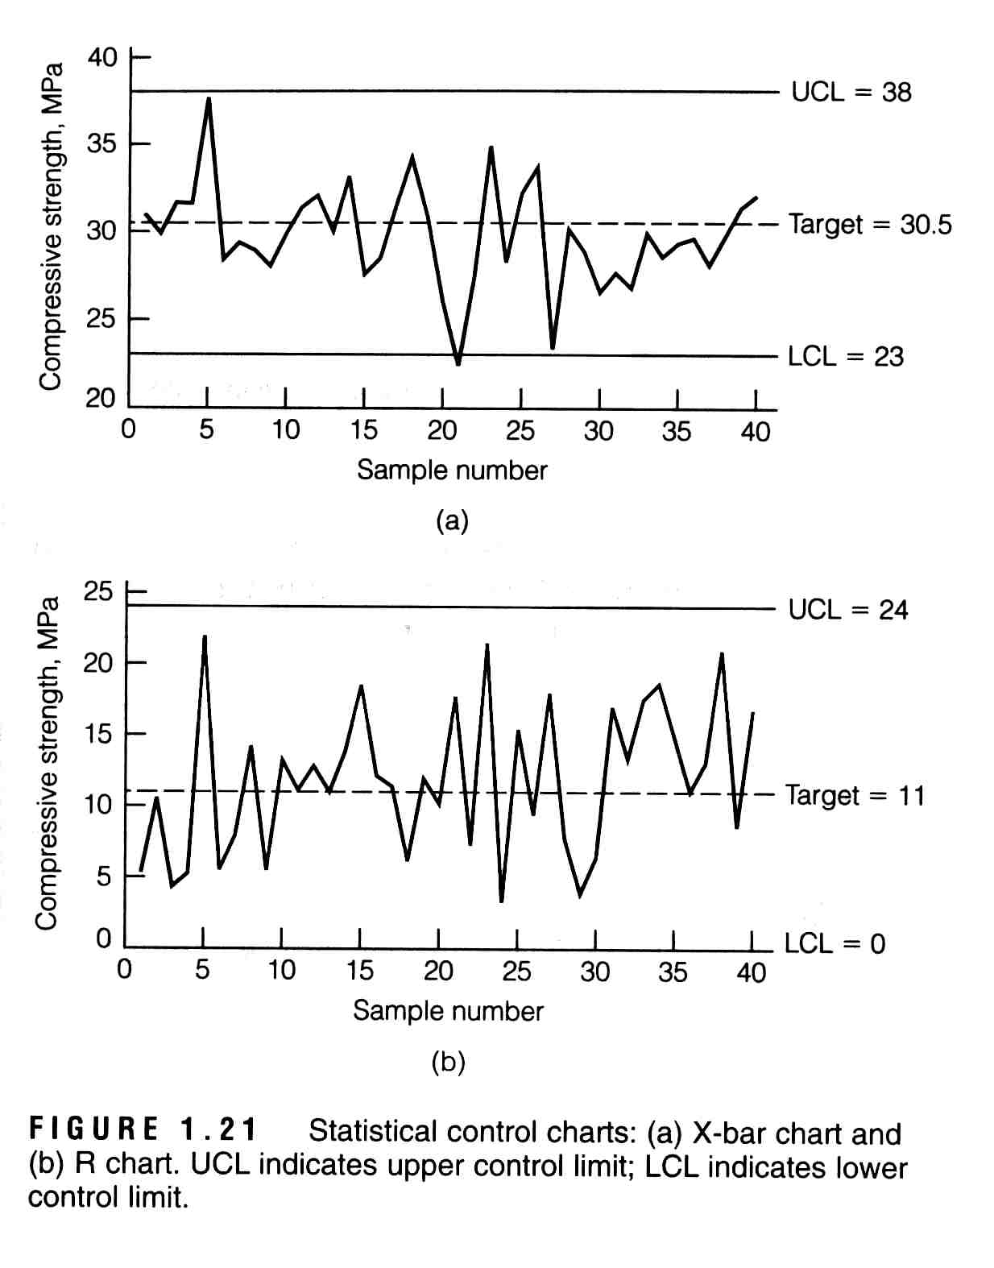
Control Charts
Decrease inspection frequency
Early detection of troubles
Provide a record of quality
Basis of acceptance
Mamlouk/Zaniewski, Materials for Civil and Construction Engineers, Fourth Edition. Copyright © 2017 Pearson Education, Inc.

Slide 9
Experimental Error
Caused by 3 factors:
Procedural errors
are often undiscovered
Machine errors (bias)
if known and constant can be easily corrected
Human errors
minimize by repetition, double-checking, etc.
Always do more than one test
Mamlouk/Zaniewski, Materials for Civil and Construction Engineers, Fourth Edition. Copyright © 2017 Pearson Education, Inc.

