Slide 1
ENGR 1330: Computational Thinking with Data Science
Lesson 6: NumPy In Python
Dinesh S. Devarajan Whitacre College of Engineering Texas Tech University

Slide 2
Topic Outline
NumPy library
Data representation: Arrays - vectors and
matrices
Data operations: Mathematical operations,
indexing, selection, and copying

Slide 3
Objectives
To be able to represent data in different forms via the NumPy library
To be able to access data within a NumPy array
To be able to perform basic mathematical functions on the NumPy arrays

Slide 4
Computational Thinking Concepts
NumPy arrays: Vectors and matrices
Data representation
Data interpretation, manipulation, and analysis of NumPy arrays
Decomposition
Algorithm design

Slide 5
Library Setup
Built-in with CoCalc
You do not have to do any extra steps to install the library in Python

Slide 6
NumPy in Python

Slide 7
NumPy
NumPy: Numerical Python
Foundational library for scientific computing
All data science libraries rely on NumPy as one of their building blocks

Slide 8
Features of NumPy
Features:
Provides a fast and efficient multi-dimensional array object called ‘ndarray’ (n-dimensional array) – NumPy arrays
Functions for performing computations with arrays and mathematical operations between arrays
Linear algebra operations and random number generation

Slide 9
Multi-dimensional Array
1D array
10
15
7
2
0
1
2
3
Index positions
2D array
0
4
20
13
9
Rows
5
9
12
0
Index positions
1
2
10
15
7
2
0
1
2
3
Columns
Index positions

Slide 10


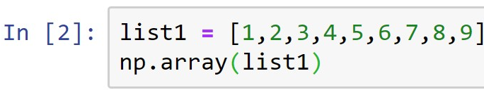
NumPy Arrays
NumPy arrays can be 1-dimensional (1D) or 2-dimensional (2D)
Creating a 1D array: Vector
Importing NumPy library
(Demo)
Function to create a NumPy array

Slide 11
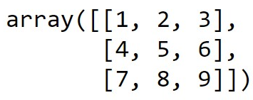
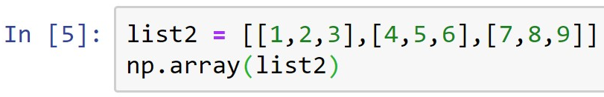
NumPy Arrays
Creating a 2D array: Matrix
Function to create a NumPy array
What will be the shape of the above 2D NumPy array?
(Demo)

Slide 12
NumPy Arrays
Other functions to create NumPy arrays easily
arange( ): Returns evenly spaced array elements
linspace( ): Returns evenly spaced array elements
zeros( ): Returns an array of zeros
ones( ): Returns an array of ones
eye( ): Returns an identity matrix
random.randint( ): Returns random integers
(Demo)

Slide 13
Arrays: Basic Operations
Functions to do basic operations on NumPy arrays
min( ): Returns minimum value in an array
max( ): Returns maximum value in an array
argmin( ): Returns minimum value position in an array
argmax( ): Returns maximum value position in an array
reshape( ): Reshaping an array to a specific shape
sort( ): Sorting an array in ascending order
sum( ): Summing the array elements
(Demo)

Slide 14
Arrays: Mathematical Operations
Functions to do mathematical operations on NumPy arrays
sqrt( ): Returns square root of array elements
exp( ): Returns exponential of array elements
sin( ): Returns trigonometric sine of array elements
cos( ): Returns trigonometric cosine of array elements
log( ): Returns natural logarithm of array elements
log10( ): Returns base 10 logarithm of array elements
(Demo)

Slide 15
Arrays: Indexing, Selection, & Copying
Indexing: An important step in manipulating and analyzing arrays
Conditional selection: Selecting array elements based on specific conditions typed using conditional operators
Copying: Always use the copy( ) function to copy arrays and to preserve the original array
(Demo)

Slide 16
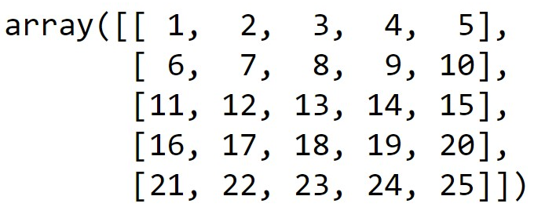
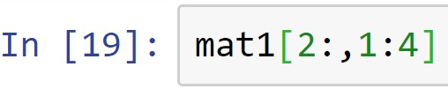
Discussion Exercise
mat1 =
How would you index and slice the elements within the red-dashed box above from the matrix named ‘mat1’?
(Demo)

Slide 17
Summary
Concepts of representing data in the form of NumPy arrays are covered
Concepts of interpreting, manipulating, and analyzing data within NumPy arrays are covered

