Slide 1
EGR 1330 Computational Thinking with Data Science
Data Display

Slide 2
Outline
Charts: line, bar, histogram, scatter plot.
Pandas library
Matplotlib library

Slide 3
Objective
Be able to visualize data with different types of charts using Pandas or Matplotlib.
Do visual inference from charts.

Slide 4
Libraries setup
Built-in with Cocalc
Built-in with Anaconda

Slide 5
Categorical Distributions
Data come in many forms that are not numerical. Data can be pieces of music, or places on a map. They can also be categories into which you can place individuals:
The individuals are cartons of ice-cream, and the variable is the flavor in the carton
The individuals are professional basketball players, and the variable is the player's team.

Slide 6
Bar charts
Used to represent graphical representation for categorical distributions.
The bars are equally spaced and equally wide. The length of each bar is proportional to the frequency of the corresponding category.

Slide 7
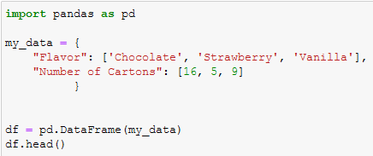
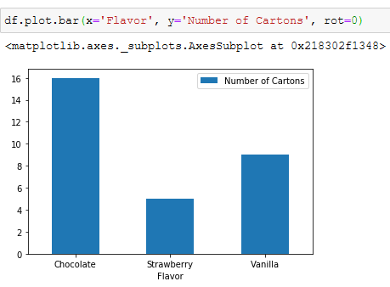
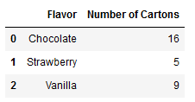
Live example - Pandas
Create a categorical dataset and create a bar chart using Pandas and Matplotlib.
Rotate labels

Slide 8
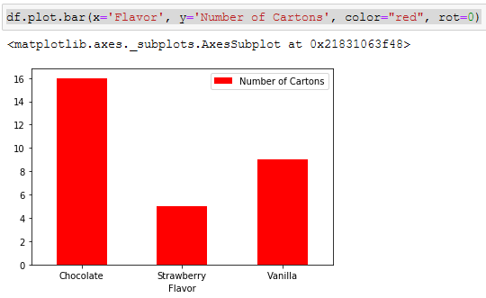
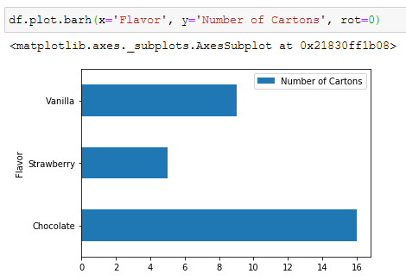
Live example - Pandas

Slide 9
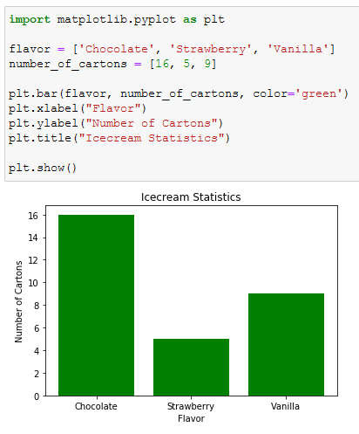
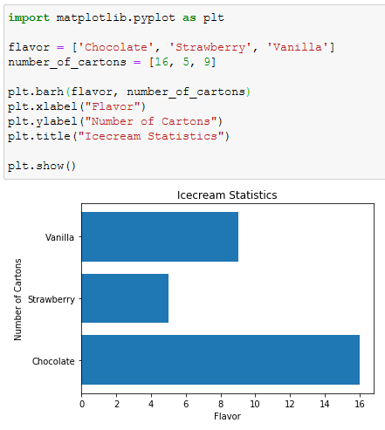
Live example - Matplotlib

Slide 10
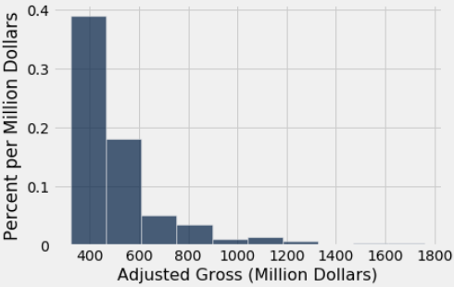
Histogram
A histogram is an approximate representation of the distribution of numerical data.
Each bar is a contiguous interval called bin.
Summarize the distribution

Slide 11
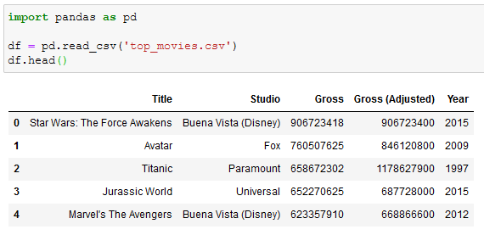
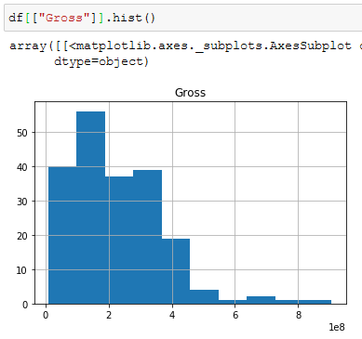
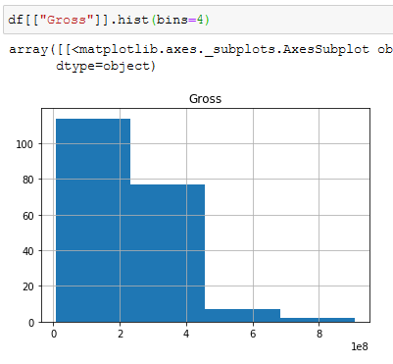
Live example - Pandas
Use top-movies dataset and create a histogram chart using Pandas and Matplotlib.

Slide 12
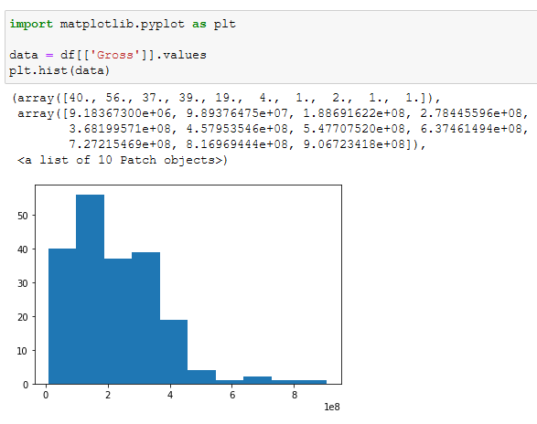
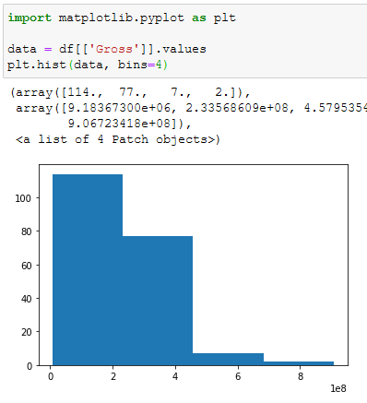
Live example - Matplotlib

Slide 13
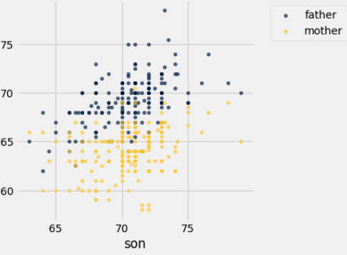
Scatter Plot
A scatter plot is a type of plot using Cartesian coordinates to display values for typically two variables for a set of data.

Slide 14
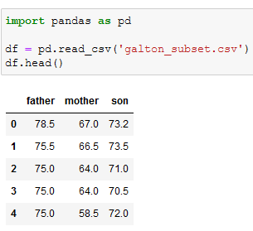
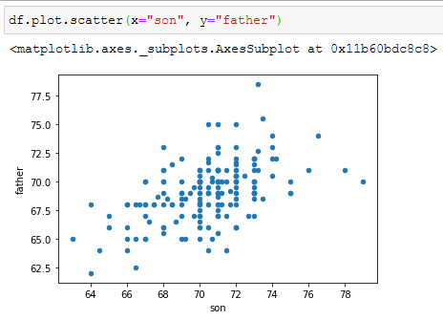
Live example - pandas
Use galton-subset dataset and create a scatter plot using Pandas and Matplotlib.

Slide 15
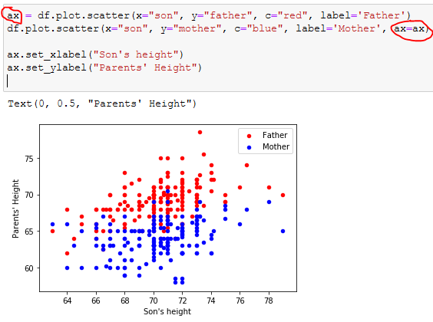
Live example - pandas

Slide 16
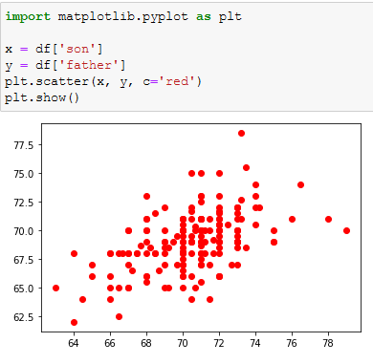
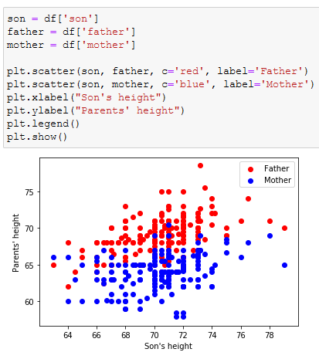
Live example - Matplotlib

Slide 17
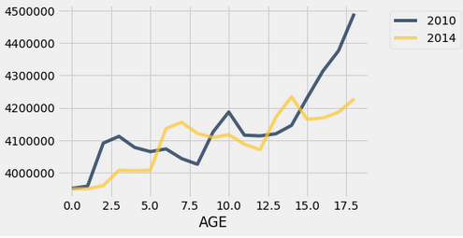
Line Chart
A line chart or line plot or line graph or curve chart is a type of chart which displays information as a series of data points connected by straight line segments.

Slide 18
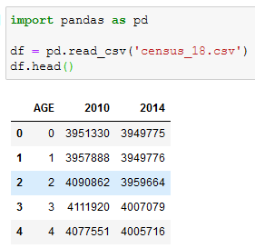
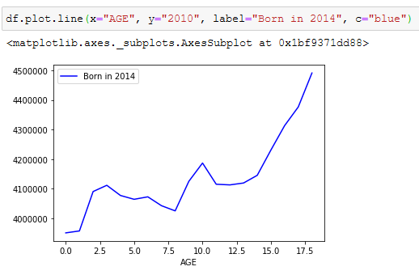
Live example - pandas
Use census dataset and create a line chart using Pandas and Matplotlib.

Slide 19
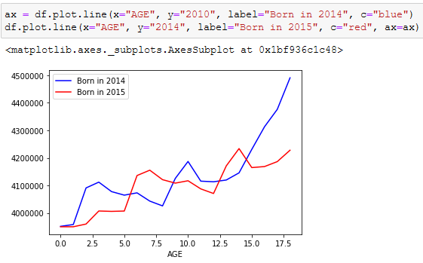
Live example - pandas

Slide 20
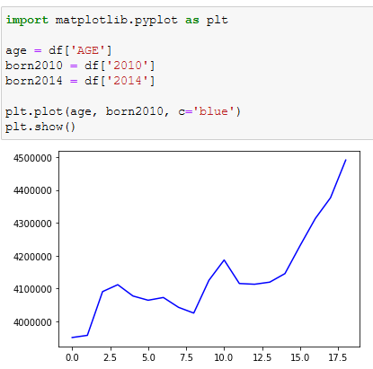
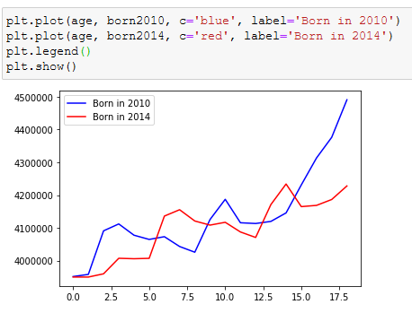
Live example - Matplotlib

