Slide 1
ENGR 1330 Computational Thinking with Data Science
NumPy

Slide 2
Topic Outline
NumPy library
Data representation: Arrays - vectors and
matrices
Data operations: Mathematical operations,
indexing, selection, and copying

Slide 3
Objectives
To be able to represent data in different forms via the NumPy library
To be able to access data within a NumPy array
To be able to perform basic mathematical functions on the NumPy arrays

Slide 4
Computational Thinking Concepts
NumPy arrays: Vectors and matrices
Data representation
Data interpretation, manipulation, and analysis of NumPy arrays
Decomposition
Algorithm

Slide 5
NumPy in Python

Slide 6
NumPy
NumPy: Numerical Python
Foundational library for scientific computing
All data science libraries rely on NumPy as one of their building blocks

Slide 7
Features of NumPy
Features:
Provides a fast and efficient multi-dimensional array object called ‘ndarray’ (n-dimensional array) – NumPy arrays
Functions for performing computations with arrays and mathematical operations between arrays
Linear algebra operations and random number generation

Slide 8
Multi-dimensional Array
1D
10
15
7
2
2D
4
20
13
9
5
9
12
0
10
15
7
2
3D
…

Slide 9

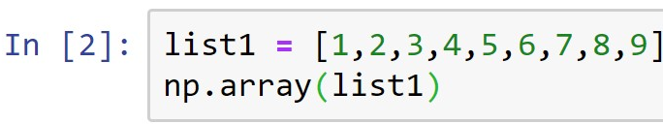
NumPy Arrays
NumPy arrays can be 1-dimensional (1D) or 2-dimensional (2D)
Creating a 1D array: Vector
Importing NumPy library
(Demo)
Function to create a NumPy array

Slide 10
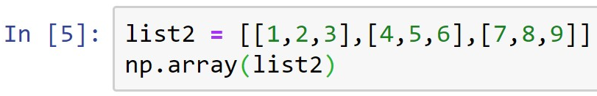
NumPy Arrays
Creating a 2D array: Matrix
Function to create a NumPy array
What will be the shape of the above 2D NumPy array?
(Demo)

Slide 11
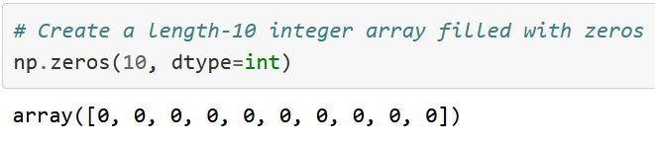
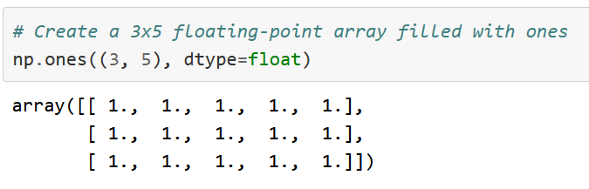
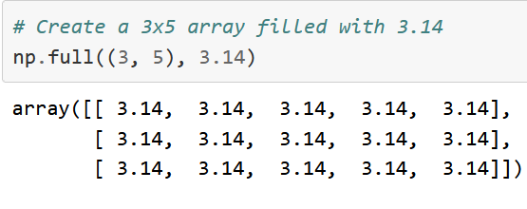
Numpy Arrays

Slide 12
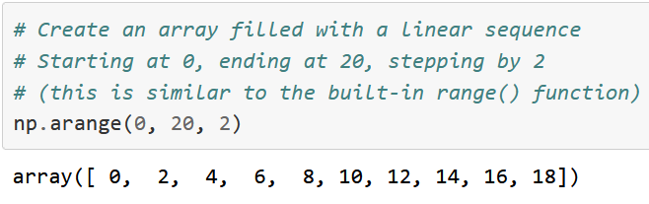
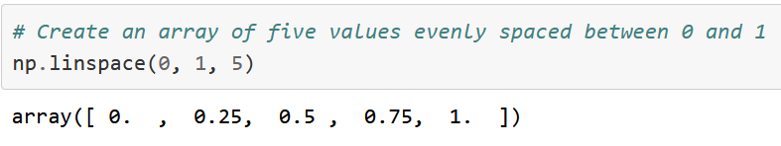
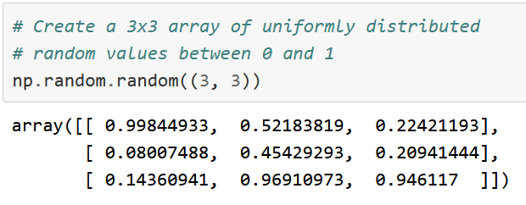
Numpy Arrays

Slide 13
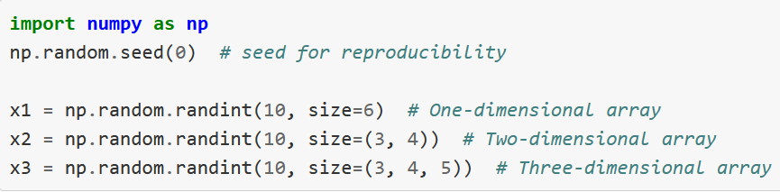
Numpy Arrays

Slide 14
NumPy Arrays
Other functions to create NumPy arrays easily
arange( ): Returns evenly spaced array elements
linspace( ): Returns evenly spaced array elements
zeros( ): Returns an array of zeros
ones( ): Returns an array of ones
random.randint(.): Returns random integers
(Demo)

Slide 15
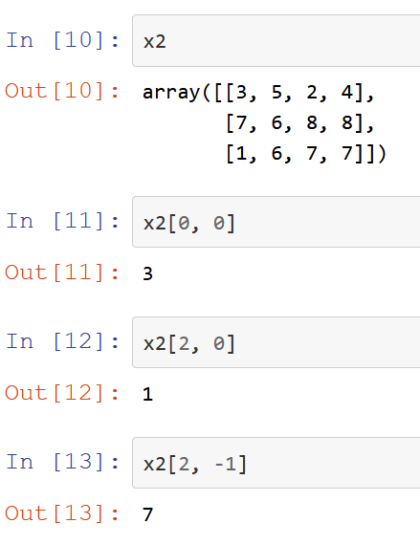
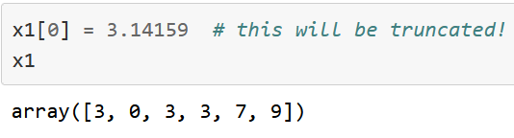
Arrays: Indexing
Indexing: Accessing elements of array
Numpy array is:
- Mutable
- Unique data type
- Assigning to other datatype will be truncated silently.

Slide 16
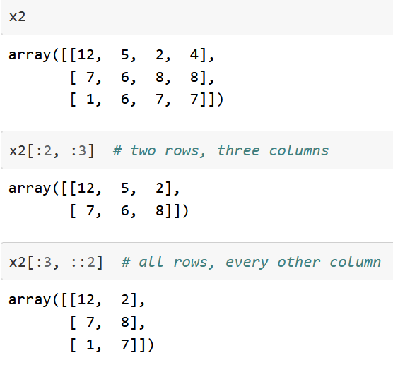
Arrays: Slicing & Striding
1D: x[start:stop:step]
2D: x[start1:stop1:step1, start2:stop2:step2]

Slide 17
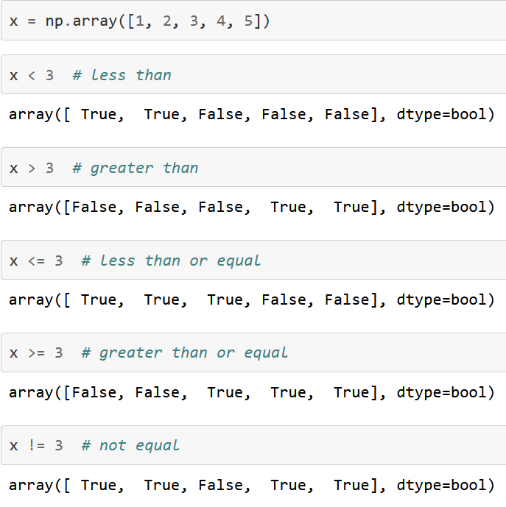
Array: Comparison
Operator | Meaning
== | Equal
< | Less than
> | Greater than
!= | Different
<= | Less than or equal
>= | Greater than or equal

Slide 18
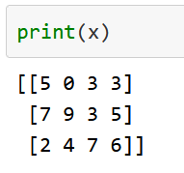
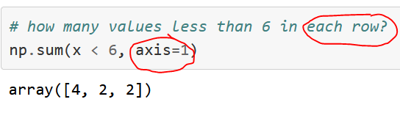
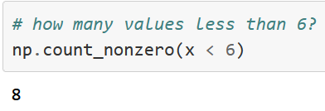
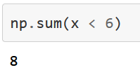
Array: Counting
Note: axis=0 is column
Count elements below six

Slide 19
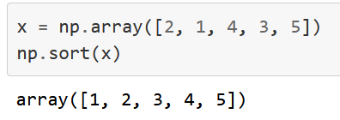
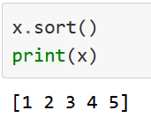
Array: sorting
1D array

Slide 20
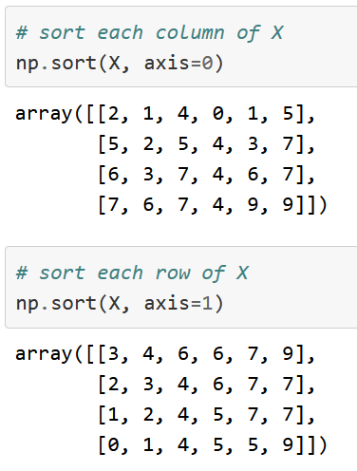
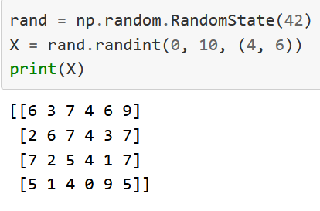
Array: sorting
2D array

Slide 21
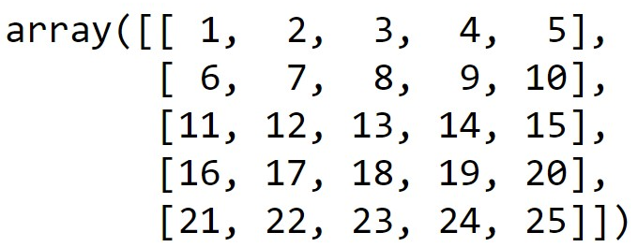
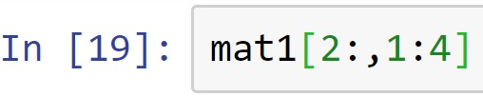
Discussion Exercise
mat1 =
How would you index and slice the elements within the red-dashed box above from the matrix named ‘mat1’?
(Demo)

Slide 22

Arrays: Functions
Functions to do basic operations on NumPy arrays
np.append(arr, values, axis=None): Returns appended array
(Demo)

Slide 23
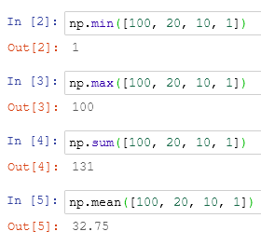
Arrays: Basic Operations
np.min( ): Returns minimum value in an array
np.max( ): Returns maximum value in an array
mean(.): Returns mean value of an array
sum( ): Summing the array elements
(Demo)

Slide 24
Arrays: Mathematical Operations
Functions to do mathematical operations on NumPy arrays
sqrt( .): Returns square root of array elements
exp(.): Returns exponential of array elements
sin( .): Returns trigonometric sine of array elements
cos( .): Returns trigonometric cosine of array elements
log(. ): Returns natural logarithm of array elements
(Demo)

Slide 25
Summary
Concepts of representing data in the form of NumPy arrays are covered
Concepts of interpreting, manipulating, and analyzing data within NumPy arrays are covered

