Slide 1
ENGR 1330 Computational Thinking with Data Science
Pandas

Slide 2
Topic Outline
Pandas library
Data representation: Dataframes
Data operations: Indexing, summarizing statistics, aggregation, grouping, filling and dropping values, and read/write files

Slide 3
Objectives
To be able to represent data in the form of dataframes via the Pandas library
To be able to access and manipulate data within a dataframe
To be able to obtain basic statistical measures of data within a dataframe

Slide 4
Computational Thinking Concepts
Pandas dataframes
Data representation
Data interpretation, manipulation, and analysis of Pandas dataframes
Decomposition
Algorithm

Slide 5
Pandas
Pandas: Derived from the term ‘Panel Data’
Dataframe: 2-dimensional mutable and heterogenous tabular data structure
Provides rich data structures and functions designed to make working with data fast, easy, and expressive

Slide 6
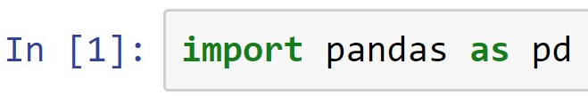
Pandas Dataframes
Creating a dataframe:
Importing Pandas library
columns
index
columns
rows
Function to create a Pandas dataframe
What will be the shape of the above 2D Pandas dataframe?
(Demo)

Slide 7
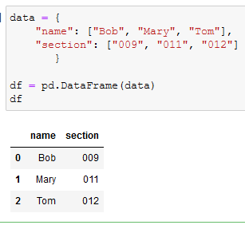
Pandas Dataframes
Creating a dataframe: from dictionary
Dictionary’s keys
Auto indexing

Slide 8
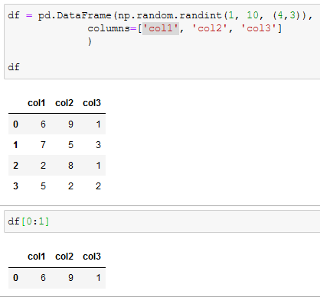
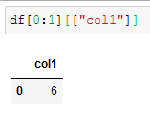
Dataframes: Indexing, slicing
Selecting rows and all columns: same as indexing in list.
df[start:end:step]
Selecting rows and some columns: include in a list of names of selecting columns.

Slide 9
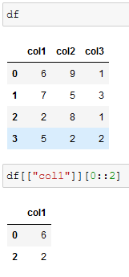
Dataframes: Indexing, slicing
Select columns first then rows later.

Slide 10
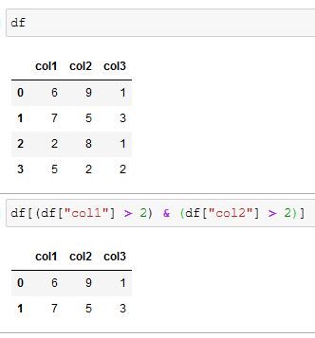
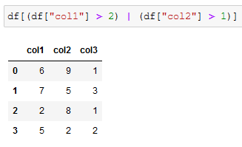
Indexing with conditions
Operator | Meaning
& | Both must true
| | Either condition true
or
and

Slide 11
Dataframes: Basic Operations
Functions to do basic operations on Pandas dataframes
df.head( ): Returns first 5 rows of a dataframe
df.info( ): Returns information such as number of rows and columns about a dataframe
df.describe( ): Returns basic statistical measures of a
dataframe
(Demo)

Slide 12
Dataframes: Basic Aggregation
Functions to do basic operations on Pandas dataframes
df.mean(. ): mean of rows or columns
df.min( .): min element of rows or columns
df.max(. ): max element of rows or columns
df.sum(.): Returns the sum of rows or columns
(Demo)

Slide 13
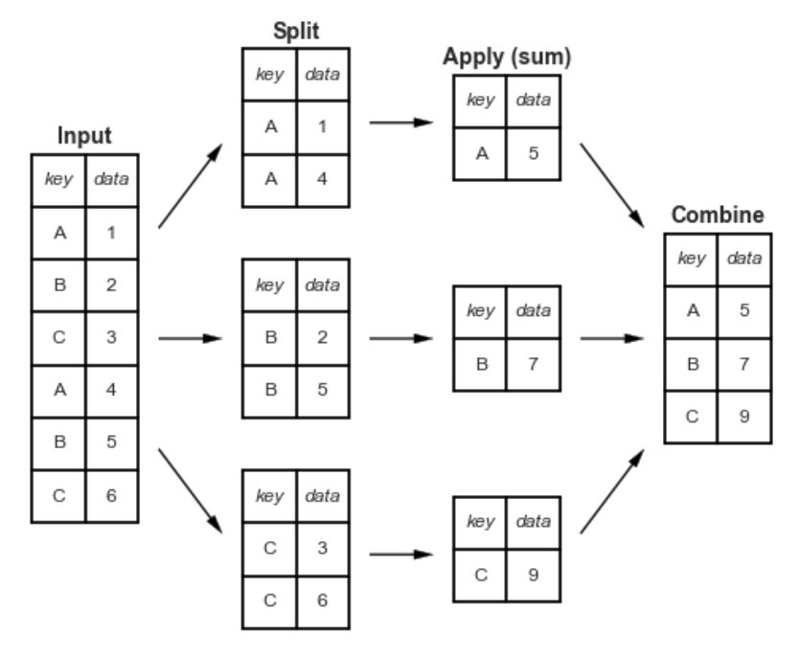
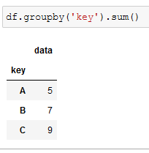
Aggregation with Grouping
Grouping all columns

Slide 14
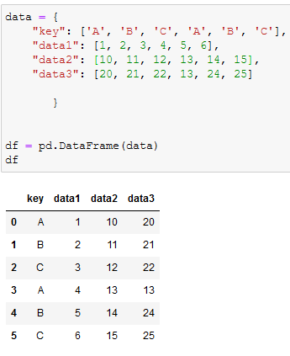
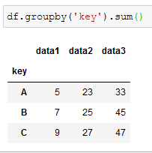
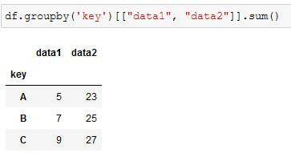
Aggregation with Grouping
Grouping all columns
Grouping for selected columns

Slide 15
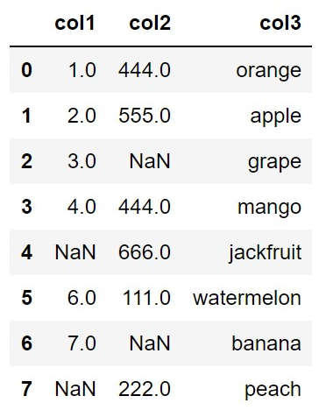
Dataframes: Dropping values
Often, the data will consist of missing values ‘NaN’
df =
Missing values lead to problems in the data analysis process

Slide 16

Dataframes: Dropping values
You can use the dropna( ) function to drop all the rows consisting of the missing values
New dataframe after filling values
Function to drop values
(Demo)

Slide 17

Dataframes: Filling values
You can also use the fillna( ) function to fill values (e.g. a value of ‘0’ in the place of ‘NaN’) in the place of missing values
New dataframe after filling values
Function to drop values
Fill value
(Demo)

Slide 18

Dataframes: Filling values
You can also use the fillna( ) function to fill values (e.g. mean value of each column in the place of ‘NaN’) in the place of missing values
New dataframe after filling values
Function to drop values
Fill value
(Demo)

Slide 19
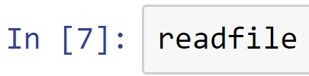
Dataframes: Reading a File
Objective is to read the data in a ‘.csv’ (comma separated values) file and print it as a dataframe
File object
Function to read .csv file
File name
Printing the contents of the .csv file to the output screen
(Demo)

Slide 20
Dataframes: Writing a File
Objective is to write the data in a new ‘.csv’ (comma separated values) file
Function to read .csv file
File name
Excludes row labels
Note: File name that you give will first be created in the same folder where the Jupyter notebook is present
(Demo)

Slide 21
Summary
Concepts of representing data in the form of Pandas dataframes are covered
Concepts of interpreting, manipulating, and analyzing data within Pandas dataframes are covered

