Slide 1
EGR 1330 Computational Thinking with Data Science
Data Display

Slide 2
Outline
Charts: line, bar, histogram, scatter plot.
Pandas library
Matplotlib library

Slide 3
Objective
Be able to visualize data with different types of charts using Pandas or Matplotlib.

Slide 4
Categorical Distributions
Data come in many forms that are not numerical. Data can be pieces of music, or places on a map. They can also be categories into which you can place individuals:
The individuals are cartons of ice-cream, and the variable is the flavor in the carto
The individuals are professional basketball players, and the variable is the player's team.

Slide 5
Bar charts
Used to represent graphical representation for categorical distributions.
The bars are equally spaced and equally wide. The length of each bar is proportional to the frequency of the corresponding category.

Slide 6
Live example
Find a simple categorical dataset and create a bar chart using Pandas and Matplotlib.

Slide 7
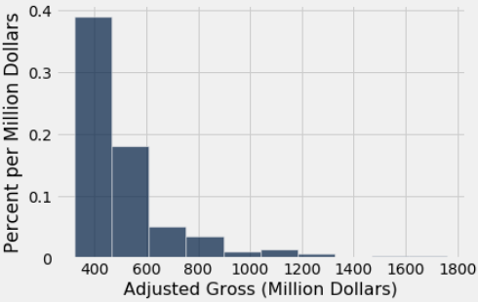
Histogram
A histogram is an approximate representation of the distribution of numerical data.
Each bar is a contiguous intervals called bin.

Slide 8
Live example
Use top-movies dataset and create a histogram chart using Pandas and Matplotlib.

Slide 9
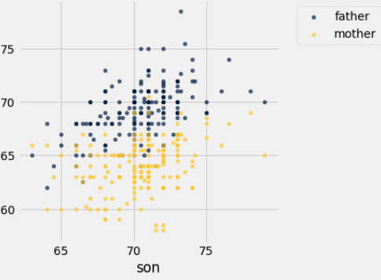
Scatter Plot
A scatter plot is a type of plot using Cartesian coordinates to display values for typically two variables for a set of data.

Slide 10
Live example
Use galton-subset dataset and create a scatter plot using Pandas and Matplotlib.

Slide 11
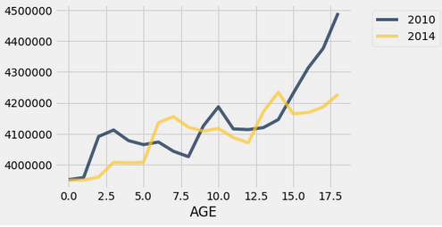
Line Chart
A line chart or line plot or line graph or curve chart is a type of chart which displays information as a series of data points connected by straight line segments.

Slide 12
Live example
Use census dataset and create a line chart using Pandas and Matplotlib.

