Slide 1
ENGR 1330 Computational Thinking with Data Science
Finding Probabilities

Slide 2
Outline
Concepts of sample, population, and probabilities
Computing probability: single events, both events, at least event.

Slide 3
Objective
Be able to find probabilities of events.

Slide 4
Sample and Population
A population includes all of the elements from a set of data.
Example: All people living in the US
A sample consists one or more observations drawn from the population.
Draw 1,000 people in all people living in the US

Slide 5
Probabilities
By convention, probabilities are numbers between 0 and 1, or, equivalently, 0% and 100%; denoted by:
Impossible events have probability 0.
Events that are certain have probability 1.
P(event)
P$\left(an event does not happen\right)=1 −P(the event happens)$

Slide 6
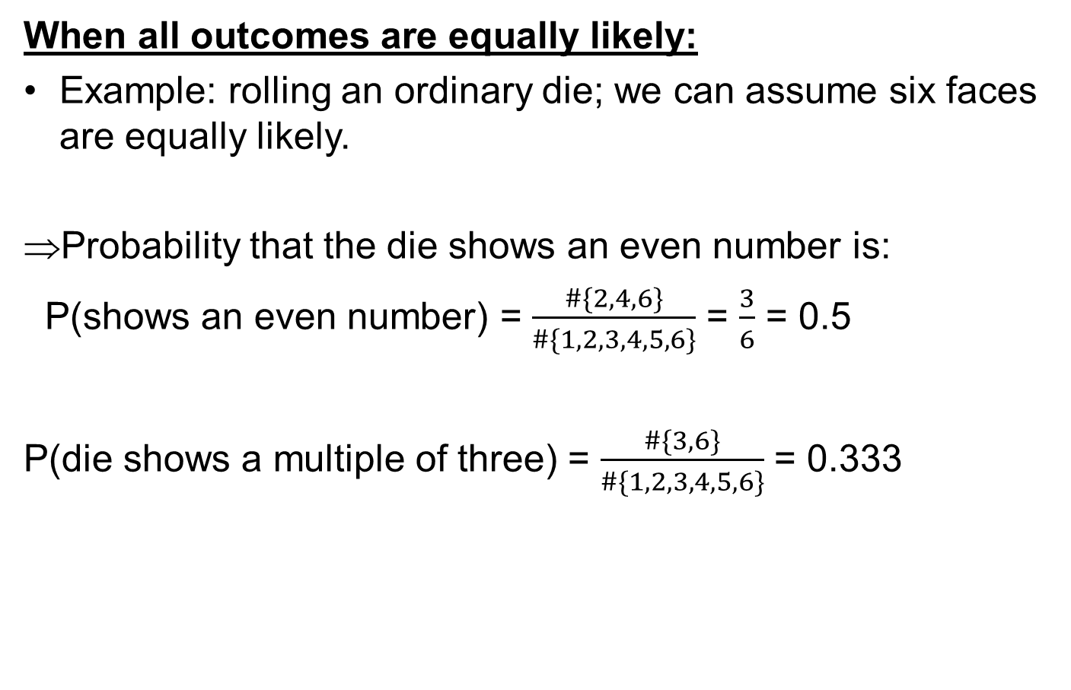
Compute probability
When all outcomes are equally likely:
Example: rolling an ordinary die; we can assume six faces are equally likely.
Probability that the die shows an even number is:
P(shows an even number) = $\frac{\#\{2, 4, 6\}}{\#\{1, 2, 3, 4, 5, 6\}}$ = $\frac{3}{6}$ = 0.5
P(die shows a multiple of three) = $\frac{\#\{3, 6\}}{\#\{1, 2, 3, 4, 5, 6\}}$ = 0.333
P(an event happens) = $\frac{\#\{outcomes that make the event happen\}}{\#\{all outcomes\}}$

Slide 7
Compute probability
When two events must both happen:
Example: A box that contains three tickets: one red, one blue, and one green.
Draw two tickets at random without replacement; that is, you shuffle the three tickets, draw one, shuffle the remaining two, and draw another from those two.
What is the chance you get the green ticket first, followed by the red one?

Slide 8


Compute probability
Possible pairs of colors: RB, RG, BR, BG, GR, GB
P(GR) = $\frac{\#\{GR\}}{\#\{RB, RG, BR, BG, GR, GB\}}$ = 1/6
Other solution: green ticket picked first => 1/3
Red is next (two tickets remaining to pickup red): => ½
P(green first, then red) = $\frac{1}{3}$ * $\frac{1}{2}$ = $\frac{1}{6}$
Multiplication rule:
P(two events both happen) = P(one event happens) *
P(the other event happens, given that the first one happened)

Slide 9
Compute probability
When an Event an Happen in Two Different Ways :
we want the chance that one of the two tickets is green and the other red.
=> This event doesn't specify the order in which the colors must appear. So they can appear in either order.
P(one green and one red) = P(GR) + P(RG) = 1/6 + 1/6 = 1/3
Additive rule:
P(an event happens) = P(first way it can happen) +
P(second way it can happen)

Slide 10
Computing probability
At least one success:
We used to question about the likelihood that a particular individual in a population is selected to be in the sample.
The individual is called “success”. The problem is now finding the chance the sample contains a success.
Example: tossing a coin twice: HH, HT, TH, TT
The chance of getting at least one head in two tosses is: 3/4
Other solution:
P(at least one head in two tosses) = 1 – P(both tails) = 1 – ¼ = 3/4
P(both tails) = ½ * ½ = 1/4
Thanks to multiplication rule.
P(at least one head in 17 tosses) = ?

Slide 11
Computing probability
P(at least one head in 17 tosses) = 1 – (1/2)¹⁷
P(a single roll is not 6) = ?
P(a single roll is not 6) = P(1) + P(2) + P(3) + P(4) + P(5) = 5/6
P(at least one 6 in two rolls) = 1 – P(both rolls are not six) = 1 – (5/6)²
P(at least one 6 in 17 rolls) = 1 – P(17 rolls are not six) = 1 – (5/6)¹⁷

Slide 12
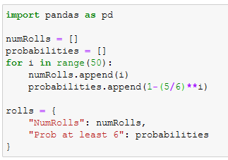
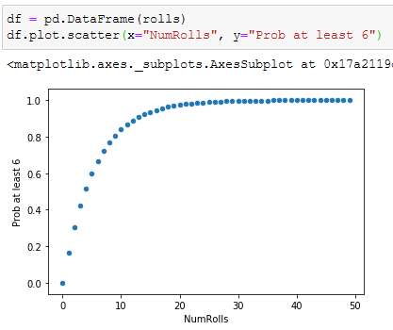
Compute probability

