Slide 1
ENGR 1330 Computational Thinking with Data Science
Hypothesis Testing (cont.)

Slide 2
Decision and Uncertainty
Test statistic: is a statistic that we use to make decision.
Ex. |p-0.75|
P-value: p-value of a test is the chance, based on the model in the null hypothesis, that the test statistic will be equal to the observed value or even further in the direction that supports the alternative.
Significant level (α): How you are willing to committing errors. Usually it equals to 0.05
p-value <= α: Reject null hypothesis
p-value > α: Fail to reject null hypothesis

Slide 3
Framework for Hypothesis Testing
Step 1: Define the hypotheses (Null hypothesis and alternative hypothesis)
Step 2: Define test statistic
Step 3: Draw the distribution of the test statistic under assumption of null hypothesis.
Step 4: State the conclusion with p-value

Slide 4
Error Probabilities
 | Null is true | Alternative is true
Test favors the Null | Correct result | Error (Type II)
Test favors the Alternative | Error (Type I) | Correct result
Type 1: False positive; example: “an innocent person is convicted” Type 2: False negative; example: “a guilty person is not convicted”
Covid-19 or Cancer prediction?

Slide 5
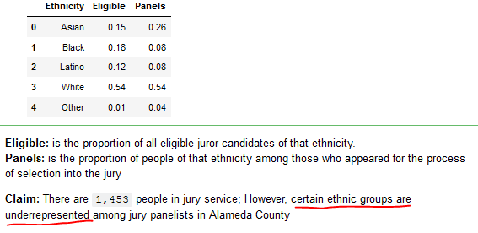
Hypothesis testing: Example 1
In 2010, the American Civil Liberties Union (ACLU) of Northern California presented a report on jury selection in Alameda County, California. The report concluded that certain ethnic groups are underrepresented among jury panelists in Alameda County, and suggested some reforms of the process by which eligible jurors are assigned to panels.

Slide 6
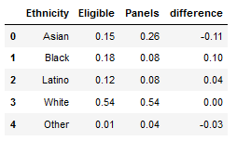
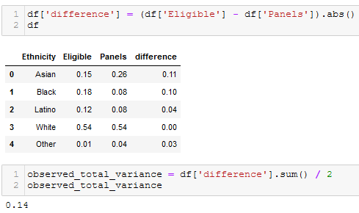
Hypothesis testing: Example 1
Compute the difference between “Eligible” and “Panels”:
difference = Eligible - Panels
Convert all negative entries to positive and add them all.
Total variance = sum_of_all_absolute_differences / 2
Sum of all differences is zero: because sum of all eligibles is 1
And sum of all panels is 1

Slide 7
Hypothesis testing: Example 1
Generate proportions of all “Eligible” groups randomly. Then we compute its total variance with “Panels” and verify if the observed total variance lies in the distribution of the random ones.
Null Hypothesis: They are the same
Alternative Hypothesis: Certain group is underrepresented.
Formal format utilizing the test statistic total variance:
Null Hypothesis:
random_total_variance >= observed_total_variance
Alternative Hypothesis:
random_total_variance < observed_total_variance

