Slide 1
ENGR 1330 Computational Thinking with Data Science
Confidence Intervals
Bootstrap

Slide 2
Outline
Concept of percentiles
Bootstrap method

Slide 3
Objective
Understand the concept of percentiles
Be able to perform bootstrap method in estimating statistic.

Slide 4
Percentiles
Numerical data can be sorted. Thus the values of a numerical data set have a rank order. A percentile is the value at a particular rank.
Rank k^{th} percentile:
Definition 1: The smallest value that is greater than k percent of the values.
Definition 2: The smallest value that is greater than or equal to k percent of values.
Definition 3: An interpolated value between the two closest ranks.

Slide 5
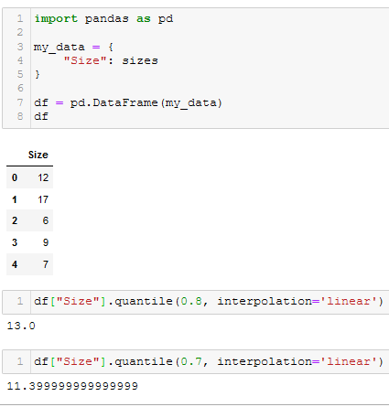
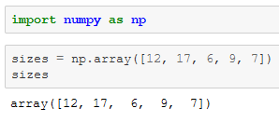
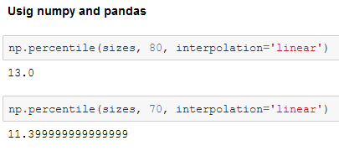
Quantiles
First quantile: 25th percentile
Second quantile: 50th percentile
Third quantile: 75th percentile

Slide 6
Bootstrap
Recall that we can use sample to estimate unknown statistic of a population.
How much could those estimates vary? => draw another sample from the population, and compute a new estimate based on the new sample.
Unfortunately, we don’t have the resources to go back to the population and draw another sample.
Solution: The bootstrap generates new random samples by a method called resampling: the new samples are drawn at random from the original sample.
We can estimate the variation of the unknown statistic after resampling

Slide 7
Bootstrap Method
Step 1: Draw a large random sample from the population.
Step 2: Bootstrap your random sample and get an estimate from the new random sample.
Step 3: Repeat the above step thousands of times, and get thousands of estimates.
Step 4: Pick off the "middle 95%" interval of all the estimates.
Middle 95% is called confidence interval

Slide 8

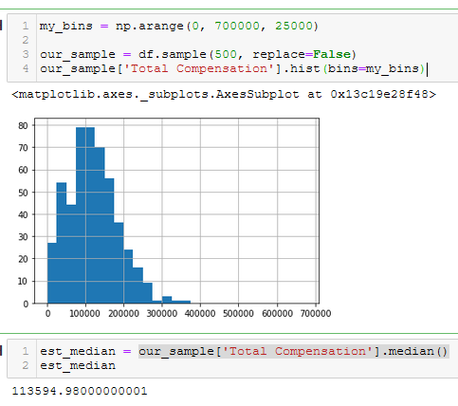

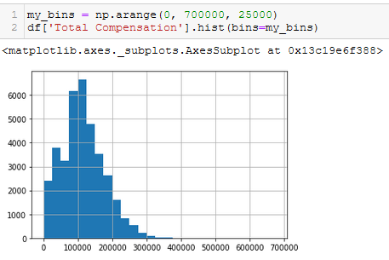

Example: Employee Compensation
Population Data
One sample

Slide 9
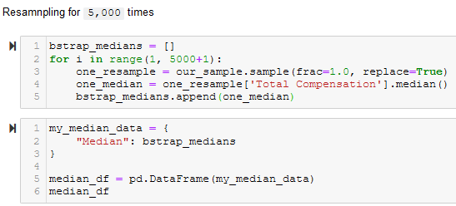
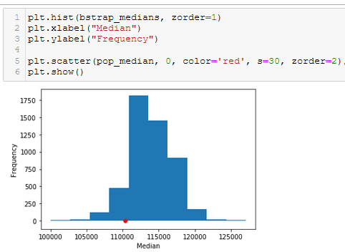
Example: Employee Compensation
Bootstrap

Slide 10
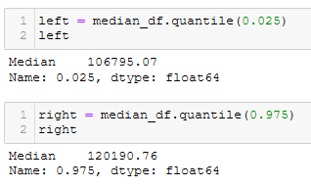
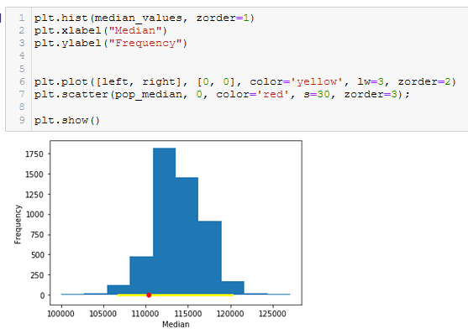
Example: Employee Compensation
95% of the medians fall into the range [left, right].
The red dot is also in this range

Slide 11
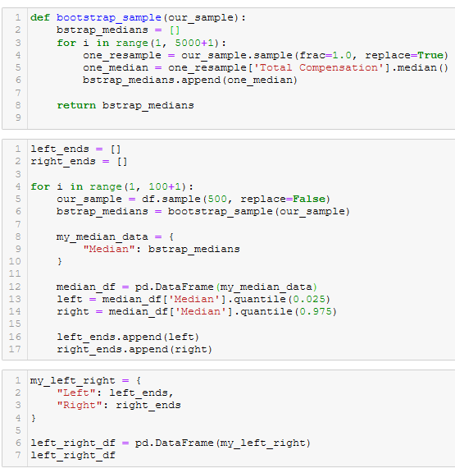
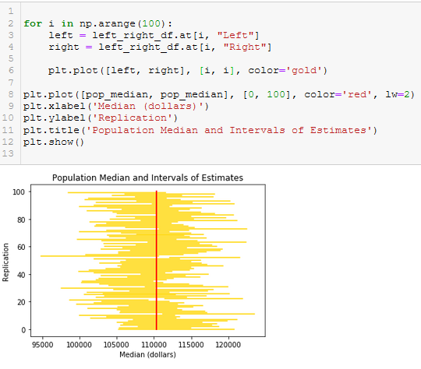
Example: Employee Compensation
100 simulations and 92% of them covers the red dot
Most of the simulations contain the red dot

