Slide 1
ENGR 1330: Computational Thinking with Data Science
Lesson 9: Pandas In Python
Dinesh S. Devarajan Whitacre College of Engineering Texas Tech University

Slide 2
Topic Outline
Pandas library
Data representation: Dataframes
Data operations: Indexing, summarizing statistics
filling and dropping values, and
read/write files

Slide 3
Objectives
To be able to represent data in the form of dataframes via the Pandas library
To be able to access and manipulate data within a dataframe
To be able to obtain basic statistical measures of data within a dataframe

Slide 4
Computational Thinking Concepts
Pandas dataframes
Data representation
Data interpretation, manipulation, and analysis of Pandas dataframes
Decomposition

Slide 5
Pandas in Python

Slide 6
Pandas
Pandas: Derived from the term ‘Panel Data’
Primary data structure is dataframe
Dataframe: 2-dimensional mutable and heterogenous tabular data structure
Popular among statisticians and data scientists

Slide 7
Features of Pandas
Features:
Provides rich data structures and functions designed to make working with data fast, easy, and expressive
Useful in data manipulation, cleaning, and analysis
Excels in performance and productivity

Slide 8
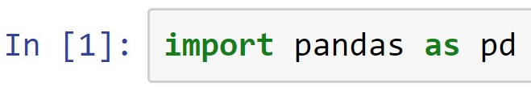
Pandas Dataframes
Creating a dataframe:
Importing Pandas library
Function to create a Pandas dataframe
What will be the shape of the above 2D Pandas dataframe?
(Demo)

Slide 9
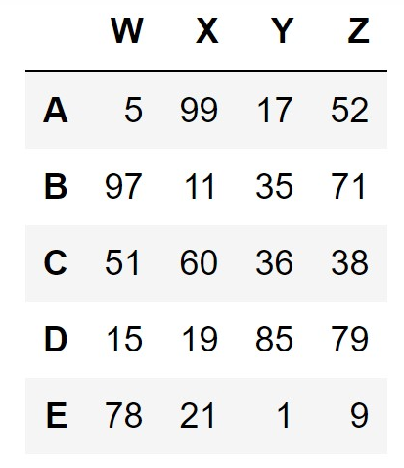
Dataframes: Indexing
df =
How would you index and slice all the elements of column ‘X’ in the above dataframe named ‘df’?
(Demo)

Slide 10
Dataframes: Indexing
df =
How would you index and slice all the elements of columns ‘X’ and ‘Z’ in the above dataframe named ‘df’?
(Demo)

Slide 11
Dataframes: Indexing
df =
How would you index and slice all the elements of row ‘C’ in the above dataframe named ‘df’?
When dealing with row indexing, use loc[ ] indexer
(Demo)

Slide 12
Dataframes: Indexing
df =
How would you index and slice all the elements of rows ‘C’ and ‘E’ in the above dataframe named ‘df’?
When dealing with row indexing, use loc[ ] indexer
(Demo)

Slide 13
Dataframes: Indexing
df =
How would you index and slice the elements within the red-dashed box from the dataframe named ‘df’?
When dealing with row indexing, use loc[ ] indexer
(Demo)

Slide 14
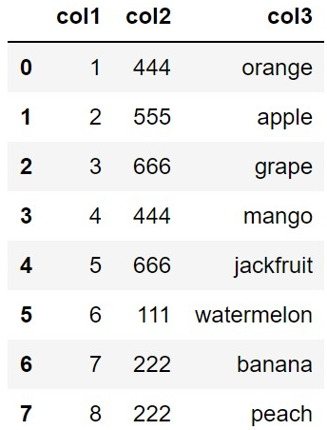
Dataframes: Conditional Selection
df =
What fruit corresponds to the number 555 in ‘col2’?
What fruit corresponds to the minimum number in ‘col2’?
(Demo)

Slide 15
Dataframes: Basic Operations
Functions to do basic operations on Pandas dataframes
head( ): Returns first 5 rows of a dataframe
info( ): Returns information such as number of rows
and columns about a dataframe
describe( ): Returns basic statistical measures of a
dataframe
(Demo)

Slide 16
Dataframes: Basic Operations
Functions to do basic operations on Pandas dataframes
sum( ): Returns the sum of a column or a row
unique( ): Returns the unique elements in a column
nunique( ): Returns the number of unique elements
in a column
value_counts( ): Returns the number of occurrences of
each unique value
(Demo)

Slide 17
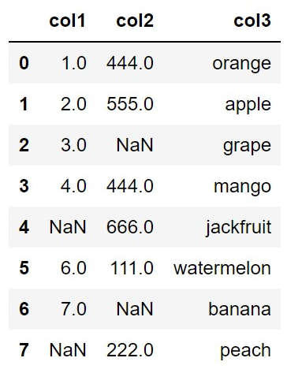
Dataframes: Dropping values
Often, the data will consist of missing values ‘NaN’
df =
Missing values lead to problems in the data analysis process

Slide 18

Dataframes: Dropping values
You can use the dropna( ) function to drop all the rows consisting of the missing values
New dataframe after filling values
Function to drop values
(Demo)

Slide 19

Dataframes: Filling values
You can also use the fillna( ) function to fill values (e.g. a value of ‘0’ in the place of ‘NaN’) in the place of missing values
New dataframe after filling values
Function to drop values
Fill value
(Demo)

Slide 20

Dataframes: Filling values
You can also use the fillna( ) function to fill values (e.g. mean value of each column in the place of ‘NaN’) in the place of missing values
New dataframe after filling values
Function to drop values
Fill value
(Demo)

Slide 21
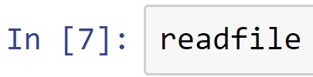
Dataframes: Reading a File
Objective is to read the data in a ‘.csv’ (comma separated values) file and print it as a dataframe
File object
Function to read .csv file
File name
Printing the contents of the .csv file to the output screen
(Demo)

Slide 22
Dataframes: Writing a File
Objective is to write the data in a new ‘.csv’ (comma separated values) file
Function to read .csv file
File name
Excludes row labels
Note: File name that you give will first be created in the same folder where the Jupyter notebook is present
(Demo)

Slide 23
Summary
Concepts of representing data in the form of Pandas dataframes are covered
Concepts of interpreting, manipulating, and analyzing data within Pandas dataframes are covered

