Slide 1
ENGR 1330 Computational Thinking with Data Science
Correlation and Regression

Slide 2
Topic Outline
Association
Correlation coefficient
Regression

Slide 3
Objectives
Able to compute correlation using Pandas
Able to plot regression line of two variables

Slide 4

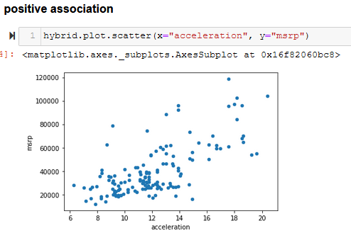
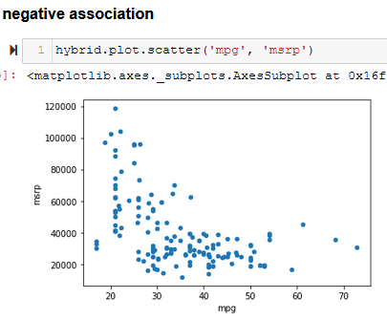
Association
Along with the negative association, the scatter diagram of price versus efficiency shows a non-linear relation between the two variables
Still derive useful information even NOT paying attention to the units in which the variables were measured.

Slide 5
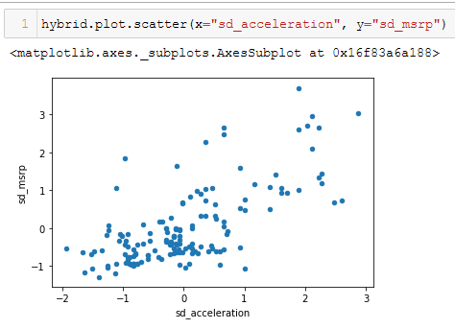
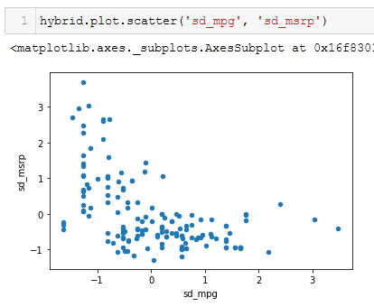
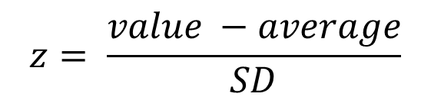
Association (cont.)
Convert to standard units
$$z= \frac{value −average}{SD}$$
Positive association
Negative association

Slide 6
Correlation coefficient
The correlation coefficient, denoted r measures the strength of the linear relationship between two variables. Graphically, it measures how clustered the scatter diagram is around a straight line.
The correlation coefficient r is a number between −1 and 1.
r measures the extent to which the scatter plot clusters around a straight line.
r=1 if the scatter diagram is a perfect straight line sloping upwards
r=−1 if the scatter diagram is a perfect straight line sloping downwards.

Slide 7
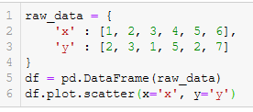
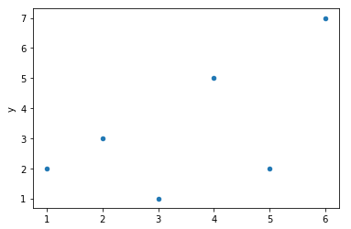
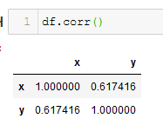
Correlation coefficient (cont.)
r is the average of the products of the two variables, when both variables are measured in standard units.
r is a pure number. It has no units. This is because r is based on standard units.
r is unaffected by changing the units on either axis. This too is because r is based on standard units.
r is unaffected by switching the axes.

Slide 8
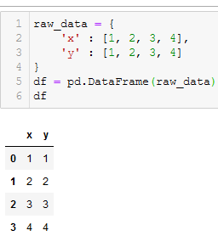
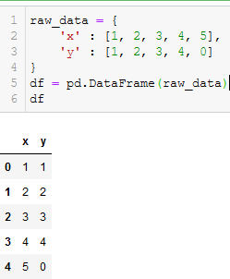
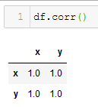
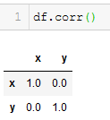
Examples
Outlier
Pairwise correlation of columns
Pairwise correlation of columns

Slide 9
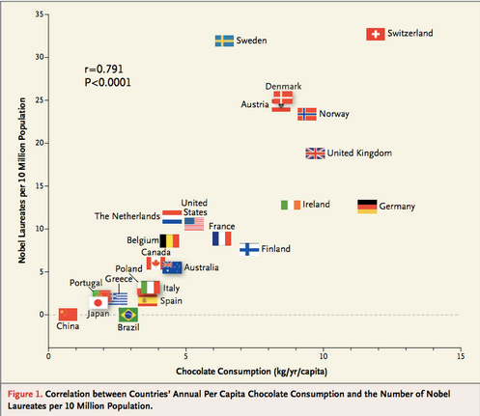
Note about Correlation
Correlation only measures association. Correlation does not imply causation.
weight vs the math ability of children may be positive but not causation. Age is a confounding variable.
Correlation measures linear association. Other association (non-linear like quadratic, etc.) might have very low correlation.
Correlations based on aggregated data (ecological correlations) can be misleading.

Slide 10
Regression Line
The correlation coefficient r doesn't just measure how clustered the points in a scatter plot are about a straight line. It also helps identify the straight line about which the points are clustered.
=> Regression line
In regression, we use the value of one variable (which we will call x) to predict the value of another (which we will call y). When the variables x and y are measured in standard units, the regression line for predicting y based on x has slope r and passes through the origin.

Slide 11

Regression Line
x and y are in standard units
$$estimate of y=r∗x$$
x and y are in original units
$\frac{Estimate of y −average of y}{SD of y}$ = $r∗ \frac{the given x −average of x}{SD of x}$
$$Slope of the regression line=r ∗ \frac{SD of y}{SD of x}$$
$$intercept of the regression line=average of y −slope∗average of x$$

Slide 12

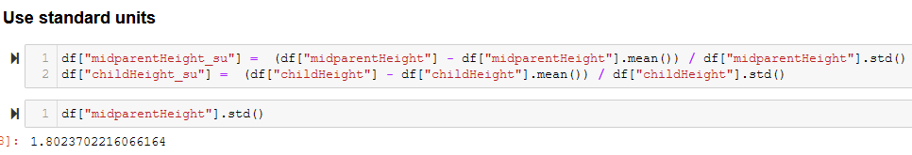
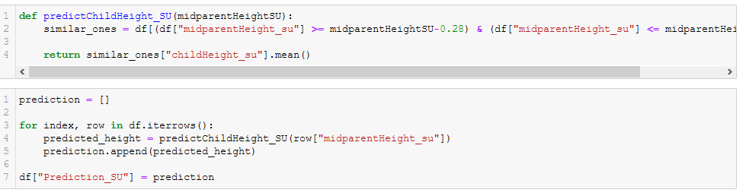
Example – Child Height Prediction
Create prediction column using average of children whose midparentHeight similar

Slide 13
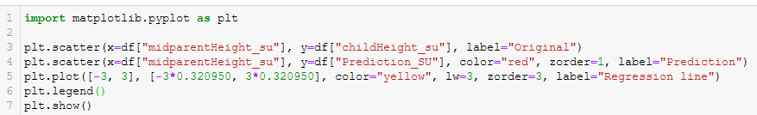
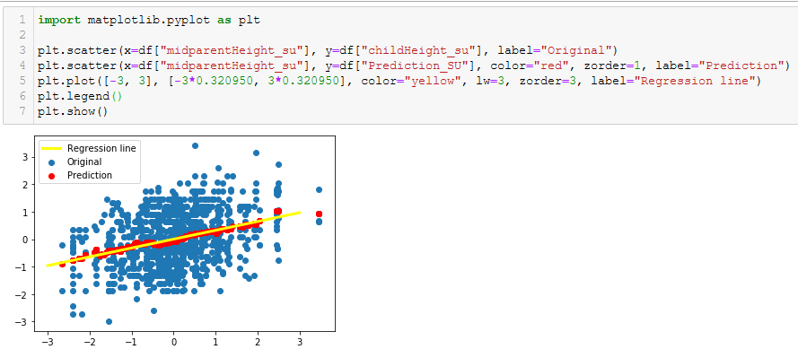
Example – Child Height Prediction
Plot original, prediction, and regression line together
Tall parents have children who are not quite as exceptionally tall, on average. called this as regression to mediocrity.
Exceptionally short parents had children who were somewhat taller relative to their generation, on average. In general, individuals who are away from average on one variable are expected to be not quite as far away from average on the other. This is called the regression effect.

