Slide 1
ENGR 1330 Computational Thinking with Data Science
Classification

Slide 2
Topic Outline
Concept of classification
Classifier, training set, testing set.

Slide 3
Objectives
Able to train a classifier and perform prediction

Slide 4
Classification
For each order Amazon receives, Amazon would like to predict: is this order fraudulent?
Doctors would like to know: does this patient have cancer?
Politicians would like to predict: are you going to vote for them?
Observation: Each individual or situation where we'd like to make a prediction is called an observation
Each observation has multiple attributes, which are known (for example, the total value of the order on Amazon, or the voter's annual salary).
Each observation has a class, which is the answer to the question we care about (for example, fraudulent or not, or voting for you or not).

Slide 5
Supervised learning
Supervised learning is the task of learning a function that maps an input to an output based on example input-output pairs. It infers a function from labeled training data consisting of a set of training examples [1].
Breast cancer (Malignant, benign)
1(y)
Malignant ?
?
0(n)
Tumor size
Classification problem: Discrete valued output (0 or 1 or more)
[1] https://en.wikipedia.org/wiki/Supervised_learning

Slide 6
Supervised learning
Two features
Age
?
Tumor size

Slide 7
Classification Algorithm
Classifier: Analyze the training set and come up an algorithm for predicting the class of future observations. Classifiers do not need to be perfect to be useful. In other words, you don't want the classifier to make too many errors, but it doesn't have to get the right answer every single time.
Training data: A bunch of observations, where we know the class of each observation. The collection of these pre-classified observations is also called a training set. It is used to build the classification algorithm.
Testing data: A bunch of observations, where we know the class of each observation used to test the performance of the classifier. The collection of these observation is also called a testing set.

Slide 8
Example: Chronic kidney disease
Given records of patients with CKD
Predict a new patient with certain diagnosis (hemoglobin, glucose) having CKD or not?
We rely on the most similar patient that has been diagnosed to make decision on CKD

Slide 9
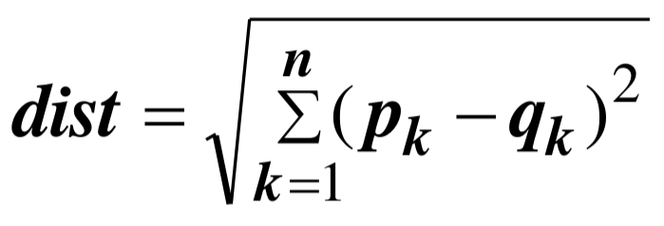
Comparing Similarity between People
Treat each person as a point in a coordinate system of 2 dimensions.
Similarity is the distance between two points
The closer of the points, the more similar they are
Euclid distance
A
C
B
n: number of dimensions
Require standardization if the scales are different.

Slide 10
K Nearest Neighbors (KNN)
k=1
?
Yes
No

Slide 11
K Nearest Neighbors (KNN)
k=5
?
Yes
No

Slide 12
Nearest Neighbor Classifier
We find the nearest point in the scatterplot and check whether it is blue or gold; we predict that the new patient should receive the same diagnosis as that diagnosed patient.
Nearest neighbor
Find the point in the training set that is nearest to the new point.
If that nearest point is a "CKD" point, classify the new point as "CKD". If the nearest point is a "not CKD" point, classify the new point as "not CKD".
K-Nearest neighbor
Compute distance from new point to other points in training set
Sort them in ascending order and take k closest patients as references.
Use the diagnosis results of k patients for counting votes and making decision.

Slide 13

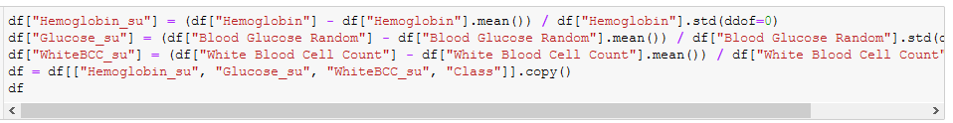
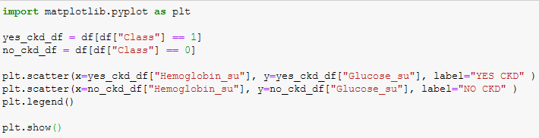
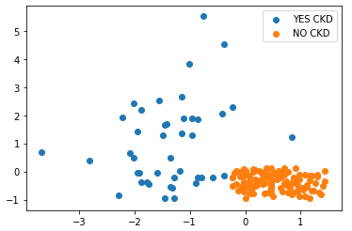
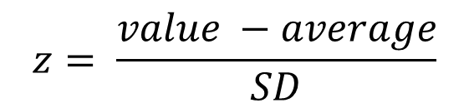
Nearest Neighbor Classifier
$$z= \frac{value −average}{SD}$$
How a computer can automatically predict a new patient about CKD?

Slide 14
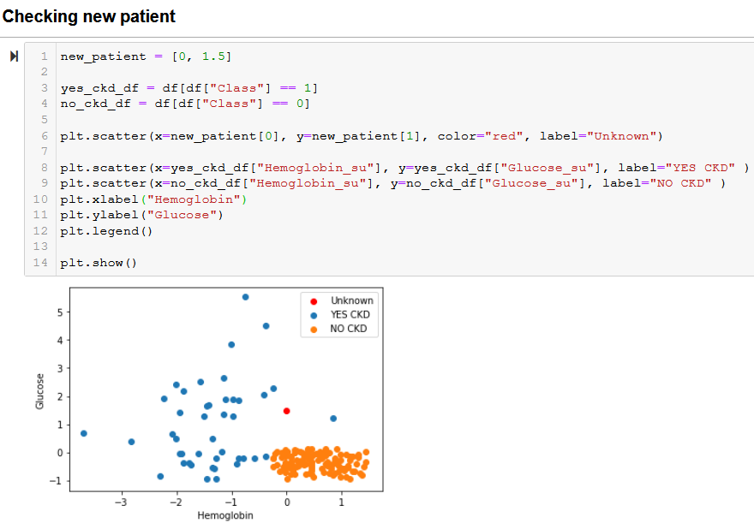
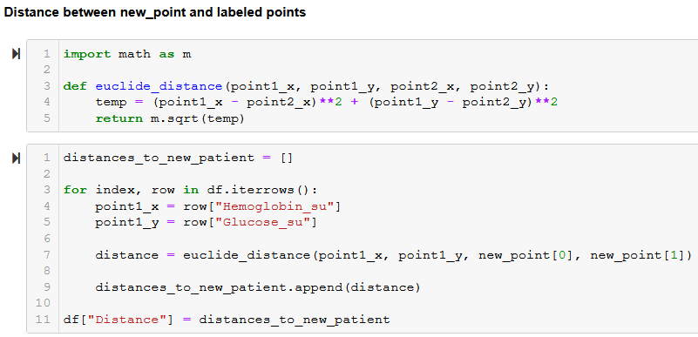
K-Nearest Neighbor Classifier
Euclid distance

Slide 15
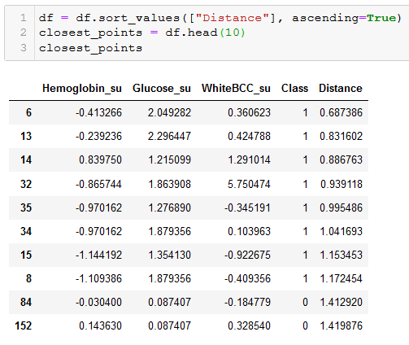
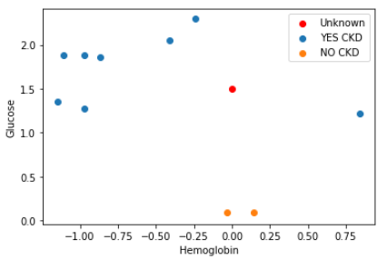
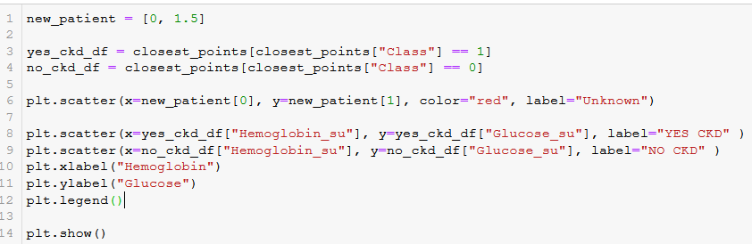

K-Nearest Neighbor Classifier
K nearest neighbors
Plot k=10 neighbors
Major votes

