Slide 1
EGR 1330 Computational Thinking with Data Science
Introduction to Computational Thinking with Data Science

Slide 2
Instructors
Instructor : Long Nguyen
Email : long.nguyen@ttu.edu
Office hours : By appointment via email.
Teaching Assistant: TBD
Email:
Office hours:
Study materials: Blackboard
https://www.blackboard.ttu.edu
Textbook (online): https://www.inferentialthinking.com
The lectures may be recorded.

Slide 3
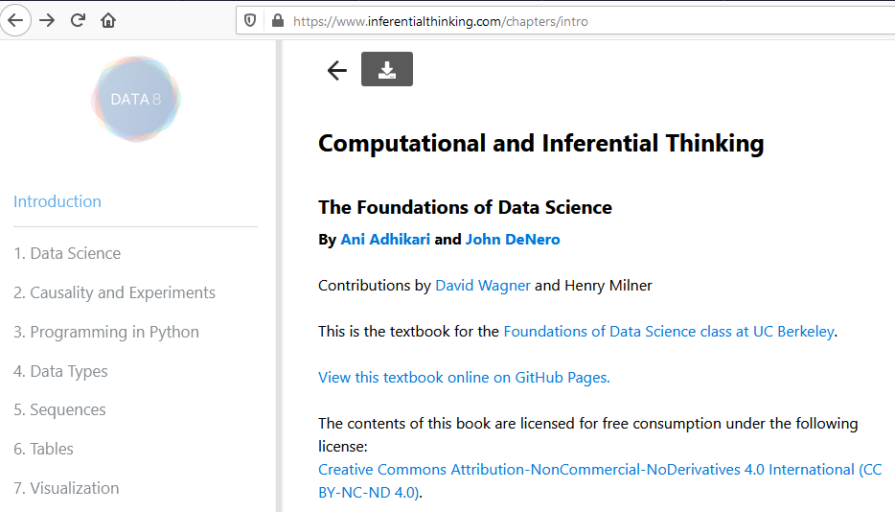
Text book: Inferential Thinking

Slide 4
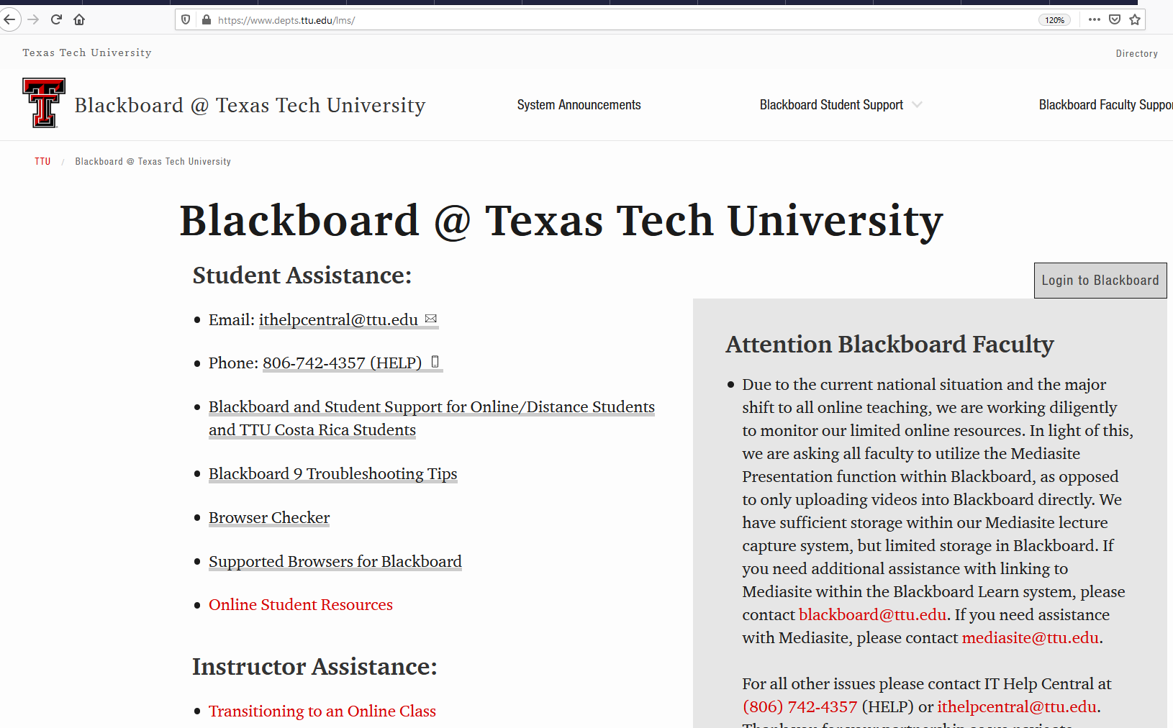
Blackboard
https://www.blackboard.ttu.edu
Login with your credentials.

Slide 5
Course Content
Computational thinking for problem-solving: Logical problem solving, decomposition, pattern recognition, abstraction, representation, algorithm design, and generalization.
Python Programming: Variables, constants, data types, data structures, strings, math Operators, boolean operators, expressions, program constructs, functions, loop, I/O files, modules, and database.
Data science fundamentals:
✓ Experimental setup: Importing and formatting data sets, displaying data, data pre-processing.
Introductory statistical analysis with Python: Elementary statistics, randomness, sampling, probability distribution, confidence intervals, hypothesis testing, and A/B testing
Basic data analysis, visualization, and machine learning: Data pre-processing, basic supervised/unsupervised learning, performance evaluation metrics.

Slide 6
Learning outcome
Be able to implement basic Python programs using computational thinking concepts.
Know basic Python programming constructs and libraries relevant to data science.
Be able to write Python scripts to perform fundamental data analytics and basic visualization.

Slide 7
Laboratory Environment
Online: https://cocalc.com/doc/jupyter-notebook.html
Individual: Download and Install Anaconda at https://www.anaconda.com

Slide 8
Course Requirements
Midterm 1 (14%): Computational thinking with programming principles
Midterm 2 (14%): Statistical analysis
Midterm 3 (14%): Computational thinking with Data modeling
Lab participation (6%)
Labs (15%)
Quizzes (12%)
Project (25%)
>= 90 : A
>=80 : B
>=70 : C
>=55 : D
< 55 : F

Slide 9
COVID-19 Instruction
Contingency Statement: If Texas Tech University campus operations are required to change because of health concerns related to the COVID-19 pandemic, it is possible that this course will move to a fully online delivery format. Should that be necessary, students will be advised of technical and/or equipment requirements, including remote proctoring software.
Illness-based Statement: See from syllabus.
Useful links:
Student Health Services
Student Affair COVID-19
Student COVID-19 Protocol
Texas Tech Commitment

Slide 10
Illness-based Statements
If at any time during this semester you feel ill => you are encouraged not to attend face-to-face class meetings or events.
Please review the steps outlined below that you should follow to ensure your absence for illness will be excused:

Slide 11
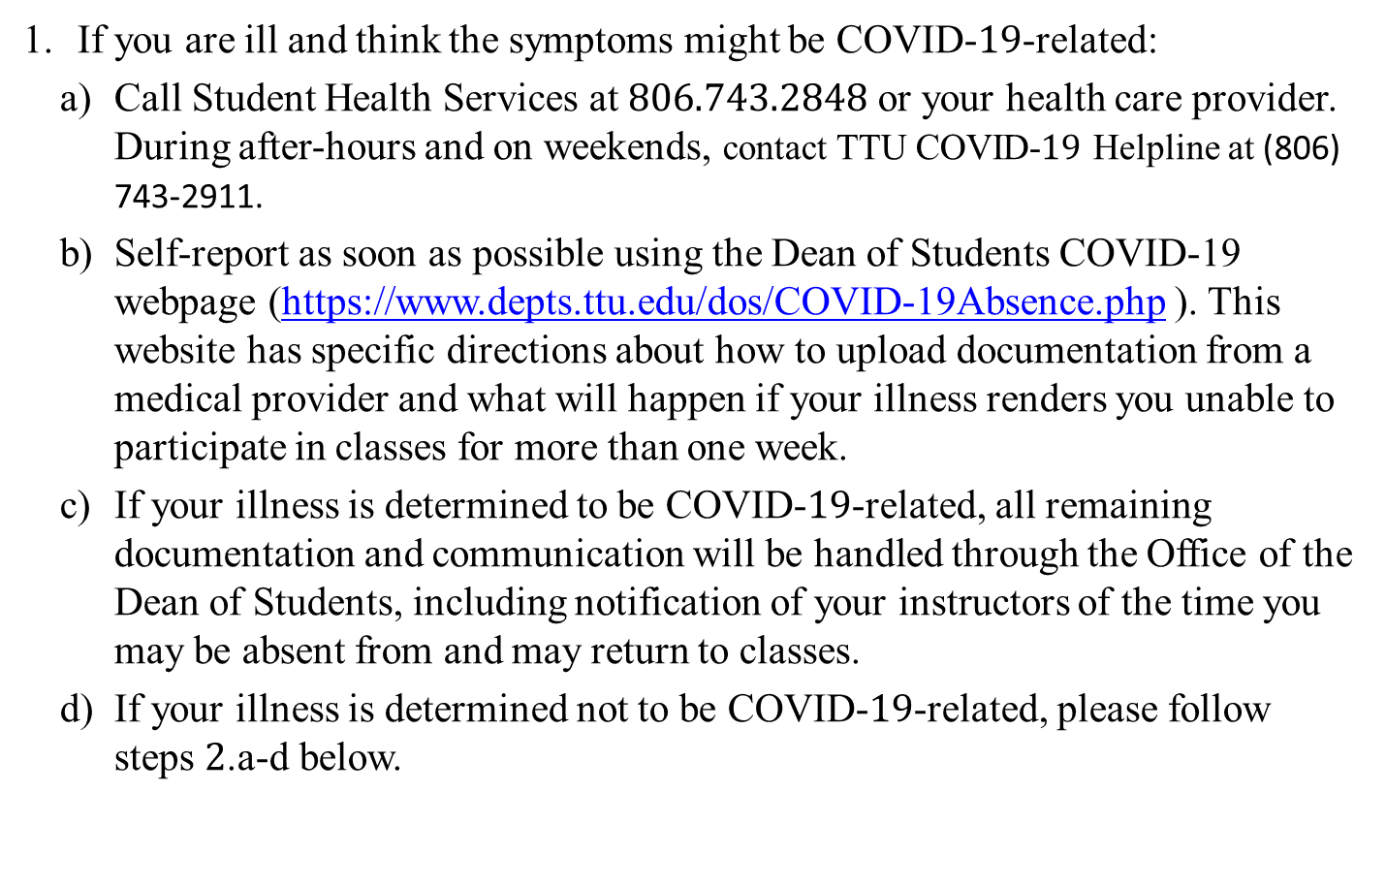
Illness-based Statements
If you are ill and think the symptoms might be COVID-19-related:
Call Student Health Services at 806.743.2848 or your health care provider. During after-hours and on weekends, contact TTU COVID-$19$ Helpline at (806) 743-2911.
Self-report as soon as possible using the Dean of Students COVID-19 webpage (https://www.depts.ttu.edu/dos/COVID-19Absence.php ). This website has specific directions about how to upload documentation from a medical provider and what will happen if your illness renders you unable to participate in classes for more than one week.
If your illness is determined to be COVID-19-related, all remaining documentation and communication will be handled through the Office of the Dean of Students, including notification of your instructors of the time you may be absent from and may return to classes.
If your illness is determined not to be COVID-19-related, please follow steps 2.a-d below.

Slide 12
Illness-based Statements
2. If you are ill and can attribute your symptoms to something other than COVID-19:
If your illness renders you unable to attend face-to-face classes, participate in synchronous online classes, or miss specified assignment due dates in asynchronous online classes, you are encouraged to contact either Student Health Services at 806.743.2848 or your health care provider. Note that Student Health Services and your own and other health care providers may arrange virtual visits.
During the health provider visit, request a “return to school” note.
E-mail the instructor a picture of that note.
Return to class by the next class period after the date indicated on your note

Slide 13
COVID-19 Policies and Procedures in Engineering Buildings
All people entering an Engineering Building must wear a mask and maintain social distances (6 Ft) at all times
Do not enter any Engineering Building until 3 minutes before your class is scheduled to begin, and you must enter through a designated door (exception for ADA compliance) and maintain social distancing (see signs on exterior doors to identify entrance and exit doors)
Leave through an designated door. Signage will indicate traffic directions; you are required to follow that signage (except in the case of a fire or emergency, leave from the closest door)
All classrooms have assigned seating and students are to sit in the same seat every class, as well as wipe off their seat, desk, and equipment (wipes provided) when they enter each classroom, and prior to leaving each classroom

Slide 14
COVID-19 Policies and Procedures in Engineering Buildings
No eating or drinking in any common areas or the classrooms, and no loitering in buildings
Stay 9 ft from the instructor(s)
Students will be dismissed row by row starting immediately at the class scheduled ending time. That gives 10 mins to clear the room.
In case of inclement weather (e.g., rain or snow) students can form orderly lines, in the buildings, while maintaining the proper 6 ft distancing right up to the classroom door

Slide 15
Classroom Policy
NO texting or talking on the cellphone or other electronic devices, and reading a newspaper.

Slide 16
ADA Statement
Any student who, because of a disability, may require special arrangements in order to meet the course requirements should contact the instructor as soon as possible to make necessary arrangements. Students must present appropriate verification from Student Disability Services during the instructor's office hours.
Please note that instructors are not allowed to provide classroom accommodation to a student until appropriate verification from Student Disability Services has been provided.
For additional information, please contact Student Disability Services office in 335 West Hall or call 806.742.2405.

Slide 17
Academic Integrity Statement
Academic integrity is taking responsibility for one’s own class and/or course work, being individually accountable, and demonstrating intellectual honesty and ethical behavior.
Academic achievement includes scholarship, teaching, and learning, all of which are shared endeavors. Grades are a device used to quantify the successful accumulation of knowledge through learning. Adhering to the standards of academic integrity ensures grades are earned honestly.
Academic integrity is the foundation upon which students, faculty, and staff build their educational and professional careers

Slide 18
Religious Holiday Statement
“Religious holy day” means a holy day observed by a religion whose places of worship are exempt from property taxation under Texas Tax Code §11.20.
A student who intends to observe a religious holy day should make that intention known to the instructor prior to the absence.
A student who is absent from classes for the observance of a religious holy day shall be allowed to take an examination or complete an assignment scheduled for that day within a reasonable time after the absence.
A student who is excused may not be penalized for the absence; however, the instructor may respond appropriately if the student fails to complete the assignment satisfactorily.

Slide 19
Ethical Policy
Cheating is prohibited, and the representation of the work of another person as your own will be grounds for receiving a failing grade in the course.

