Slide 2
Packback is an AI-supported online discussion platform for developing critical thinking, curiosity, and writing skills.
Student Feedback
Spring 2019 Student Feedback Survey
“In past classes where Packback wasn’t used, I wasn’t all that interested in the material. I just did what I had to do to pass the class. I didn’t think I’d care about a GenEd ever before Packback.”

Slide 3
Critical questioning skills are essential to college and post-grad life:
In asking effective questions while interviewing to select the right job after graduation.
In identifying opportunities for innovation, when starting a business, or working within a team.
In learning new skills independently after graduation, to keep adapting to a changing world!

Slide 4
Our specific Packback course objectives
In this class we’re using Packback to:
Share Computational Thinking Problems and Solutions
Because if forces citation, our collective CCMR improves.
Share scripts that you find, with only classmates
This is the tolerated venue for program sharing in this class – again because there is a citation
Capture nature of difficulties you are having [Instructor will use these to modify course in the future]

Slide 5

How Packback discussion fits into this course
Packback will be used in this course as a way to integrate and apply course concepts.
Remembering new factual information and course concepts.
Course Lecture
Mastery of Course Objectives
Analyzing, Evaluating, and Generating discussion into broader contexts.
Quizzes & Tests
Packback
Proving Understanding of course information and concepts.

Slide 6
Participation requirements & How you will be graded

Slide 7
Packback is worth [15%] of your final grade!
This is an important assignment, please take it seriously as it will affect your final grade.

Slide 8



Participation requirements
Weekly Deadline
[Monday] at [11:59 PM]
What to Post
per deadline period
Post [1] Question
Post [2] Responses
(Your choice of a Response, Counterpoint, or Supporting point)
Other Expectations
[Posts must have a minimum Curiosity Score of 50]
[Partial Credit / No Partial Credit]

Slide 9
Packback’s AI & How to check your grade

Slide 10

Posts on Packback are reviewed by AI
Packback’s AI
Packback’s AI “flags” posts that may be violating community guidelines.
Posts are then reviewed by Packback moderators.
Offending posts are moderated and no longer count for credit until they are re-published.
Packback’s AI flags for:
Plagiarism
Closed Ended Questions (e.g. “What is the definition of mitosis?”)
Class Logistics Posts (e.g. “When is the next test?”)
Low Effort/Low Detail Posts

Slide 11


What happens if your post is moderated?
Post is “Flagged”
If your post is “Flagged”, you have not yet lost points!
At this time, your post is still published and still counts for credit.
Post is “Moderated”
If your post is moderated, it is unpublished and no longer counts for credit.
If your post is “Moderated”, you receive an email notifying you.
Post is “Republished”
From the email, you can “edit & re-publish” the post.
Doing so will earn back your points for the post without penalty, so long as you edit before grades are entered.

Slide 12
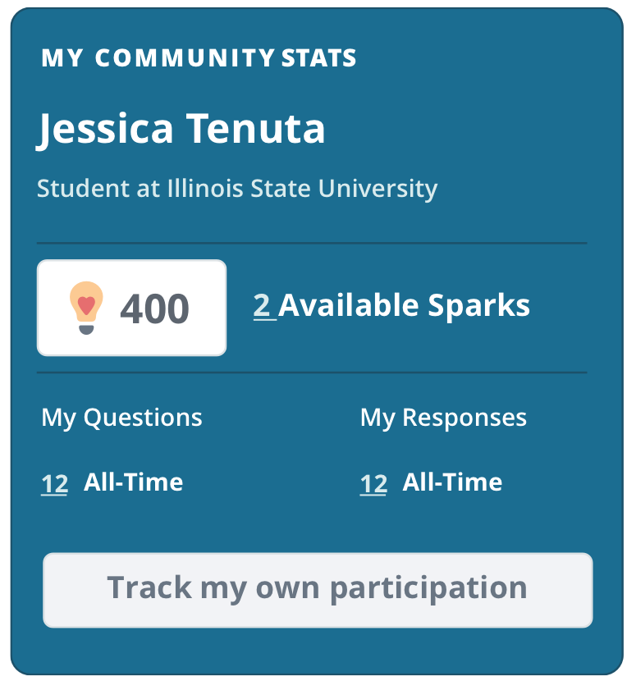
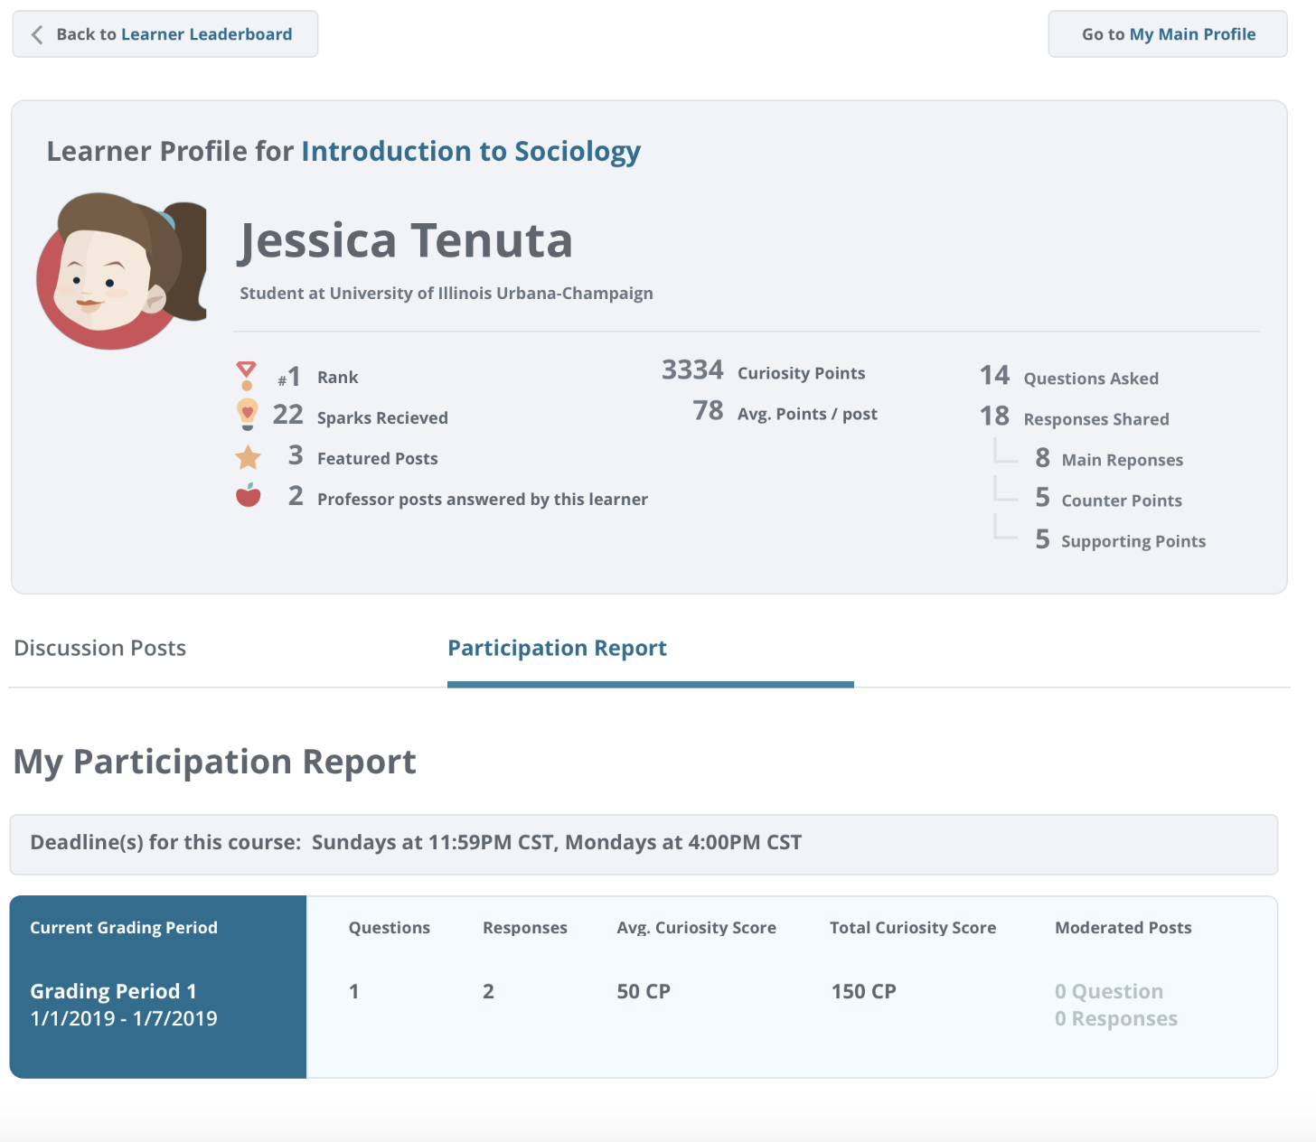
Track your participation
Your Name
You can check your current participation by deadline period to make sure you’ve earned your full points for the week.
Note: If you have any moderated posts, you can track them here!

Slide 13
Getting started & Getting help

Slide 14

Registering for Packback
You will have received an invitation in your school email inbox.
Follow the instructions in the email to checkout and finish registration.
Be sure to create an account with the same email where you were sent the invitation!
Don’t see it? Check spam!
Didn’t get an email?
Sign up directly on Packback
Click “Join Community” button
Enter the “Community Look-Up Key” from our course syllabus
You only need this key if you didn’t get the invite.

Slide 15
Need Help? Email help@packback.co
Packback’s support team is available 7 days a week, and will help you will all technical issues.
Do NOT email me with Packback issues; their team will be able to help faster!

