Slide 1
EGR 1330 Computational Thinking with Data Science
Computational Thinking and Programming Principles

Slide 2
Outline
Concepts of Computational thinking
Variables, data types in Python programming
Operators and precedence in Python programming

Slide 3
Objective
Understand the concept of computational thinking
Use of Python variables, data types, and some operators in programming.

Slide 4
Computational thinking
Computational thinking refers to the thought processes involved in expressing solutions as computational steps or algorithms that can be carried out by a computer. (Cuny, Snyder, & Wing, 2010; Aho, 2011; Lee, 2016).

Slide 5
CT vs Programming
Programming: Write code in a specific programming language to address a certain problem.
Computational thinking: It is not just about programming. It is an approach to solve problems using concepts and ideas from computer science.

Slide 6
Computational Thinking Approach
Breaking down a problem into smaller parts
Looking for patterns in the problems
Figuring out what information is needed
Developing a step-by-step solution

Slide 7
Pillars of Computational Thinking
1. Decomposition
2. Pattern Recognition
4. Algorithms
3. Abstraction

Slide 8
Decomposition
Decomposition is the process of taking a complex problem and breaking it into more manageable sub-problems.
Examples:
Writing a paper:
Introduction
Body
conclusion.
Wide-viewed (Panorama) image:
Taking multiple overlapped photos
Stitch them
INTRODUCTION
BODY
CONCLUSION

Slide 9

Pattern Recognition
Find similarities, or shared characteristics of the problems
Complex problem becomes easier to solve. Use same solution each occurrence of the pattern.
Example:
Upload an album of photos to Facebook: same pattern.
Compression
Metadata
Name,
Location,
Date,
…
Data Server
Different photos

Slide 10
Data Representation and Abstraction
Determine important characteristics of the problem and filter out ones that are not important.
Use these characteristics to create a representation of what we are trying to solve.
Students in a University
Books in an online bookstore
Important | NOT important
Name | Favorite color
Billing address | Food preferences
Phone number | Shoe size
Student Id | ….
…
Important | NOT important
title | Cover color
ISBN | Author’s hometown
authors | Complete content
category | ….
…

Slide 11
Algorithms
Step-by-step instructions of how to solve a problem
Identifies what is to be done, and the order in which they should be done
Making a cup of tea
Fill electric kettle
Boil it
Pour hot water in a cup
Put teabag in the cup
Steep for 3 minutes
Remove the teabag

Slide 12
Case Study: Scheduling a meeting
Decomposition: Two steps process
Schedule an earlier meeting request
Remove conflicting request with the one just scheduled.
Pattern:
Look at unscheduled requests and pick the best one
Abstraction:
Each request is represented with proposed start time, end time, and student name for the meeting.
Algorithm:
Meeting request at earliest time
Schedule it
Look at other requests one by one and remove it if overlapped with the scheduled ones.

Slide 13
Python for Computational Thinking
Program: It is the realization of an algorithm using a syntax that the computer can understand.
Algorithm: is to manipulate the data
Data: is stored in memory.
Program accesses the data in memory using its address.
Variable is used to have friendly name for accessing data memory address. We don’t need to know where exactly the memory address is.

Slide 14
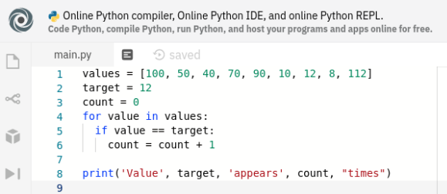
Variables
A meaningful name for a piece of data stored in memory
Value can change during execution of the program
Define with a name and initial value
Assign new value using equal sign (“=“)

Slide 15
Variables
Valid variables?
Should be meaningful
May consist of letters, digits, and underscores but may not start with a digit or a special character.
Should not include uppercase letters (Python convention).
a) exchange_rate = 0.1
b) my_name = “John”
c) is_student = True
d) name = my_name
e) my_name = “Brian”
f) $_class = “python”
g) 1class = “programming”

Slide 16
Variables
Valid variables?
Should be meaningful
May consist of letters, digits, and underscores but may not start with a digit or a special character.
Should not include uppercase letters (Python convention).
a) exchange_rate = 0.1
b) my_name = “John”
c) is_student = True
d) name = my_name
e) my_name = “Brian”
f) $_class = “python”
g) 1lass = “programming”

Slide 17
Keywords
Reserved words: Internally defined keywords in Python
You cannot use reserved words as variable names
True
class
return
is
finally
False
if
for
lambda
continue
None
del
from
while
nonlocal
and
def
global
not
with
as
elif
try
or
yield
break
else
import
pass
assert
except
in
raise

Slide 18
Data types
Numeric data types:
Integer: Whole number that can be positive, negative or zero
E.g.: 2045, 767, 0, -87, -435
Float: Floating point number that has a decimal place
E.g.: 1433.3, 140.75, -25.187, -100.1

Slide 19
Data types
String: Collection of one or more characters that are enclosed within single or double quotes
E.g.: ‘Hello World!’, “Computational Thinking with Data Science”
Boolean: Data type that takes one of the two possible values - True or False
Advanced data types:
Valid variables?
Array
Set
a) exchange_rate = 0.1
b) my_name = “John”
c) is_student = True
d) name = my_name
e) my_name = “Brian”
f) $_class = “python”
g) 1lass = “programming”
List
Dictionary
Tuple

Slide 20

Comments for Code
Comments: Useful information to help the readers understand the source code, i.e., helps in understanding the logic behind the Python code
Comments: Starts with a hashtag symbol (#)
E.g.: # This is the workshop on Computational Thinking with Data Science

Slide 21
Operators on Variables
num1 = 15
num2 = 2
Operation | Operator | Result
sum = num1 + num2 | + | 17
diff = num1 – num2 | - | 13
product = num1 * num2 | * | 30
quotient = num1 / num2 | / | 7.5
integer_quotient = num1 // num2 | // | 7
power = num1 ** num2 | ** | 225
modulus = num1 % num2 | % | 1

Slide 22

Precedence of Operators
Operator | Description
() | Parentheses (grouping)
** | Exponentiation
*, /, % | Multiplication, division, remainder
+, - | Addition, subtraction
c = $\sqrt{a2+b2}$
Which one is correct?
c
1) c = a*a + b*b**0.5
b
2) c = (a*a + b*b)**0.5
a
3) c = ((a*a) + (b*b))**0.5

Slide 23
Comparison operators
Python code | Meaning
a == b | Equal to
a != b | Not equal to
a > b | Greater than
a >= b | Greater than or equal to
a < b | Less than
a <=b | Less than or equal to

Slide 24
Input and Output
Python provides two in-built functions for input and output operations
input( ): This function takes the input and evaluates the expression
Python automatically detects the data type entered
print( ): This function prints the output
Multiple expression can be passed with each of them separated by a comma
Converts the expressions into a string before writing to the screen
Note: Functions can also be written by the user (user-defined functions)

Slide 25
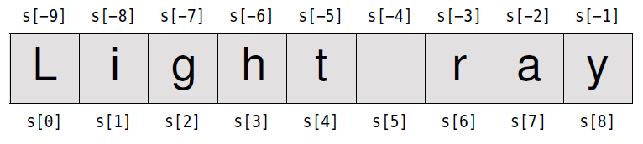
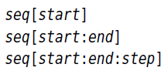
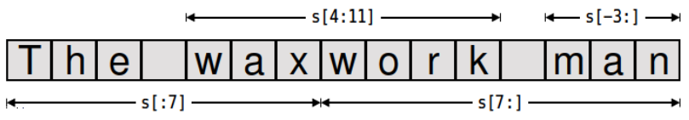

String
string holds a sequence of characters
string is immutable
Indexing:
Comparison: <, >, <=, >=, ==, !=
Slicing:

Slide 26
Examples
1) Write a program that requests the user to enter two numbers and prints the sum, product, difference and quotient of the two numbers.
2) Write a program that reads in two integers and determines and prints whether the first is a multiple of the second. (Hint: Use the modulus operator.)
3) State the order of evaluation of the operators in each of the following Python statements and show the value of x after each statement is performed.
a) x = 7 + 3 * 6 / 2 - 1
b) x = 2 % 2 + 2 * 2 - 2 / 2
c) x = ( 3 * 9 * ( 3 + ( 9 * 3 / ( 3 ) ) ) )
4) Add more examples for string indexing

