Slide 1
ENGR 1330: Computational Thinking with Data Science
Lesson 6: Class, Objects, and File Handling
Dinesh S. Devarajan Whitacre College of Engineering Texas Tech University

Slide 2
Topic Outline
Class and Objects in Python
File Handling in Python

Slide 3
Objectives
To understand the use of classes and objects to do effective coding in Python
To understand the basic idea of how to manipulate the data in a file using file handling options in Python

Slide 4
Computational Thinking Concepts
Decomposition
Class and Objects
Abstraction
File handling
Decomposition

Slide 5
Class and Objects in Python

Slide 6
Object-Oriented Programming
What is Object-Oriented Programming (OOP)?
Useful paradigm where classes define concepts and objects are instance of classes
Way of thinking and implementing code

Slide 7
Object-Oriented Programming
How would you describe an apple to a person?
It is a fruit
It has color and flavor
How would you describe an apple to a computer?
OOP comes in handy to communicate with computers

Slide 8
Object-Oriented Programming
How would you describe an apple to a computer?
Define a class called ‘Apple’ that contains the characteristics of an apple
Define an instance of that ‘Apple’ class called an object
You can create many instances and hence, many objects for the ‘Apple’ class

Slide 9
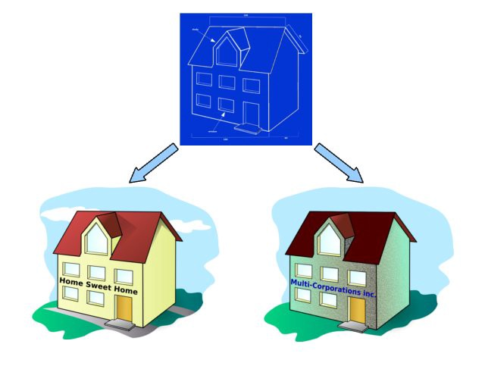
Object-Oriented Programming
Think of class as a blueprint to build a house
You can build many houses (objects) using a single blueprint (class)
Figure Source:
https://medium.com/@trulymhvu/everything-is-an-object-in-python-29d3aae8de5

Slide 10
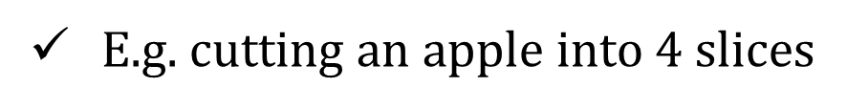
Object-Oriented Programming
Core concept: Attributes and methods
Attributes: Characteristics associated to a type
E.g. color and flavor of an apple
Methods: Functions associated to a type
E.g. cutting an apple into $4$ slices

Slide 11
Object-Oriented Programming
A more relevant example: Accessing a file that contains data
Attributes: Characteristics associated to a type
E.g. file name, size, and creation date
Methods: Functions associated to a type
E.g. reading and modifying the data in a file

Slide 12
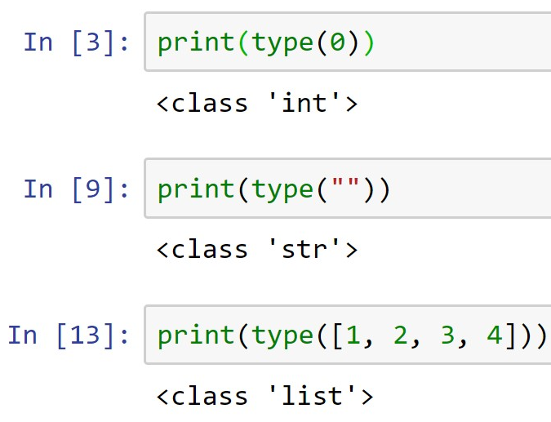
Built-In Classes and Objects
Guess what?....
Numbers, strings, lists, and dictionaries are all objects in Python
Each of them was an instance of a class
class ‘int’
(Demo)
class ‘str’
class ‘list’

Slide 13
In-Built Classes and Objects
dir(“ ”): To display all the methods associated with the string class
upper(): Creates an uppercase version of a string
count(): Counts the number of occurrences of a substring
help(“ ”): Tells us how to use the methods associated with the string class

Slide 14
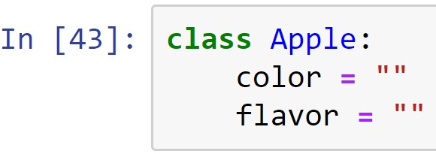
User-Defined Classes
We have been using in-built classes and objects so far
We will now define our own classes and objects
Creating a class named ‘Apple’ with attributes color and flavor
Class name
Attributes
(Demo)

Slide 15
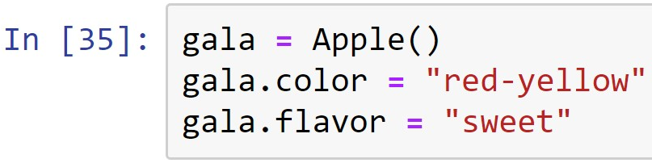
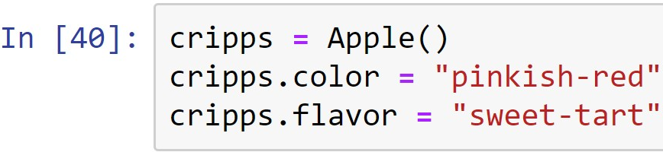
User-Defined Objects
Creating objects (new instances) for the ‘Apple’ class
Object name
Assigning
attributes
Object name
Assigning
attributes
(Demo)

Slide 16
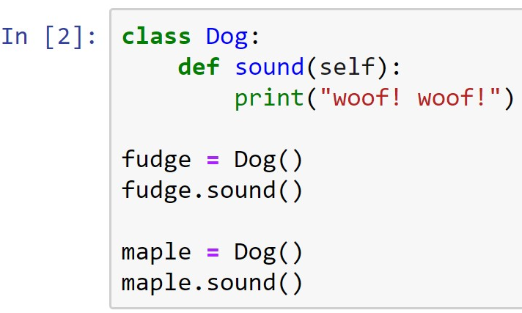
Methods
Methods: Functions that operate on the attributes of a specific instance of a class
Parameter: represents the instance that the method is being executed on
Method
(Demo)

Slide 17
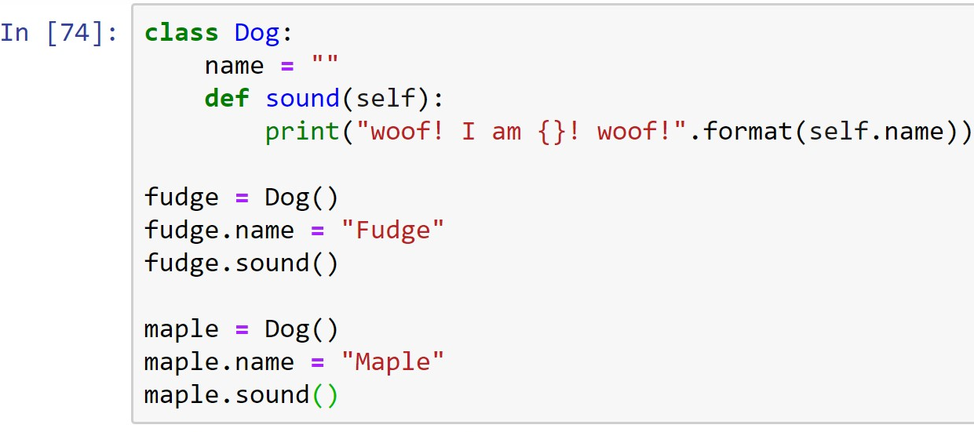
Instance Variables
Instance variables: Variables that have different values for different instances of the same class
Instance variable
(Demo)

Slide 18
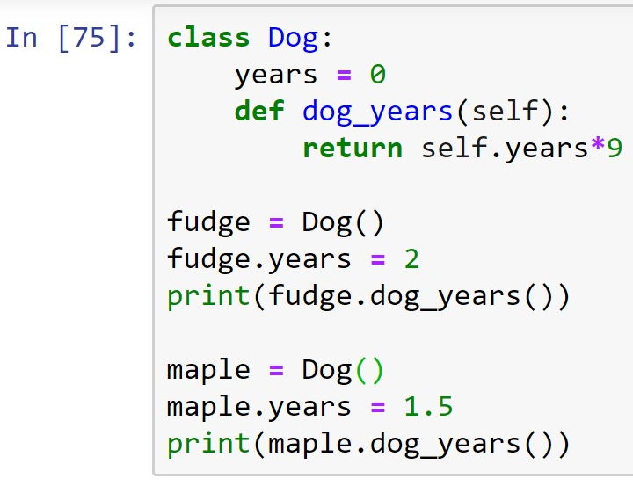
Instance Variables
Methods can also be used to do mathematical operations to return values
Instance variable
(Demo)

Slide 19
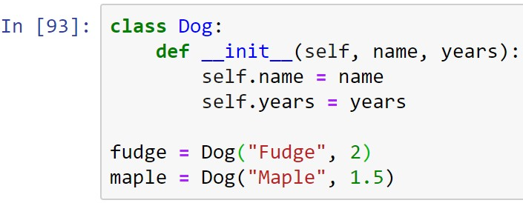
Special Methods: Constructors
Constructors: Used to initialize instance attributes when an object is created
Constructor
Attributes initialized within the constructor
Initializing instance attributes
(Demo)

Slide 20
Discussion Exercise
Can you now write a class such that the dog can say its name and age (in dog years) using constructors?

Slide 21
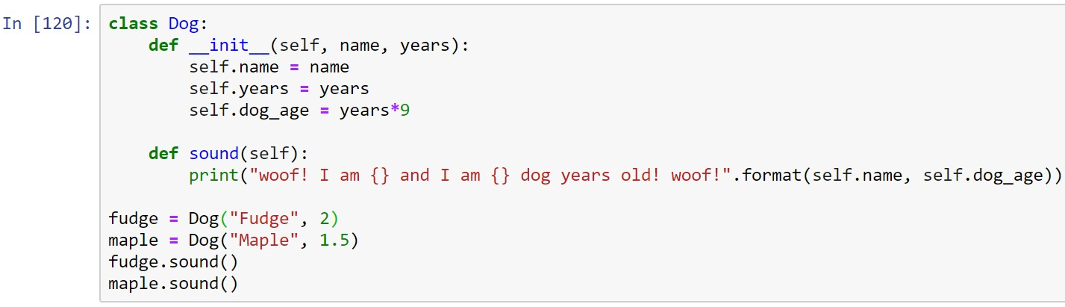
Discussion Exercise
Solution:
(Demo)

Slide 22
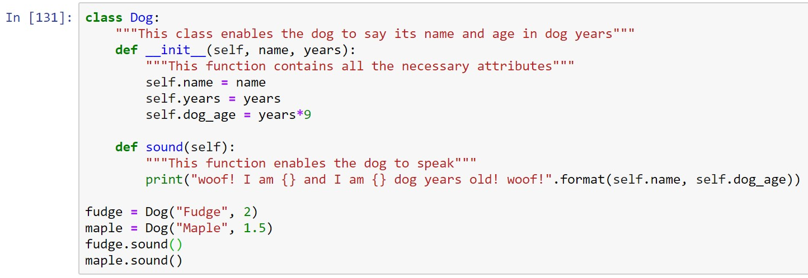
Docstrings
Docstrings: A brief comment that explains the purpose of the class and the methods used inside the class
Docstrings are typed between triple quotes
represents docstrings
(Demo)

Slide 23

Docstrings
Docstrings are useful for others to understand your code easily
Using help(Class name) displays the docstrings that explains the user-defined classes and methods
(Demo)

Slide 24
File Handling in Python

Slide 25
File Handling
open( ) function in Python is useful to work with files
Different modes to open a file:
“r” – opens a file for reading
“w” – opens a file for writing
“a” – opens a file for appending
“x” – creates a specified file

Slide 26
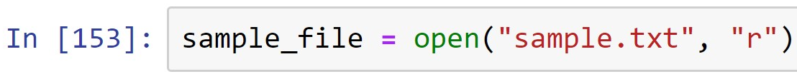

Reading a File
Reading a file named ‘sample.txt’
File object
File name
Mode
Printing the contents of the file named ‘sample.txt’ using read( ) function
(Demo)

Slide 27
Appending a File
Appending a file named ‘sample.txt’
File object
File name
Mode
Appending text using the write( ) function
(Demo)

Slide 28
Summary
Concepts of class and objects in Python are covered
Concepts of basic file handling modes in Python are covered

