Slide 1
Computational Thinking with Data Science 5. Programming Principles Functions & Variable scope Turgut Batuhan Baturalp, (Dr. Batu) Whitacre College of Engineering Texas Tech University

Slide 2
Topic Outline
Functions in Python
Creating a Function
Calling a Function
Variable Scopes
Types of Scopes
Recursive Functions

Slide 3
Objectives
To understand the role, types and usage of Functions.
To understand and implement Functions in Python under various configurations.
To understand the role and types of variable scopes.
To understand and implement variable scopes in Python under various configurations.

Slide 4
Computational Thinking Concepts
Decomposition
Functions
Algorithm design
Decomposition
Variable Scopes
Algorithm design
Recursive Functions
Pattern recognition

Slide 5

What is a Function in Coding?
Function: A piece of code that you can easily use multiple times by calling it in the code. Basically, functions are packages of codes that executes certain tasks.
https://youtu.be/0eo0ESEX9DE

Slide 6
How to use Functions?
A function is a block of code which only runs when it is called.
You can pass data, known as parameters, into a function.
A function can return data as a result.
They are useful for decomposition, since Functions can be used to modularize a program.
Things you can do using functions:
Creating a function
Calling a function (I bet you did this before. For example, if you searched anything on Google, you called the search function; or when you press the plus button on your calculator, you are calling the sum function. )

Slide 7
Creating a function
In Python a function is defined using the def keyword:
Example

Slide 8
Calling a function
To call a function, use the function name followed by parenthesis:
Example

Slide 9
Function - Return
All functions in Python have a return value, including the functions does not have the return statement.
Functions without the return statement will return None.
None is a special constant.
None is equivalent to False.

Slide 10
Function Examples – 1
Function to calculate sum of the first n numbers?
Calling the defined function:

Slide 11
Function Examples – 2
Function to calculate sum of the first n numbers?
Calling the defined function:

Slide 12
Function Arguments w/ Default Values
Does NOT allow argument with default value followed by arguments without default values.

Slide 13
Variable Scope & Types of Scopes
A variable is only available from inside the region (a function for example) it is created. This is called scope.
Types of Scopes:
Local Scope: A variable created inside a function belongs to the local scope of that function and can only be used inside that function.
Function Inside Function: In this case, the variable is not available outside the function, but it is available for any function inside the function (nested functions).
Global Scope: A variable created in the main body of the code is a global variable and belongs to the global scope. Global variables are available from within any scope, global and local.

Slide 14
Rules & tips about variable scopes
If you operate with the same variable name inside and outside of a function, they will be treated as two separate variables, one available in the global scope (outside the function) and one available in the local scope (inside the function).
If you need to create a global variable, but are stuck in the local scope, you can use the global keyword. The global keyword makes the variable global.

Slide 15
Function Arguments & Variable Scope
Class | Description | Immutable
bool | Boolean value | Yes
int | Integer | Yes
float | Floating-point number | Yes
str | Character string | Yes
tuple | Immutable sequence of objects | Yes
list | Mutable sequence of objects | No
set | Unordered set of distinct objects | No
dict | Associative mapping | No
Immutable objects: can not change after it is created. Passed to function by value.
Mutable objects: can change after it is created. Passed to function by reference.

Slide 16
Function Scope Example
Possible to have function definition inside another function definition.

Slide 17
Function in Built-in Modules
How to know how to use a function?
https://docs.python.org/2/library/math.html

Slide 18
Function in Built-in Modules
How to know how to use a function?
https://docs.python.org/2/library/math.html

Slide 19
Live Demo: Variable Scopes in Function
Live demo 2: variable scope and pass by reference

Slide 20
Recursive Function
Recursive Function: Function that invokes itself.

Slide 21
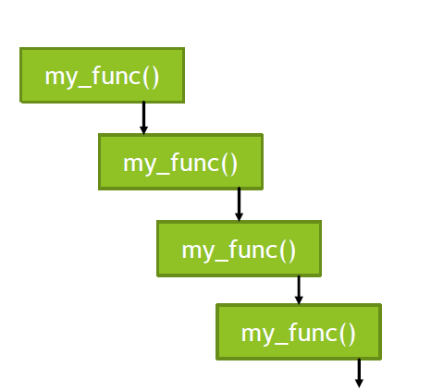
Recursive Function - 2
Infinite recursive calls
Need termination case: called base case
Invocation of the function: call recursion step

Slide 22
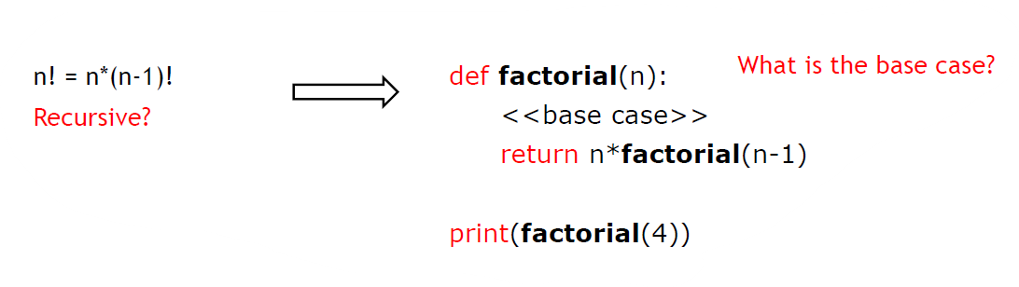
Recursive Function Example
For a given value of n, calculate n!
n = 4
n! = 4x3x2x1

Slide 23
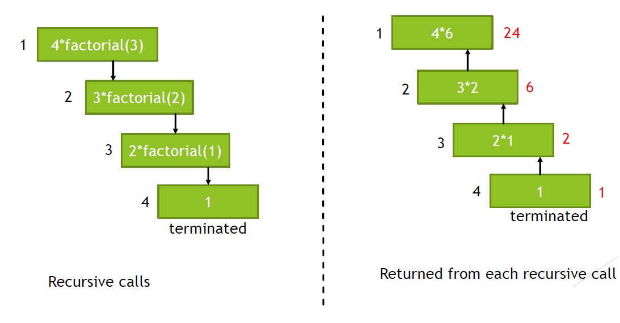
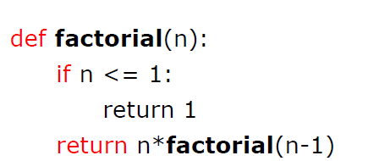
Recursive Function Example
Live demo: recursive function

Slide 24
Built-in String Functions - 1
There are very useful built-in functions of Python for String applications.
The following method generates an uppercased version of a string.
The following method generates an lowercased version of a string.

Slide 25
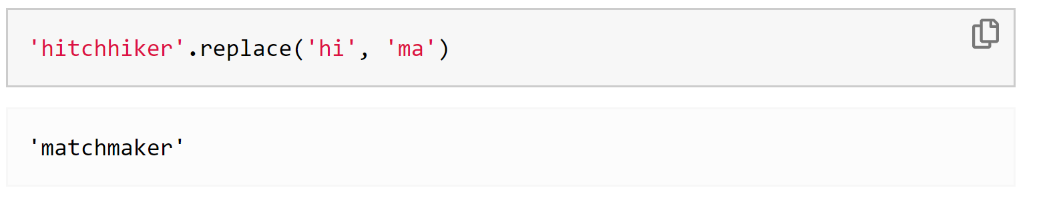
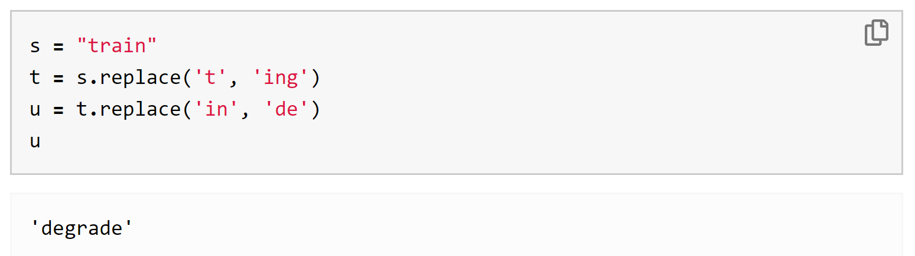
Built-in String Functions - 2
One of the most important method is replace, which replaces all instances of a substring within the string. The replace method takes two arguments, the text to be replaced and its replacement.
String methods can also be invoked using variable names, as long as those names are bound to strings.

Slide 26
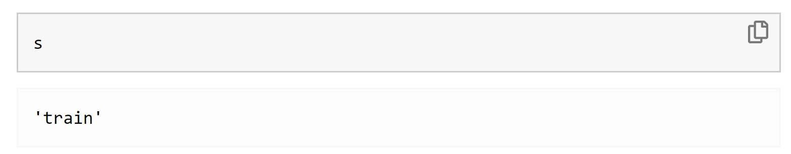
Built-in String Functions - 3
Note that the line t = s.replace('t', 'ing') doesn't change the string s, which is still "train". The method call s.replace('t', 'ing') just has a value, which is the string "ingrain".
The replace function is not unique to strings, can be applicable to other types of objects.

