Slide 1
ENGR 1330: Computational Thinking with Data Science
Lesson 3: Data Structures and Conditional Statements
Dinesh S. Devarajan Whitacre College of Engineering Texas Tech University

Slide 2
Topic Outline
Data Structures in Python
Conditional Statements in Python

Slide 3
Objectives
To understand different data structures available in Python that can be helpful in handling data effectively
To understand and implement the concept of decision making in Python using conditional statements

Slide 4
Computational Thinking Concepts
Data structures: Arrays, lists, tuples, sets, and dictionaries
Data representation
Data interpretation, manipulation, and analysis of NumPy arrays
Decomposition
Decomposition
Conditional statements
Algorithm design

Slide 5
Data Structures in Python

Slide 6
Python Data Structures
Data Structures
Arrays
Dictionaries
Lists
Sets
Tuples

Slide 7
Arrays
Arrays: Can be used to store only elements of a specific data type
Properties:
Ordered: Elements in an array can be indexed
Mutable: Elements in an array can be altered

Slide 8
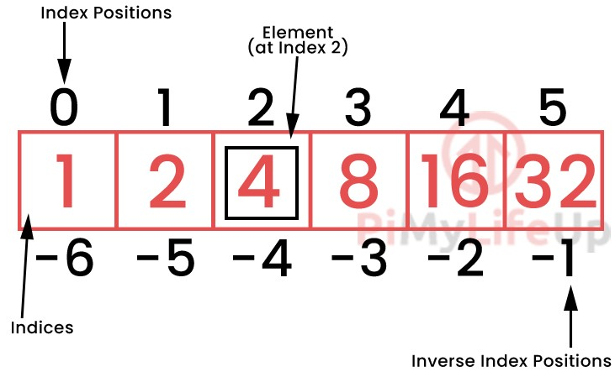
Arrays
Visual representation of an array
Figure Source:
https://pimylifeup.com/python-arrays/

Slide 9
Arrays
Data type that an array must hold is specified using the type code
‘f’ for float
Floating numbers
‘d’ for double
‘i’ for signed int
Integers
‘I’ for unsigned int

Slide 10
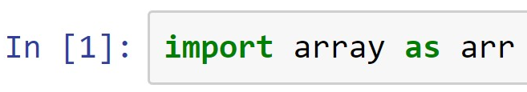
Arrays
To use arrays, a library named ‘array’ must be imported
Library name
Alias
Creating an array that contains floating numbers
Type code
(Demo on arrays)

Slide 11
Lists
Lists: Can be used to store elements of different data types
Properties:
Ordered: Elements in a list can be indexed
Mutable: Elements in a list can be altered
Mathematical operations must be applied to each element of the list

Slide 12
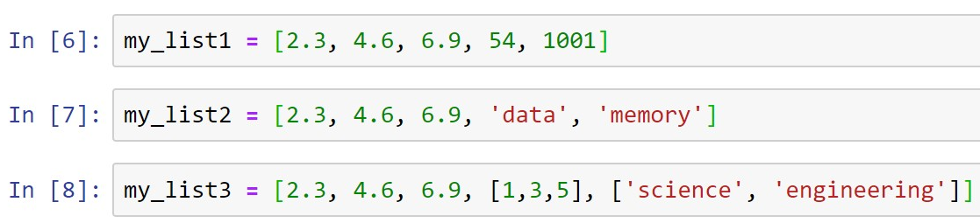
Lists
Elements of a list are enclosed in square brackets [ ]
Creating lists that contains different data types
Nested list: Lists within a list
(Demo on lists)

Slide 13
Tuples
Tuples: Can be used to store elements of different data types
Properties:
Ordered: Elements in a tuple can be indexed
Immutable: Elements in a tuple cannot be altered
Tuples are memory efficient because of their immutable property

Slide 14
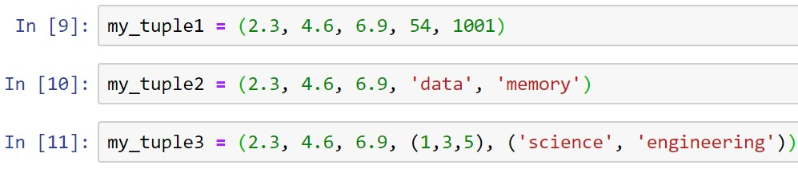
Tuples
Elements of a tuple are enclosed in round brackets ( )
Creating tuples that contains different data types
Nested tuple: Tuples within a tuple
(Demo on tuples)

Slide 15
Sets
Sets: Can be used to store elements of different data types
Properties:
Unordered: Elements in a set cannot be indexed
Mutable: Elements in a set can be altered
Non-repetition: Elements in a set are unique

Slide 16
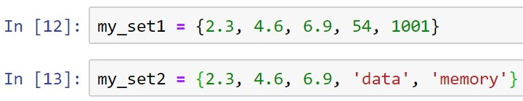
Sets
Elements of a set are enclosed in curly brackets { }
Creating sets that contains different data types
Sets cannot be nested
(Demo on sets)

Slide 17
Dictionaries
Dictionaries: Can be used to store elements of different data types
Each element in a dictionary have unique key
Properties:
Unordered: Elements in a dictionary cannot be indexed
Mutable elements: Elements in a dictionary can be altered
Immutable keys: Keys in a dictionary cannot be altered

Slide 18
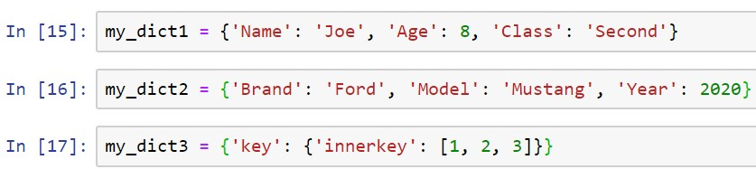
Dictionaries
Key-Element pairs of a dictionary are enclosed in curly brackets { }
Creating dictionaries that contains different data types
Nested dictionary: Dictionary within a dictionary
(Demo on dictionaries)

Slide 19
Conditional Statements in Python

Slide 20
Conditional Statements
Decision making via conditional statements is an important step in algorithm design
Controls the flow of execution of a program

Slide 21
Conditional Statements
Conditional statements in Python
if statement
if....else statements
if....elif....else statements

Slide 22
if Statement
if: To check if a condition is true or not
Start
True
if condition
False
Body of if
Stop

Slide 23
if Statement
Implementation in Python
if <condition>:
<statements>
Indentation is required for statements inside the body of ‘if’ statement
Statements intended by four spaces

Slide 24
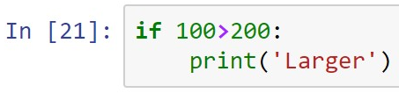
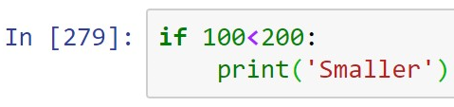
Discussion Exercise
What would be the outputs for the below two ‘if’ statements?
(Demo)

Slide 25
if....else Statements
if....else: Program proceeds to ‘else’ block only if the condition associated with ‘if’ block fails
Start
False
if condition
True
Body of if
Body of else
Stop

Slide 26
if....else Statements
Implementation in Python
if <condition>:
<statements>
else:
<statements>
Note: if and else are two separate blocks of code

Slide 27
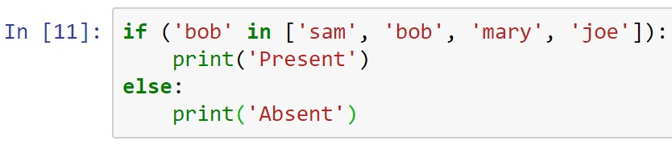
Discussion Exercise
What would be the output for the below ‘if....else’ statements?
(Demo)

Slide 28
if....elif....else Statements
if....elif....else: Used for evaluating multiple conditions
Start
False
if condition
True
False
Body of if
elif condition
True
Body of elif
Stop
Body of else

Slide 29
if....elif....else Statements
Implementation in Python
if <condition>:
<statements>
elif <condition>:
<statements>
else:
<statements>
Note: if, elif, and else are three separate blocks of code

Slide 30
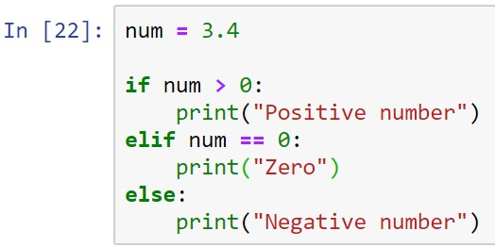
Discussion Exercise
What would be the output for the below ‘if....elif....else’ statements?
(Demo)

Slide 31
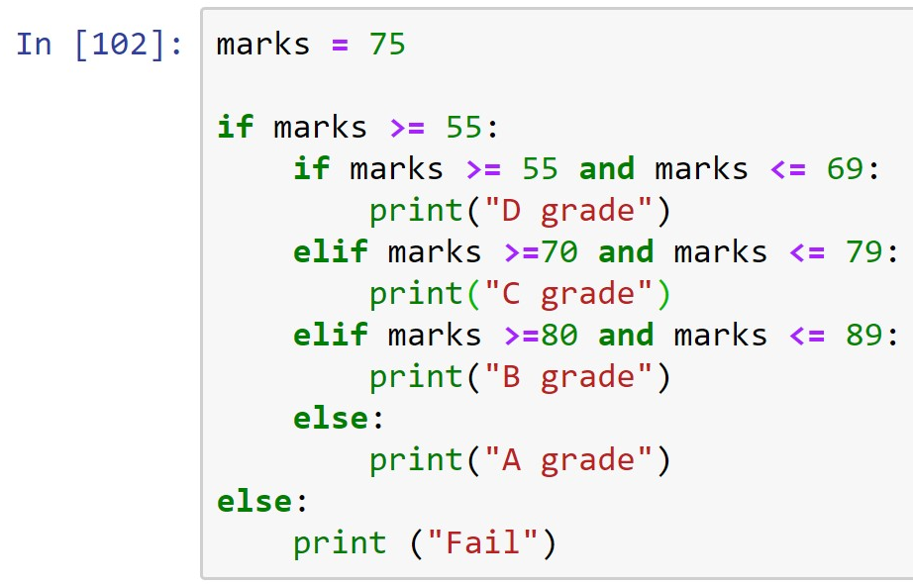
Nested Conditional Statements
What would be the output for the below nested conditional statements?
if....elif....else statements within an if statement
(Demo)

Slide 32
Summary
Concepts of different data structures in Python are covered
Concepts of conditional statements in Python are covered

