Slide 1
ENGR 1330 Computational Thinking with Data Science 4. Programming Principles - Loops Turgut Batuhan Baturalp, (Dr. Batu) Whitacre College of Engineering Texas Tech University

Slide 2
Topic Outline
Loops in Python
For Loop
While Loop
Nested Loops
Conditional Statements of Loops

Slide 3
Objectives
To understand concept of loops.
To understand loops types available in Python.
To understand and implement loops in various examples and configurations.

Slide 4
Computational Thinking Concepts
Pattern recognition
Loops
Algorithm design

Slide 5
What is a Loop in Coding?
Loops: The action of doing something over and over again.
Basically, Loops repeats a portion of code a set number of times until a process is complete.
Repetitive tasks (Loops) are very common and essential in programming. They save time in coding and minimizes the coding errors.

Slide 6
Example
If you think any mass manufacturing process, we apply the same process again and again. Even for something very simple such as preparing a PB sandwich:
If we need to make 1000 PB sandwich, it is much easier with an automated process such as loops.
Also your code will be much more organized and shorter..
Start
Gather Ingredients
Get a knife
Spread the PB to one slice
Spread the Jelly to other slice
Put them together
Notes:
So we need to repeat this process 1000 times to make 1000 PB sandwiches.
So, you write for code once for a process and you use it as many times as you need using the loop feature.

Slide 7
Types of Loops
Since loop is a sequence of instructions that is continually repeated until a certain condition is reached. There are 2 main types loops based on the condition.
Notes:
For Loops:
A for loop is used for iterating over a sequence. Usually use with predefined number of iterations. For example, preparing 1000 PB sandwiches. Basically it works like a counter, it executes a sequence of statements multiple times and abbreviates the code that manages the loop variable.
While Loops:
A while loop repeats the statement while a given condition is TRUE. It tests the condition before executing the loop body. Usually use with undefined number of iterations but knowing terminating conditions. For example, preparing PB sandwiches until everyone is stuffed.

Slide 8
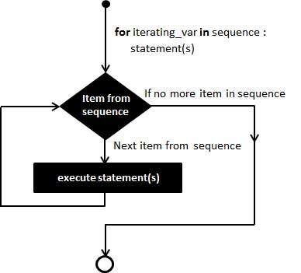
For Loops
This flow chart explains how a for loop works:
If a sequence contains an expression list, it is evaluated first.
Then, the first item in the sequence is assigned to the iterating variable iterating_var.
Next, the statements block is executed. Each item in the list is assigned to iterating_var, and the statement(s) block is executed until the entire sequence is exhausted.

Slide 9
For loops
Computers can repeat things over and over very quickly.
A for loop steps through each of the items in a collection type, or any other type of object which is iterable.
for <item> in <collection>:
<statements>
for <item> in <collection>:
<statements>
else:
<other statements>
If <collection> is a list or a tuple => the loop steps through each element of the sequence
for c in [1, 2, 3, 4, 5]:
print(“c=“, c)

Slide 10
For loops
If <collection> is a string, then the loop steps through each character of the string.
for c in “Texas tech university”:
print(c)
If the elements of <collection> are collections then <item> can match the structure of the elements.
for c in [“first”, “second”, “third”]:
print(c)
for (x, y) in [(-1, 1), (-2, 2), (-3, 3)]:
print(“x=“, x, “,y=“, y)

Slide 11
For loops with range and enumerate functions
range(number): returns a list of numbers from one up to but not including the number passed to it
for n in range(10):
print(n)
range(start, end): returns a list of numbers from start up to but not including the number end passed to it
for n in range(1, 10):
print(n)

Slide 12
For loops with range and enumerate functions
range(start, end, steps): returns a list of numbers from start up to but not including the number end with incremental step steps passed to it
for n in range(1, 10, 2):
print(n)
Loop with elements and indices access:
myList = [“one”, “two”, “three”]
for i, e in enumerate(myList):
print(“index=“, i, “; element=“, e)

Slide 13
for loop examples
Example1: Sum all the numbers from 1 to n
1 + 2 + 3 + 4 + 5 + 6 + 7 + 8 + 9 + 10
How to instruct computer to solve this problem?

Slide 14
for loop examples
Example1: Sum all the numbers from 1 to n
1 + 2 + 3 + 4 + 5 + 6 + 7 + 8 + 9 + 10
sum1
sum2
sum3
……

Slide 15
For loop examples
Example2: Sum all the even numbers from 1 to n
2 + 4 + 6 + 8 + 10 + 12 + 14 + 16 + 18 + 20
sum1
sum2
sum3
……

Slide 16
For loop examples
Example3: Print the triangle below. Allow user to enter the height of the triangle.
*
* *
* * *
* * * *
* * * * *
Hint: to print to screen without moving cursor to new line => use print(“*”, end=“ ”)

Slide 17
for loop examples: live demo
Example1: Sum all the numbers from 1 to n
1 + 2 + 3 + 4 + 5 + 6 + 7 + 8 + 9 + 10
Example2: Sum all the even numbers from 1 to n
2 + 4 + 6 + 8 + 10 + 12 + 14 + 16 + 18 + 20
Example3: Print the triangle below. Allow user to enter the height of the triangle.
*
* *
* * *
* * * *
* * * * *
Hint: to print to screen without moving cursor to new line => use print(“*”, end=“ ”)

Slide 18
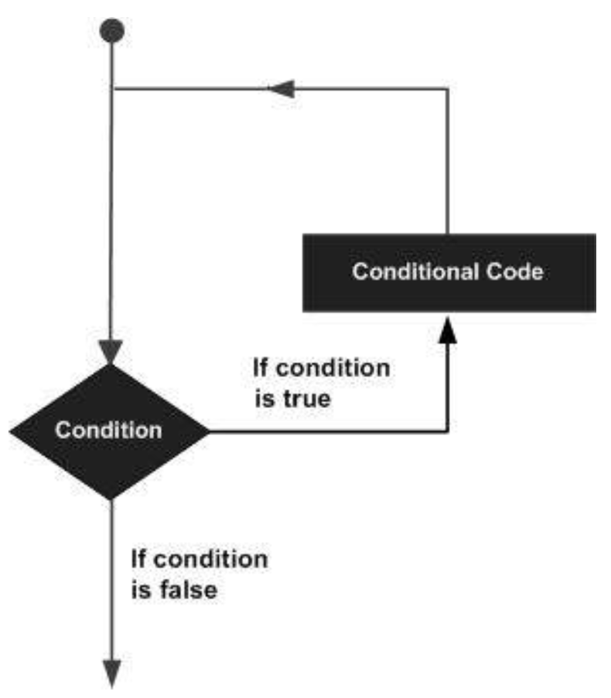
While Loops
This flow chart explains how a while loop works:
The condition may be any expression, and true is any non-zero value. The loop iterates while the condition is true.
When the condition becomes false, program control passes to the line immediately following the loop.

Slide 19
while loops
Use when a loop is required with respect to a conditional expression
while <boolean expression>:
<statements>
When do NOT want to execute statements in case of a false boolean expression
while <boolean expression>:
<statements>
else:
<other statements>

Slide 20
while loops
Use when a loop is required with respect to a conditional expression
while <boolean expression>:
<statements>
while <boolean expression>:
<statements>
else:
<other statements>
When we want to execute statements in case of a false boolean expression

Slide 21
while loop examples: live demo
Example1: Sum all the numbers from 1 to n
1 + 2 + 3 + 4 + 5 + 6 + 7 + 8 + 9 + 10
Example2: Sum all the even numbers from 1 to n
2 + 4 + 6 + 8 + 10 + 12 + 14 + 16 + 18 + 20
Example3: Print the triangle below. Allow user to enter the height of the triangle.
*
* *
* * *
* * * *
* * * * *
Hint: to print to screen without moving cursor to new line => use print(“*”, end=“ ”)

Slide 22
Nested Loops
Python programming language allows to use one loop inside another loop.
You can mix and match for or while loops and make them nested into each other.
A loop that occurs within another loop. Inner loop will be executed one time for each iteration of outer loop.
for <item1> in <collection1>:
for <item2> in <collection2>:
<statements>
Print multiple tables from 1 to 10
for n in range(1, 11):
for m in range(1, 11):
print(n, ”x”, m,”=“, n*m)

Slide 23
Control Statements of Loops
break statement: Terminates the loop statement and transfers execution to the statement immediately following the loop.
continue statement: Causes the loop to skip the remainder of its body and immediately retest its condition prior to reiterating.
pass statement: The pass statement is used when a statement is required syntactically (for the syntax) but you do not want any command or code to execute.

