Slide 1
Wireless Carbon Nanofiber Aggregate Sensor System for Real-Time Water Level Monitoring and Flood Warning
Y.L. Mo, Yuhua Chen , Jinghong Chen – University of Houston
T.G. Cleveland Texas Tech University

Slide 2
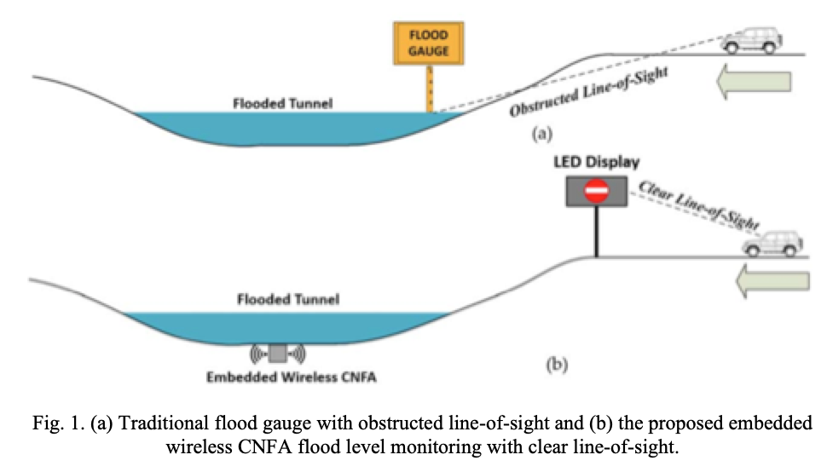
Application Concept
(2) Microprocessor sends signal to warning display
Receiver system
(1) Sensor embedded into material.
Sensor system

Slide 3
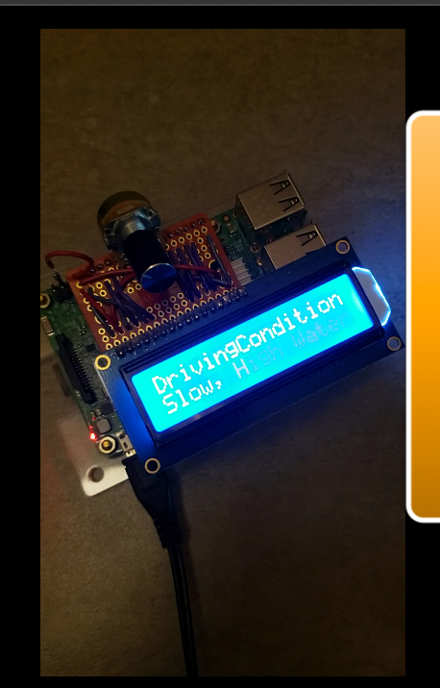
Reciever System
Raspberry PI 3B+
Creates a wireless network and assigns network addresses.
Issues remote commands to the sensor system and retrieves results from the remote
LCD Display
Issues message based on water level.
The reciever will run 15 hours on 2400 m Ah battery use or solar panel for inedfinite runtime feasible

Slide 4
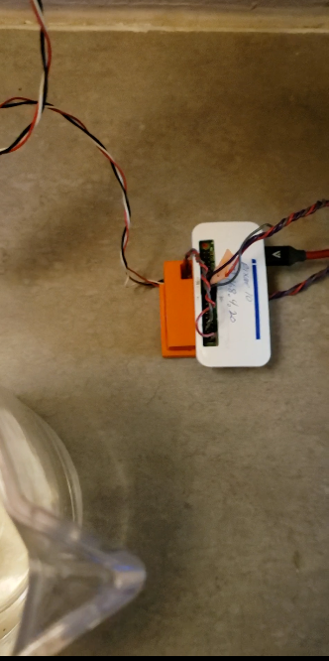
Sensor Controller
Raspberry Pi Zero-W
Controls the MCP3008 A/D Microprocessor
Interprets and stores water level meusurements
Transmits values to receiver device
15 hrs on battery(2400 mAh) ; solar power feasible
Resistor ladder
Contact completes circuit on a bridge circuit
Intent to be able to resolve ~3 mm depth increments

Slide 5
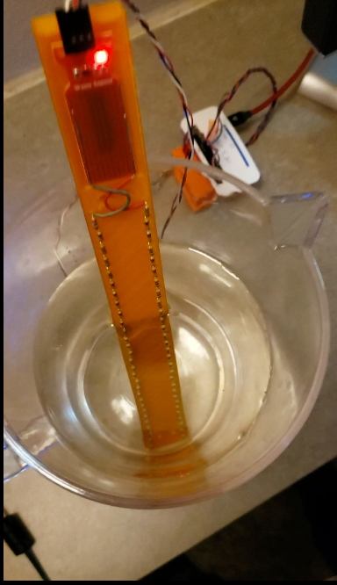
Sensor System
Resistor ladder
Contact completes circuit on a bridge circuit
Intent to be able to resolve ~3 mm depth increments

Slide 6
Housings
Mechanical components – microprocessor housing, resistor ladder are 3D printed
100% infill 3D using PETG was still unexpectedly porous
3D files sent to CNC mill to fabricate a ladder for field test from Garolite

Slide 7
System Integration
Entire system controlled by Receiver that creates the network and send remote procedure calls to the sensor array
Sensor can also run autonomous and store data locally

Slide 8
Status
Contact Sensor
Proven technology
System integration and fabrication of self-calibrating sensor ladders
Ready to test outdoors using solar power
Add GSM module and could admin control using cellular telephony

Slide 9
System in Operation
YouTube video demonstrating integrated system. NO SOUND https://youtu.be/LJPS-5k690Q

