Slide 1

GenAI Rollup Screening Framework
Why the Best AI Acquisition Targets
Are the Ones AI Cannot Replace
February 2026 | Working Draft | Not for Distribution

Slide 2
THE PROBLEM
PE assumes durable workflows and stable human labor models which support recurring revenue. AI challenges both
60–70%
57%
300M
of activities now
automatable
of occupations have
≥25% task exposure
jobs globally face
AI exposure
McKinsey, 2023
Anthropic, 2025
Goldman Sachs, 2023
The question is not WHETHER AI affects these vendors and businesses. It’s which ones capture the value. AI reduces the cost of cognitive work and generalizes across tasks, vertical software risks margin compression and feature commoditization.
The Moat in the Machine | Dutchess Management | February 2026 | Working Draft

Slide 3
APPROACH
A Factor-Based Screen for GenAI Disruption Risk and Upsid
Core evidence
16 hand-validated verticals + 121-vertical LLM-scored extension
Statistical methods
Spearman ρ (rank-order, outlier-robust). Permutation, LOO, bootstrap CI, partial correlations
Market validation
264 equities across 21 proxy baskets. Returns Mar 2023–Feb 2026. Beta-adjusted vs. SPY, IWM, XLI
Validation stack
7 methods: permutation, LOO, threshold sensitivity, panel DID, Webb index, expanded N=21, 121-vertical replication
Confidence
Highest for directionality (moats + automation interaction). Lower for exact point estimates and MOIC
Known limitation
Hand calibrated N=16 is small. Interaction effect (ρ = 0.826) substantially stronger than EBITDA margin alone (ρ = 0.521)
The Moat in the Machine | Dutchess Management | February 2026 | Working Draft

Slide 4
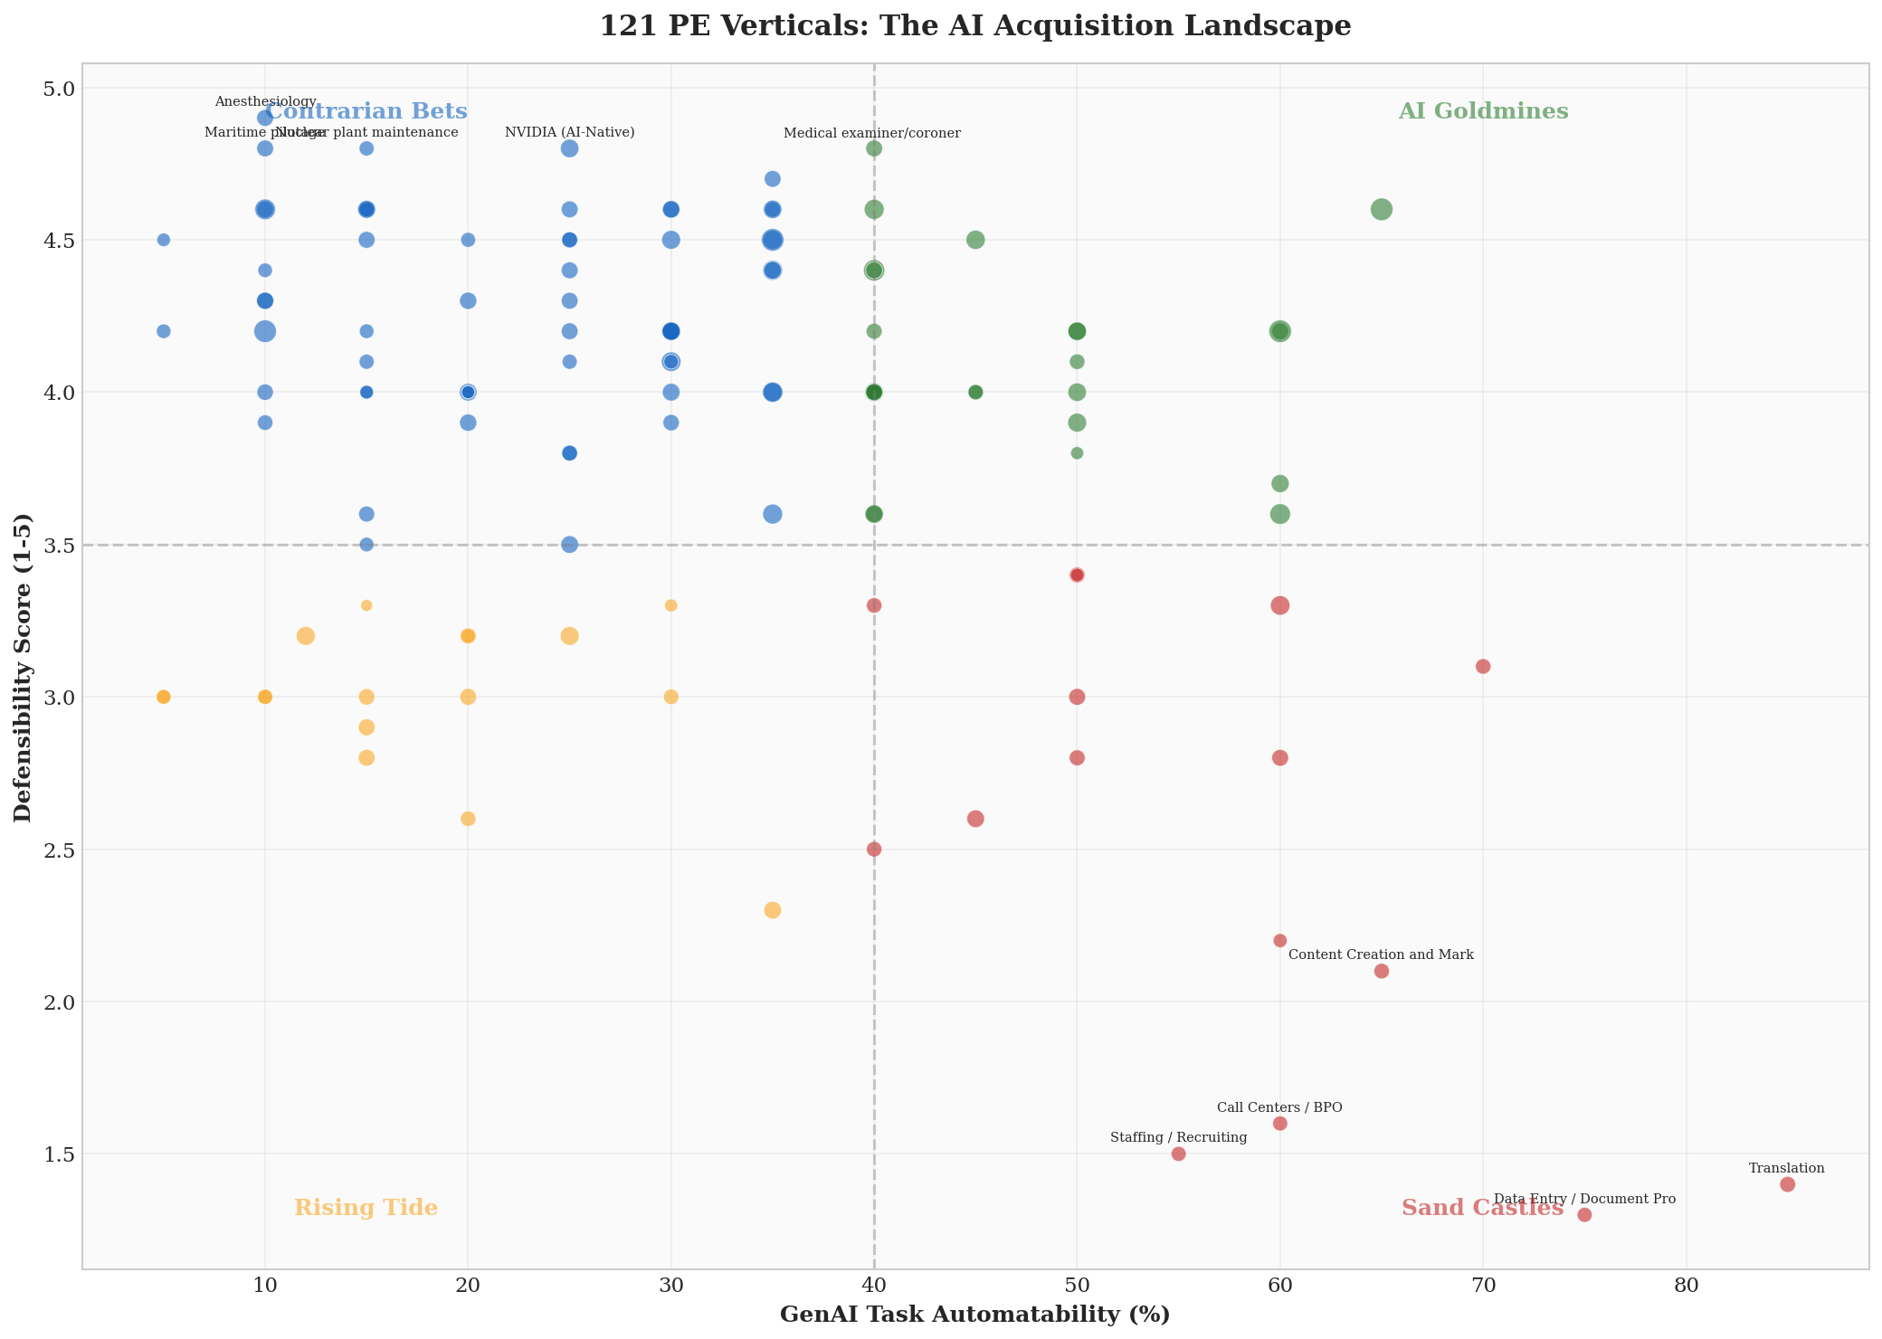
PLAYBOOK BY QUADRANT
These quadrants emerged naturally from data.
BUY
HOLD / BUILD
AI GOLDMINE
CONTRARIAN BET
High Auto, High Moat Deploy AI behind a defensible moat.
Retain 80–90% of margin gains.
Low Auto, High Moat Physical AI upside + consolidation.
Safe from cognitive AI wave.
AVOID
SELECTIVE
SAND CASTLE
RISING TIDE
High Auto, Low Moat No moat = no margin retention.
Market already destroying these.
Low Auto, Low Moat Low AI exposure, low moat.
Roll-up + ops discipline.
The Moat in the Machine | Dutchess Management | February 2026 | Working Draft

Slide 5
WHAT WE FOUND
Score any vertical in 60 seconds.
After analyzing various data points from public matters, the following factors were predictive of the outlook for a given company given GenAI exposure.
Can AI do the work?
1
60pt
Task automation exposure of core revenue work. How much can a language model automate?
Can you keep the gains?
2
60pt
Regulatory environemnt, switching costs, physical presence. Can competitors or the client replicate the AI savings? Can AI make the category obsolete entirely?
Can a robot show up?
3
40pt
Physical AI as margin modifier. Autonomous vehicles, drones, humanoid robotics.
The Moat in the Machine | Dutchess Management | February 2026 | Working Draft

Slide 6
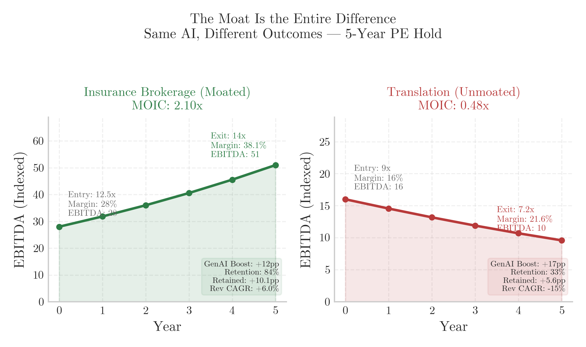
SAME AI, DIFFERENT MOAT → DIFFERENT MOIC
The critical variable is not the size of the AI opportunity — it’s margin retention from AI savings.
MARGIN RETENTION BY QUADRANT
AI Goldmine
80–90% retention
Margin Retention Rate
Contrarian Bet
85–95%
Rising Tide
50–65%
Sand Castle
25–40%
Margin Retention Rate
The Moat in the Machine | Dutchess Management | February 2026 | Working Draft

Slide 7
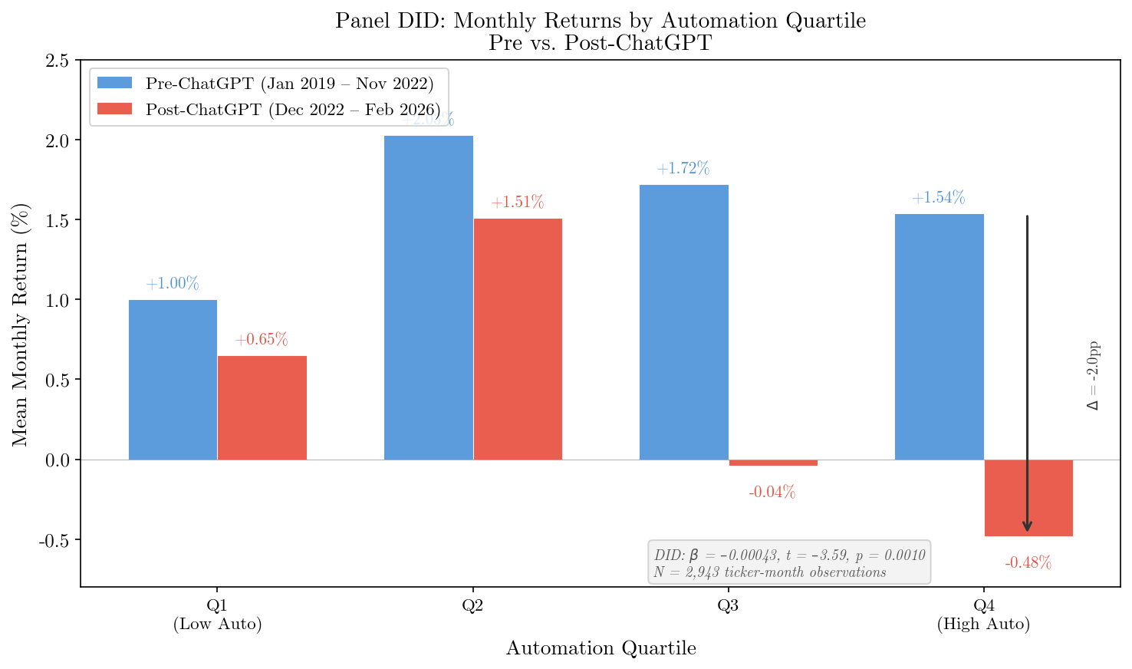
GENAI CREATED AN OBSERVABLE STRUCTURAL CHANGE
The automation penalty appeared only after ChatGPT. A panel DID confirms the structural break where automation exposure drives lower returns.
Panel DID with ticker & month fixed effects. SEs clustered at ticker level. Break date: Nov 30, 2022.
The Moat in the Machine | Dutchess Management | February 2026 | Working Draft

Slide 8
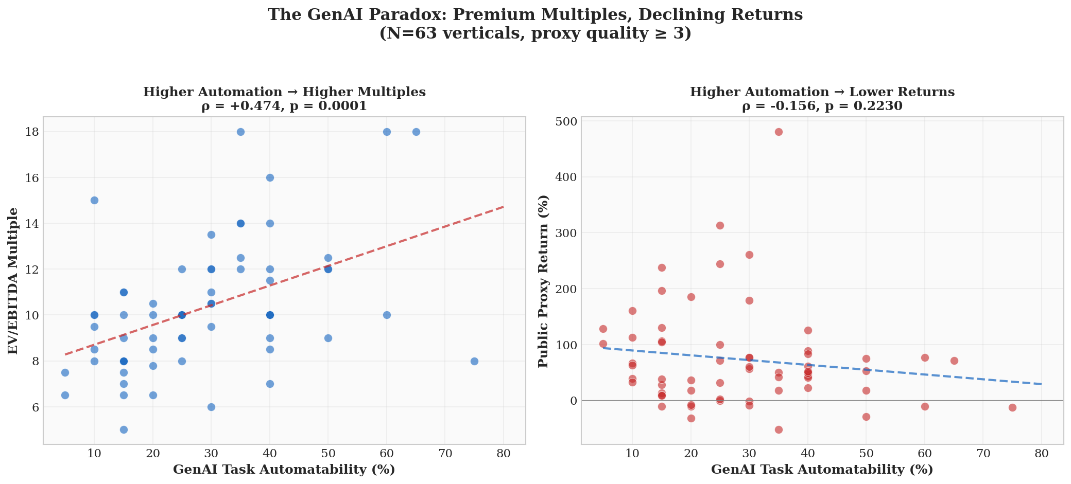
BUYER BEWARE
PE M&A data vs Automation scoring shows buyers were paying premium multiples for Sand Castles.
EV/EBITDA vs. automation: ρ = +0.474 (p = 0.0001)
Returns vs. automation: ρ = −0.584 (p = 0.018)
The Moat in the Machine | Dutchess Management | February 2026 | Working Draft

Slide 9
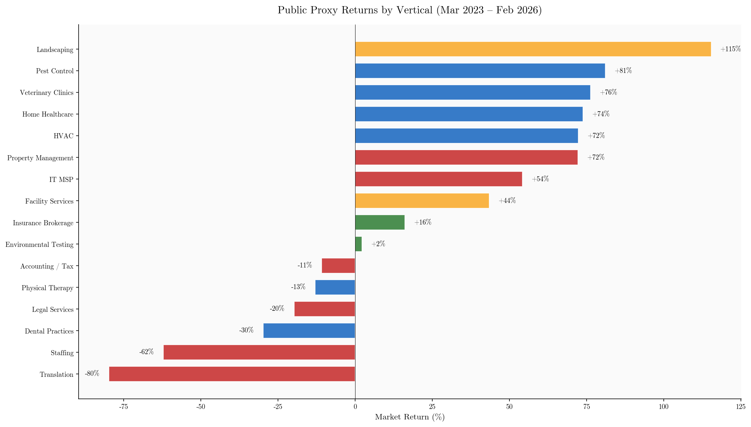
AND LOWER MARKET RETURN DRIVEN BY EXPOSURE IS STATISTICALLY OBSERVABLE AS REPRICING PICKS UP PACE
Yahoo Finance proxy baskets, Mar 2023–Feb 2026. tickers.
Task automatability vs. return: Sand Castles avg. −43% (excl. macro-confounded). Contrarian Bets avg. +44%. ρ = −0.584, p = 0.018.
The Moat in the Machine | Dutchess Management | February 2026 | Working Draft

Slide 10
WHAT WE TESTED AND WHAT FAILED
We started with every variable we could source and ran correlations against EV/EBITDA. Most failed.
The market doesn’t reward AI upside. It rewards the ability to keep it.
Variable | ρ | p-value | Verdict
Task Automatability | −0.119 | 0.661 | ✗ No signal
AI Startup Density | +0.203 | 0.451 | ✗ No signal
Revenue Growth | +0.089 | 0.744 | ✗ No signal
SG&A Ratio | −0.156 | 0.564 | ✗ No signal
Defensibility Index | +0.493 | 0.050 | ✓ Significant
Licensing Requirement | +0.495 | 0.052 | ✓ Marginal
Composite Score | +0.574 | 0.021 | ✓ Significant
The Moat in the Machine | Dutchess Management | February 2026 | Working Draft

Slide 11
IC DECISION BANDS(SEGMENT/VERTICAL LEVEL)
Convert the composite score into default IC action. Bands calibrated valuation spread data
GO
85–100
Proceed with standard diligence
CONDITIONAL
70–84
Proceed with explicit AI-risk mitigations
REPRICE
55–69
Restructure terms or add price protection
NO-GO
<55
Pass unless unique option value
The Moat in the Machine | Dutchess Management | February 2026 | Working Draft

Slide 12
APPENDIX
Backup analyses, validation details, and methods.

Slide 13
SCALE CHECK: 121-VERTICAL EXTENSION
Interaction persists at scale: high-auto ρ = +0.528 (p = 0.0003), low-auto ρ = +0.249 (p = 0.028).
The Moat in the Machine | Dutchess Management | February 2026 | Working Draft

Slide 14
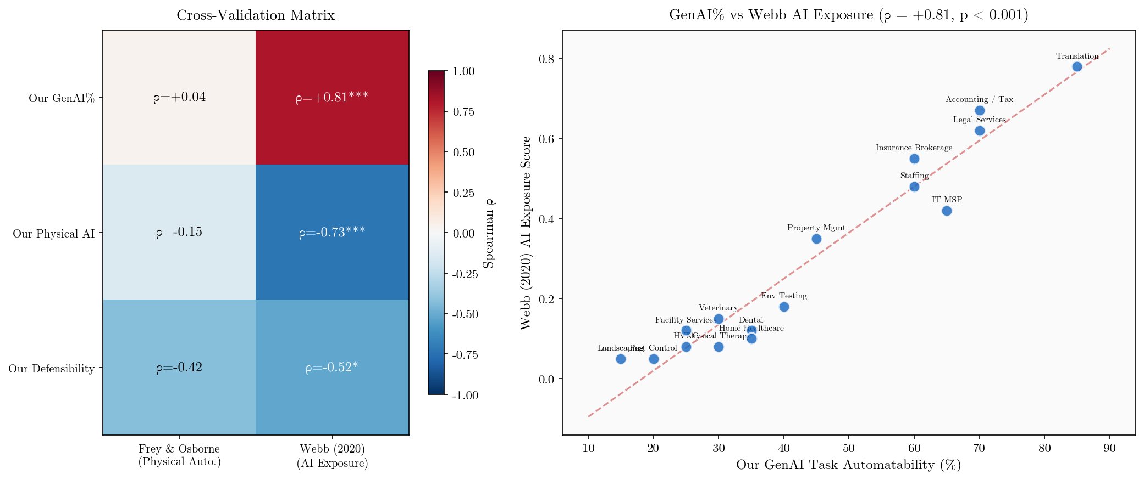
EXTERNAL VALIDATION: WEBB AI EXPOSURE INDEX
GenAI% vs. Webb (2020): ρ = +0.81 (p < 0.001). Strong independent construct validation.
The Moat in the Machine | Dutchess Management | February 2026 | Working Draft

Slide 15
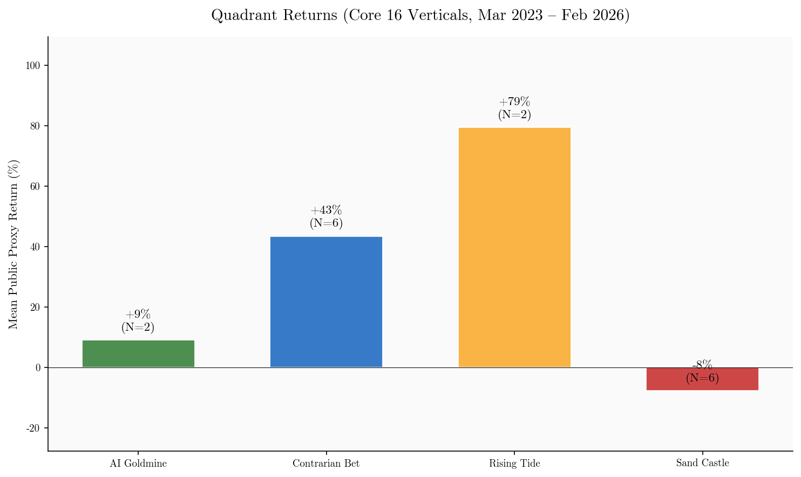
QUADRANT RETURN BREAKDOWN
Core 16 cleaned baskets. AI Goldmines (+9%) confirm moat = shield, not sword.
The Moat in the Machine | Dutchess Management | February 2026 | Working Draft

Slide 16
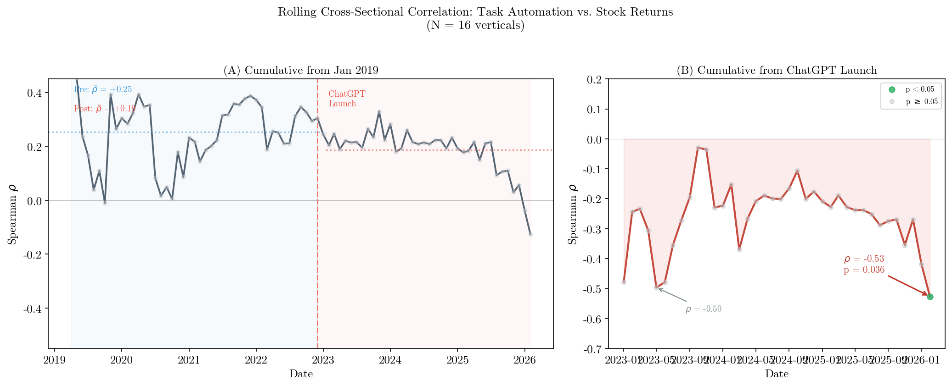
ROLLING CORRELATION OVER TIME
Signal persists through cycles. Currently ρ = −0.53, p = 0.036. Weakened during 2024 rally, re-strengthened since.
The Moat in the Machine | Dutchess Management | February 2026 | Working Draft

Slide 17
DATA INTEGRITY AND TICKER AUDIT
Four proxy baskets corrected
Iron ore miner in Env. Testing, modular space co. in HVAC, REIT + funeral in Landscaping, real estate in Accounting.
Corrections changed details, not direction
Individual vertical returns shifted by up to 80pp. Framework-level signal strengthened after cleanup.
Two Sand Castles show macro confounds
IT MSP tickers are defense contractors (ρ = +0.62 with XLRE). Property Mgmt tracks CRE cycle. Explicitly tagged.
Pure Sand Castle return
Excluding confounded verticals: average −43%. Including all: average −7.7%.
The Moat in the Machine | Dutchess Management | February 2026 | Working Draft

Slide 18
HOW WE STRESS-TESTED THIS
Seven independent validation methods. The core finding survives all of them.
1
Permutation test
10,000 random shuffles. p = 0.019 for high-auto subsample.
2
Leave-one-out
Zero sign changes across all 8 jackknife samples. ρ = +0.71 to +0.91.
3
Threshold sensitivity
Interaction holds at automation thresholds from 25% to 45%.
4
Panel DID
2,943 obs. Chow F = 7.58, p = 0.0005. DID β significant at 0.1% level.
5
External index (Webb)
GenAI% validated at ρ = +0.81 (p < 0.001) against independent academic measure.
6
Expanded backtest (N=21)
ρ = −0.489, p = 0.025. Bootstrap 95% CI does not cross zero.
7
121-vertical replication
Interaction replicates: high-auto ρ = +0.528 vs. low-auto ρ = +0.249.
The Moat in the Machine | Dutchess Management | February 2026 | Working Draft

