Slide 1


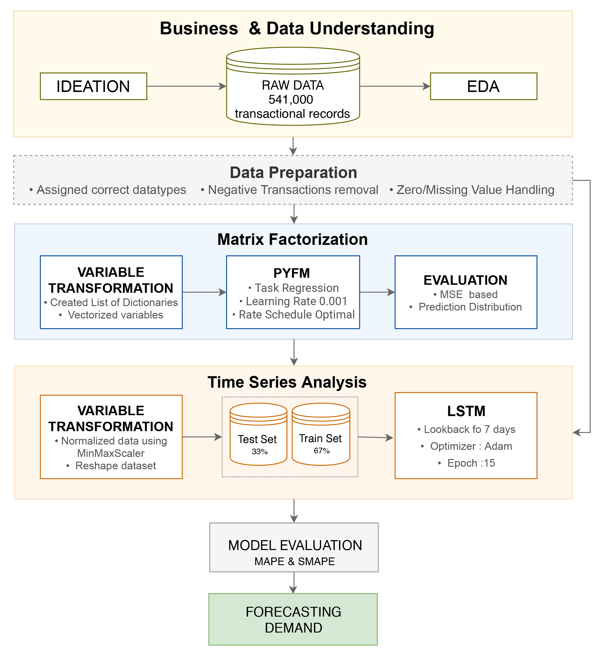
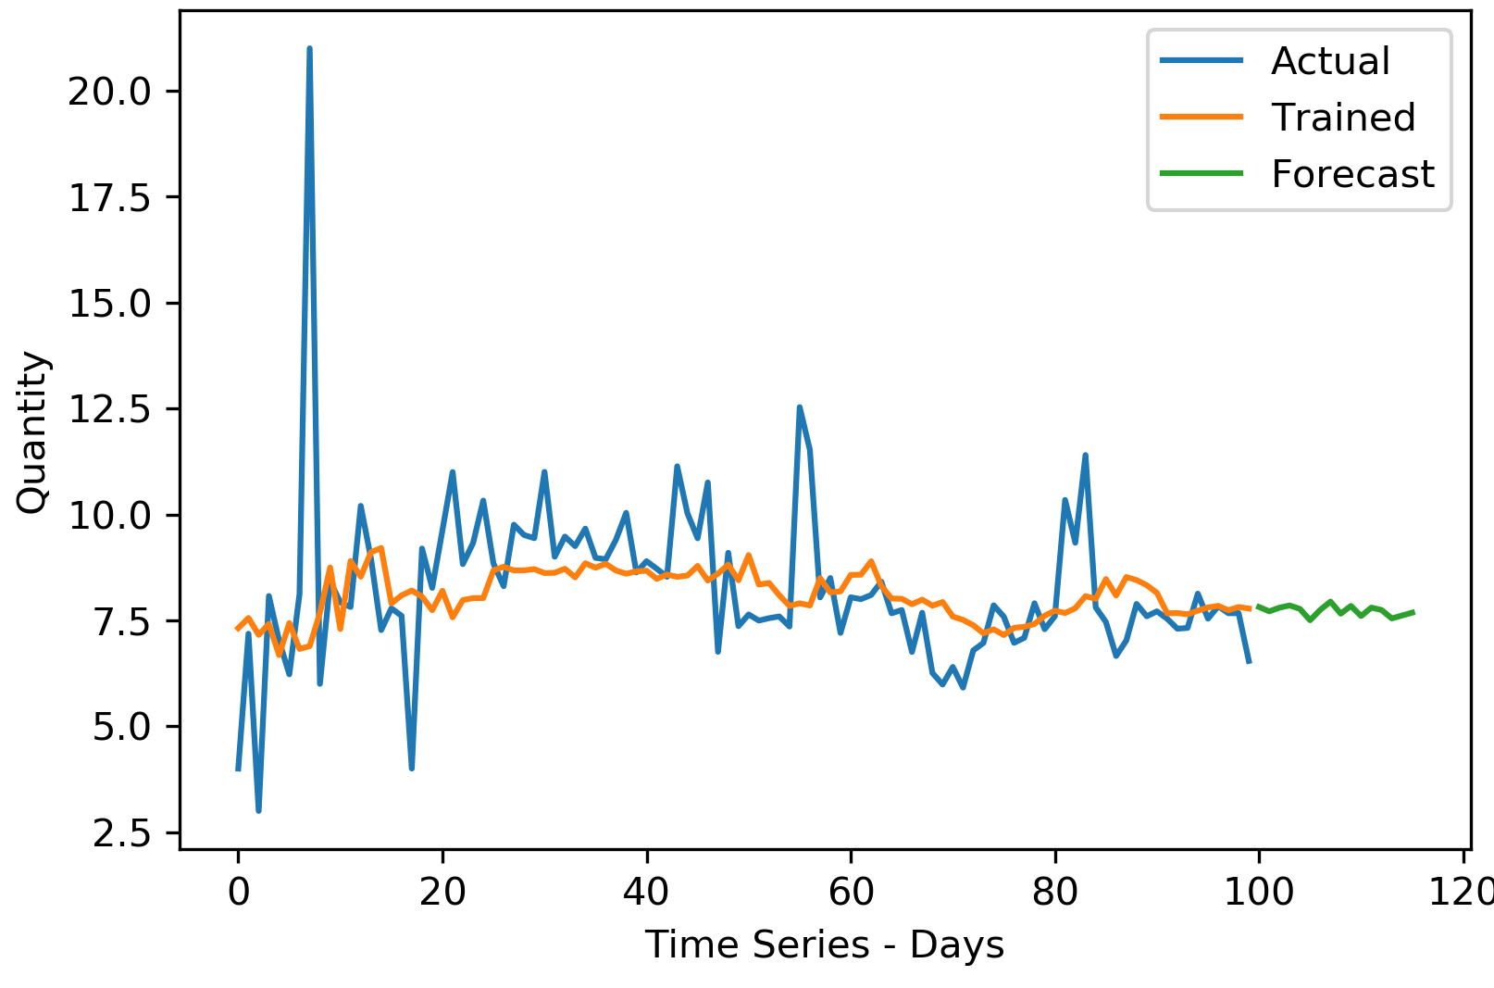
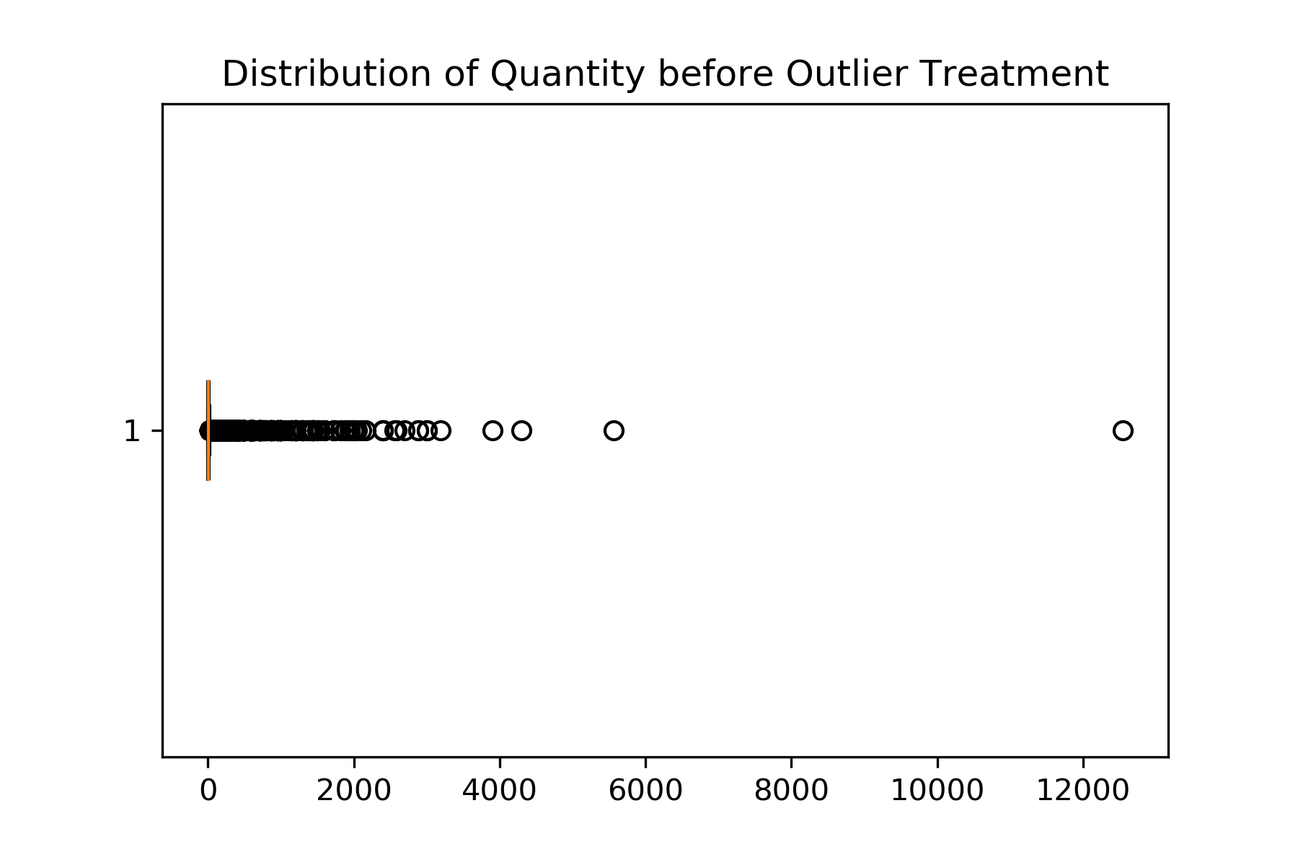
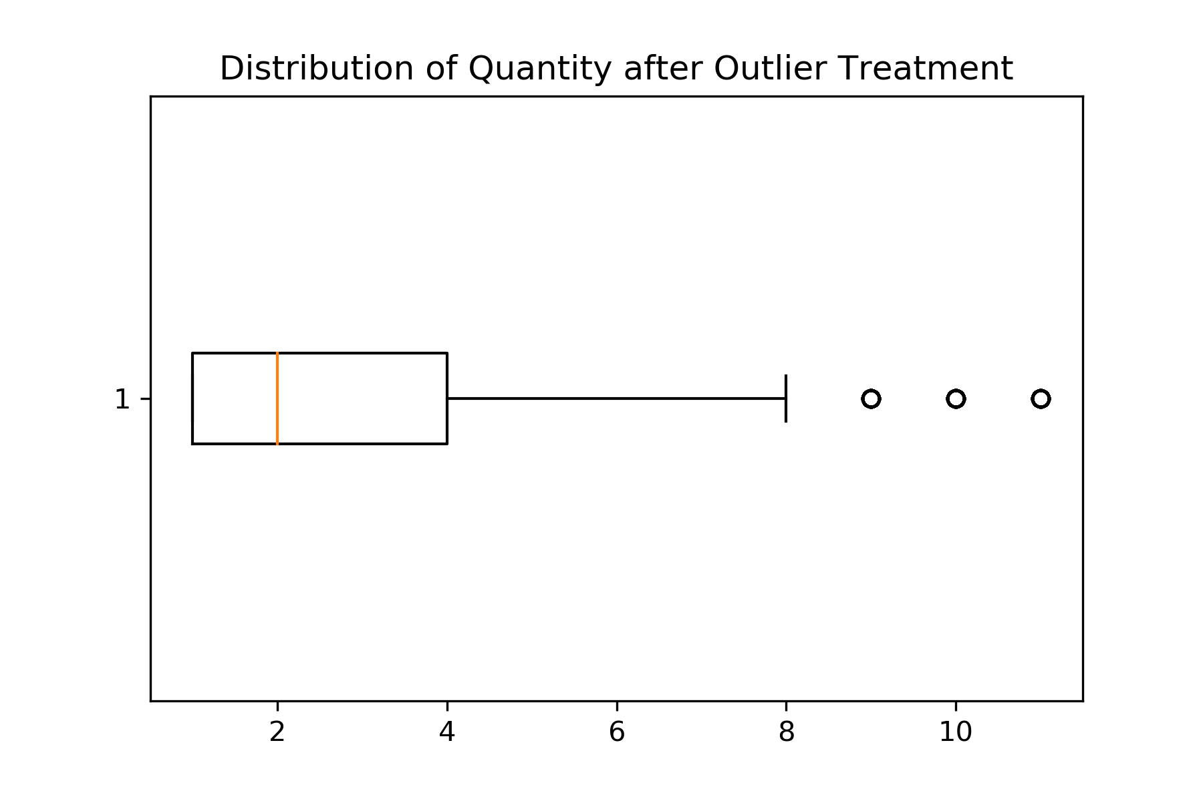
Retail Demand Forecasting – Using Factorization Machines
Jeffrey Chittaranjan, Maharshi Dutta, Mohinder Goyal, Shantam Mogali, Sneha Doddigarla, Matthew A. Lanham
Purdue University Krannert School of Management
jchittar@purdue.edu; dutta33@purdue.edu; goyal62@purdue.edu; smogali@purdue.edu; sdoddiga@purdue.edu; lanhamm@purdue.edu
`
ABSTRACT
METHODOLOGY
RESULTS
For a business to grow exponentially as well as serve customers efficiently, building a sound demand forecasting model is critical. However, sparse demand across retail stores often leads to inaccurate predictions leading to a loss in revenue.
Factorization Machines(FM) is a new model class that helps in the predictive analytics of this sparse demand to facilitate the forecasting process.
FM’s works on interactions between variables using factorized parameters and can estimate interactions even in problems with hugely sparse data. We use the Long short-term memory (LSTM) along with FM’s to produce a time-series forecasting model capable of scalable and accurate for predictions and help strengthen the sales and revenue generation strategy.
Step 1: Towards building the model to use the factorization machines. The data as explained was cleaned up and then prediction was done using PyFM library.
Step 2: The second step was using the LSTM Model for the actual time-series forecast based on the predicted sparse demand using FM. The evaluation metric used was SMAPE value.
Stock Code | 2010 | 2010 | 2010 | 2010 | 2010 | 2010 | 2010 | 2010 | 2010 | 2010
 | 12-01 | 12-02 | 12-03 | 12-04 | 12-05 | 12-06 | 12-07 | 12-08 | 12-09 | 12-10
10002 | NaN | NaN | 1 | NaN | 1 | NaN | NaN | NaN | NaN | NaN
10080 | NaN | NaN | NaN | NaN | NaN | NaN | NaN | NaN | NaN | NaN
10120 | NaN | NaN | 3 | NaN | NaN | NaN | NaN | NaN | NaN | NaN
10123C | NaN | NaN | 1 | NaN | NaN | NaN | NaN | NaN | NaN | 1
10124A | NaN | NaN | NaN | NaN | NaN | 4 | NaN | NaN | NaN | NaN
Stock Code | 2010 | 2010 | 2010 | 2010 | 2010 | 2010 | 2010 | 2010 | 2010 | 2010
 | 12-01 | 12-02 | 12-03 | 12-04 | 12-05 | 12-06 | 12-07 | 12-08 | 12-09 | 12-10
10002 | 2 | 1.8 | 1 | 1.6 | 1 | 2 | 2.6 | 1.2 | 18 | 2.2
10080 | 2.9 | 3.2 | 2.5 | 3 | 2.6 | 2.6 | 3.5 | 2.3 | 2.7 | 3
10120 | 3.3 | 2.4 | 3 | 3.9 | 4.5 | 3.4 | 3.1 | 4.1 | 3.8 | 1
10123C | 2.2 | 2.8 | 1 | 2.1 | 2.6 | 2.1 | 2.5 | 1.8 | 2.4 | 2.9
10124A | 2.8 | 1.8 | 2.7 | 3 | 3.6 | 4 | 2.2 | 3.4 | 3.2 | 3.2
INTRODUCTION
Factorization Machine
It is challenging to build useful forecasts for sparse demand products. If the forecast is lower than the actual demand, it can lead to poor assortment and replenishment decisions, and customers will not be able to get the products they want when they need them. If the forecast is higher than the actual demand, the unsold products will occupy inventory shelves, and if the products are perishable, they will have to be liquated at low costs to prevent spoilage.
Overstocks costs retailers 3.2% in lost revenue while understocks(out-of-stocks) costs 4.1%. Overstocks may be costing retailers $123.4 billion every year, and out-of-stocks take away another $129.5 billion from the bottom line.
The objective of our model is to use the Online retail data set which provides historic sales across various products. We use FM’ s to predict the sparse demand with missing transactions.
Research Questions
How well does FM perform at predicting intermittent demand?
How does FM approach improve the overall time-series forecast?
Fig 4. Pre-FM State
Fig 5. Post-FM State
Lower is better
FM+ LSTM
LSTM
Fig 6. LSTM Model for Daily Demand Forecast
Fig 7. SMAPE score comparison
FACTORIZATION MACHINE
DATA
Fig 2. Process Flow
CONCLUSIONS
Factorization machines (FM) are a generic approach to combine the generality of feature engineering with the superiority of factorization models in estimating interactions between categorical variables of large domain
The data used is a multivariate sequential time-series dataset representing transactional data of UK based online retail store. Transactions ranged from Dec 2010 to Dec 2011. While the dataset contained observations from geographic locations all over Europe, we chose to analyze transactions only from UK, which comprise of 91% (n=493,137) of entire records.
Thus, FMs along with time-series forecasting techniques are found to be better at predicting demand for products with sparse demand
If we have a product with actual business sales of 100 units with each unit selling at $15, the LSTM + FM with a SMAPE error of 14% Predicts sales between 90-115 units, where as the LSTM Model with 54% SMAPE error predicts 60-170 units. This would mean an approx. opportunity cost ranging between $600 to $1100.
Although the FM model improves forecasting accuracy compared to time-series forecasting, the accuracy can be further improved by factoring seasonal demand into the model
Days
K
R
P
Days
Products
Products
Q
Distribution of quantity before outlier treatment
Distribution of quantity after outlier treatment
K
Sparse
Fig 1. The FM Methodology
Fig 3. Before & After Outlier treatment

