Slide 1


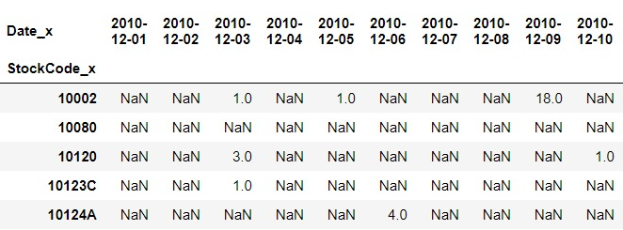
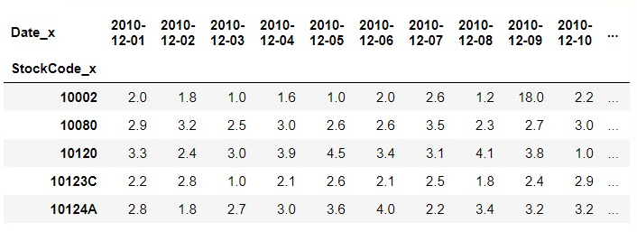
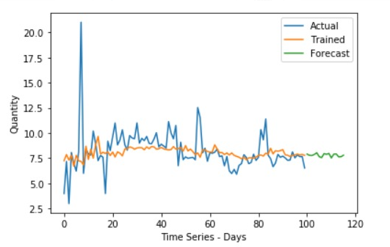
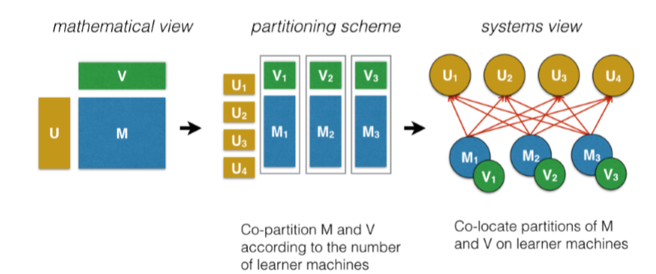
Retail Demand Forecasting – Using Factorization Machines
Jeffrey C, Maharshi D, Mohinder G, Shantam M, Sneha D, Matthew A. Lanham
Purdue University Krannert School of Management
jchitter@purdue.edu; dutta33@purdue.edu; goyal62@purdue.edu; smogali@purdue.edu; sdoddiga@purdue.edu; lanhamm@purdue.edu
Abstract
The Process Flow
Results
For a business to grow exponentially as well as serve customers efficiently, building a sound demand forecasting model is key. However, sparse demand across retail stores often leads to inaccurate prediction leading to loss in revenue.
Factorization Machines(FM) is a new model class which helps in predictive analytics of these sparse demand to facilitate the forecasting process.
FM’s works on interactions between variables using factorized parameters and are able to estimate interactions even in problems with hugely sparse data. We use the Long short term memory (LSTM) along with FM’s to come up with time-series forecasting model capable of scalable and accurate for predictions and help strengthen the sales and revenue generation strategy.
Step 1 Towards building the model to use the factorization machines. The data as explained was cleaned up and then prediction was done using PyFM library. The Mean Square error was tested while executing the FM model yielded the best results for prediction of sparse demand matrix generated.
Step 2 : The second step was using the LSTM Model for the actual time-series forecast based on the predicted sparse demand using FM. The evaluation metric used was SMAPE value. This would yield the actual benefit to Sales/Retail store managers helping them maintain a fitting inventory.
Introduction
Fig 3. Pre-FM State
Fig 4. Post-FM State
It is challenging to build useful forecasts for sparse demand products. If the forecast is lower than the actual demand, it can lead to poor assortment and replenishment decisions, and customers will not be able to get the products they want when they need them. If the forecast is higher than the actual demand, the unsold products will occupy inventory shelves, and if the products are perishable, they will have to be liquated at low costs to prevent spoilage.
The overall objective of our model is to use the Online retail data set which provides us with historic sales across various countries and products for a firm. We use this information given, and make use of FM’ s to predict the sparse demand with missing transactions. The above step then enhances the overall demand forecast achieved with LSTM analysis.
As part of the this project we will answer the following questions:
How well does matrix factorization perform at predicting intermittent demand?
How does matrix factorization approach improve the overall time-series forecasting?
Fig 5 : LSTM Model for Daily Demand Forecast
Fig5: Forecasted Demand
Factorization Machines
Conclusions
Factorization machines (FM) are a generic approach to combine the generality of feature engineering with the superiority of factorization models in estimating interactions between categorical variables of large domain
Reiterate why the problem is important in a sentence or two.
Provide the answers to your research questions.
Discuss how your findings can be used for improved decision-support or decision-making or anything else you feel is an important take-away from what you learned.
Fig 1. The FM Methodology

