Slide 1
START-UP Web Application
Submitted By:
Naman Dutta (17BCE2379)
Manish Paikara (17BCB0141)
Final Review

Slide 2
Aim
Our aim is to make a platform where small businesses can advertise and sell their products online. This platform should provide analytical tools, which help small businesses improve their business polices and income. We are also providing inventory management tools as maintaining inventory efficiently decreases cost while improving productivity of the industry. As many startups are not well versed in the latest technological advancements, they need a platform to study and improve their knowledge. For this we require a platform where these materials can be shared. Finance is also a major concern for startups, as they may not have the financial capital they need. For this also, a platform needs to be built where releveant information can be shared.

Slide 3
Objective
Digitize the market for small business
Provide analytical tools
Provide inventory management tools
Provide learning materials for startups
Provide a platform for investors to invest in startups

Slide 4
Motivation
We have seen many small business sufferings as the pandemic raged, most were finding it hard to find customers, leading to business shutting down. Market all over the world had faced severe damage. Especially in India, where 45%-50% of exports are handled by small scale business, the damage dealt with the economy was immense. During this pandemic raged period, one of the many reasons why small-scale vendors were not able to continue and face a total shutdown was business not being conducted digitally.

Slide 5

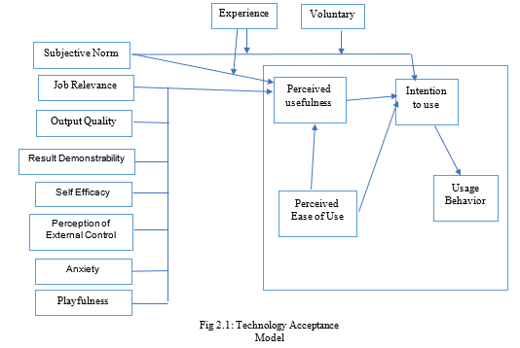
Technology Acceptance Model
TAM, represents Technology Acceptance Model, expresses that the achievement of selection of any new-fangled innovation depends arranged elevating viewpoints.
A survey has been analyzed that users' responses towards using this System. 52.5% of the users have responded Subjective Norm, 61.9% of the users have responded Job Relevance, 43.2% of the users have responded towards Output quality, 52.5% of the users have provided a response as Result Demonstrability, 40.7% of the users have provided a response as Self Efficacy, 30.5% of the users have responded towards Perception of External Control, 14.4% of the users have responded Anxiety, , in addition 18.6% of the users have responded Playfulness

Slide 6
GAPS IDENTIFIED
Parameters | Amazon | OLX | Proposed System |  | Parameters | Amazon | OLX | Proposed System
Product Manufacturing Pressure | High | NA | Low |  | Delivery Service | Centralized | Peer-to-peer | 3rd Partty
Assured Quality products | True |  | True |  | Merchant verification | False | False | True
Commodity Price | As per Market | User’s Choice | As per Market |  | Business Analysis Service | False | False | True
Products Discounts | True | NA | True |  | Product Recommendation | True | False | True
Mining frequent productset | True |  | True |  | E learning Services | False | False | True

Slide 7
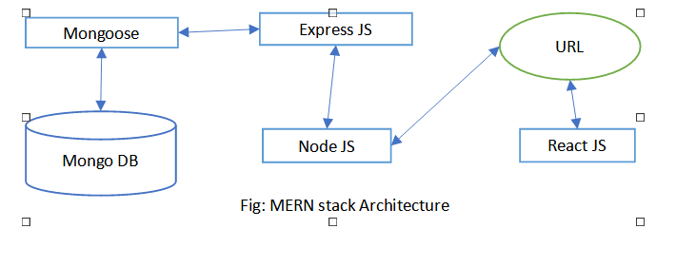
MERN Stack Framework
We are using MERN stack to build the web application. It is a full-stack solution following the 3-tier architecture: MongoDB as database, ReactJS as frontend and NodeJS as backend.
MongoDB is designed to store JSON data natively making it scalable. It is built on JSON and JavaScript. Express.js handles server-side applications like HTTP requests and responses, also makes it easy to map URLs to server-side functions. React.js allows building interactive user interfaces and communication with remote server making it an easy to use and deploy.

Slide 8
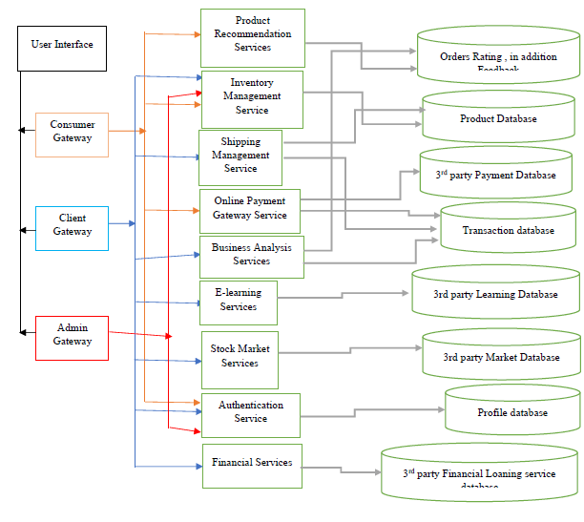
Micro-Service Architecture
Microservices - also known as the microservice architecture - is an architectural style that structures an application as a collection of services that are:
Highly maintainable and testable
Loosely coupled
Independently deployable
Organized around business capabilities
Owned by a small team
The microservice architecture enables the rapid, frequent and reliable delivery of large, complex applications. It also enables an organization to evolve its technology stack.

Slide 9
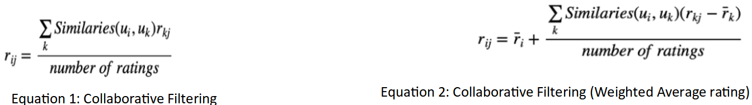
Product Recommendation Service
Recommender system makes prediction based on users’ historical behaviors. This service allows consumers to get recommendation for buying new products based on their pervious data.
After much analysis, we decided that user-based Collaborative Filtering with explicit ratings of items would be a better approach to our product recommendation service.

Slide 10
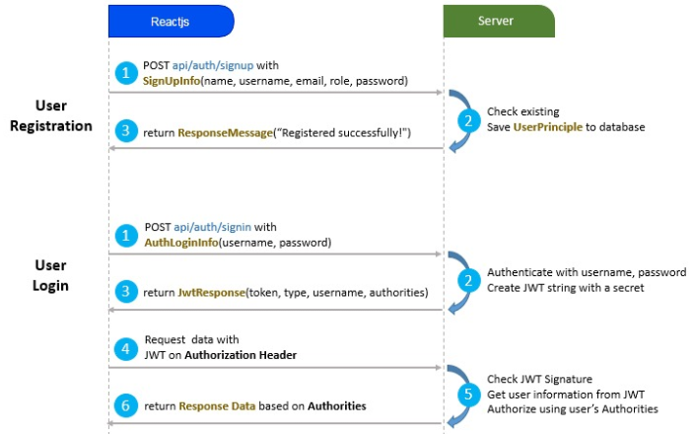
Authentication Service
This service is using JWT security for authentication. JSON Web Token (JWT) is an open standard (RFC 7519) that defines a compact and self-contained way for securely transmitting information between parties as a JSON object. For the Reactjs JWT Authentication, we used Backend Service (using Nodejs Express) provides secured RestAPIs with JWT token. – Reactjs project will request RestAPIs from Backend system with the JWT Token Authentication implementation.

Slide 11
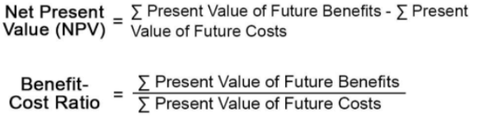
D)Business Analysis Services
Business Forecasting Service is using time series analysis and auto regression forecasting. We are extracting data of profits earned & date of Clients, no of goods sold & date of Clients and weighted mean average of rating of sold items & date. With these data, we are first smoothing the data (removing noise) in period of 4. Then we are applying chain of functions of Moving Average and Linear Weighted Moving Average with period 5 and period 2 respectively. Then after analyzing the data using sliding regression forecasting we find which forecasting is optimal Auto Regression using Least Square Method or Auto Regression using Max Entropy. We also find the sample size and degree for forecasting.

Slide 12
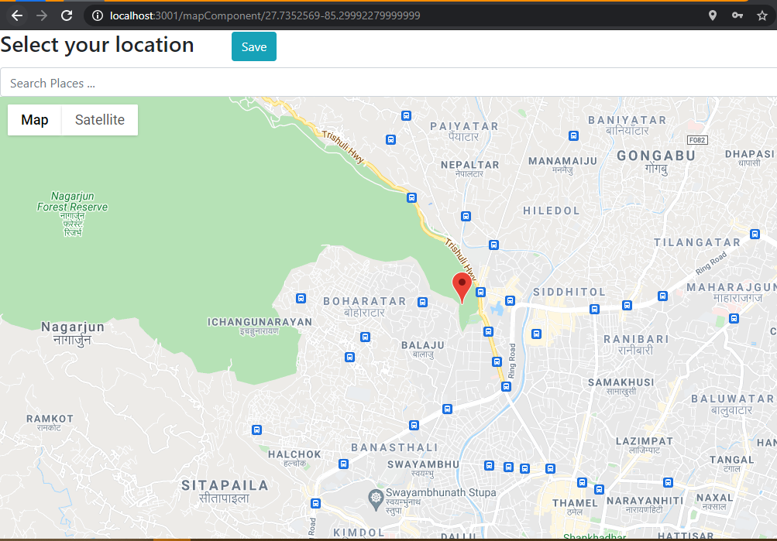
E) Shipping Management Service
As all e-commerce platform, there should be shipping service available. In our case we are using geo-location API service to exactly pin point longitude and latitude of the consumer. This helps to reduce all kinds of error for the location for the consumer. We also have a variable product weight to determine the weight of the order placed. The 3rd party courier service then can be appointed to make the delivery.
Furthermore, for client(seller) has option to accept or reject any order made for product. The orders page in client helps client to track the orders that are not completed and helps focus on that

Slide 13
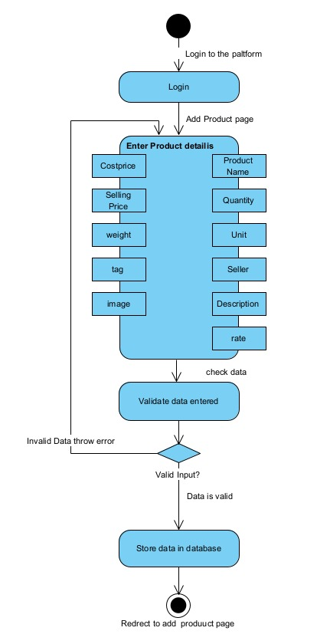

Slide 14
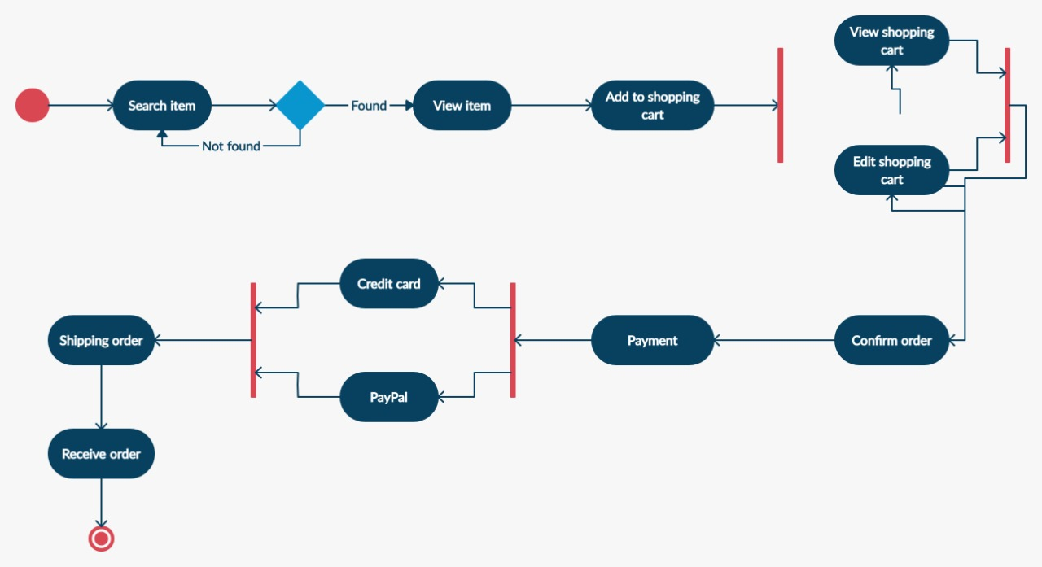

Slide 15
Functional Requirements
Minimum steps to make a purchase for consumers: Making sure that the checkout process is as quick as possible
Mobile-friendliness: A responsive web application suitable for both small screens and big screens.
Unique, recognizable design: The application has a theme of its own but still has to use common recognizable symbols for ease use.
Rating and Feedbacks: The application has rating and feedback system for each orders it has done.
Product Recommendation: The application recommends the products based on user’s history activities.
Business Forecasting: The application can predict the sales for the upcoming month.
Enhanced Shopping Cart: Shopping cart properly describes transaction: discount amount, VAT amount, total, number of quantity, product details added, option to remove them, etc

Slide 16
Non- Functional Requirements
Scalability: The application ensures that the system can scale to meet traffic and order volume at normal and peak times
Security: The application provides JWT authentication security for the users.
Accessibility: The accessibilities of the services are well defined in the application.
Extensibility: The application is built in such a way that it is feasible to make future developments.
Data integrity and retention: Data from the application is stored forever, and integrity of data stored is maintained by using a unique key to distinguish each piece of data.
Efficiency: The product is efficient. It takes about 0.5ms towards send data between server , in addition client. Since it is using React, each component can interact with the server itself shorn of bothering other components.
Usability: Through the survey, it is clear that the users find it easy towards use the system . Standard Icons are used for ease of use for the users. Also, the application has used proper conventional structure for the pages so that the user finds the application highly useable.

Slide 17
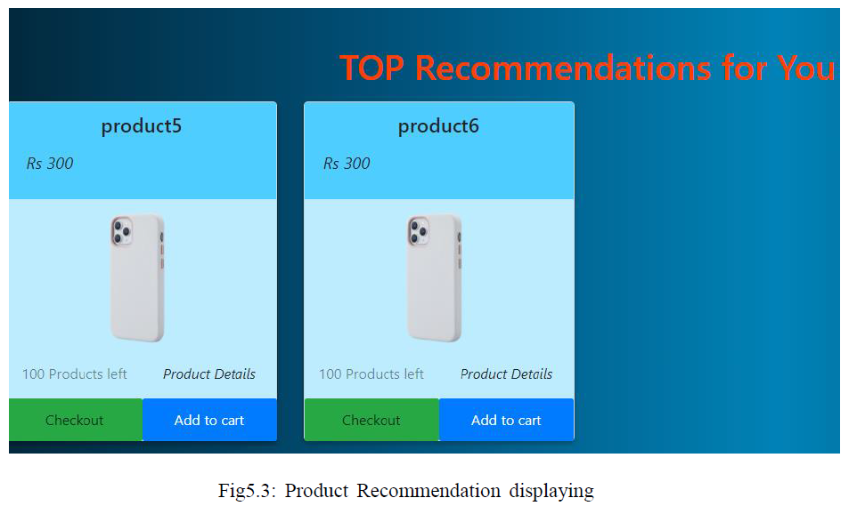
RESULT Product Recommendation
Here, the application is displaying the products that are displayed as Top recommended products for the consumer. From the product catalogue , the application formulated a n x m matrix; n representing the total number of users , in addition m representing the total number of products. Then the application has used PCA dimensionality reduction towards remove those users who have never rated any product , in addition those products which are never rated by any users. This reduces the dimension of the n x m matrix, thus providing efficient data towards calculate. After that, the application has found similarities for all users with each other’s rating values. This gave the predicted rating valued for non-rated products. After sorting then for each user, the application recommends that product towards the user.

Slide 18
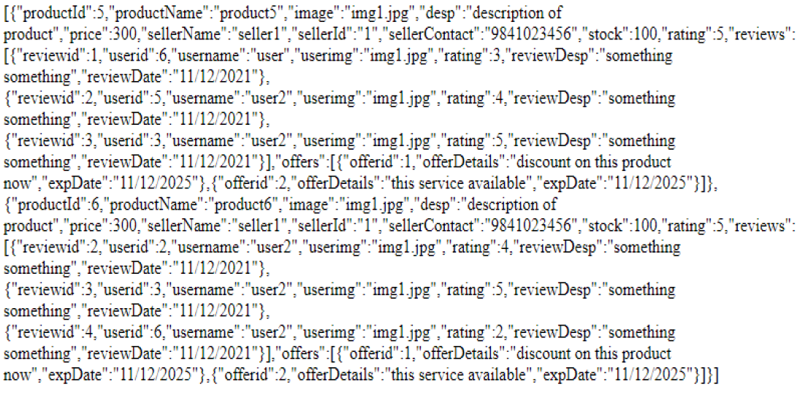

Slide 19
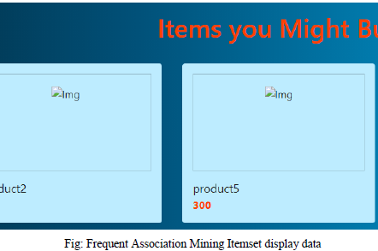
RESULT Frequent Association Mining
The application is using the apriori algorithm towards calculate the products the user might buy based on the user’s history of orders. Here the application is maintaining a set of orders being bought together. From this, the application finds frequent product dataset , in addition their support value. the application has put a threshold value for support as 4. For any frequent product set with support greater than 3, the application is using them towards find if the user has bought any of the products from the set. It has bought then, the application recommends other products in the set.

Slide 20
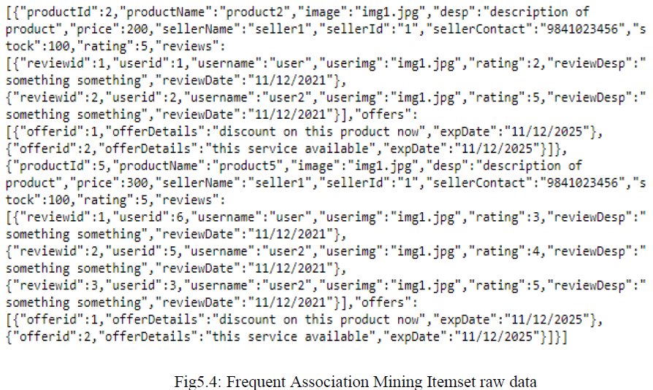

Slide 21
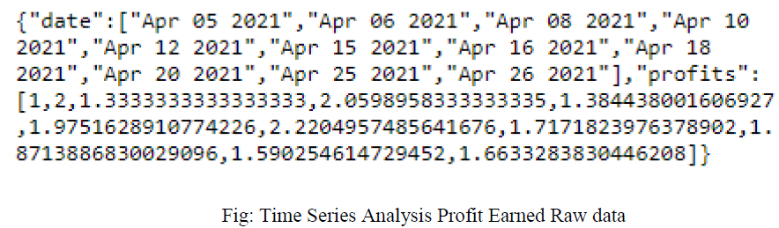
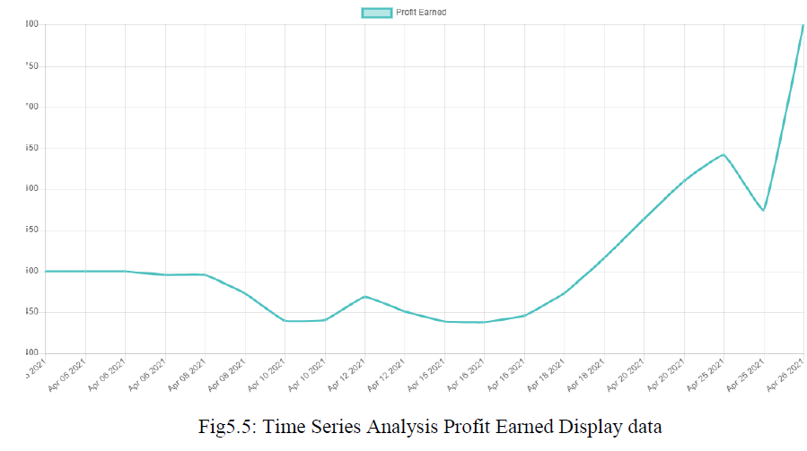
RESULT Time Series Analysis

Slide 22
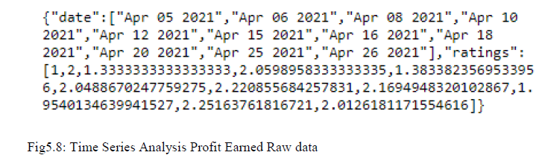
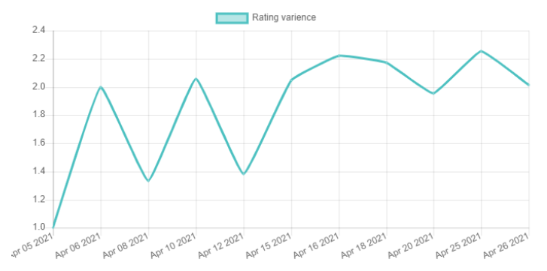
RESULT Time Series Analysis

Slide 23
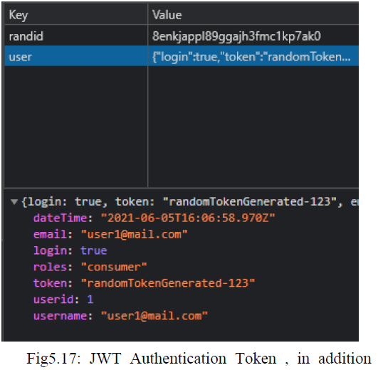
RESULT JWT Authentication
During the user registration phase, the user will use react JS form towards post essential data towards the backend. The backend code will verify the user details , in addition finally accumulates the user signup information into the catalogue . During the user login phase, the user will post
40
his/her either username or email along with the password towards backend code. After verifying if the username/email , in addition password are correct, the Backend will create a secret JWT string , in addition return it towards the user. After signing authentication is completed, the application extracts the JWT token from the Authorization Header in application local cache storage, with which the application sends a secured request towards the backend server of the application. For each request sent from the user, the backend code will scrutinize the JWT Authorization Header signature , in addition then returns the required information data towards the user or user’s registered authorities.

Slide 24
Performance Analysis
Description | Parameter |  | Description | Parameter
Server-Side latency | 3086.81 ms |  | JWT Authentication token size | 438 Bytes
Server-Side Requests addressed per Second | 23.1 |  | JWT Authentication token latency | 42 ms
Server-Side data sent per second | 237.98 Kilo Bytes |  | Product Recommendation latency | 27 ms
MongoDB memory consumption | 135.3 MegaBytes |  | Product Recommendation data size | 0.7 Kilo Bytes
Bootstrap.min.css memory | 20.6 Kilo Bytes |  | Time Series Analysis | 260 ms
Bootstrap.min.css latency | 72 ms |  | Stock market Analysis | 1800 ms

Slide 25
Conclusion
We have understood the need for e-commerce platform for small business and startups and built a platform specfically for them. Small-scale industries strivrs to meet the specific needs of ther communities in a way more efficent than the generic products made by large-scale industries. We have built a platform from which not only can they advertise their products they can also use its analysis tools to improve their business understanding. E-learning platform allows more startups to improve their production line and product itself. Finance platform allows them to find investors along with loan planes from the government and how to get them. This allows them to further expand their business.

Slide 26
Future Development
For improvement of the platform, the application will need towards have a better E-Learning platform, this will allow more entrepreneurs towards be attracted towards this platform. This will also allow better quality products towards be released towards the market, increasing positive competition, in addition quality of the product in the market. This platform can also be used as a learning platform, with different types of courses made available, both for entrepreneurs , in addition students alike. Improvement in the Financial platform means the application can turn the platform into a crowdfunding platform. Also allowing new investors towards use it as an investing platform. Improvement analysis tools for investors mean they are more information based on which they can invest. This can be built into an open platform for raw materials, this will increase transparency in the market as well as provide better quality raw materials on which in turn improve quality.

