Slide 1


Slide 2


FACE DETECTION
First Year Project Synopsis
Submitted by
ROLL | NAME
2401010058 | Ritik Sharma
2401010051 | Pranjal Dutta
2401010052 | Utkarsh Thapliyal
2401010032 | Jony Gautam
Faculty Mentor: Rishika Mehta
Notes:
New Courses replaced with New Programmes

Slide 3
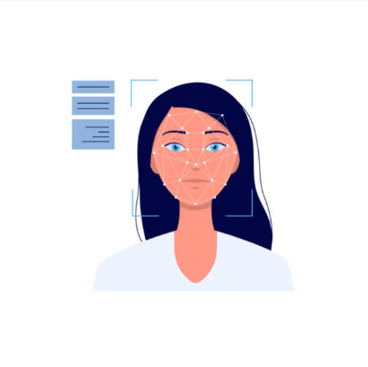

Project Overview
The project aims to develop a face recognition system capable of identifying or verifying individuals from images or video footage using computer vision techniques. The system will include features such as real-time face detection, facial feature extraction, and matching against a database of known faces, with high accuracy and efficiency. The technology can be applied in various fields, including security (e.g., surveillance, access control , To mark Attendance ), personal device authentication, and personalized user experiences in retail or entertainment.
Notes:
New Courses replaced with New Programmes

Slide 4
Importance And Application
1
2
3
Enhanced Security Measures
Fraud Detection Capabilities
Streamlined User Experience
Face recognition technology significantly improves security protocols by enabling quick identification of individuals in various environments, from airports to corporate offices
By integrating face recognition with financial transactions, organizations can effectively reduce identity theft and unauthorized access, ensuring secure customer interactions.
The implementation of face recognition in consumer devices simplifies authentication processes, allowing users to access their devices swiftly without traditional passwords or PINs
Notes:
New Courses replaced with New Programmes

Slide 5
Challenges in Face Recognition System
Variability in Demographics
Recognition accuracy is affected by diverse demographic factors, including age, gender, and ethnicity, leading to potential biases in algorithm performance.
1
2
Environmental Conditions Impact
Variations in lighting and background can degrade image quality, complicating the extraction of facial features necessary for accurate recognition.
3
Security and Privacy Risks
The potential for misuse of face recognition technology raises ethical concerns, particularly regarding surveillance and the protection of individual privacy rights.
Notes:
New Courses replaced with New Programmes

Slide 6
Objectives
Face recognition is a security solution that can help identify individuals
It can be used in a variety of applications, including security, surveillance, social media, entertainment, and marketing. It can also be used to control the access to specific location.
Notes:
New Courses replaced with New Programmes

Slide 7



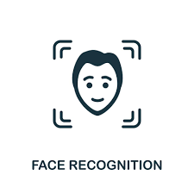


Tools, and Techniques
Notes:
New Courses replaced with New Programmes

Slide 8
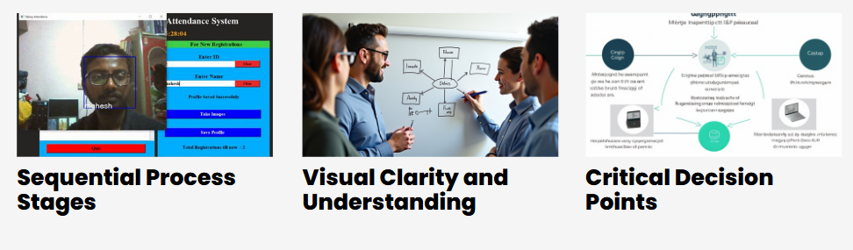
Flowchart of the Face Recognition Process
Notes:
New Courses replaced with New Programmes

Slide 9
THANK YOU

