Slide 1

CAPSTONE PROJECT (LOAN DATA)
Checkpoint 2
Checkpoint 1
Checkpoint 3
Visualization using Python
Exploratory Data Analysis
Visualization using Power Bi
Model Building using ML Algorithms
Data Manipulation using Python
SQL – ORACLE
Statistical Analysis using Python
Data Analysis using Big Data Tools
Data Analysis on Cloud
Deployment of ML model using Flask
AI ACADEMY
BATCH I GROUP 5
_{Shubhaditya Dutta}
_{Narayani Patil}
_{Chinmay Raut}
_{Jayanth Marisetty}
_{Rimjhim Gupta}

Slide 2
INDEX
01
04
07
Data manipulation using Python
Exploratory Data Analysis
Data Analysis using Big Data Tools
02
05
08
Analysis using SQL Queries
Data Analysis on Cloud
Visualization using Power-BI
09
03
06
Statistical Analysis using Python
Deployment of ML model using Flask
Model Building using ML algorithms

Slide 3

Road Map
Deployment of ml model using flask
Big data
(Data manipulation, EDA, ML Models)
AZURE CLOUD
(LINKED SERVICE TO POWER BI)
Ml modelling
Exploratory data analysis
Data Manipulation
Notes:
Tags: path, journey, roadmap, signs

Slide 4
DATA MANIPULATION USING PYTHON
Step 5
Treating Outliers
Step 4
Treating missing values
Step 3
Detecting Outliers
Step 2
Detecting missing values
Step 1
Acquiring data

Slide 5




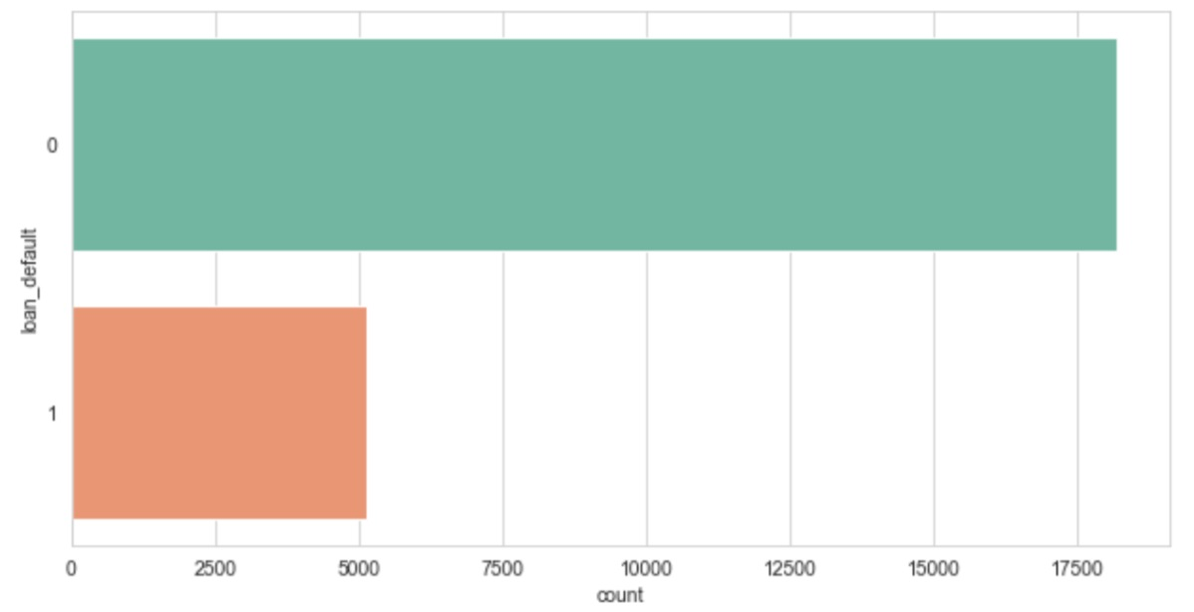
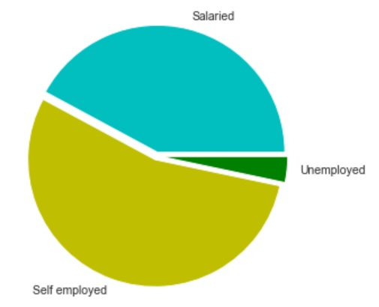

Slide 6
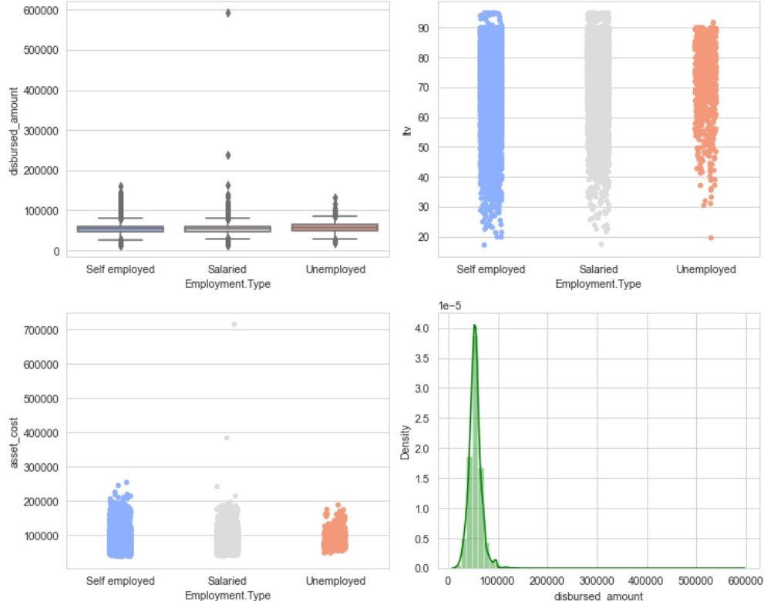
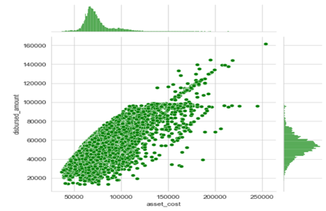
Outlier detection and treatment
The joint plot shows the direct relation between asset_cost and disbursed_amount.

Slide 7
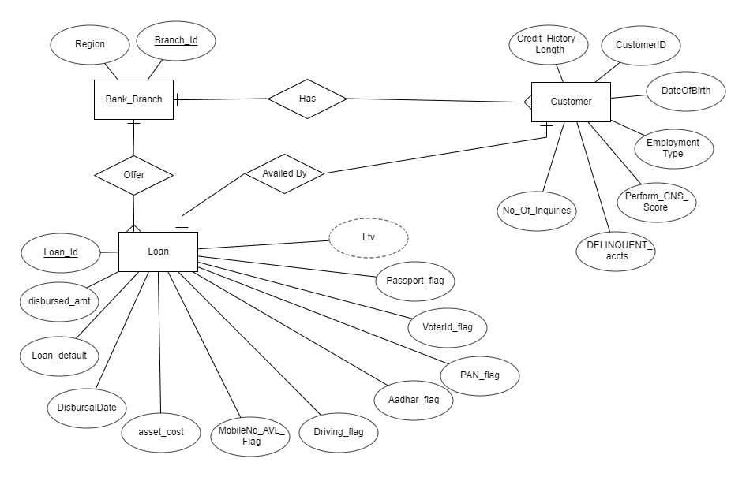
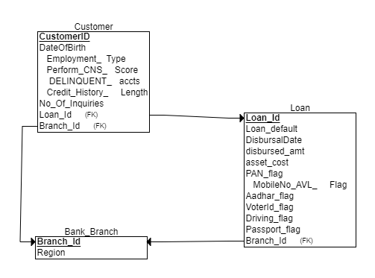
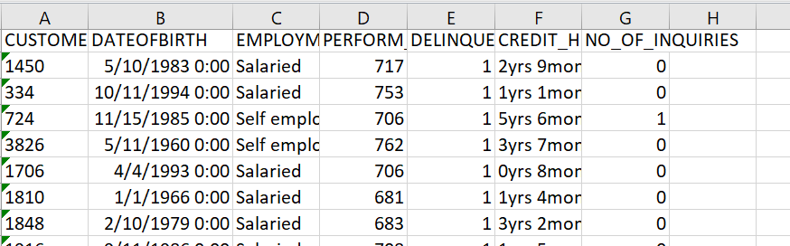
SQL - ORACLE
Entity Relationship Diagram
Relational Schema
Perform SQL Queries
Generate Reports of those customers where the loan is disbursed based on the Cibil score ranging between 670 -780 and who acquired the loan for > 1 time and loan default is 1 or 0.

Slide 8
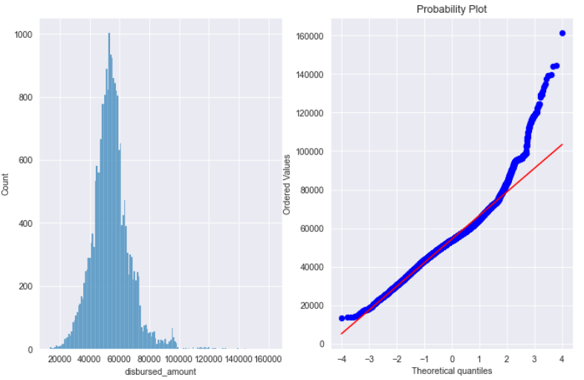
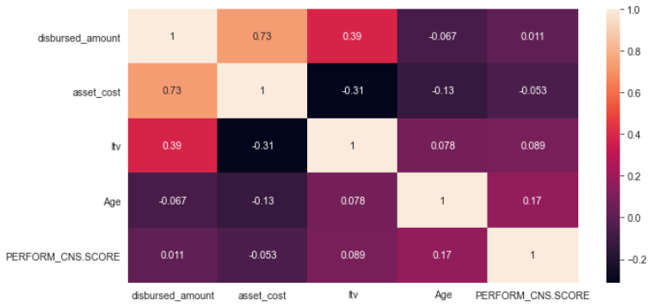
STATISTICAL ANALYSIS USING PYTHON
It is evident that the loan amount distribution is normal with a positive skew shown in both hist plot and Q-Q plot (the higher values shows higher variance) may be due to the loan base being comprised of more than one group of people that is based on employment type.
We chose disbursed_amount as our primary feature for variance analysis as it shows higher correlation with most of the other numerical features. It is dependent on asset cost and loan to value ratio excluding loan charges, hence will capture the linear relationship between all these features.

Slide 9
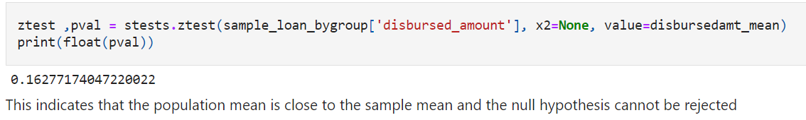
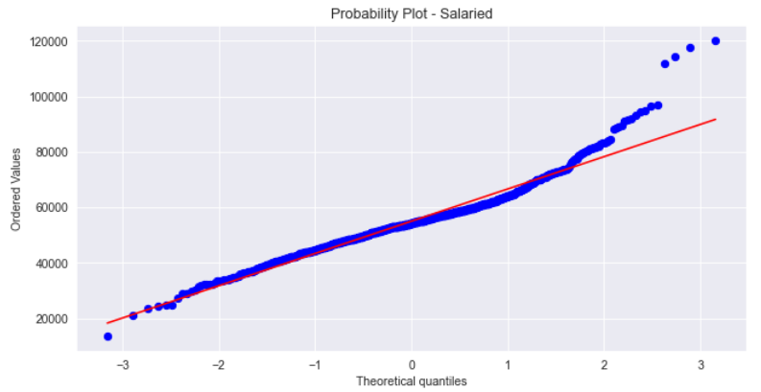
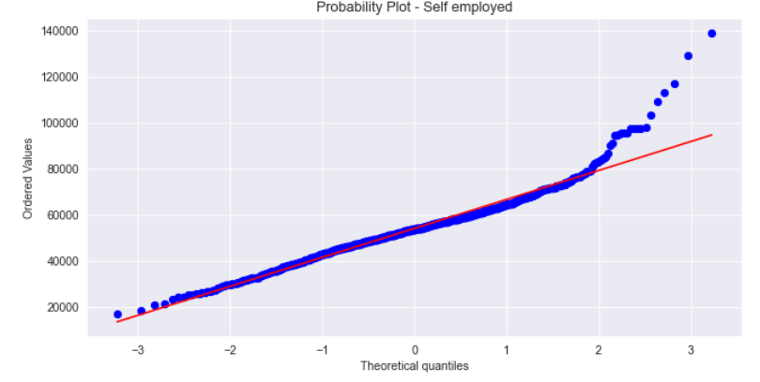
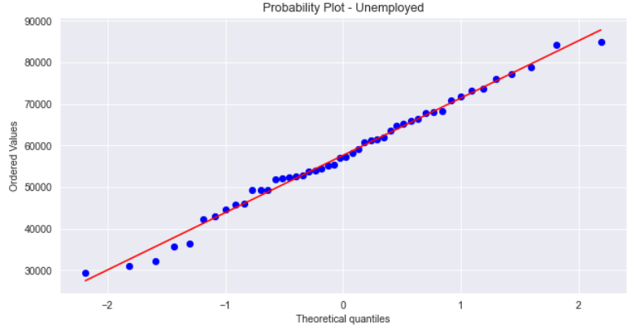
Hypothesis Testing
1. Determine if the chosen sample represents the whole population.
H₀: μ₁= x_bar (population mean of disbursed amounts and the sample mean are equal)
H₁: μ₁!=x_bar (population mean of disbursed amounts and the sample mean are not equal)
α = 0.05.
2. By plotting Probability plot, it is observed that the sample loan amount distribution based on each employment type is normal.

Slide 10
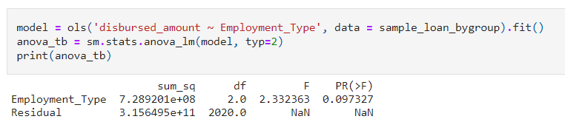
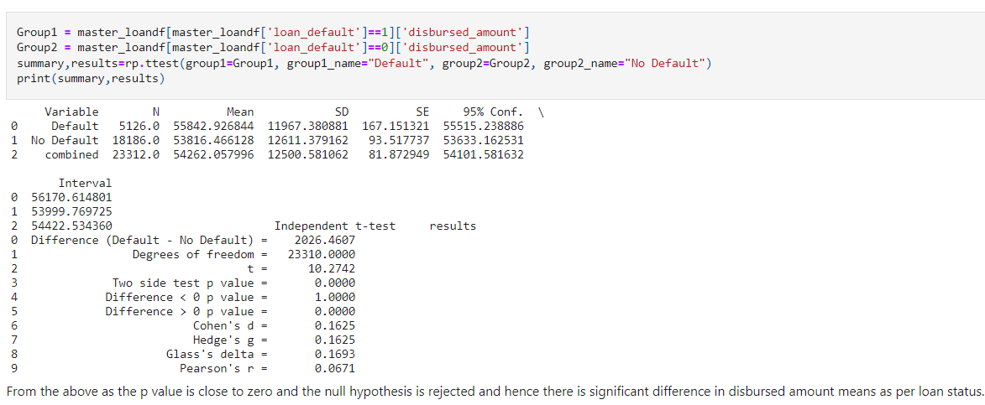
3. H₀: μ₁= μ₂ = μ₃ (mean of disbursed amounts as per employment within the population are equal)
H₁: Not all disbursed amount means as per category are equal
Conducting ANOVA Test
Using regression of loan_amount of the whole sample on loan amount with different employment types.
From the above, p_value > significance of 0.05 and the null hypothesis cannot be rejected. So, we conclude that various employment type do not contribute to insample variance. The loan amount is evenly distributed between different groups (between group ANOVA test). The sample shows within group variance rather than between group variance.
4. H₀: μ₁= μ₂ (mean of disbursed amounts as per loan status with-in the population are equal)
H₁: Not all disbursed amount means as per loan status are equal

Slide 11
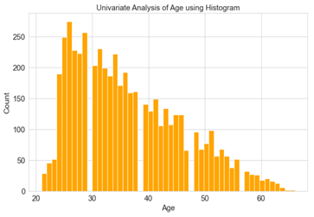
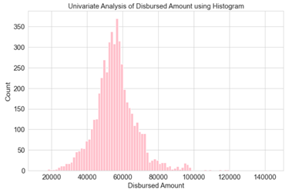
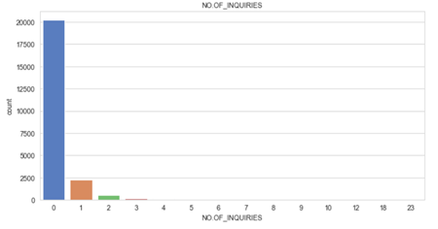
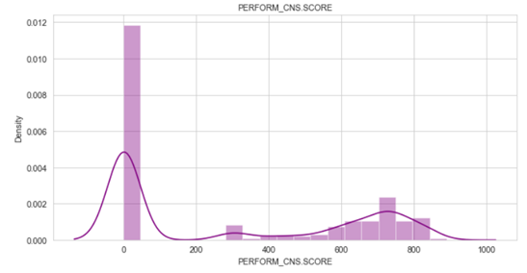
EXPLORATORY DATA ANALYSIS

Slide 12
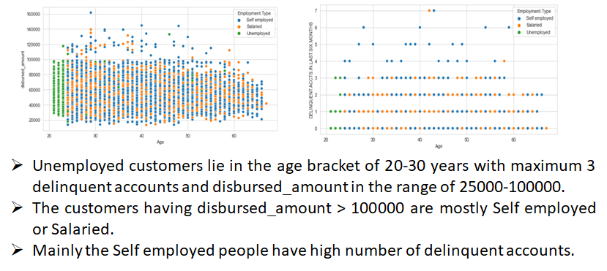
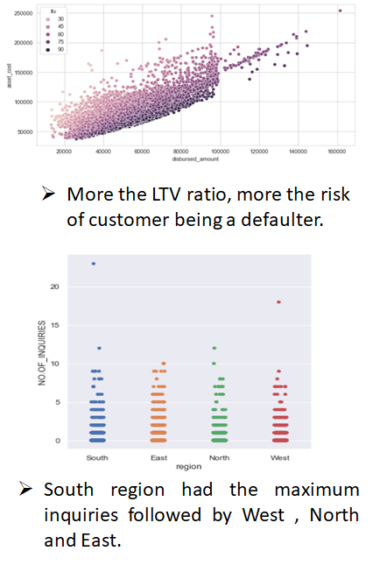
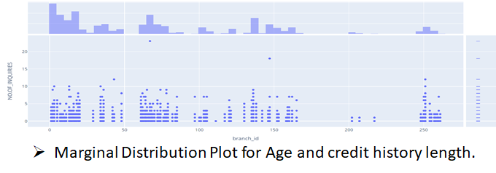
Bivariate analysis of various features of the dataset

Slide 13
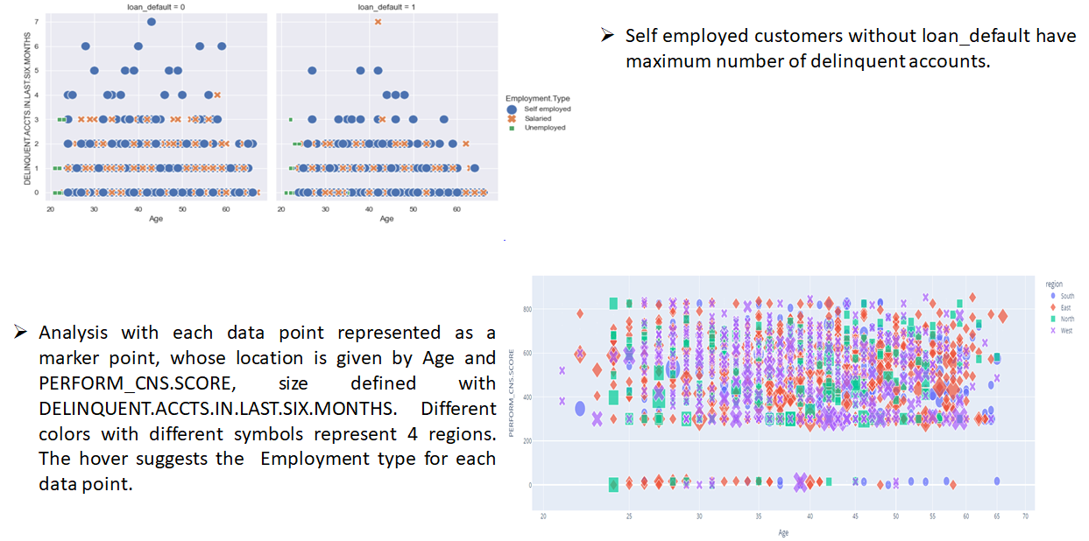
Multivariate analysis of various features of the dataset

Slide 14
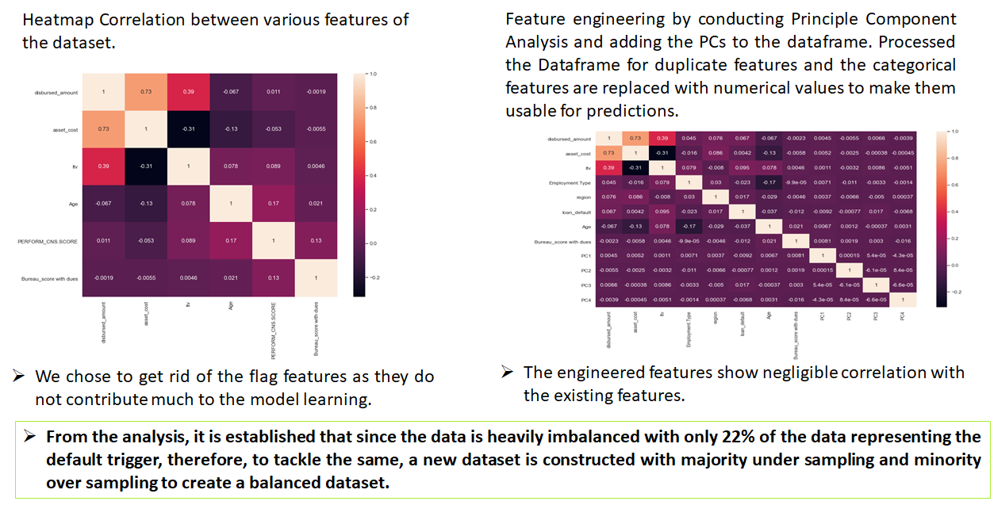
Feature engineering

Slide 15
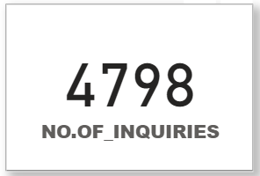
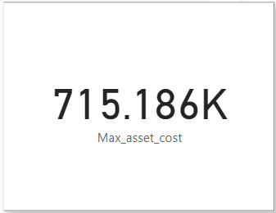
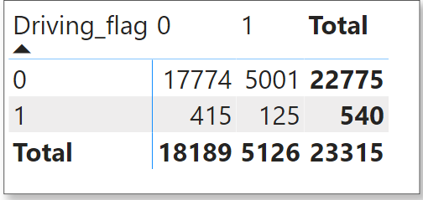
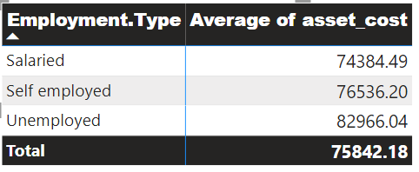
VISUALIZATION USING POWER-BI
What was the maximum
asset cost?
What were the total
inquiries done?
What is the average loan default
for each driving flag?
What is the average asset cost
for each employment type?

Slide 16
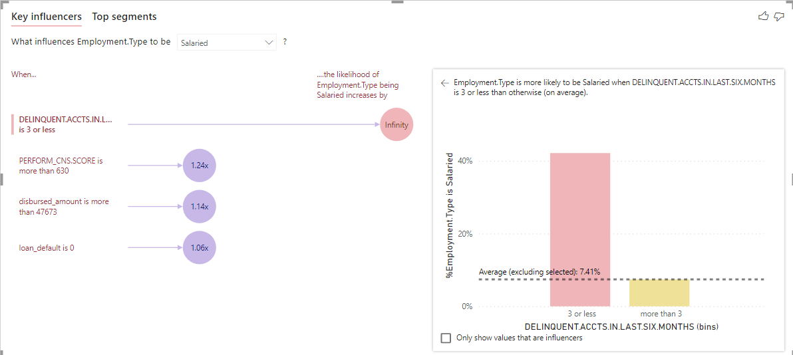
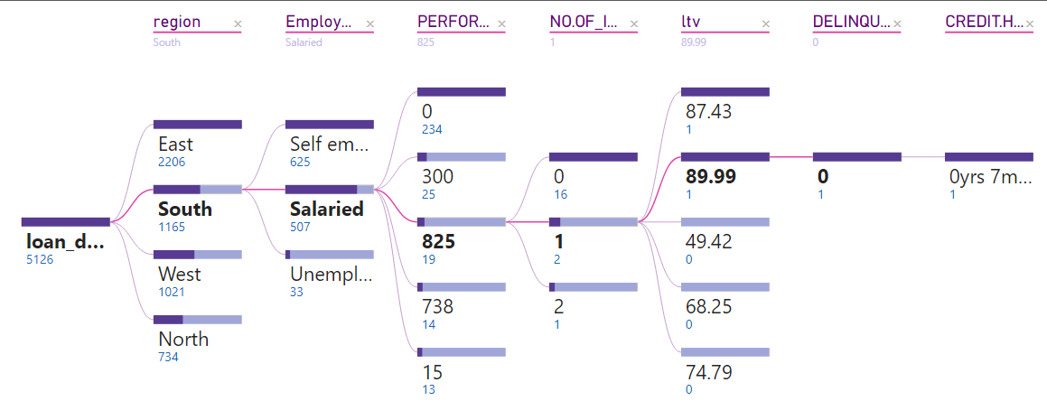
Display to Key Influencer Visual for the appropriate columns and indicate your inferences.
Display a decomposition tree
for the data.

Slide 17
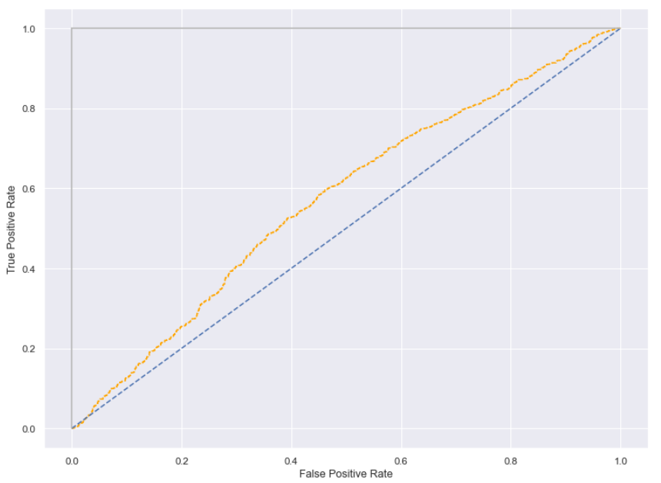
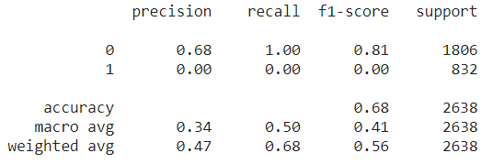
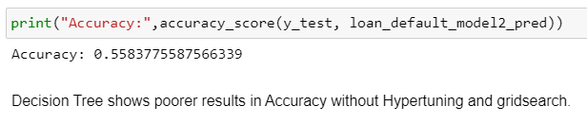

Model building using ML algorithms
Model 1 - Logistic Regression
ROC curve is plotted to determine the optimal classification threshold and it is observed that it is around 0.6.
Splitting the resampled dataset with
training set = 80% and test set = 20%.
Even after resampling, the model accuracy for the default trigger is nearly 68%.
The Hyper tuning of threshold and optimal parameters with grid search did not show promising model accuracy improvement. The accuracy is around 69%.
The right metric to evaluate the performance would be Root Mean Square Error.
Robust Scaler also did not improve/contribute to the model accuracy which is as expected as the data was already treated for outliers.
Model 2 - Decision Tree
Using Grid Search in Decision Tree also keeps the accuracy not more than 69%.

Slide 18
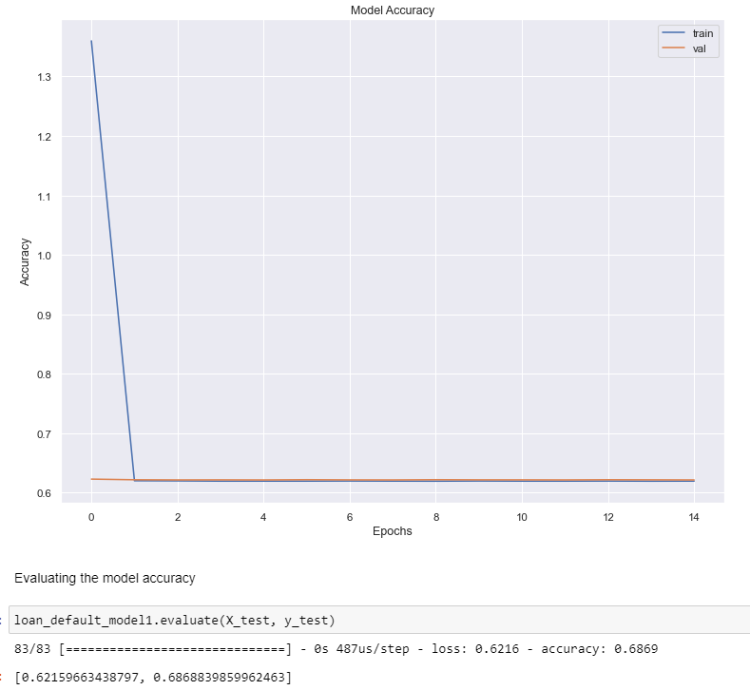
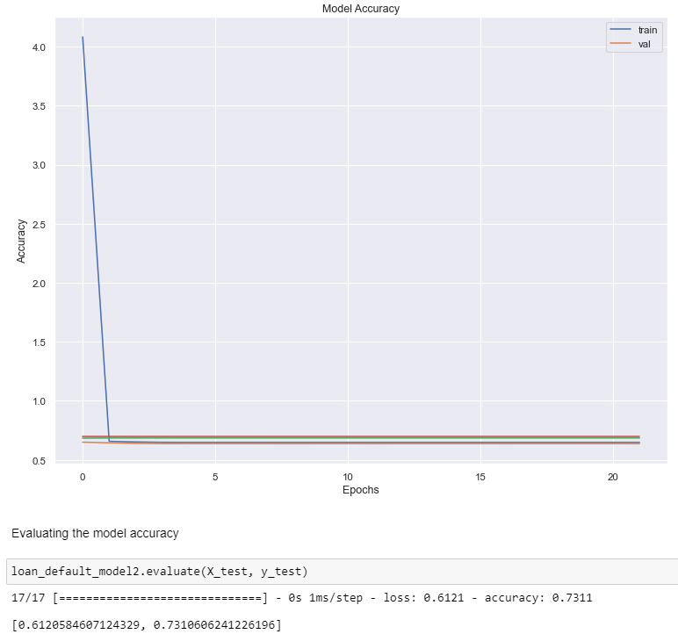
Considering only the PCA's for our DNN model, we got the best accuracy as 73.11% else our model accuracy score is capped at ~ 69% even with hyper tuning and best parameters. This is mainly due to the imbalanced nature of the data. With the best parameters Decision Tree shows an accuracy equivalent to the Logistic Regression. The issue with the given dataset is that it is heavily imbalanced. The industry standard for such loan risk dataset is Logistic Regression.
Model 3 - Deep Neural Network
Approach 1 : Considering the dataset features and PCA's
Approach 2:Considering the PCA's only

Slide 19

DATA ANALYSIS USING BIG DATA TOOLS
Step 1:
PySpark application to load the Spark Data Frames.
Step 2:
Save the master_loan_df into Hive tables on a Hadoop cluster in an optimized format, that is parquet.
Step 3:
Perform profiling of the data through PySpark.
Step 4:
Logistic Regression model gave the accuracy of nearly 77% with RMSE as 0.474. Therefore, we suggest Logistic Regression as the best model that can be used for our dataset.
Step 6:
Ensure that the profiled data through Pyspark is migrated correctly wherever the source is an RDBMS.
Logistic Regression, Linear Regression, Decision Tree and Random Forest Tree models were implemented and the accuracy for each was found.
Step 5:
PySpark routines to cleanse the data, replace the missing values, and the data transformations using RDD.

Slide 20
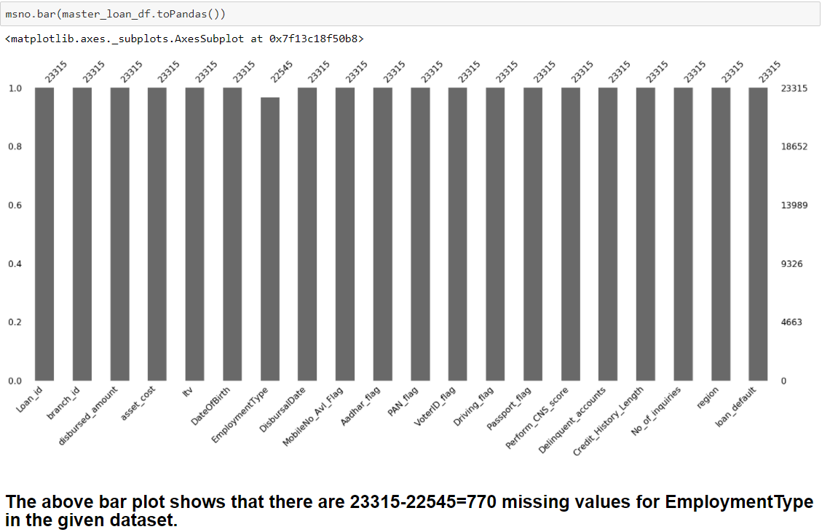
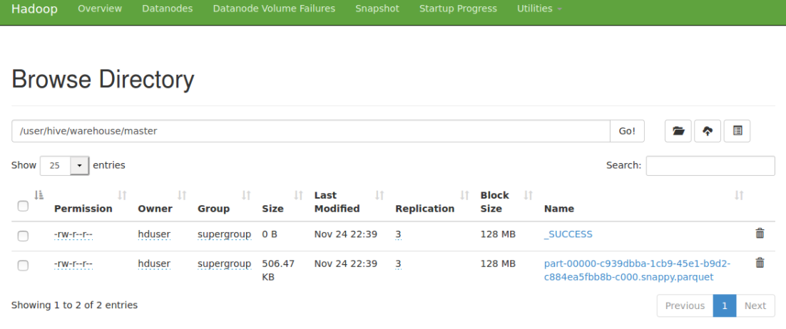
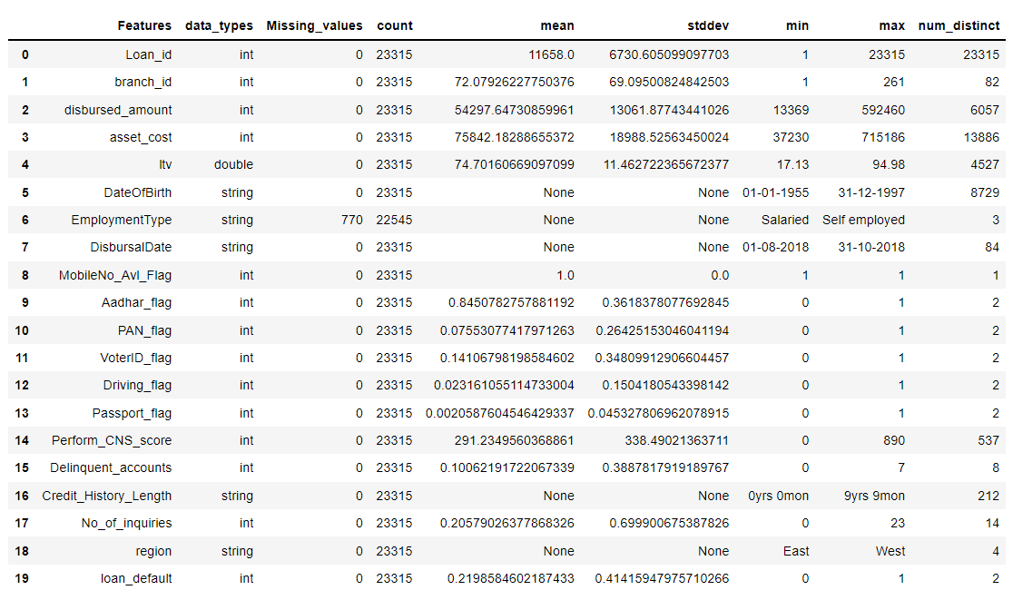
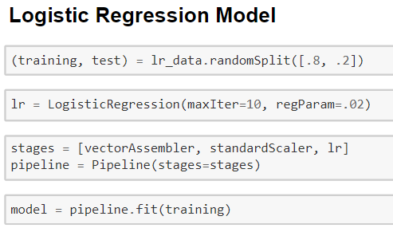
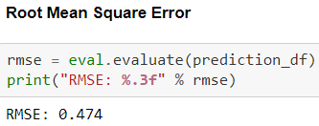
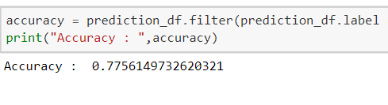
The optimized format for data storing on a Hadoop cluster is parquet format which is a compressed columnar data format developed for use in any Hadoop based system. Profiled Dataframe
Identifying the missing values
Logistic Regression model

Slide 21
DATA ANALYSIS ON CLOUD (AZURE)
Move the Data Set to Azure Synapse Storage Gen2
Create a serverless
SQL pool to query
the data from Storage gen 2
Perform various
analytics on
PowerBi.
Create a
Linked service to
PowerBI
Create a Folder

Slide 22
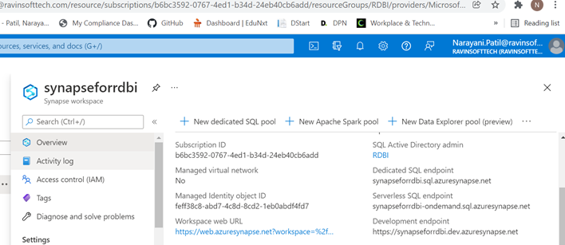
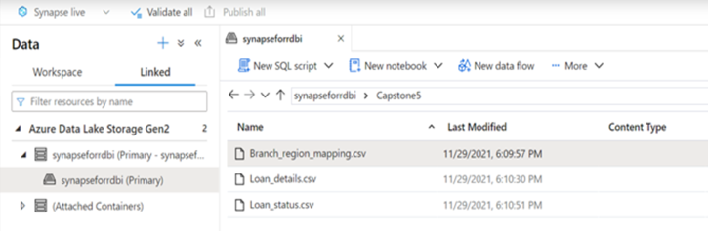
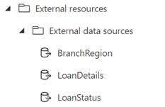
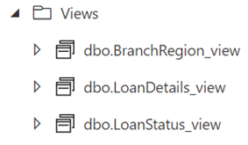
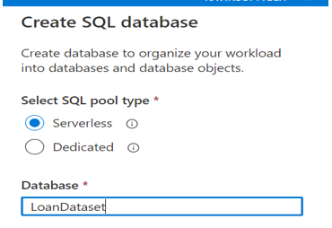
To move our Loan Dataset to Azure Storage, we used synapsefordbi which was given already
Next step is, we created folder named Capstone5 to upload datafiles from local system to azure data storage.
Created external data sources and views

Slide 23
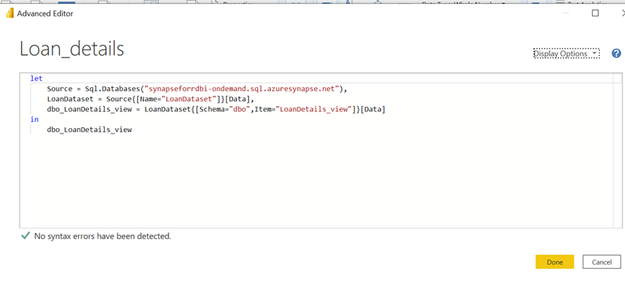
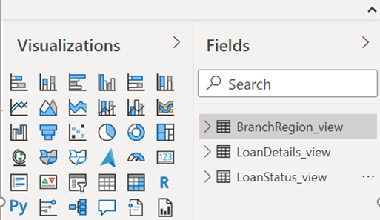
We took the serverless SQL end point and used that to
connect azure synapse storage with desktop power bi.

Slide 24
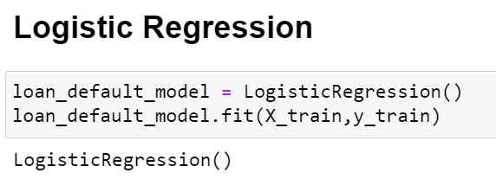
5.
Deployment
DEPLOYMENT OF MODEL USING FLASK
Flask web server
4.
3.
HTML webpage
2.
Machine Learning Model
1.
Objective
We use the Flask framework to host local servers and when routing the webpages. We will use it when deploy our Machine Learning model locally
Built a Form using HTML to accept the inputs from the user.
Logistic regression
model
We should deploy our Machine Learning model using the Flask webserver.

Slide 25
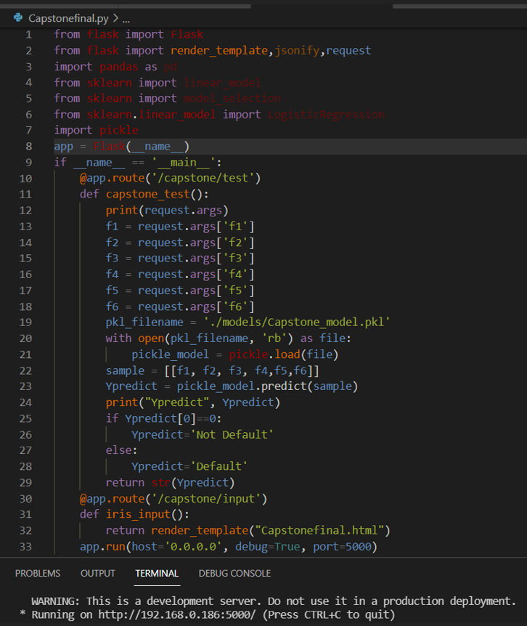


Deployment of ML model using Flask
Generating Pickle File for Model
Flask Web server
HTML Webpage

Slide 26




Deployment of ML model using Flask

Slide 27
THANK YOU

