Slide 1
HTML FORMS
HTML Forms are required when you want to collect some data from the site visitor. For example during user registration you would like to collect information such as name, email address, credit card, etc.
A form will take input from the site visitor and then will post it to a back-end application such as CGI, ASP Script or PHP script etc. The back-end application will perform required processing on the passed data based on defined business logic inside the application.
There are various form elements available like text fields, textarea fields, drop-down menus, radio buttons, checkboxes, etc.

Slide 2
FORMS:
Without forms, a Web site is “read-only” – it just provides information to the user
Forms enable the user to provide information to the Web site. For example, the user can:
Perform searches on Web site
Give comments
Ask for info that is not available on the Website
Place order for goods and services

Slide 3
Can be simple or very complex
Can fill a whole page or just a single line
Can contain a single element or many
Are always placed between the <BODY> and </BODY> tags of a Web page

Slide 4
FORMS:
Are GUI-based
May contain:
Text fields
Check boxes
Buttons
Scrollable lists

Slide 5
The HTML <form> tag is used to create an HTML form and it has following syntax:
<form action="Script URL" method="GET|POST“ name=“form1”>
form elements like input, textarea etc.
</form>
Any standard HTML element (except another <form>) can be contained within <form>
Attributes: NAME = “name” and ACTION =“url”
NAME: Name the form (For tasks related to user input data processing )
ACTION: The URL of the program that will process the data when the form is submitted .

Slide 6
<FORM name="sendEmail" method="post" action="sendMailScriptURL">
Elements of the form
</FORM>
name: Name given to the form
method: Forms can be submitted through two alternate methods – GET & POST
action: Specifies the URL that is accessed when the form is being submitted

Slide 7
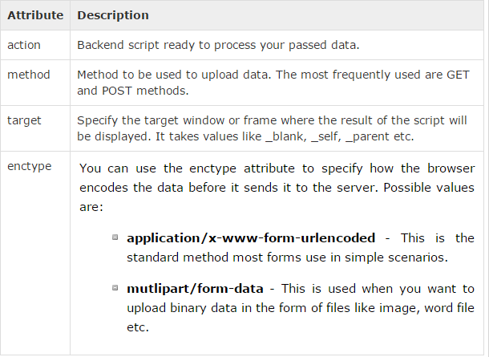
Form Attributes:
Apart from common attributes, following is a list of the most frequently used form attributes:

Slide 8
Server-Side Scripts
Are programs that reside on Web servers
Receive info that a user enters in a form
Process that info and take appropriate action
Examples:
CGI scripts on Unix servers
ASP scripts on Windows servers

Slide 9
HTML Form Controls:
There are different types of form controls that you can use to collect data using HTML form:
Text Input Controls
Checkboxes Controls
Radio Box Controls
Select Box Controls
File Select boxes
Hidden Controls
Clickable Buttons
Submit and Reset Button

Slide 10
Text Input Controls:
There are three types of text input used on forms:
Single-line text input controls - This control is used for items that require only one line of user input, such as search boxes or names. They are created using HTML <input> tag.
Password input controls - This is also a single-line text input but it masks the character as soon as a user enters it. They are also created using HTMl <input> tag.
Multi-line text input controls - This is used when the user is required to give details that may be longer than a single sentence. Multi-line input controls are created using HTML <textarea> tag.

Slide 11
Text Field
A single line field which is used when you want the user to type letters, numbers, etc. in a form.
Example:
<input type = "text" name = "firstname">
NAME: Name given to this form element
SIZE: The number of characters allowed in this text field. If you do not include this attribute, the text length will be 20 by default.

Slide 12
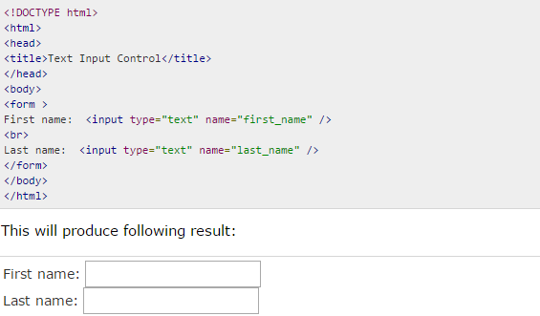
Single-line text input controls:
This control is used for items that require only one line of user input, such as search boxes or names. They are created using HTML <input> tag.
Example
Here is a basic example of a single-line text input used to take first name and last name:

Slide 13
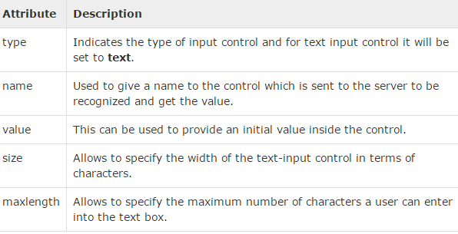
Attributes:
Following is the list of attributes for <input> tag for creating text field.

Slide 14
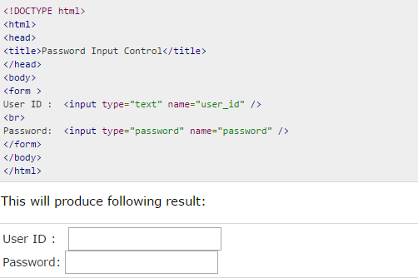
Password input controls:
This is also a single-line text input but it masks the character as soon as a user enters it. They are also created using HTML <input> tag but type attribute is set to password.
Example
Here is a basic example of a single-line password input used to take user password:

Slide 15
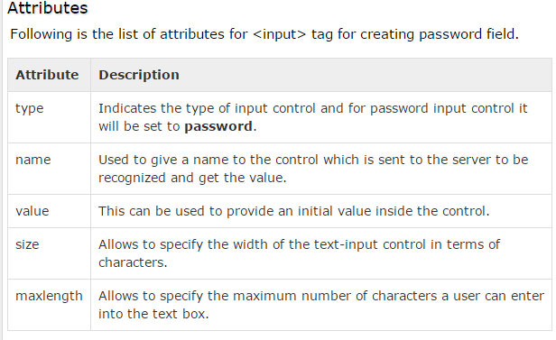

Slide 16
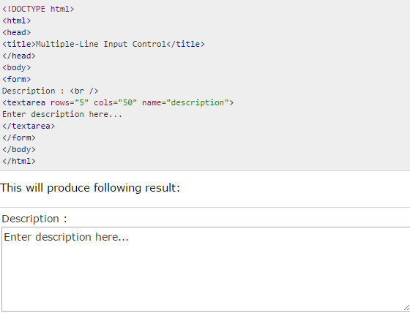
Multiple-Line Text Input Controls:
This is used when the user is required to give details that may be longer than a single sentence. Multi-line input controls are created using HTML <textarea> tag.
Example:
Here is a basic example of a multi-line text input used to take item description:

Slide 17
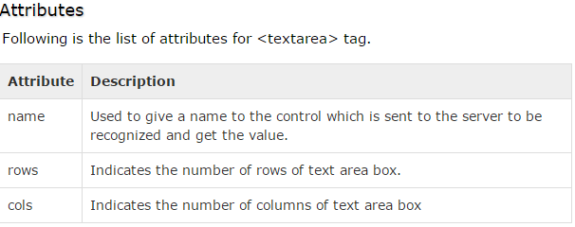

Slide 18
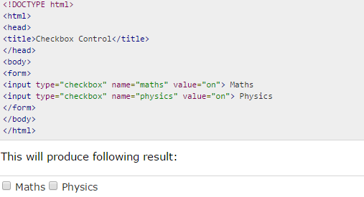
Checkbox Control:
Checkboxes are used when more than one option is required to be selected. They are also created using HTML <input> tag but type attribute is set to checkbox.
Example:
Here is an example HTML code for a form with two checkboxes:

Slide 19
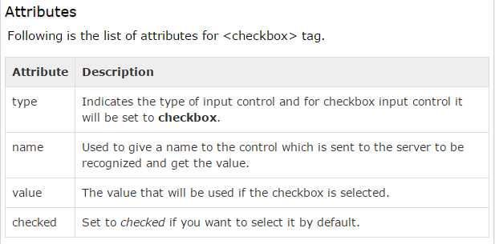

Slide 20
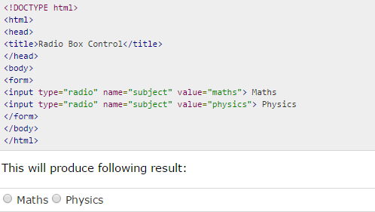
Radio Button Control:
Radio buttons are used when out of many options, just one option is required to be selected. They are also created using HTML <input> tag but type attribute is set to radio.
Example
Here is example HTML code for a form with two radio buttons:

Slide 21
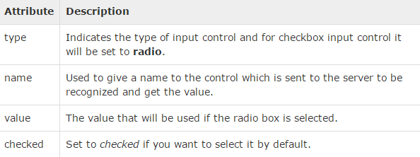
Attributes:
Following is the list of attributes for radio button.

Slide 22
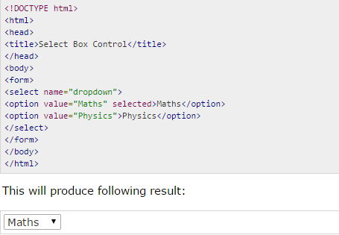
Select Box Control:
A select box, also called drop down box which provides option to list down various options in the form of drop down list, from where a user can select one or more options.
Example
Here is example HTML code for a form with one drop down box.

Slide 23
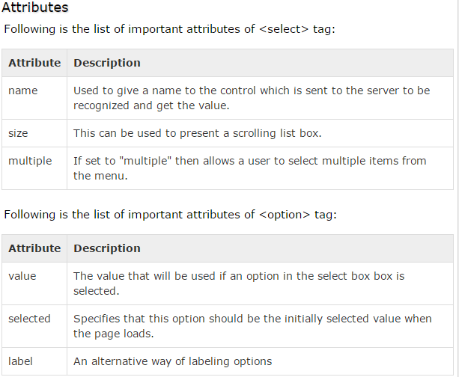

Slide 24
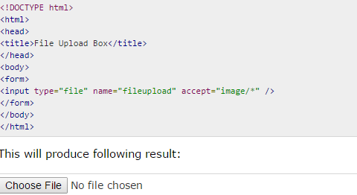
File Upload Box:
If you want to allow a user to upload a file to your web site, you will need to use a file upload box, also known as a file select box. This is also created using the <input> element but type attribute is set to file.
Example:
Here is example HTML code for a form with one file upload box:

Slide 25
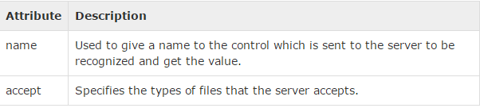
Attributes:
Following is the list of important attributes of file upload box:

Slide 26
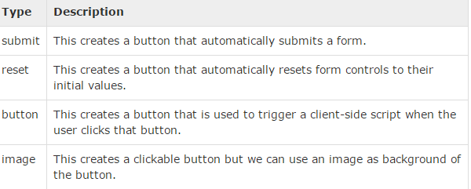
Button Controls:
There are various ways in HTML to create clickable buttons. We can also create a clickable button using <input> tag by setting its type attribute to button. The type attribute can take the following values:

Slide 27
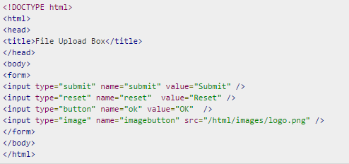

Example
Here is example HTML code for a form with three types of buttons:

Slide 28
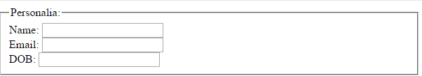
FIELDSET & LEGEND:
<html>
<body>
<form>
<fieldset>
<legend>Personalia:</legend>
Name: <input type="text"><br>
Email: <input type="text"><br>
DOB: <input type="text">
</fieldset>
</form>
</body>
</html>

Slide 29
Processing Data
After the web page receives the data (input) from the client of the web page by some means such as a form elements, it needs to be processed.
There are two possible location for processing data
The data can be sent thru network to a web-server machine where all such processing requests are processed. Then the result will be sent to the client machine which initiated the request by opening a page and filling some sort of forms.
The data can be processed at client machine by some tiny programs embedded in the web page. These tiny programs are sent to client side along the web page when the user loads the web page.

Slide 30
Scripts
Scripts are these tiny programs within the web page. (inside HTML).
They are List of instructions for processing data presented on the page in a variety of ways such as the data submitted using some kind of form element.
This data processing by mean of some script is done at the client machine as opposed to the Server machine.
JavaScript is an example of a scripting language which is being understood by most web browsers just as any other HTML element.

Slide 31
Event Handlers
Form elements are made to interact with scripts (small programs within the page for processing data).
This interactions are done by means of Event Handlers.
Event Handlers are attributes of form elements which their values determine what sort of actions to take in case an event occurred.

Slide 32
Examples of Events
Submitting a form
Clicking a mouse
Passing a mouse over a link
Loading a page
Selecting an item or a button.
Clicking a button, link ,…
Changing the value of a text field or text area
…

Slide 33
Event Handlers for Text Field
<FORM NAME =“form1">
Number 1: <INPUT TYPE=“text” NAME=“num1” VALUE = “0”
ONCHANGE=“do this action”>
</FORM>
The value of the event handler attribute can be a piece of java script for running some process (for example processing the data in the text field) in response to a change to value of the text field.
ONSELECT is another possible event handler attribute for text field.

Slide 34
Event Handler for Checkbox/Radio Button
ONCLICK : when a radio button/check box has been clicked. Example:
bike:
<input type="checkbox" name="vehicle” value="Bike“
onclick = “do action related to clicking the bike”> <br>
car: <input type="checkbox" name="vehicle" value="Car“
onclick = “do action related to clicking the car” > <br>
airplane:
<input type="checkbox" name="vehicle" value="Airplane“
onclick = “do action related to clicking the airplane”>

