Slide 1


Slide 2
HTML Tags
What's a Tag?
An HTML tag is a coded command used to indicate how part of a Web page should be displayed.
These coded commands are called HTML tags because they "tag" pieces of text and tell the Web browser what kind of text it is. This allows the Web browser to display the text the right way.
Compiled by : S. Agarwal, Lecturer & Systems Incharge, St. Xavier's Computer Centre, Kolkata : sxcc@vsnl.net

Slide 3
Opening and Closing Tags
Most HTML tags have two parts: an opening tag to indicate where a piece of text begins, and a closing tag to show where the piece of text ends. Closing tags start with a forward slash (/) just after the < symbol (e.g., </BODY>).
        …….
        <BODY>
        .
        .
        </BODY)
        ………
Compiled by : S. Agarwal, Lecturer & Systems Incharge, St. Xavier's Computer Centre, Kolkata : sxcc@vsnl.net

Slide 4
In this document, as in every HTML document, the words starting with < and ending with > are actually coded commands.
<HTML>
<HEAD>
<TITLE>My First Web Page</TITLE>
</HEAD>
<BODY>
Hello world!
</BODY>
</HTML>
Compiled by : S. Agarwal, Lecturer & Systems Incharge, St. Xavier's Computer Centre, Kolkata : sxcc@vsnl.net

Slide 5
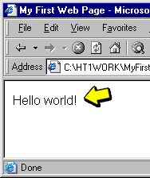
A Body Tag
The <BODY> tag tells the Web browser where the actual body text of the page begins, and </BODY> indicates where it ends.
Everything between the <BODY> and </BODY> tags will appear in the main display area of the Web browser window.
...
<BODY>
Hello world!
</BODY>
...
Compiled by : S. Agarwal, Lecturer & Systems Incharge, St. Xavier's Computer Centre, Kolkata : sxcc@vsnl.net

Slide 6
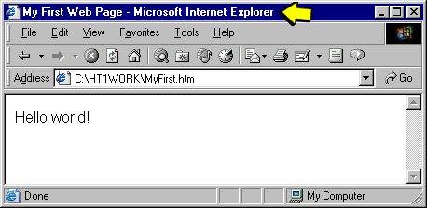
The <TITLE> Tag
Internet Explorer and Netscape Communicator display any text between <TITLE> and </TITLE> at the very top of the browser window. The title text will also be used to identify the page on the Explorer Favorites menu or the Navigator Bookmarks menu when someone selects Add Bookmark or Add to Favorites.
Compiled by : S. Agarwal, Lecturer & Systems Incharge, St. Xavier's Computer Centre, Kolkata : sxcc@vsnl.net

Slide 7
Required HTML Tags
You will use the <BODY> and <TITLE> tags in every HTML page you create because every Web page needs a title and some body text.
You will also use the other two tags shown in the figure — <HTML> and <HEAD>. Putting <HTML> at the very beginning of a document simply indicates that this is a Web page. The </HTML> at the end indicates that the Web page is over.
<HTML>
<HEAD>
<TITLE>My First Web Page</TITLE>
</HEAD>
<BODY>
Hello world!
</BODY>
</HTML>
Compiled by : S. Agarwal, Lecturer & Systems Incharge, St. Xavier's Computer Centre, Kolkata : sxcc@vsnl.net

Slide 8
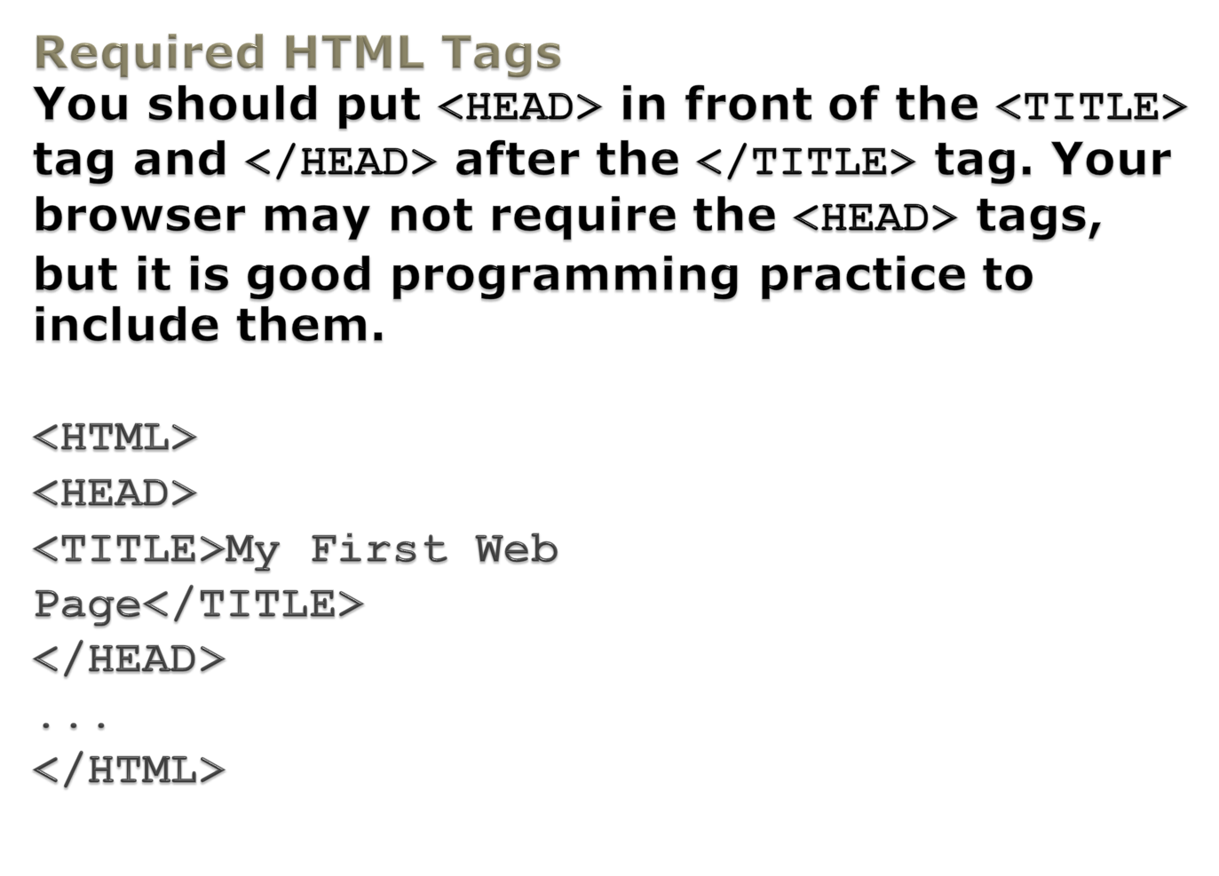
Compiled by : S. Agarwal, Lecturer & Systems Incharge, St. Xavier's Computer Centre, Kolkata : sxcc@vsnl.net

Slide 9
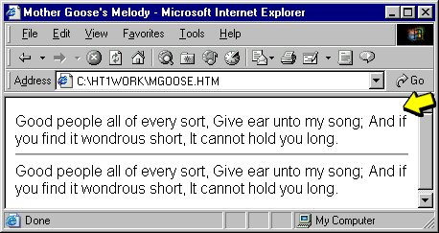
Automatic Line Wrap
When the text reaches the edge of the browser window, it automatically wraps down to the next line, no matter where the line breaks were in the original HTML file.
...
And if you find it wondrous short, It cannot hold you long.
<HR />
Good people all of every sort,
Give ear unto my song;
...
Compiled by : S. Agarwal, Lecturer & Systems Incharge, St. Xavier's Computer Centre, Kolkata : sxcc@vsnl.net

Slide 10
The <BR /> and <P>Tags
To control where line and paragraph breaks actually appear, you must use HTML tags. The <BR /> tag forces a line break, and the <P> tag creates a paragraph break.
The difference between these two tags is that <P> and its closing tag </P> are used to surround a block of text and will insert extra space both above and below the text. By contrast, <BR /> is used to break a line wherever it is placed. It will not insert a blank line.
...
<P>When I was a little boy<BR />
I wash'd my<BR />Mother's Dishes.<BR />
I put my finger in my<BR />
Ear, and pull'd out<BR />
Little fishes.</P>
...
Compiled by : S. Agarwal, Lecturer & Systems Incharge, St. Xavier's Computer Centre, Kolkata : sxcc@vsnl.net

Slide 11
The Heading Tags
When you browse through Web pages on the Internet, you can't help but notice that most of them have a heading at the top which appears larger and bolder than the rest of the text.
<H1>, <H2>, and <H3>
As you can see in HTML code shown below, the HTML to create headings couldn't be simpler. For a big level 1 heading, put an <H1> tag at the beginning and an </H1> tag at the end. For a slightly smaller level 2 heading, use <H2> and </H2> instead, and for a little level 3 heading, use <H3> and </H3>.
Compiled by : S. Agarwal, Lecturer & Systems Incharge, St. Xavier's Computer Centre, Kolkata : sxcc@vsnl.net

Slide 12
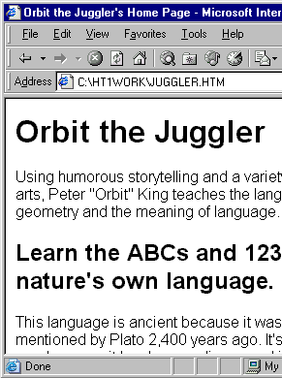
...
<H1>Orbit the Juggler</H1>
Using humorous storytelling and a variety of circus arts,
...
<H2>Learn the ABCs and 123s of nature's own language.</H2>
This language is ancient because
...
Compiled by : S. Agarwal, Lecturer & Systems Incharge, St. Xavier's Computer Centre, Kolkata : sxcc@vsnl.net

Slide 13
The Title versus ...
It's important to remember the difference between a title and a heading. These two words are often interchangeable in day-to-day English, but when you're talking HTML, <TITLE> gives the entire page an identifying name which isn't displayed on the page itself.
... the Heading
The heading tags, on the other hand, cause some text on the page to be displayed with visual emphasis. There can be only one <TITLE> per page, but you can have as many <H1>, <H2>, and <H3> headings as you want, in any order that suits your fancy.
Compiled by : S. Agarwal, Lecturer & Systems Incharge, St. Xavier's Computer Centre, Kolkata : sxcc@vsnl.net

Slide 14

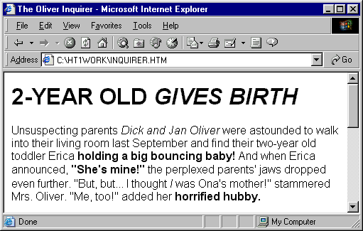
Emphasizing Text
For boldface text, put the <B> tag at the beginning of the text and </B> at the end. Similarly, you can make any text italic by enclosing it between <I> and </I>.
If you want bold italics, put <B><I> in front of the text and </I></B> after it. You can also use italics within headings, but boldface usually won't show in headings because they are already bold.
Compiled by : S. Agarwal, Lecturer & Systems Incharge, St. Xavier's Computer Centre, Kolkata : sxcc@vsnl.net

Slide 15
Other Formatting Tags
Other Formatting Tags
Tag
Function
<SMALL>
Small text
<BIG>
Big text
<SUP>
Superscript
<SUB>
Subscript
<STRIKE>
Strikethrough (draws a line through text)
<U>
Underline
<TT>
Monospaced (typewriter) font
<PRE>
Monospaced font preserving spaces and line breaks
<EM>
Emphasized (italic) text
<STRONG>
Strong (boldface) text
Compiled by : S. Agarwal, Lecturer & Systems Incharge, St. Xavier's Computer Centre, Kolkata : sxcc@vsnl.net

Slide 16
Paragraph Alignment
Use these tags to align the text on your Web page.
Format
HTML Code
To align a paragraph to the right margin
<P ALIGN="right">
To center a paragraph
<P ALIGN="center">
To align a paragraph to the left margin
<P ALIGN="left">
Compiled by : S. Agarwal, Lecturer & Systems Incharge, St. Xavier's Computer Centre, Kolkata : sxcc@vsnl.net

Slide 17
Attributes
The word ALIGN is called an attribute of the <P> tag. Attributes are special code words used inside an HTML tag to control exactly what the tag does. You can use the ALIGN attribute with just about any HTML tag that contains text, including <H1>, <H2>, the other heading tags, and some tags you will meet later. There are many other attributes besides ALIGN. You will find out how to use them as you learn more HTML tags.
Compiled by : S. Agarwal, Lecturer & Systems Incharge, St. Xavier's Computer Centre, Kolkata : sxcc@vsnl.net

Slide 18
The <DIV> Tag
When you want to set the alignment of more than one paragraph or heading at a time, you can use the ALIGN attribute with the <DIV>, or division, tag (e.g., <DIV ALIGN=>).
Everything you put between
<DIV ALIGN="center"> and </DIV>,
will be centered. This may include lines of text, paragraphs, headings, images and all the other things.
Compiled by : S. Agarwal, Lecturer & Systems Incharge, St. Xavier's Computer Centre, Kolkata : sxcc@vsnl.net

Slide 19
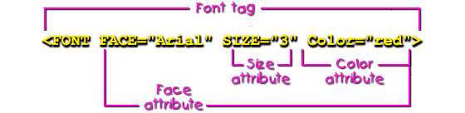
The <FONT> Tag
To set the size and color of any text on a Web page, use the <FONT> tag. The SIZE attribute can take any value from 1 (tiny) to 7 (big), with 3 being the normal default size.
Compiled by : S. Agarwal, Lecturer & Systems Incharge, St. Xavier's Computer Centre, Kolkata : sxcc@vsnl.net

Slide 20
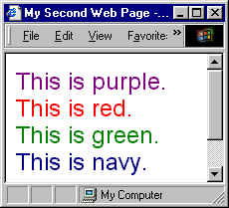
The COLOR Attribute
The COLOR attribute can take any of the following standard color names: black, white, red, green, blue, yellow, aqua, fuchsia, gray, lime, maroon, purple, navy, olive, silver, or teal.
...
<FONT SIZE="5" COLOR="purple">This is purple.</FONT><BR />
<FONT SIZE="5" COLOR="red">This is red.</FONT><BR />
...
Compiled by : S. Agarwal, Lecturer & Systems Incharge, St. Xavier's Computer Centre, Kolkata : sxcc@vsnl.net

Slide 21
The FACE Attribute
Eventually Netscape and Microsoft added another extremely powerful form of font control: the FACE attribute of the <FONT> tag. This allows you to specify the actual typeface that should be used to display text — and has been the source of much rejoicing among Webmasters who are awfully sick of Times and Courier!
<FONT FACE="Comic Sans MS" SIZE="5" COLOR="red">
PURE MAPLE SYRUP<BR />
<FONT SIZE="4">A VERMONT TRADITION</FONT></FONT><P>
Compiled by : S. Agarwal, Lecturer & Systems Incharge, St. Xavier's Computer Centre, Kolkata : sxcc@vsnl.net

Slide 22
The <BASEFONT> Tag
To make all the text on the Web page larger, you can put <BASEFONT SIZE="4"> </BASEFONT> (or any size you want from 3 to 7) just after the <BODY> tag.
Using <BASEFONT>
<BASEFONT> is just a time-saving tag for setting the overall size of all text in a document. The size of all headings will also be relative to the <BASEFONT SIZE>. SIZE is the only allowable attribute and no closing tag is used.
Compiled by : S. Agarwal, Lecturer & Systems Incharge, St. Xavier's Computer Centre, Kolkata : sxcc@vsnl.net

Slide 23
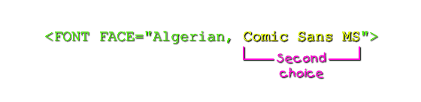
Second Choice Fonts
You can also specify a "second choice" font, for people who don't have your first choice font installed on their computer.
Compiled by : S. Agarwal, Lecturer & Systems Incharge, St. Xavier's Computer Centre, Kolkata : sxcc@vsnl.net

Slide 24

Using Less Common Fonts
If you want to use a font on your Web page that isn't one of the standard fonts, the user will never see an error message if the font can't be found; the worst thing that could happen is that the user won't see your special font, but will still see the text in the next best font that can be found.
Compiled by : S. Agarwal, Lecturer & Systems Incharge, St. Xavier's Computer Centre, Kolkata : sxcc@vsnl.net

Slide 25
Inserting Special Characters
You can insert these special characters at any point in an HTML document by looking up the appropriate escape codes.
Note that there are also codes for the angle brackets (< >), quote symbol ("), and ampersand (&) in the table. You need to use these escape codes if you want these symbols to appear on your pages as characters, because the Web browser will otherwise interpret them as HTML commands.
Compiled by : S. Agarwal, Lecturer & Systems Incharge, St. Xavier's Computer Centre, Kolkata : sxcc@vsnl.net

Slide 26
Some HTML Special Characters
Character
Numeric Code
Code Name
Description
"
&#34;
&quot;
Quotation mark
&
&#38;
&amp;
Ampersand
<
&#60;
&lt;
Less than
>
&#62;
&gt;
Greater than
¢
&#162;
&cent;
Cent sign
£
&#163;
&pound;
Pound sterling
Compiled by : S. Agarwal, Lecturer & Systems Incharge, St. Xavier's Computer Centre, Kolkata : sxcc@vsnl.net

Slide 27
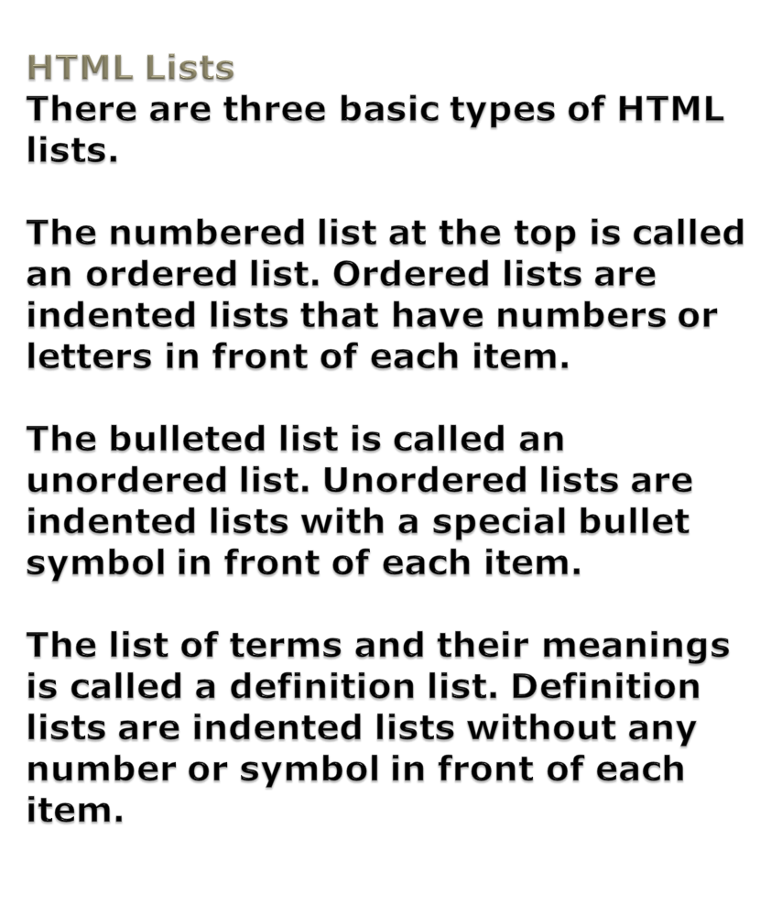
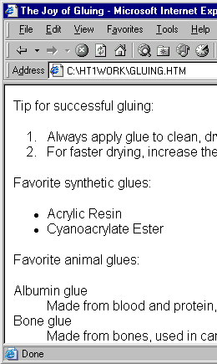
Compiled by : S. Agarwal, Lecturer & Systems Incharge, St. Xavier's Computer Centre, Kolkata : sxcc@vsnl.net

Slide 28
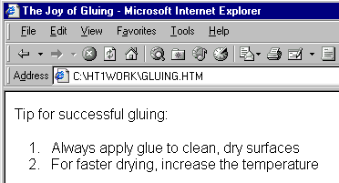
An Ordered List
An ordered list begins with the <OL> tag and ends with a closing </OL> tag. Numbers and line breaks appear automatically at each <LI> tag, and the entire list is indented.
...
<OL>
<LI>Always apply glue to clean, dry surfaces</LI>
<LI>For faster drying, use drier machine</LI>
<LI>Clamp glue joints for safety</LI>
</OL>
...
Compiled by : S. Agarwal, Lecturer & Systems Incharge, St. Xavier's Computer Centre, Kolkata : sxcc@vsnl.net

Slide 29
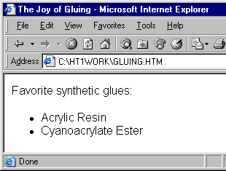
An Unordered List
An unordered list opens with the <UL> tag and closes with </UL>. It looks just like an ordered list, except that bullets appear at each <LI> tag instead of numbers.
...
Favorite synthetic glues:
<UL>
<LI>Acrylic Resin</LI>
<LI>Cyanoacrylate Ester</LI>
</UL>
...
Compiled by : S. Agarwal, Lecturer & Systems Incharge, St. Xavier's Computer Centre, Kolkata : sxcc@vsnl.net

Slide 30
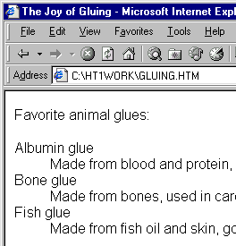
A Definition List
A definition list starts with the <DL> tag and ends with </DL>. The <DT> tags surround each term to be defined, with the <DD> tags enclosing the term's definition. Line breaks and indentation appear automatically.
...
Favorite animal glues:
<DL>
<DT>Albumin glue</DT>
<DD>Made from blood and protein, used in plywood</DD>
<DT>Bone glue</DT>
<DD>Made from bones, used in cardboard boxes</DD>
<DT>Fish glue</DT>
<DD>Made from fish oil and skin, good for photo mounting</DD>
</DL>
...
Compiled by : S. Agarwal, Lecturer & Systems Incharge, St. Xavier's Computer Centre, Kolkata : sxcc@vsnl.net

Slide 31
Distinctive Bullets
Both Internet Explorer and Netscape Communicator will normally use a solid disc for the first-level bullet, a hollow circle for the second-level bullet, and a solid square for all deeper levels. However, you can explicitly choose which type of bullet to use for any level by using
<UL TYPE="disc">,
<UL TYPE="circle">, or
<UL TYPE="square">
Numbered and Lettered Points
The TYPE attribute also works with ordered lists, but instead of choosing a type of bullet you choose the type of numbers or letters to place in front of each item. You can use roman numerals (TYPE="I"), capital letters (TYPE="A"), and lowercase letters (TYPE="a"), along with ordinary numbers in a multi-level list.
Compiled by : S. Agarwal, Lecturer & Systems Incharge, St. Xavier's Computer Centre, Kolkata : sxcc@vsnl.net

Slide 32
Nesting Ordered and Unordered Lists
Ordered and unordered lists can also be nested inside one another, down to as many levels as you wish. You can construct a complex indented outline from several unordered lists.
...
<UL><LI>West Germanic Languages</LI>
<UL><LI>English</LI>
<UL><LI>British</LI>
<UL><LI>BBC</LI>
<LI>Cockney</LI>
<LI>Dubliner</LI>
...
Compiled by : S. Agarwal, Lecturer & Systems Incharge, St. Xavier's Computer Centre, Kolkata : sxcc@vsnl.net

Slide 33
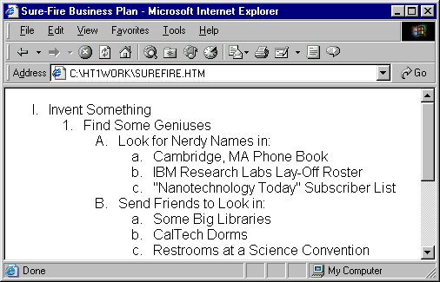
<HTML>
<HEAD><TITLE>Sure-Fire Business Plan</TITLE></HEAD>
<BODY>
<OL TYPE="I"><LI>Invent Something</LI>
<OL><LI>Find Some Geniuses</LI>
<OL TYPE="A"><LI>Look for Nerdy Names in:</LI>
<OL TYPE="a"><LI>Cambridge, MA Phone Book</LI>
<LI>IBM Research Labs Lay-Off Roster</LI>
<LI>"Nanotechnology Today" Subscriber List</LI>
</OL>
<LI>Send Friends to Look in:</LI>
<OL TYPE="a"><LI>Some Big Libraries
<LI>CalTech Dorms</LI>
<LI>Restrooms at a Science Convention</LI>
</OL>
</OL>
<LI>Hire Them to Design and Build It</LI>
<OL TYPE="A"><LI>Take Out a Loan
<LI>Wave Cash Under Their Noses</LI>
<LI>Rent a Big House with a Lab in the Back</LI>
</OL>
</OL>
<LI>Market It Big Time</LI>
<OL><LI>Run Lots of TV Ads</LI>
<LI>Open a Web Site</LI>
<LI>Rake In the Green</LI>
</OL>
</OL>
</BODY>
</HTML>
Compiled by : S. Agarwal, Lecturer & Systems Incharge, St. Xavier's Computer Centre, Kolkata : sxcc@vsnl.net

Slide 34
Output of the previous example :
Compiled by : S. Agarwal, Lecturer & Systems Incharge, St. Xavier's Computer Centre, Kolkata : sxcc@vsnl.net

Slide 35
The START Attribute
Here's one more seldom-used but handy-when-you-need-it trick:
You can start an ordered list with any number (or letter) with the START attribute.
<OL START="3">
starts a numbered list at 3 instead of 1.
Individual points can be renumbered with the VALUE attribute (<LI VALUE="12">, for example).
Compiled by : S. Agarwal, Lecturer & Systems Incharge, St. Xavier's Computer Centre, Kolkata : sxcc@vsnl.net

Slide 36
Using a Number with START and VALUE
Note that you must always use numbers with the START and VALUE attributes.
To make a list that starts with the letter C, for example, you need to type
<OL TYPE="A" START="3">
Compiled by : S. Agarwal, Lecturer & Systems Incharge, St. Xavier's Computer Centre, Kolkata : sxcc@vsnl.net

Slide 37
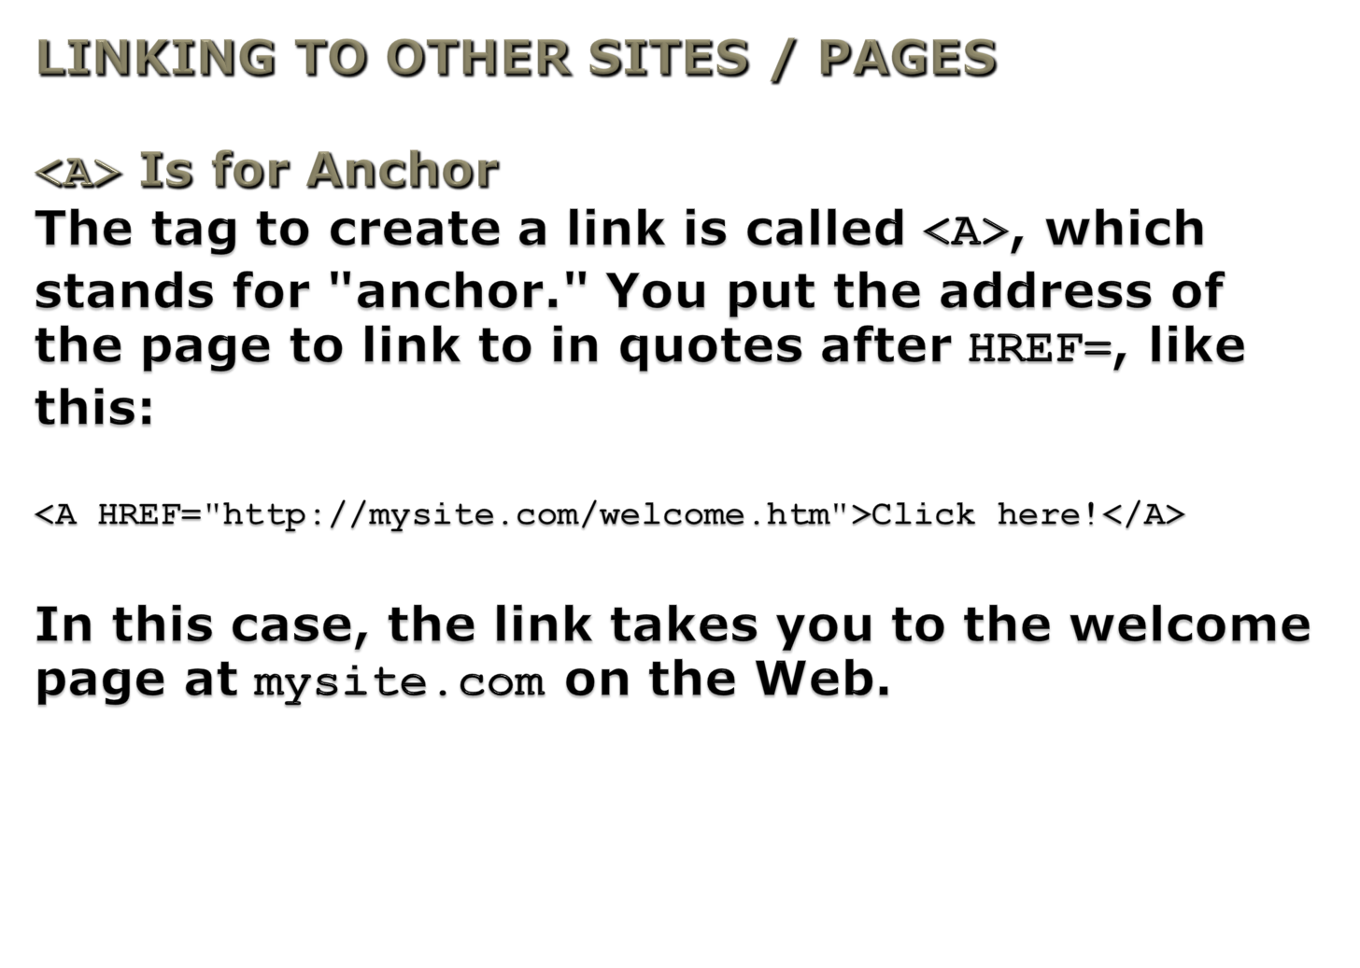
Compiled by : S. Agarwal, Lecturer & Systems Incharge, St. Xavier's Computer Centre, Kolkata : sxcc@vsnl.net

Slide 38
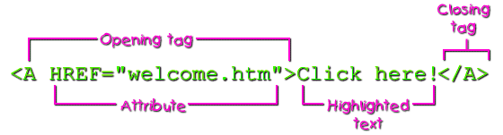
HREF Is an Attribute of <A>
In this code, HREF stands for Hypertext Reference and is called an attribute of the <A> tag. The four basic parts of a hyperlink are shown in the figure.
Compiled by : S. Agarwal, Lecturer & Systems Incharge, St. Xavier's Computer Centre, Kolkata : sxcc@vsnl.net

Slide 39

LINKING IN THE SAME PAGE
You can specify anchor points within a Web page. The example shown below is a link that would take you to a point named "top" (which is probably located at the top of the document) when the link is selected.
Compiled by : S. Agarwal, Lecturer & Systems Incharge, St. Xavier's Computer Centre, Kolkata : sxcc@vsnl.net

Slide 40
How Links Are Made
How did we do this? Let's look at the HTML code for intra-page links. To see how such links are made, take a look first at this <A> tag in the HTML document below:
<A ID="top"></A>
Two Kinds of Anchors
Here's an easy way to remember the difference between these two different types of <A> tags:
<A HREF> is what you click.
<A ID> is where you go when you click.
Compiled by : S. Agarwal, Lecturer & Systems Incharge, St. Xavier's Computer Centre, Kolkata : sxcc@vsnl.net

Slide 41
An E-Mail Link
An HTML link to an e-mail address might look like this:
<A HREF="mailto:oliver@pibsoft.com">
Send me an e-mail message.</A>
Compiled by : S. Agarwal, Lecturer & Systems Incharge, St. Xavier's Computer Centre, Kolkata : sxcc@vsnl.net

Slide 42
The <IMG /> Tag
To put an image on a Web page, first move the image file into the same directory folder as the HTML text file. Then insert the following HTML tag at the point in the text where you want the image to appear (using the name of your image file instead of myimage.gif):
<IMG SRC="myimage.gif" />
Compiled by : S. Agarwal, Lecturer & Systems Incharge, St. Xavier's Computer Centre, Kolkata : sxcc@vsnl.net

Slide 43

The ALT Attribute
The <IMG> tag in this HTML code includes a short ALT text message. The ALT stands for alternate text because this message will appear in place of the image in older Web browsers that don't display graphics.
Always Use ALT
You should generally include a suitable ALT attribute in every <IMG> tag on your Web pages, keeping in mind the variety of situations where people might see that message
Compiled by : S. Agarwal, Lecturer & Systems Incharge, St. Xavier's Computer Centre, Kolkata : sxcc@vsnl.net

Slide 44
Using <DIV ALIGN>
You can use these tags to align text:
<DIV ALIGN="center">
<DIV ALIGN="right">
<DIV ALIGN="left">
These tags align text to the center of a page or to the left or right margins. Both text and images are affected by these tags.
Compiled by : S. Agarwal, Lecturer & Systems Incharge, St. Xavier's Computer Centre, Kolkata : sxcc@vsnl.net

Slide 45
Text Wrap
You do this by including an ALIGN attribute within the <IMG> tag itself, as shown in the second and third <IMG> tags.
<IMG SRC="house.gif" ALT="Our Humble Abode" /></DIV>
<IMG SRC="dicko.gif" ALIGN="left" ALT="Dick" />
...
<IMG SRC="jano.gif" ALIGN="right" ALT="Jan" />
Note that ALIGN means something different in an <IMG> tag than it does in a <DIV> tag. <IMG ALIGN="right"> will align an image to the right and cause any text that follows to wrap around the image. <DIV ALIGN="right">, on the other hand, just controls the alignment and never causes text to wrap around images.
Compiled by : S. Agarwal, Lecturer & Systems Incharge, St. Xavier's Computer Centre, Kolkata : sxcc@vsnl.net

Slide 46
CREATING TABLES
The table basically has only 3 tags...
<TABLE>
  The main tag. Used to tell the browser "this is a table", along with some attributes like size, border width and a few other things.
<TR>
  TableRow defines a horizontal row of <TD> (TableData) cells.
<TD>
  Specifies an indiviual block or cell in a table row.
Compiled by : S. Agarwal, Lecturer & Systems Incharge, St. Xavier's Computer Centre, Kolkata : sxcc@vsnl.net

Slide 47
A table is made up of rows which in turn are made up of cells...
<--This---
----is----
-----a----
---Table--
----Row-->
cell
cell
cell
Compiled by : S. Agarwal, Lecturer & Systems Incharge, St. Xavier's Computer Centre, Kolkata : sxcc@vsnl.net

Slide 48
The <TABLE> tag – to start and end a table.
<HTML>
<HEAD>
<TITLE>Joe's a swell guy</TITLE>
</HEAD>
<BODY>
<TABLE>
</TABLE>
</BODY> </HTML>
Compiled by : S. Agarwal, Lecturer & Systems Incharge, St. Xavier's Computer Centre, Kolkata : sxcc@vsnl.net

Slide 49
Every table needs at least one row.
<TABLE>
<TR>
</TR>
</TABLE>
And of course every row has to have at least one table data cell.
<TABLE>
<TR>
<TD>
</TD>
</TR>
</TABLE>
Compiled by : S. Agarwal, Lecturer & Systems Incharge, St. Xavier's Computer Centre, Kolkata : sxcc@vsnl.net

Slide 50
Now you need something to put in that cell. in the <TD> cell.
<TABLE>
<TR>
<TD>
Ed.
</TD>
</TR>
</TABLE>
Compiled by : S. Agarwal, Lecturer & Systems Incharge, St. Xavier's Computer Centre, Kolkata : sxcc@vsnl.net

Slide 51
Adding border to the table :
<TABLE BORDER=1>
<TR>
<TD>Ed</TD>
</TR>
</TABLE>
(1 Indicates the size of the border.)
Ed
Compiled by : S. Agarwal, Lecturer & Systems Incharge, St. Xavier's Computer Centre, Kolkata : sxcc@vsnl.net

Slide 52
Specifying a table size.
<TABLE BORDER=3 WIDTH=100%>
<TR>
<TD>Ed, Rick and Tom</TD>
</TR>
</TABLE>
Ed, Rick and Tom
<TABLE BORDER=3 WIDTH=75%>
<TR>
<TD>Ed, Rick and Tom</TD>
</TR>
</TABLE>
Ed, Rick and Tom
Compiled by : S. Agarwal, Lecturer & Systems Incharge, St. Xavier's Computer Centre, Kolkata : sxcc@vsnl.net

Slide 53
Let's reduce the table size to 50% of the browser window.
<TABLE BORDER=3 WIDTH=50%>
<TR> <TD>Ed</TD> </TR>
</TABLE>
Ed
Now we will specify a width of 50 instead of 50%.
<TABLE BORDER=3 WIDTH=50> <TR> <TD>Ed</TD> </TR> </TABLE>
Ed
Now 100.
<TABLE BORDER=3 WIDTH=100> <TR> <TD>Ed</TD> </TR> </TABLE>
Ed
As you can see there are two ways to specify table width - Percentage & Size.
Compiled by : S. Agarwal, Lecturer & Systems Incharge, St. Xavier's Computer Centre, Kolkata : sxcc@vsnl.net

Slide 54
We can also change the height.
<TABLE BORDER=3 WIDTH=100 HEIGHT=75>
<TR>
<TD>Ed</TD>
</TR>
</TABLE>
Ed
Compiled by : S. Agarwal, Lecturer & Systems Incharge, St. Xavier's Computer Centre, Kolkata : sxcc@vsnl.net

Slide 55
We can control where in the cell the data will appear.
<TABLE BORDER=3 WIDTH=100 HEIGHT=75>
<TR>
<TD ALIGN="center">Ed</TD>
</TR>
</TABLE>
<TABLE BORDER=3 WIDTH=100 HEIGHT=75>
<TR>
<TD ALIGN="right">Ed</TD>
</TR>
</TABLE>
<TABLE BORDER=3 WIDTH=100 HEIGHT=75>
<TR>
<TD ALIGN="left">Ed</TD>
</TR>
</TABLE>
Compiled by : S. Agarwal, Lecturer & Systems Incharge, St. Xavier's Computer Centre, Kolkata : sxcc@vsnl.net

Slide 56
We can also align vertically in a cell.
<TABLE BORDER=3 WIDTH=100 HEIGHT=75>
<TR>
<TD ALIGN="left" VALIGN="top">Ed</TD>
</TR>
</TABLE>
<TABLE BORDER=3 WIDTH=100 HEIGHT=75>
<TR>
<TD ALIGN="left" VALIGN="bottom">Ed
</TD>
</TR>
</TABLE>
<TABLE BORDER=3 WIDTH=100 HEIGHT=75>
<TR>
<TD ALIGN="left" VALIGN="middle">Ed
</TD>
</TR>
</TABLE>
Default is usually middle.
Compiled by : S. Agarwal, Lecturer & Systems Incharge, St. Xavier's Computer Centre, Kolkata : sxcc@vsnl.net

Slide 57
Inserting image in a cell :
<TABLE BORDER=3 WIDTH=100 HEIGHT=75>
<TR>
<TD ALIGN="left" VALIGN="middle">
<IMG SRC="ed.gif" WIDTH=32 HEIGHT=32 ALT="Ed">
</TD>
</TR>
</TABLE>
Compiled by : S. Agarwal, Lecturer & Systems Incharge, St. Xavier's Computer Centre, Kolkata : sxcc@vsnl.net

Slide 58
<table border=3>
<tr>
<td>NAME</td><td>PHY</td><td>CHEM</td><td>MATH</td>
</tr>
<tr>
<td>R GOMES</td><td>82</td><td>73</td><td>64</td>
</tr>
<tr>
<td>D HARI</td><td>66</td><td>77</td><td>88</td>
</tr>
</table>
NAME
PHY
CHEM
MATH
R GOMES
82
73
64
D HARI
66
77
88
Compiled by : S. Agarwal, Lecturer & Systems Incharge, St. Xavier's Computer Centre, Kolkata : sxcc@vsnl.net

Slide 59
COLSPAN & ROWSPAN
COLSPAN – Indicates how many columns the particular cell overlaps.
ROWSPAN – Indicates how many rows the particular cell overlaps.
<tr>
<td rowspan="2">NAME</td>
<td colspan="3">MARKS</td>
</tr>
<tr>
<td>PHY</td>
<td>CHEM</td>
<td>MATH</td>
</tr>
<tr>
NAME
MARKS
PHY
CHEM
MATH
R GOMES
82
73
65
D HARI
66
77
88
Compiled by : S. Agarwal, Lecturer & Systems Incharge, St. Xavier's Computer Centre, Kolkata : sxcc@vsnl.net

Slide 60
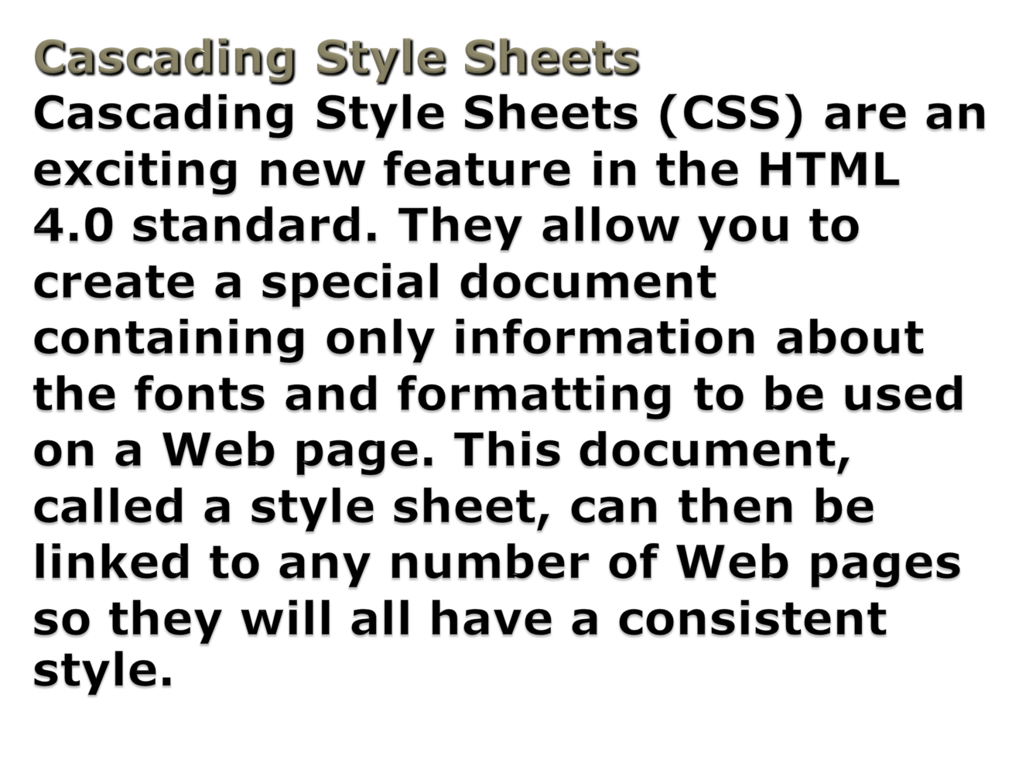
Compiled by : S. Agarwal, Lecturer & Systems Incharge, St. Xavier's Computer Centre, Kolkata : sxcc@vsnl.net

Slide 61
Advantages of Style Sheets
First, because a single style sheet may control the appearance of many pages, you can change the look and feel of your entire Web site just by changing a single style sheet. For complex Web sites, this might save you from spending hours modifying each page individually.
The second big advantage of style sheets is that they will allow more precise control over the appearance of your pages than any previous version of HTML.
Compiled by : S. Agarwal, Lecturer & Systems Incharge, St. Xavier's Computer Centre, Kolkata : sxcc@vsnl.net

Slide 62

STYLE SHEET
A style sheet is essentially a set of rules that defines the design and layout of a document before the browser even reads the HTML tags.
Benefits of Style Sheets
Style sheets have several advantages over directly embedded style information in the HTML code, including the following:
Easier to maintain — Say you format each heading on a page individually for font size, then later on you want to increase the size of all your headings. You will have to go back and change each one. With a single, separate rule to format headings in general, the style can be changed by making a single change to the rule.
Proper display across browsers — CSS provides a common format that all the major browsers support consistently.
Better for accessibility — When structural and presentational aspects are separated, text reader programs and other alternative software can read your pages.
Compiled by : S. Agarwal, Lecturer & Systems Incharge, St. Xavier's Computer Centre, Kolkata : sxcc@vsnl.net

Slide 63
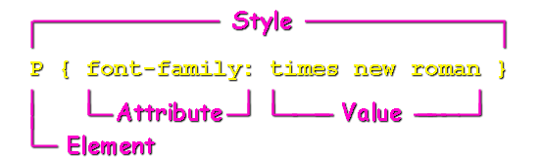
Parts of a Rule
There are three basic parts to a style rule:
The element (tag) you want to affect (H1, P)
The attribute you want to affect (background, font face, font color)
The value (blue, Arial)
Compiled by : S. Agarwal, Lecturer & Systems Incharge, St. Xavier's Computer Centre, Kolkata : sxcc@vsnl.net

Slide 64
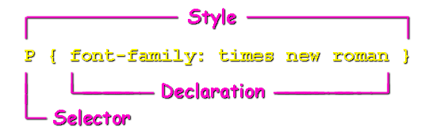
Selectors and Declarations
The structural element that you want to format is referred to as the selector. In its basic form, a selector consists of an HTML element name without its angle brackets — for example, H1 or P.
The selector is then followed by a declaration. A declaration consists of a property and a value, which are enclosed within curly brackets and separated by a colon.
Therefore, H1 { color: red } is a style rule that sets the color of all H1 headings to red.
Compiled by : S. Agarwal, Lecturer & Systems Incharge, St. Xavier's Computer Centre, Kolkata : sxcc@vsnl.net

Slide 65
Multiple Declarations
Similarly, if you want to specify more than one property for a single element, you can group declarations separated by a semicolon.
You can place each declaration on its own line to make your code easier to read, as shown here.
P { color: red; text-align: center; font-weight: bold }
P {
color: red;
text-align: center;
font-weight: bold
}
Compiled by : S. Agarwal, Lecturer & Systems Incharge, St. Xavier's Computer Centre, Kolkata : sxcc@vsnl.net

Slide 66
A Simple Style Sheet
<HTML>
<HEAD>
<STYLE TYPE="text/css">
BODY { background: ivory; margin-left: 24pt}
H1 { color: red; font-size: 30pt; font-family: tahoma }
P { font-family: times new roman }
</STYLE>
<TITLE>Apple Cider</TITLE>
</HEAD>
<BODY>
<H1>WARNING!</H1>
<P>This product has not been pasteurized and, therefore,
may contain harmful bacteria that can cause serious
illness in children, the elderly, and persons with
weakened immune systems.</P>
</BODY>
</HTML>
Compiled by : S. Agarwal, Lecturer & Systems Incharge, St. Xavier's Computer Centre, Kolkata : sxcc@vsnl.net

Slide 67
Attaching the Style Sheet
Although CSS separates document formatting from HTML code, it still needs to be linked to the HTML in order to work with it to present the document. There are three ways to incorporate style sheets into a page. These different layers of style rules may be applied ("cascaded") in succession to affect a document's final look:
Within the STYLE element in the page header (internal style sheets)
In a separate file (external style sheets)
Within individual HTML tags (inline style sheets)
Compiled by : S. Agarwal, Lecturer & Systems Incharge, St. Xavier's Computer Centre, Kolkata : sxcc@vsnl.net

Slide 68
Method 1: Internal Style Sheets
Internal style sheets — also called embedded style sheets — are contained within the <STYLE> tags. This element goes in the HEAD section of a document, as you have seen in our example Web page.
The type attribute of the STYLE element tells the browser what type of style sheet you are working with. Although CSS is currently the only style sheet language in use with HTML documents, this attribute allows for specifying other style sheet languages down the road.
Whatever is between the <STYLE> tags makes up the style sheet. Any number of style rules may be included in the sheet.
<STYLE TYPE="text/css">
BODY { background: ivory; margin-left: 24pt}
H1 { color: red; font-size: 30pt; font-family: tahoma }
P { font-family: times new roman }
</STYLE>
Compiled by : S. Agarwal, Lecturer & Systems Incharge, St. Xavier's Computer Centre, Kolkata : sxcc@vsnl.net

Slide 69
Method 2: External Style Sheets
The more complex a Web page's design, the more complex the style sheets become. It is often preferable to maintain all the style definitions in a separate document. With an external style sheet, you can change the look of several Web pages, or an entire Web site, by changing one file.
An external style sheet consists of the style rules by themselves. You can create a style sheet file with any text editor. Just remember to save it with a .css extension.
The <LINK> Tag
You can link the external style sheet file with the Web page using a couple of different methods. One method is to use the LINK element.
Like BR and HR, the LINK element is a self-closing tag, which means that it includes its own closing slash. It is placed in the header just like the STYLE element. It includes various attributes to indicate properties of the linked file. Suppose we save the style rules for our example in a file named aglobal.css. Then we can link the file to our Web page using the tag shown here.
<LINK REL="stylesheet" TYPE="text/css" HREF="aglobal.css" />
Compiled by : S. Agarwal, Lecturer & Systems Incharge, St. Xavier's Computer Centre, Kolkata : sxcc@vsnl.net

Slide 70
Font Properties
Besides font size and family, other common CSS font properties are
font-style
font-variant
font-weight
Italic is a font style, while bold is a font weight. Variant can be used to set text in small caps, for example.
Compiled by : S. Agarwal, Lecturer & Systems Incharge, St. Xavier's Computer Centre, Kolkata : sxcc@vsnl.net

Slide 71
<LINK> Attributes
You specify the style sheet file with the HREF attribute, just as you do for hyperlinks.
<LINK REL="stylesheet" TYPE="text/css" HREF="aglobal.css" />
For purposes of Cascading Style Sheets, the value of REL is always stylesheet. The value of TYPE is always text/css.
<LINK REL="stylesheet" TYPE="text/css" HREF="aglobal.css" />
Compiled by : S. Agarwal, Lecturer & Systems Incharge, St. Xavier's Computer Centre, Kolkata : sxcc@vsnl.net

Slide 72
Method 3: Inline Style Sheets
Finally, you can create inline style sheets by using the STYLE attribute within individual HTML tags. Most HTML elements can take the style attribute.
As you can see in the H1 tag shown here, the rules for inline style sheets are almost exactly the same as those for the STYLE element. The main difference is that quotes, not curly brackets, surround declarations. However, a colon still separates the property from the value, and a semicolon still separates declarations.
<H1 STYLE="color: red; font-size: 30pt; font-family: tahoma">
Compiled by : S. Agarwal, Lecturer & Systems Incharge, St. Xavier's Computer Centre, Kolkata : sxcc@vsnl.net

Slide 73
Backgrounds and Colors
If you want to change the background color, use the background property. Our example page has an ivory background. Besides color names, you can use Hex values or RGB values. The following style rules are all equivalent:
BODY {
background: ivory
}
BODY {
background: #FFFFF0
}
BODY {
background: RGB (255,255,240)
}
Compiled by : S. Agarwal, Lecturer & Systems Incharge, St. Xavier's Computer Centre, Kolkata : sxcc@vsnl.net

Slide 74
Text Color
Used in the BODY tag, the color property sets the color for all the text on the page. Colors can be set with standard color words, Hex values, or RGB values. There is an extensive list of color names at the World Wide Web Consortium Web site, although they encourage you to use Hex or RGB values instead.
If you just want to change the text color of a paragraph or a heading, use the color property with the appropriate selector. Our example Web page is shown here with the following color styles.
BODY {background: DarkSlateGray; margin-left: 24pt}
H1 {color: DarkSalmon; font-size: 30pt; font-family: tahoma}
P {font-family: times new roman; color: ivory}
Compiled by : S. Agarwal, Lecturer & Systems Incharge, St. Xavier's Computer Centre, Kolkata : sxcc@vsnl.net

Slide 75
Margins
The CSS margin properties are straightforward and apply to the entire element. You can specify margins with either length or percentage values. There are various measures for length, including points (pt), ems (em), centimeters (cm), or pixels (px). You can also specify different margins for each side of the element.
margin-top
margin-bottom
margin-left
margin-right
Compiled by : S. Agarwal, Lecturer & Systems Incharge, St. Xavier's Computer Centre, Kolkata : sxcc@vsnl.net

Slide 76
Vertical Alignment
Sometimes, you may want to insert a small image right in the middle of a line of text.
To line up the top of an image with the top of the tallest image or letter on the same line, use <IMG ALIGN="top" />.
To line up the bottom of an image with the bottom of the text, use <IMG ALIGN="bottom" />.
To line up the middle of an image with the middle of the text, use <IMG ALIGN="middle" />.
Compiled by : S. Agarwal, Lecturer & Systems Incharge, St. Xavier's Computer Centre, Kolkata : sxcc@vsnl.net

Slide 77
These are only the basic HTML tags.
Thank you.
Compiled by : S. Agarwal, Lecturer & Systems Incharge, St. Xavier's Computer Centre, Kolkata : sxcc@vsnl.net

