Slide 1
Google News Personalization
~ Soumodeep Dutta
M.Sc. Computer Science
3rd Semester
17419CMP028
Notes:
The Internet is vast and The challenge is in finding the right content for yourself,
search engine can help us to solve this problem if we are looking for something specific. However
many a times a user may not know what to look for, for cases like movies, songs or even news etc.
in such cases we would present a recommendation to a user based on his/her interest.

Slide 2

Outline
Background
Introduction
Challenges
System
Method
System
Algorithms
Conclusions

Slide 3
Background
Information overflow with the advent of technologies like Internet
People are drowning in data pool without getting right information they want
Challenge:
To find right information
Right Information:
Something that will answer users’ query
Something that user would love to read, listen or see
Solution:
Search Engines
Solve the first requirement
Notes:
in this age of information people are drowned in data pool, without getting the right information he/she needs
this is where the role of collaborative filtering comes, as explained by my friend kunal

Slide 4
Introduction: Collaborative Filtering
It is a technology that aims to learn user preferences and make recommendations based on user and community data
Example:
Amazon: User’s past shopping history is used to make recommendations for new products
Netflix, movie recommender
Recommendations for clubs, cosmetics, travel locations
Personalized Google News
Notes:
Collaborative filtering is a technology that aims to learn
user preferences and make recommendations based on user
and community data.

Slide 5
Challenges of Google News
Google News is visited by several millions in a period of few days
There are lots of articles being created each day
Scalability is a big issue for such personalized system
The items cannot be static as the articles are changing very fast
Normal recommender system thus unsuitable for such need
Need for a novel scalable algorithm
Notes:
google is visited by millions of user per day
and a lot of articles is being created daily.
Moreover, since it is a news based system, the items cannot be static as the articles are changing very fast
Scalability is a mojor issue
due to which existing recomender system are unsuitable.

Slide 6
Google News System
Google news record - the search queries and clicks on news stories
Makes previously read articles easily accessible
Recommends top stories based on past click history
Recommendations based on:
Click history
Click history of the community
User’s click on an article is treated as positive vote
Could be noisy
No negative votes
Notes:
The system is comprises of search queries and clicks on news stories.
recomendation is based on click history of user and clicks of the user community

Slide 7
Problem statement
Given a click history of N users,
U = {u1, u2, u3, u4, u5,…, uN }
And M items
S = {s1, s2, …, sM }
User u with click history set Cu consisting of stories
{si1, si2, …, si|Cu| }
System will recommend K stories that user might be interested in
Incorporate user feedback instantly
Notes:
U1 이런 거 고치기
즉각적인 User feedback 포함해야 한다

Slide 8
Architectures and algorithm
Algorithms
Memory-based algorithms
Predictions made based on past ratings of the user
Weighted average of ratings given by other users
Weight is the similarity of users ( Pearson correlation coefficient, cosine similarity)
Model-based algorithms
A model of the user developed based on their past ratings
Use the models to predict unseen items (Bayesian, clustering etc. )
Notes:
moving on to the related algorithms are of two types memory-based
and model-based.
in memory-based prediction is made based on the past rating of the user and the
weighted average given by other users, where the weight is the similarity between
the users.
in model-based , a model is developed based on users past rating and this model
is used to predict the the ranking of the new articles.

Slide 9
Google News Personalization Algorithm Overview
Mixture of
Model based algorithms
Probabilistic Latent Semantic Indexing
MinHash
Memory based algorithms
Item co-visitation
The scores given by each algorithm is combined as
ΣWa Rs
where Wa is the weight given to algorithm ‘a’ and Rs is its rank
Notes:
the system used by googles uses a combination of three algos
PLSI
MH
ICV
and the ranking is coputed based on a weight average of all three algo

Slide 10
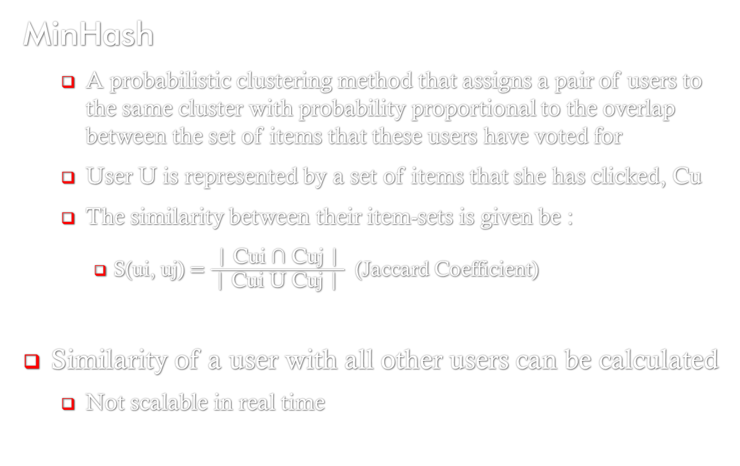
Algorithms
MinHash
A probabilistic clustering method that assigns a pair of users to the same cluster with probability proportional to the overlap between the set of items that these users have voted for
User U is represented by a set of items that she has clicked, Cu
The similarity between their item-sets is given be :
S(ui, uj) $=\frac{\text{| }\text{Cui}\text{ ∩ }\text{Cuj}\text{ |}}{ \text{| }\text{Cui} \text{U} \text{Cuj}\text{ | }}$ (Jaccard Coefficient)
Similarity of a user with all other users can be calculated
Not scalable in real time
Notes:
the MinHash Algo
is a probabilistic soft clustering algo that asigns a pair of user same cluster
with a probability, which is proportional to the overlap between the set of items
that these users have in common

Slide 11
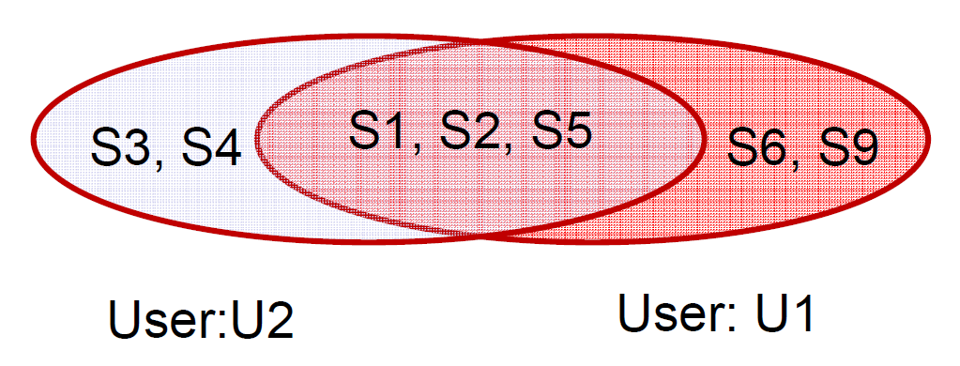
MinHash: Example
User u1 clicks on the items:
S1, S2, S5, S6, S9
Similarly, user u2 clicks on the items:
S1, S2, S3, S4, S5
Jaccard Coefficient : 3/7

Slide 12
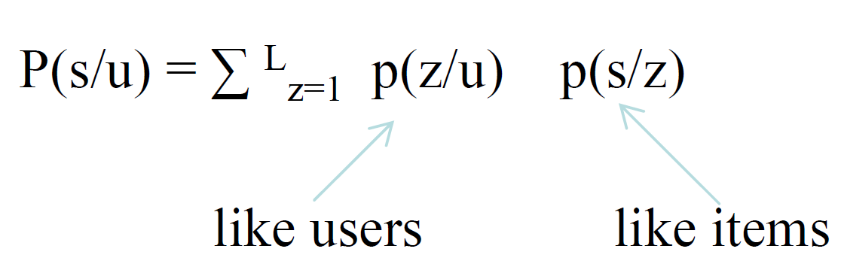
Algorithms
Probabilistic Latent Semantic Indexing[PLSI] *
With users U and items S, the relationship between users and items is learned by modeling the joint distribution of users and items as a mixture distribution
A hidden variable Z is introduced to capture this relationship, which can be thought of as representing user communities(like minded users) and item communities(like items)
Mathematically,
The conditional probabilities p(z/u) and p(s/z) are learned from the training data using Expectation maximization algorithm
Notes:
the PLSI
was developed by Hofmann for performing collaborative filtering. It models
users (u ∈ U) and items (s ∈ S) as random variables, taking values from
the space of all possible users and items respectively. the relationship
between users and items is learned by modeling the joint distribution of users and
items as a mixture distribution. Z is a parameter introduce to capture the correct relationship.
Expectation Maximization (EM) is used to learn the maximum
likelihood parameters of this model. probabilities p(z/u) and p(s/z) are learned from the training data using EM.
C=UZS
Z=diagonal matrix

Slide 13
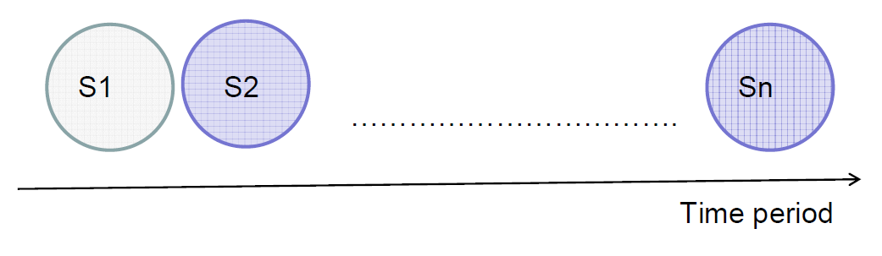
Algorithms
Co-visitation
Two stories are clicked by the same user within a certain time interval
Store as a graph with nodes at stories, edges as age discounted covisitation counts
Update graph (using user history) whenever we receive a click
Notes:
covisitation is defined as an event in which two stories are clicked by the
same user within a certain time interval.Imagine a graph whose nodes represent items
(news stories) and weighted edges represent the number of covisitation instances discounted
by time. The edges could
be directional to capture the fact this story was clicked
after the other, or not if we do not care about the order.

Slide 14
Data stored
User Table:
Cluster information (MinHash and PLSI)
Click history
Story Table:
Cluster Statistics: How many times was the story S clicked on by users from each cluster C
Co-visitation: How many times was story S co-visited with each story S’
Notes:
The user table UT and story table ST are conceptually
two dimensional tables.
The rows of the user table are indexed by user-id, and for each
user-id, two kinds of information are stored in the table:
(a) Cluster information: A list of MinHash and PLSI
cluster-ids that the user belongs to, and
(b) Click history: The list of news story-id’s that the user
has clicked on.
The rows of the story table are indexed by story-id, and
for each row in the story S, there are two main
types of statistics that are maintained in different columns:
(a) Cluster statistics: How many times was
story S clicked on by users from each cluster C.
(b) Covisitation statistics: How many times was story
S co-visited with each story S'.

Slide 15
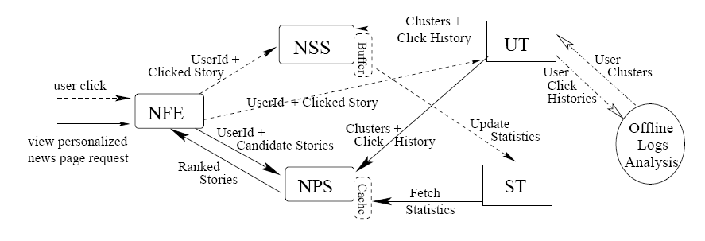
System Components
NFE: News Front End NPS: News Personalization Server
NSS: News Statistics Server UT: User Table ST: Story Table

Slide 16
Conclusion and Future Work
The Algorithms is scalable real time recommendation engines.
The system is content independent and thus easily extendible to other domains
As a future work, suitable algorithm can be explored to determine how to combine scores from different algorithms
THANK YOU

Slide 17
References
Google News Personalization: Scalable Online Collaborative Filtering by Abhinandan Das, Mayur Datar, Ashutosh Garg

