Slide 1
JTAG UART port in NIOS

Slide 2
JTAG UART introduction
The JTAG UART core with Avalon interface implements a method to communicate serial character streams between a host PC and an SOPC Builder system on an Altera
JTAG UART core eliminates the need for a separate RS-232 serial connection to a host PC for character I/O
The core provides an Avalon interface that hides the complexities of the JTAG interface from embedded software programmers.

Slide 3
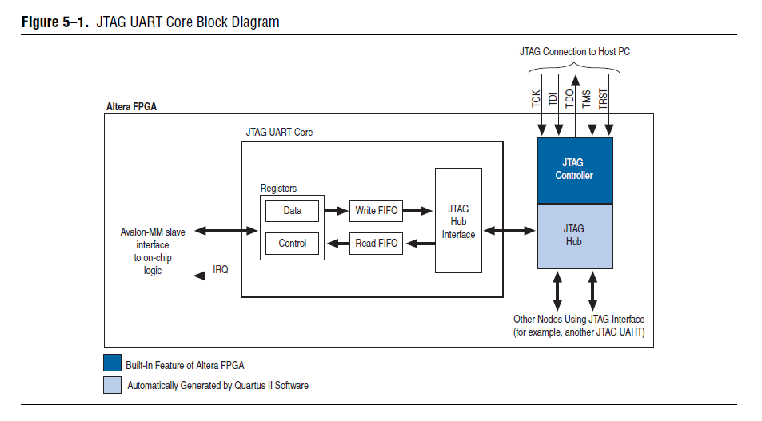
JTAG UART fundamental

Slide 4
Avalon Slave Interface and Registers
The JTAG UART core provides an Avalon slave interface to the JTAG circuitry on an Altera FPGA. The user-visible interface to the JTAG UART core consists of two 32-bit registers data and control accessed through an Avalon slave port.
Avalon master accesses the registers to control the core and transfer data over the JTAG connection.
8-bit units of data at a time; eight bits of the data register serve as a one-character payload.
The JTAG UART core provides an active-high interrupt output that can request an interrupt when read data is available, or when the write FIFO is ready for data

Slide 5
Read and Write FIFOs
The JTAG UART core provides bidirectional FIFOs to improve bandwidth over the JTAG connection
Read/write to JTAg UART data register will pop/push data into FIFO
Length: 64 Byte, width: 8-bit

Slide 6
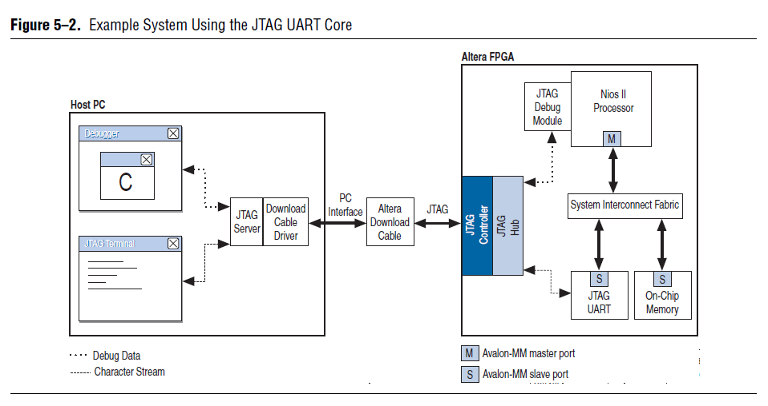
Host-Target Connection

Slide 7
Instantiating the Core in SOPC Builder
Write FIFO Settings
Depth: Depth: The write FIFO depth can be set from 8 to 32,768 bytes.
IRQ Threshold: The write IRQ threshold governs how the core asserts its IRQ in response to the FIFO emptying
Construct using registers instead of memory blocks: Turning on this option causes the FIFO to be constructed out of on-chip logic resources

Slide 8
Instantiating the Core in SOPC Builder
Read FIFO Settings
Depth: Depth: The read FIFO depth can be set from 8 to 32,768 bytes.
IRQ Threshold: The read IRQ threshold governs how the core asserts its IRQ in response to the FIFO emptying
Construct using registers instead of memory blocks: Turning on this option causes the FIFO to be constructed out of on-chip logic resources

Slide 9
Software Programming Model
HAL library support
Communicate through HAL device driver
Programming in register-level

Slide 10
HAL System Library Support
Nios II programs treat the JTAG UART core as a character mode device, and send and receive data using the ANSI C standard library functions, such as getchar() and printf()
Example 5–1 demonstrates the simplest possible usage, printing a message to stdout using printf()

Slide 11
Header files needed
altera_avalon_jtag_uart.h
This file have the declaration of HAL system library device driver

Slide 12
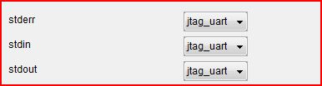
Setup I/O device in Nios IDE
3 default system I/O file devices in HAL, use BSP editor to assign character I/O ports to them

Slide 13
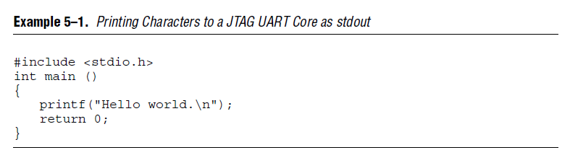
Example of using printf() for jtag uart output

Slide 14
Example of using printf() for jtag uart output
#include “stdio.h”
int main()
{
char c;
scanf(“%c”,c);
return 1;
}

Slide 15
Connect JTAG UART with file I/O
JTAG UARG driver provided by HAL allows device I/O through file operation
Device name “/dev/jtag_uart_name”
Functions: Open, Close, Write, Read

Slide 16
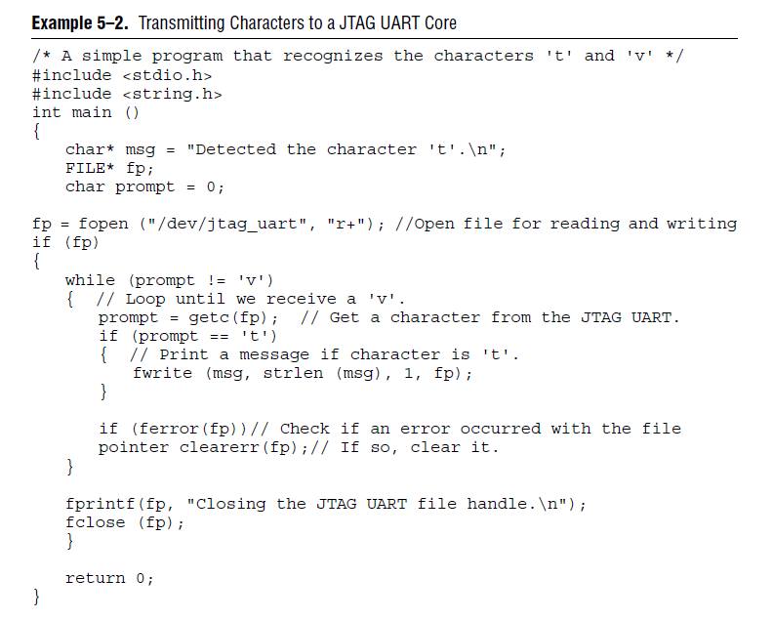
Example of jtag uart I/O

Slide 17
I/O through register access
Low level I/O operation
Need fewer HAL support
Difficult to implement
Needed when writing device driver or programming without HAL support

Slide 18
Header files needed
altera_avalon_jtag_uart_regs.h
This file defines the core's register map, providing symbolic constants to access the low-level hardware. The symbols in this file are used only by device driver functions

Slide 19
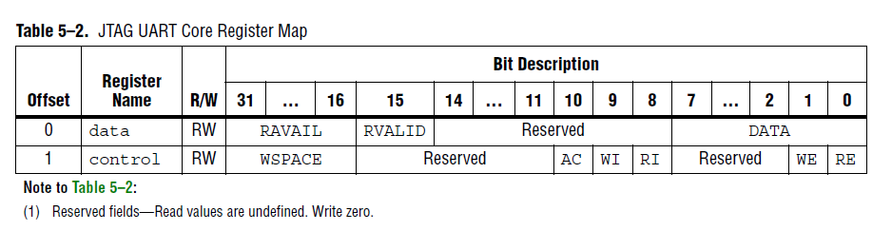
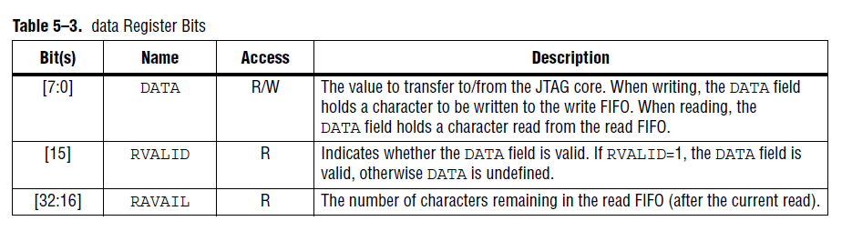
JTAG UART Register File

Slide 20
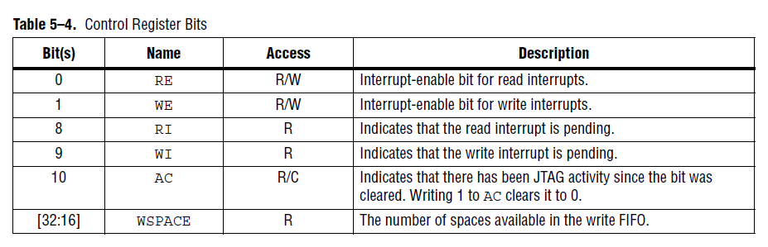
JTAG UART Register File

Slide 21
JTAG UART interrupts
The JTAG UART core has two kinds of interrupts: write interrupts and read interrupts.
The WE and RE bits in the control registe enable/disable the interrupts

Slide 22
JTAG UART interrupts
The read interrupt condition is set whenever the read FIFO has read_threshold or fewer spaces remaining
The write interrupt condition is set whenever the write FIFO has read_threshold or fewer spaces remaining

Slide 23
Read character from JTAG UART
Step 1: Read data register
c=IORD_ALTERA_AVALON_JTAG_UART_DATA(JTAG_UART_BASE)
// read character from JTAG UART port
Step 2: test valid bit
c & ALTERA_AVALON_JTAG_UART_DATA_RVALID_MSK
// ALTERA_AVALON_JTAG_UART_DATA_RVALID_MSK= 0x00008000
Step 3: if valid, copy lower 8 bits (data) out
c & ALTERA_AVALON_JTAG_UART_DATA_DATA_MSK;

Slide 24
Read character from JTAG UART
While(1)
{
c=IORD_ALTERA_AVALON_JTAG_UART_DATA(JTAG_UART_BASE);
if(c & ALTERA_AVALON_JTAG_UART_DATA_RVALID_MSK)
{
data=c & ALTERA_AVALON_JTAG_UART_DATA_DATA_MSK);
break;
}
}

Slide 25
Send character to JTAG UART port
IOWR_ALTERA_AVALON_JTAG_UART_DATA(JTAG_UART_BASE, data)
Data will be sent to JTAG_UARG and received by Host PC terminal.

Slide 26
Variable Argument List
Function declaration usually looks like:
Function (arg1,arg2,…arg n)
but some function has a special format, the argument list is not fixed until called
printf(“%d,%d,%s”,a,b,str)

Slide 27
Variable Argument List
How to implement function with variable argument list?
C convention: argument order in stack
High address…
…
…
Arg 2
Arg 1
Low address…

Slide 28
Macro definition in stdarg.h
typedef char* va_list;
#define _va_start(ap,v) ( ap = (va_list)_ADDRESSOF(v) + _INTSIZEOF(v) )
#define va_arg(ap,t) ( *(t *)((ap += _INTSIZEOF(t)) - _INTSIZEOF(t)) )
#define va_end(ap) ( ap = (va_list)0 )

Slide 29
How to get var arg address
High address…
….
Var arg 1
Fixed arg n (v)
…
Fixed arg 2
Fixed arg 1
Low address…
ap points to nex var arg after call va_arg(ap,t)
ap points to first var arg after va_start(ap,v)

Slide 30
Code sample
#include “stdarg.h”
void my_printf(char * arg, ...)
{
int i=0;
int param_num=0;
va_list ap;
printf("number of param is %s\n",arg);
param_num=atoi(arg);
va_start(ap, arg);
for(i=0;i<param_num;i++)
{
printf("The %dth param is %d\n",i+1,va_arg(ap,int));
}
va_end(ap);
}

Slide 31
Summary
JTAR UART on DE2 board
Introduction
HAL supports
Register file and register access
Interrupts
Data transmission through JTAG UART port
Variable argument lists

