Slide 1
Contextual IOT
Kamalakar Duvva

Slide 2
Overview
Description
Basic Terms
Evolution Of Context-aware Technology
High level IOT Solutions
Software Demo on IOT
References

Slide 3
Description
Nowadays Contextual Reasoning deployment in Internet Of Things leads to wide variety of smarter connected applications for personal and business purpose.In this paper I am going to explain how IOT devices can help individuals and business applications with contextual reasoning. IOT attacks and context-based permission system for appiﬁed IoT platforms.

Slide 4
Basic Terms-IOT
IOT(Internet of things) is system of interconnection of computing devices, digital machines and mechanical objects , people or animal with capable of transfer data over network without any interaction of human-to-computer or human-to-human.
The IoT allows “people and things to be connected Anytime, Anyplace, with Anything and Anyone, ideally using Any path/network and Any service”
Cont..

Slide 5
Basic Terms -IOT
The technologies incorporated with IOT
Web of Things
Network of Things
Android Things
Agro-IOT etc.
Cont..

Slide 6
Basic Terms-Contextuality
The term context defined as
Synonyms to refer to context, such as ‘environment’ and ‘situation’. [Hull et al and Ward]
The ﬁveW’s(Who,What,Where,When,Why) as the minimum information that is necessary to understand context. [Abowd and Mynatt]
If the application has context-awareness that can support presentation, execution, and tagging
Presentation: Context can be used to decide what information and services need to be presented to the user.
Execution: Automatic execution of services.
Tagging :Context needs to be tagged together with the sensor data to be processed and understood later
Cont..

Slide 7
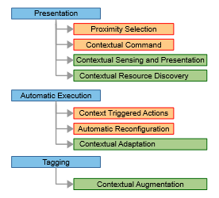
Basic Terms-Contextual Awareness

Slide 8
Basic Terms-Examples
A simple example is how to make a “smart” connected thermostat smarter.
Add data from the owner’s handset and building security systems.
Develop rules that incorporate both the data from the smart thermometer and the data from the new sources.
Enjoy a smarter and more effective thermostat
Google maps
GPS

Slide 9
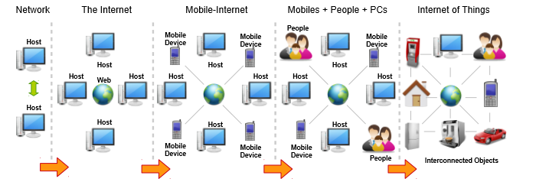
Evolution Of Context-aware Technology

Slide 10
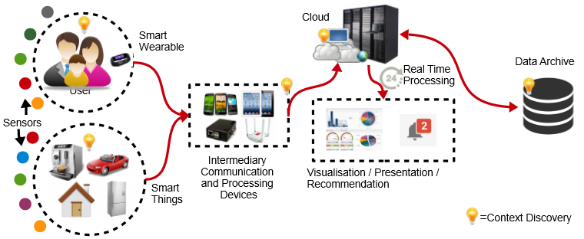
High level IOT Solutions

Slide 11
High level IOT Solutions
“The Awareness API consists of two distinct APIs which your app can use to get context signals to determine the user's current situation:
Fence API lets your app react to the user's current situation, and provides notification when a combination of context conditions are met. For example, "tell me whenever the user is walking and their headphones are plugged in". Once a fence is registered, the Fence API can send callbacks to your app even when it's not running.
Snapshot API lets your app request information about the user's current context. For example, "give me the user's current location and the current weather conditions".”
https://developers.google.com/awareness/overview#context-types

Slide 12
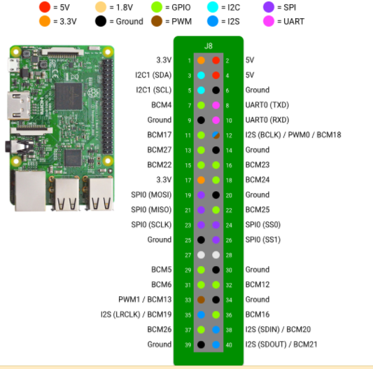
Android Things Doorbell
Raspberry Pi 3

Slide 13
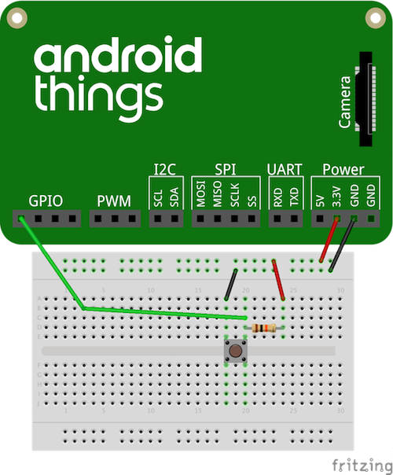
Android Things Doorbell
Circuit Diagram

Slide 14
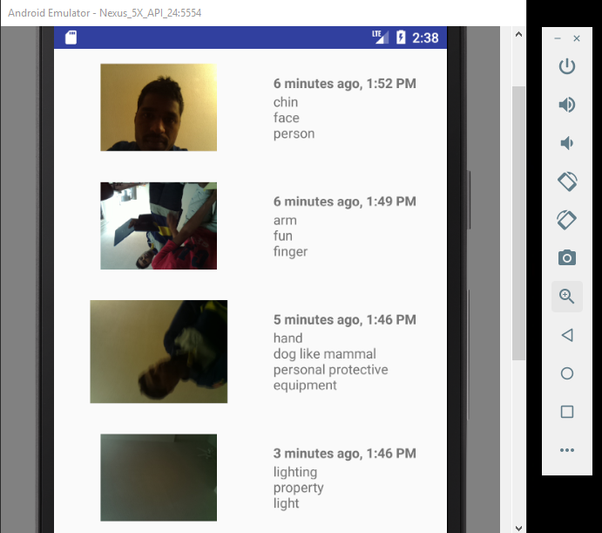
Android Things Doorbell
Output

Slide 15
References
References :
Context-aware Computing is Retrieved from
Perera, C., Liu, C. H., Jayawardena, S., & Chen, M. (2014). A survey on internet of things from industrial market perspective. IEEE Access, 2, 1660-1679.
Lukas Reinfurt, Uwe Breitenbücher, Michael Falkenthal, Frank Leymann, and Andreas Riegg. 2016. Internet of things patterns. In Proceedings of the 21st European Conference on Pattern Languages of Programs (EuroPlop '16). ACM, New York, NY, USA, Article 5, 21 pages. DOI: https://doi.org/10.1145/3011784.3011789
Guinard, D., & Trifa, V. (2016). Building the web of things: with examples in node. js and raspberry pi. Manning Publications Co..
Google, Co. (2017, August 10). Android Things. Retrieved August 14, 2017, from https://developer.android.com/things/sdk/index.html
Google, Co. (2017, August 10). Raspberry Pi I/O. Retrieved August 14, 2017, from https://developer.android.com/things/hardware/raspberrypi-io.html
Google, Co. (2017, January 26). Android Doorbell. Retrieved August 15, 2017, from https://developer.android.com/things/training/doorbell/index.html
Google, Co. (2016, November 29). Hardware 101 - Breadboard. Retrieved August 14, 2017, from https://developer.android.com/things/hardware/hardware-101.html

Slide 16
References
8. Google, Co. (2017, May 18). Google Awareness API | Google Developers. Retrieved August 14, 2017, from https://developers.google.com/awareness/overview
9. Colin Maxfield and Christine Julien. 2017. Data-directed contextual relevance in the IoT. In Proceedings of the 39th International Conference on Software Engineering Companion (ICSE-C '17). IEEE Press, Piscataway, NJ, USA, 43-46. DOI: https://doi.org/10.1109/ICSE-C.2017.13
10. Jia, Y. J., Chen, Q. A., Wang, S., Rahmati, A., Fernandes, E., Mao, Z. M., ... & Unviersity, S. J. (2017). ContexIoT: Towards Providing Contextual Integrity to Appified IoT Platforms. In Proceedings of the 21st Network and Distributed System Security Symposium (NDSS'17).
The document is Retrieved from
https://www.internetsociety.org/doc/contexlot-towards-providing-contextual-integrity-ap pified-iot-platforms

